Slide 1
Vibrant Health Family Clinics

Slide 2
Sustainability: How will we do it?
We have developed a Chronic Care Management Program
Implementation the end of 2015
Continue to report data publicly, internally and transparently
Patients first, team second and data third
Continue our work with team oriented care

Slide 3
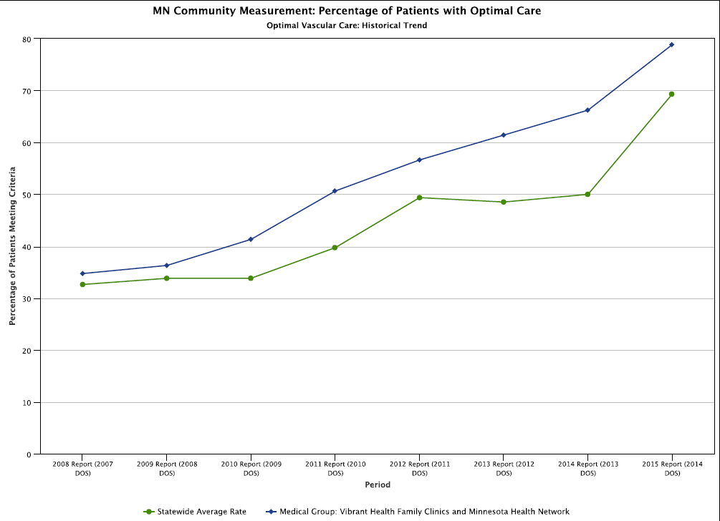

Slide 4
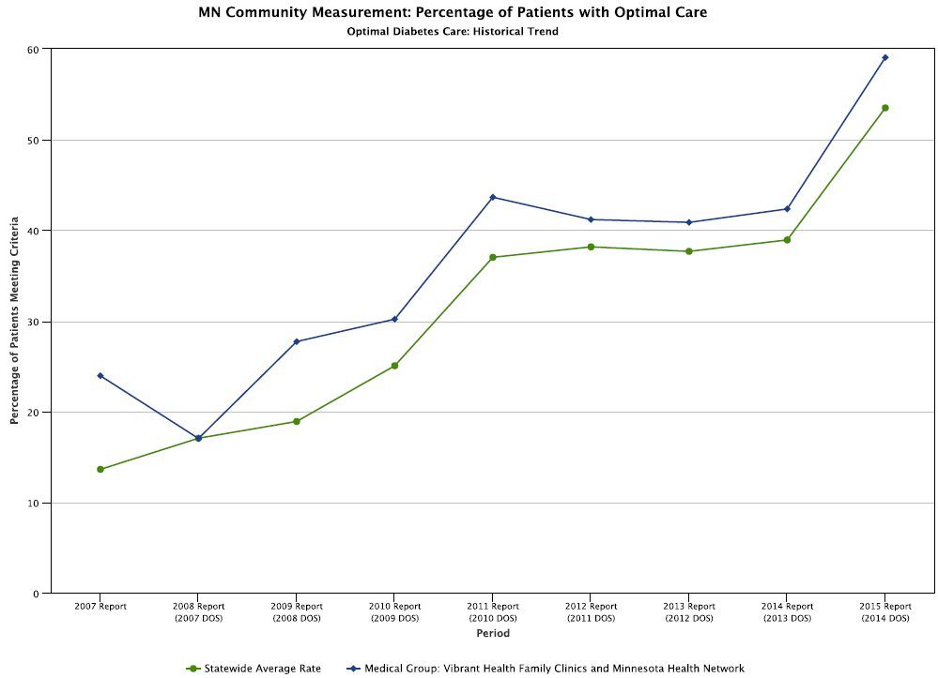

Slide 5
Chronic Care Management Program
Inform and Educate the patient
Consent obtained
Enroll and assessment plan
Comprehensive care plan
Action plan
Created a patient schedule for our Care Coordinator staff
Worked with coding to develop a billing process
Worked with our EMR vendor (Cerner) to create a registry and way to document time spent with the patient
Training for our Clinical Services Staff in October 2015
Start enrolling patients now if possible

Slide 6


Slide 7
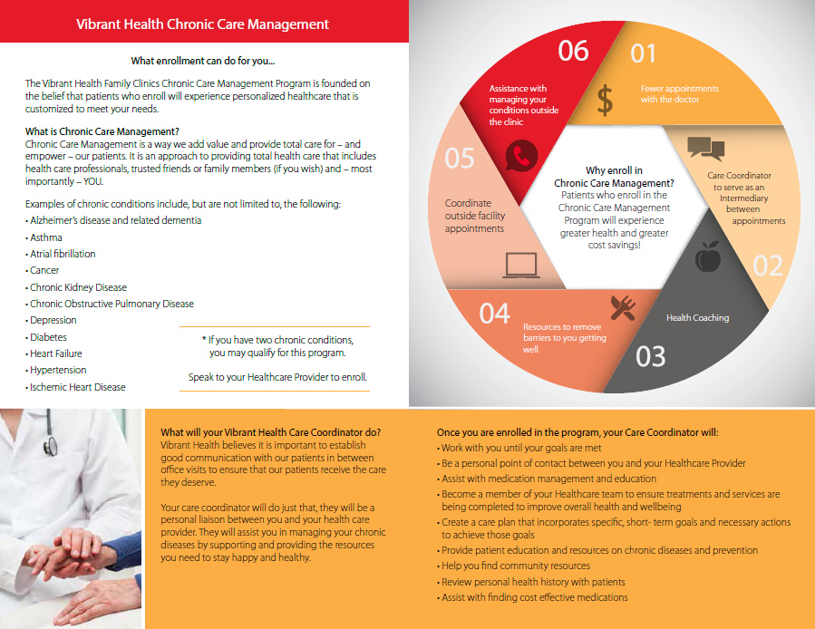

Slide 8
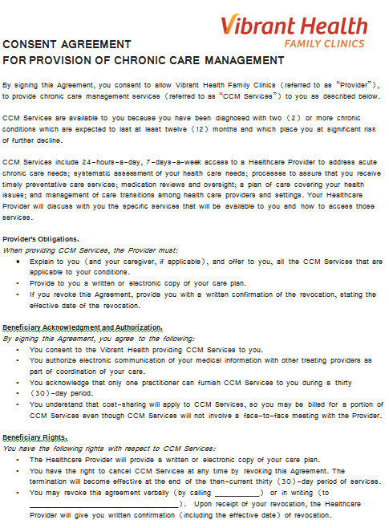


Slide 9
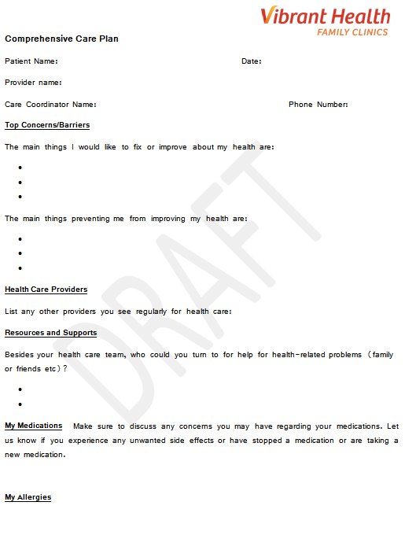

Slide 10
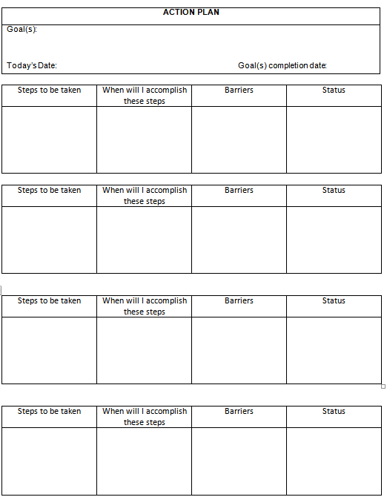

Slide 11
