Slide 1
Sharing Our Story in a Nut Shell
The Power Point entails our work with Metastar and 2 clinics in Wisconsin
The information in the power point highlights the processes, tools, policy and protocols that were shared
The two clinics we worked with chose to implement a couple of tools presented as well as one actually made it a QC project!

Slide 2
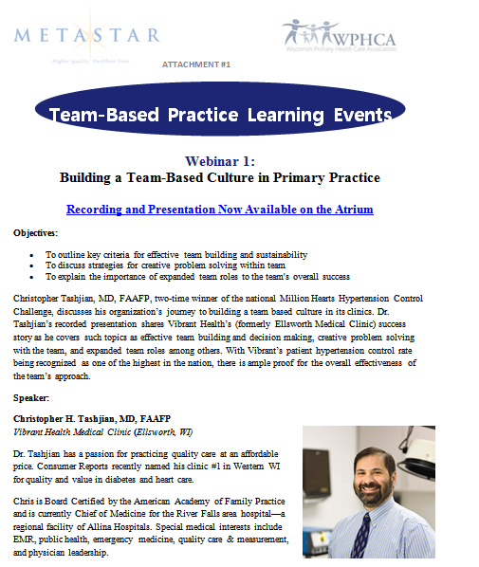

Slide 3


Slide 4

Team Based Practice Learning Series:
Mary Boles, LPN Clinic Manager
Rosanne Matzek, CMA Care Coordinator
Vibrant Health Family Clinics
Ellsworth, Wisconsin

Slide 5
The High Functioning Team
Spot Light on the Medical Assistant

Slide 6
Vibrant Health Is……
Our staff include Family Practice providers with accessibility to Internal Medicine, Pediatrics, General Surgery, OB/GYN, ENT and Cardiology clinicians at our River Falls location.
Patient Care Team Members
Provider
Medical Assistant
Care coordinator
Midlevel
Front Office Staff
Others
NCQA Certified PCMH since 2013

Slide 7
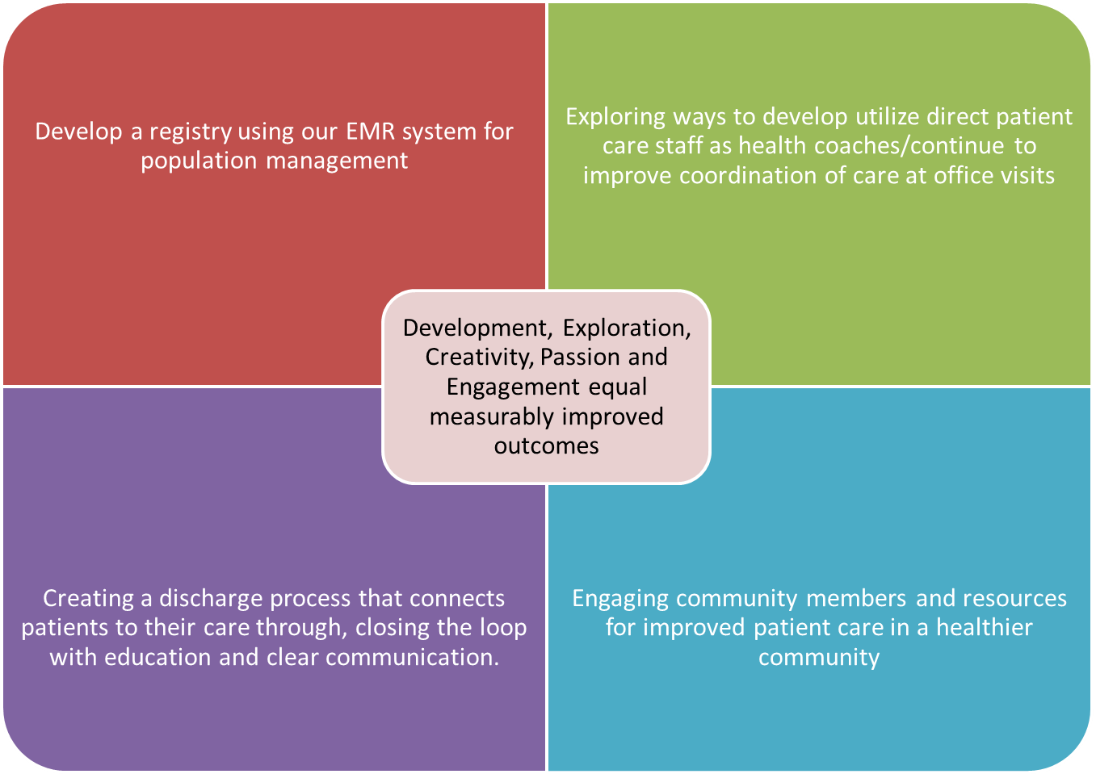
Improvement Philosophy

Slide 8

PREVISIT PLANNING
Develop Standard Previsit Planning form
Chart Review—last 2-3 visits, hospital discharge notes
3. Identify and order services
Immunizations
Lab work
Preventive needs
Prep exam room and anticipate provider needs
4. Prepare for your Depart visit with patient
Prepare order forms
Prepare for entry into recall system
Identify medication refill needs-

Slide 9
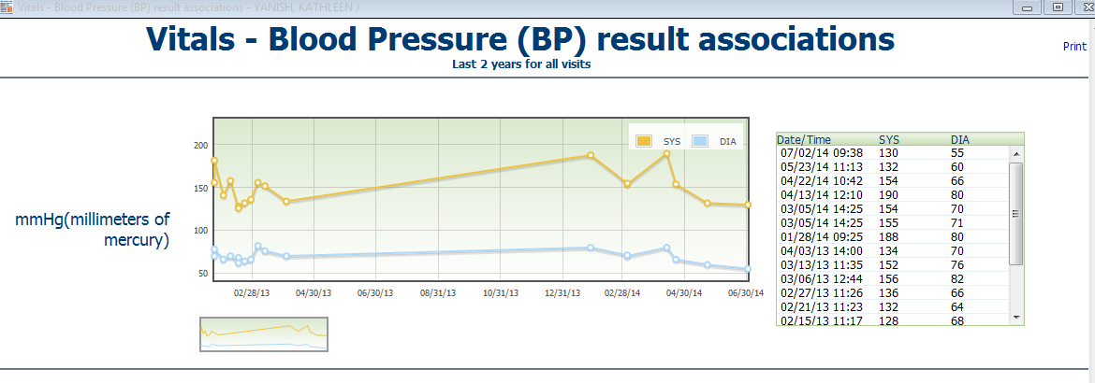
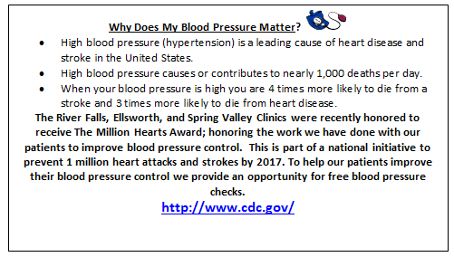
Patient Engagement
Provide patients with information so they can see how interventions or changes have made a difference. Visuals are important!
We have challenged our staff to use every patient encounter as an opportunity to recheck blood pressures and provide appropriate patient education; this keeps the patients actively involved in managing their health.

Slide 10
Tools
PVP
Standing orders
Process Mapping
Policies & Procedures
Shared decision making—colon cancer risk assessment
PDSA process
BP rechecks algorithms
(BP magnets)
In order to provide the excellent, personalized care that we do, we must have the proper tools in place for our Healthcare Providers and staff.
Using the PDSA format assures that we continually work to create and improve our processes and define accountability.

Slide 11
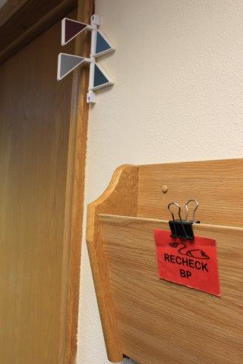
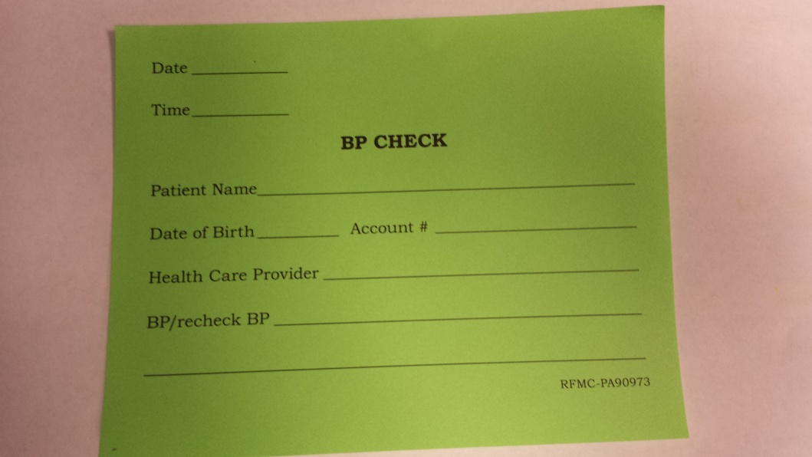
TOOLS FOR CLINICAL STAFF
Blood pressure magnets outside of the exam room door remind us to recheck elevated blood pressures.
As part of our pre-visit planning we fill out BP slips for all patients who have orders for repeat blood pressure checks. These slips are also used for walk-in free blood pressure checks.

Slide 12
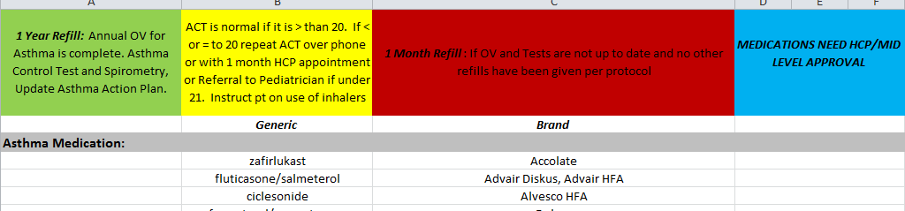
Empower your Clinical Staff
Develop Standing Orders and Protocols:
Chronic Disease Standing Orders
Preventive Service Standing Orders
Medication Refill Protocol:

Slide 13
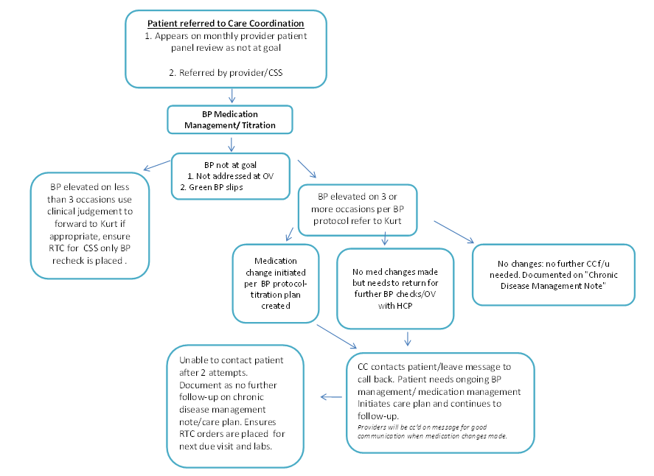
Initiation and Titration of Medications Using Established Protocols

Slide 14
Care Coordination Staff
Four experienced CMAs
Work exclusively with our chronic disease populations
Focus is on assuring our patients are informed, accountable and educated about their illness and treatment.

Slide 15
Care Coordination
Chronic Care Model Procedures
Develop evidence-based protocols specific to our practice
Medication titration for HTN, lipid and glycemic management tools specific to our practice
Relationships with partners (cardiology & others)
Transition of Care process
Preventable Readmission rates
Vulnerable Patient Population identification
Care Coordinators ensure patient-centered care by building relationships directly with patients; and facilitating effective relationships between patients and key players in their care team.

Slide 16

Care Coordination
Identify complex patients
Assist with phone calls/messages/med refills as needed for more complex, time consuming patients
Staff training and updates on Chronic Disease items
Patient Education on chronic disease topics
Identify patients needing medication titration
Contact patients between visits
Review chronic disease data base

Slide 17
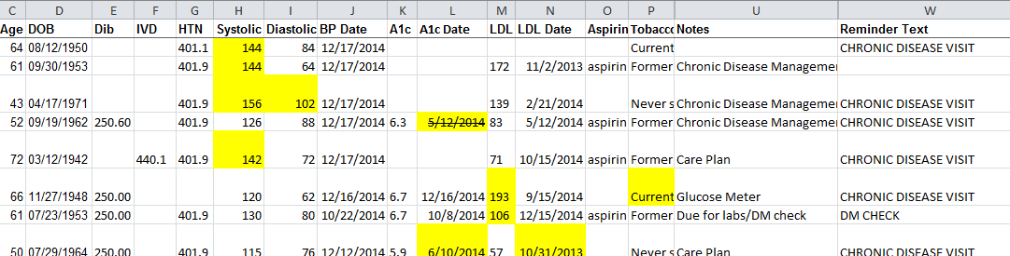
KEEPING TRACK OF YOUR PATIENTS
We extract patient data from our EHR and practice management system using our EHR Reporting program. We manipulate the data in Excel to create patient lists that function for our needs. We can therefore also collect up to date and current data. We look at this together EVERY MONTH!

Slide 18
Why it all works!
Leadership supports the process
Providers and all staff are engaged
Patients are engaged
Clinical Staff are Empowered
All staff are encouraged to work at the highest level of their role
We are transparent with data
We are proud of our success
We believe in helping our patients get well and stay well
We have caring and compassionate Care Coordinators
Team Work !!

