Slide 1
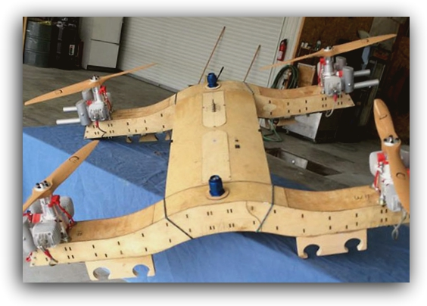
“LT Quadcopter” Concept
Aerial Robotic Systems, LLC
Project Summary
Participant Summary
The LT is a medium lift quadcopter powered by four 70cc horizontally opposed gas powered engines. ARS’s proprietary ECU controls the engines during ground operations, and monitors engines during flight. Using premixed pump gas enables quick turnarounds and longer flight times, without extensive ground support equipment.
Noel Simmons; Chief Technical Officer
Carl Lewis; Marketing Director
N. Chandra Sekhar, PhD; Software Developer
The ARS team brings extensive experience in direct sales and consultancy, engineering software development and a vast knowledge of aircraft manufacturing, including design and materials.
Technical Outcome
The LT will make a significant impact due to the pace of operations achievable, 4 hours of flight time, and up to 50 pounds of payload (with a waiver). The airframe’s robust design will last for 1000’s of flight hours with minimal need for maintenance.

