Slide 1
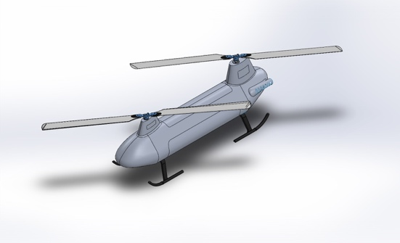
A Gasoline Powered Tandem Helicopter UAS Endure Air Inc. and Indian Institute of Technology (IIT) Kanpur
Project Summary
Participant Summary
We will design a UAS based on helicopter’s tandem configuration, powered by 2 IC engines running on gasoline. We will be utilizing the existing ‘Endure 800” a gas powered conventional helicopter platform that has proven track record. Helicopter in tandem configuration is more efficient and provide maximum lift therefore helping in meeting the project goals.
Our team consists of members with expertise in vehicle design, controls and navigation, vehicle dynamics, electronics, manufacturing, remote UAV flying and project management.
Dr Abhishek – Phd Helicopter design, Assit. Prof IIT Kanpur
Sagar Setu – PhD Scholar, Aerospace, expert in avionics
Nidhish Raj - PhD Scholar, Aerospace, expert in controls
Ankur Duhoon – MS Aerospace, expert in hardware design
Yamin Durrani – MBA, MS, BS, Program management
Technical Outcome
Our gasoline powered tandem helicopter with 48 lbs maximum take off weight will outperform any off the shelf UAS in endurance and payload handling capability by a factor of 2X.
It will be an ideal solution for first responders proving long endurance and quick refuel ability making it a highly effective solution in the field.
Useful payload | Condition | Time (min)
10 lb | 100% Hover | 90
15 lb | 100% Hover | 60
20 lb | 100% Hover | 45

