Slide 1
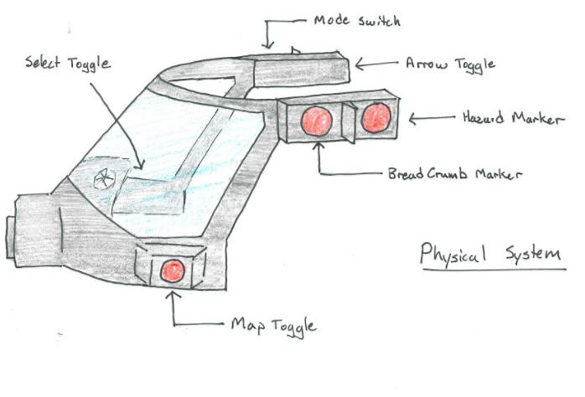
First Responder: Firefighter Enhance-VR,LLC
Project Summary
Participant Summary
Leading up to the competition, we worked with our local Fire Department to ensure our design features will work in the real world and will assist the firefighters; not a distraction. Through the use of the HTC Vive, Vive controllers and additional, custom made parts (electrical and 3D printed) we have designed a HUD that would be easy to use, posses natural characteristics of present equipment, and have data displayed in optimal locations for firefighters
Undergraduate students from Binghamton University
Matt Gill (Sr.): Electrical Engineering
C, C#, C++, Matlab, Unity, Blender, VR Development
Dylan Domenico (Sr.): Computer Engineering
C, C++, Matlab, Python, Machine Learning, VHDL/FPGA
John Null (Sr.): Computer Science
C++, C, C#, Java, Python, Maya, Unity, VR Development
Amit Bachar (Sr): Mechanical Engineering
Matlab, Creo, Solid Edge, Arena, Visual Basic, 3D printing
Technical Outcome
Creation of a VR simulated HUD with real world physical interactions (UI)
“Close-to-real” design that can be implemented beyond a VR experience
Efficient device that can be expanded with GIS

