Slide 1
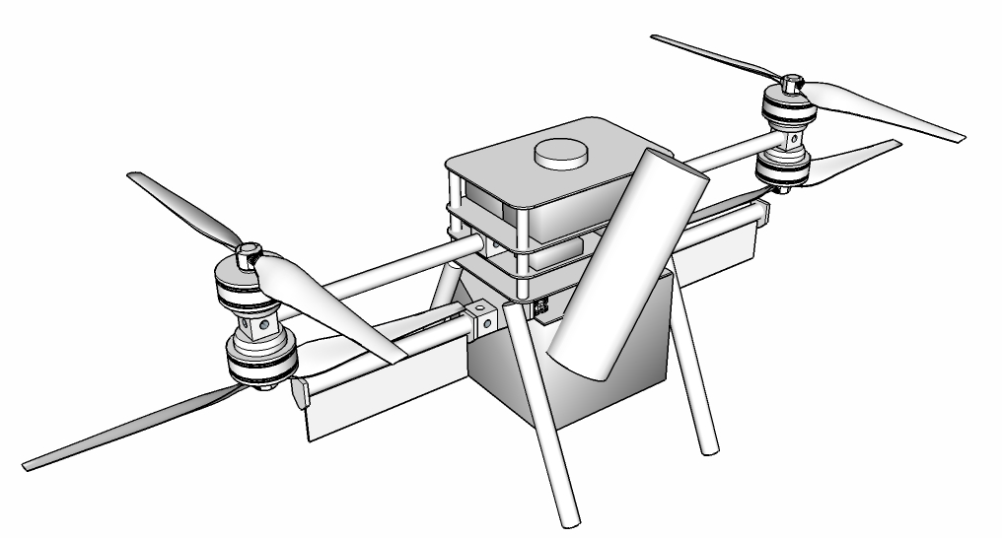
The Unmanned Aerial Systems Flight and Payload Challenge William R. Gleason
Project Summary
Participant Summary
In support of public safety agencies the goal is design a UAV that can meet the rigors of the critical mission environment in remote locations. The communication support UAV must be light weight, have a high energy density, be ready to deploy out of the box, be simple to check and repair and be cost effective. It must deployable and retrieved in fast changing dynamic environment.
Electrical Engineer > 35 years Aerospace Experience
8 years experience in UAVs, Lockheed, Sanders
System and Circuit Design, Risk and Safety Analysis
USAF Trained Technician / Instructor
20 years as Certified firefighter, ICS certifications
Life long modeler and AMA member
Technical Outcome
This approach and UAV system provides a low cost alternative to repurposed military UAVs. It is fully capable of providing varying types of support requiring large payloads on station for >30 minute times. It is usable in remote areas with a minimum amount of user training.

