Slide 1

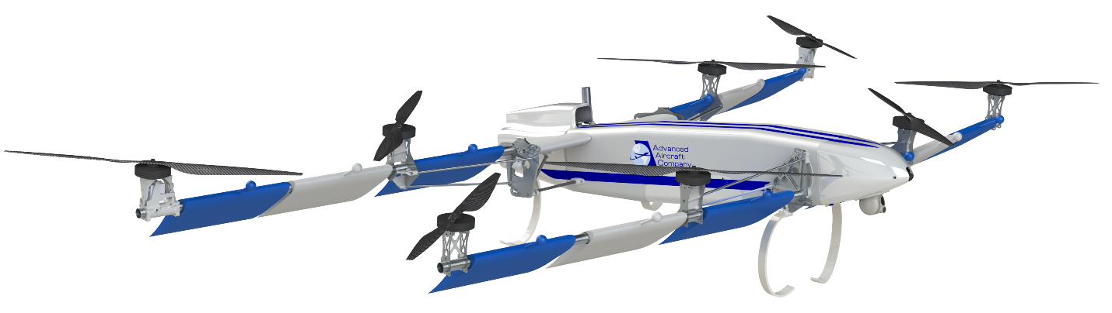
HAMR-XL
a Hybrid Electric Multi-Rotor
Project Summary
Participant Summary
The proposed project would be to scale up AAC’s existing HAMR UAS to a 55 pound takeoff weight 🡪 HAMR-XL.
This approach is unique from today’s existing multi-rotors because of the incorporation of two new technologies. The first are aerodynamic improvements to double the aerodynamic efficiency of a multi-rotor. The second is the incorporation of a hybrid electric propulsion system.
Advanced Aircraft Company (AAC) is startup long endurance VTOL UAS manufacturer. Our first product, the HAMR UAS, is a hybrid electric multi-rotor with a 3.5 hr max endurance, targeting commercial and military markets.
AAC is currently commercializing the HAMR UAS. HAMR is an acronym for hybrid advanced multi-rotor. The HAMR has a max flight time of 3.5 hours. First delivery of a HAMR to a beta customer is planned for March 5th. For more information on HAMR, please visit: http://www.advancedaircraftcompany.com/hamr/
Technical Outcome
The combination of these two technologies will increase the max flight time greater than 3 hours, while simultaneously maintaining the benefits of a conventional multi-rotor.
Unfortunately, AAC will not be able to commit to the timeline of this challenge. This proposal is intended as a request for dialogue.

