Slide 1
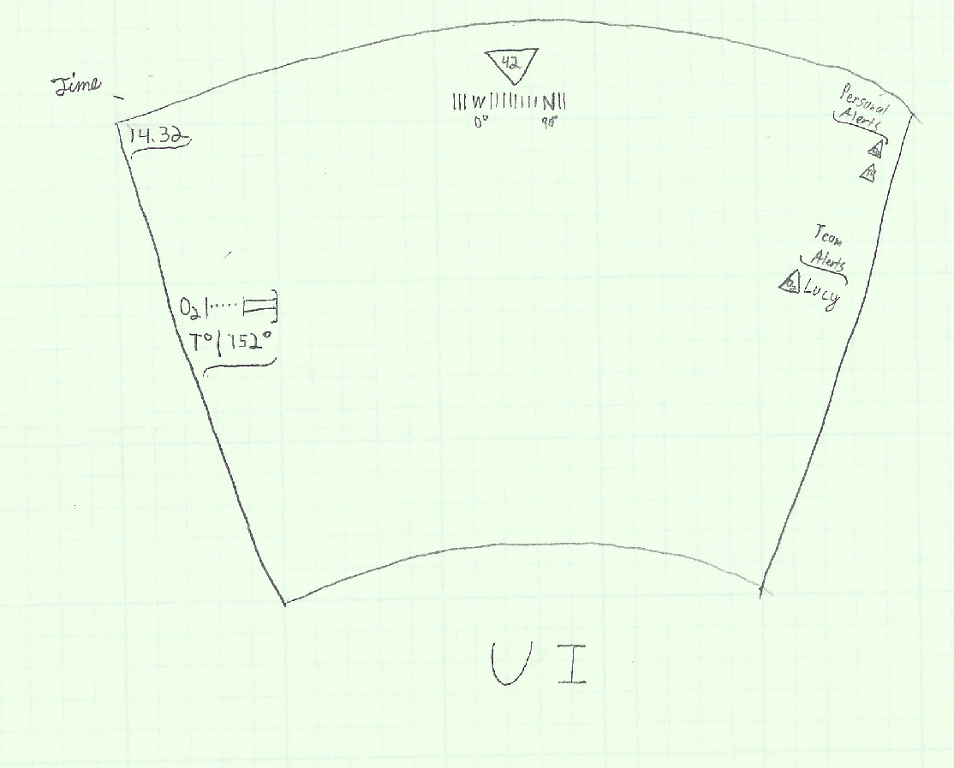
Minimalist Safe Environment for Firefighters Zubin Kane and Cameron Mosley
Project Summary
Participant Summary
Our aim is to design and develop an Augmented Reality environment with a heavy focus on minimalistic user interface. Without data cluttering and overload, firefighters will have convenient access to basic health/situation information about themselves and other nearby firefighters, which should significantly increase safety and positive outcomes
Honors Electrical/Computer Engineering students at Purdue University
Backgrounds in programming, computer systems
Experience with variety of obtrusive/unobtrusive simulated Augmented Reality UIs in digital media
One member a former NIST SHIP intern
Technical Outcome
Our proposed minimalistic approach should result in a streamlined understanding of how to present critical data using simple design principles, which will significantly contribute to advancing how we design wearables, with the minimalistic emphasis lowering costs, increasing reliability, and getting firefighters and others with hazardous jobs enough information to be safe.
Insert a picture or chart
related to your approach.

