Slide 1
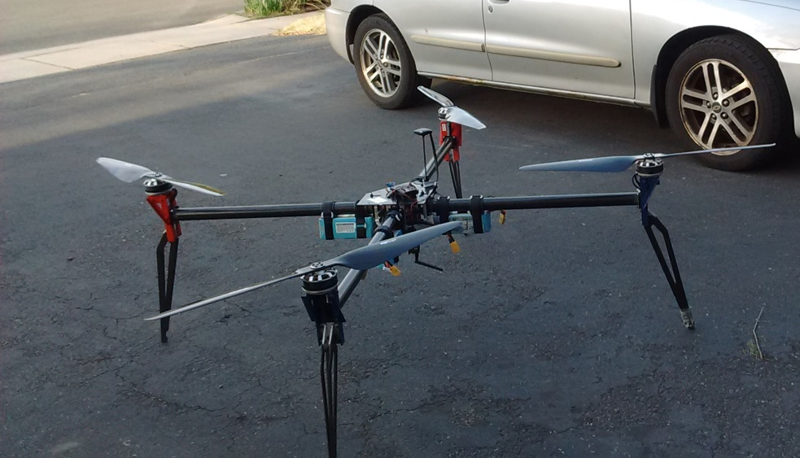
Long Endurance C2 X8 MaxPran
Project Summary
Team Members
We will provide a Long Endurance X8 UAS for use by First Responders for reliable Command and Control (C2). Our experience, skills and facilities developed over years of R&D in the energy, aerospace and UAS industry will allow us to design, build and optimize an X8 providing maximum performance. Additionally our experience in transitioning DOD SBIR technology will ensure the Long Endurance C2 X8 is a reality.
Jim Faunce, PE (ME, EE) Experienced in design, build, and delivery of Aerospace products to the US Army, Navy, Air Force, NASA & Israeli Air Force. Career spans from design of power tools for Ingersoll Rand to Fusion Energy Engineering at Princeton.
Matt Koestner (EE) has 20+ years’ experience with electronic integration and radio control. Matt is a Part 107 FAA UAS pilot.
Technical Outcome
Our prototype is designed for rapid transition to qualification testing. Beyond long flight time, our design methodology keeps in mind all requirements necessary to bring the product to market. Our design is modular allowing the initial product to take advantage of future component improvements and new developments in energy sources.
Insert a picture or chart
related to your approach.

