Slide 1
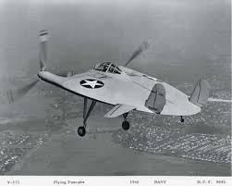
UAS Flight and Payload Challenge (Middle Tennessee State University)
Project Summary
Participant Summary
The goal for this project is to adapt the V-173 Flying Pancake to small, long endurance UAS. With the ability for 6 or more hours of flight, the unmanned Pancake can adapt to any first responder scenario. Our strategy is to reimagine the design of the Flying Pancake, making adjustments for endurance (achieved with solar technology) and high payload.
Our team consists of experienced Unmanned Aircraft System manufacturers, pilots, and technicians. We also have team members who are experts in the fields of aerodynamics, electrical systems, and unmanned vehicles. Our team has a demonstrated understanding of advanced UAS techniques, and is highly qualified to participate in a competition of this magnitude.
Technical Outcome
The proposed approach will be fruitful given the fact that the Flying Pancake has a unique and proven design. Our aircraft will have reduced drag and restored aerodynamic efficiency, all while reaping the benefits of low aspect ratio wing design. Adding solar cells to combat the draw from the Lithium-Ion batteries will help us reach our 6+ hour flight time goal. First responders will be able to utilize this mission-flexible UAS in any number of situations without worrying about flight time.
Insert a picture or chart
related to your approach.

