Slide 1
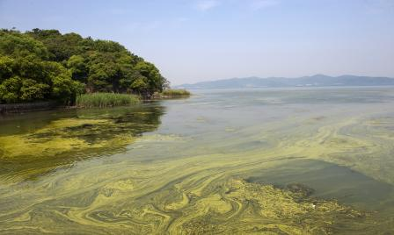








Nutrient Sensor Action Challenge
Informational Webinar • March 15, 2PM EST

Slide 2
Agenda
Welcome and Introductions
Overview
Requirements, Eligibility, Timeline, Results
Ongoing Project Support
Challenge.gov
www.challenge.gov/nutrient-sensor-action-challenge-stage-ii
Notes:
Before we jump into the details about this Challenge, we’d like to find out a little bit about you who are participating on this webinar today. You are about to see two poll questions; after you reply, we will display the results so everyone can see them.
Where are you located?
Please describe your organization.

Slide 3
Overview
Excess nitrogen and phosphorus in our waters is one of the costliest and most challenging environmental problems
Cost of water treatment
Human health effects
Hypoxia
Harmful algal blooms
Over the last 50 years, the nutrient pollution has escalated
Agricultural and urban sources
Sewage and septic systems
Atmospheric deposition
www.challenge.gov/nutrient-sensor-action-challenge-stage-ii

Slide 4
Shared Vision
A desire to accelerate the widespread use of affordable, high-performing, real-time nutrient sensors; demonstrate the value of information from these sensors in decision making; and promote sharing and integration of data into existing water monitoring efforts.
www.challenge.gov/nutrient-sensor-action-challenge-stage-ii
Notes:
Update with logos from Slide 1? YES

Slide 5

Goal
Design and implement approaches that use nutrient sensors and resulting data to improve decisions and actions for more effective nutrient management
Up to two (2) winning teams will share the prize of $100,000.
www.challenge.gov/nutrient-sensor-action-challenge-stage-ii
Notes:
Goal of the Challenge is for teams to…

Slide 6
Eligibility
Open to communities and organizations in the United States
Teams should be currently engaged in water quality monitoring and have some experience using sensors, managing data, and communicating information
Participation in Stage I of the Challenge is not a requirement for participation in Stage II
www.challenge.gov/nutrient-sensor-action-challenge-stage-ii

Slide 7
Requirements
Effective use of nutrient sensors
Deploy two or more nutrient sensors that measure P and/or N
At least one low-cost sensor (not exceeding $15,000)
At least 3 months of data collection (starting March 2018)
Data management
OGC compliant
Interoperable data protocols
Data accessible to Challenge Administrator via web services
Demonstrate how sensor data will inform decision-making
www.challenge.gov/nutrient-sensor-action-challenge-stage-ii
Notes:
Now that you’ve heard a bit about the Challenge goals, requirements, and eligibility, we’d like to ask you a few more questions.
3. Do you plan to enter the Challenge?
4. If you plan to enter the Challenge, please describe your state of preparation.

Slide 8
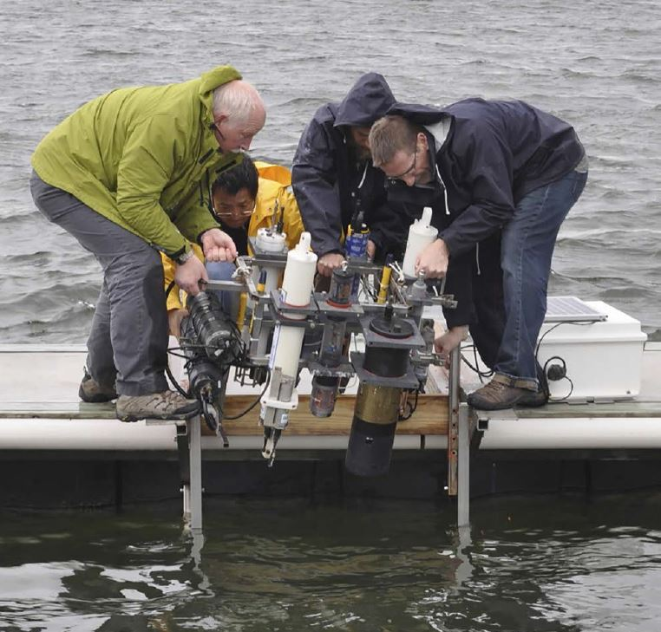
Registration
Registration due 2 weeks prior to data collection
Registration form available on Challenge.gov under “Requirements”
Submit registration on “Submit Solution” tab of Challenge.gov
www.challenge.gov/nutrient-sensor-action-challenge-stage-ii

Slide 9
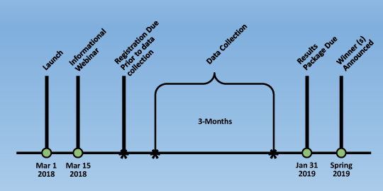
Timeline
www.challenge.gov/nutrient-sensor-action-challenge-stage-ii

Slide 10
Results Package
Due January 31, 2019
Maximum 30 pages (can include links)
Include:
Any revisions to registration
Data architecture and data summary
Potential value for improving nutrient management
Quality Assurance and Quality Control (QA/QC) approach for project
www.challenge.gov/nutrient-sensor-action-challenge-stage-ii

Slide 11
Ongoing Project Support
Monthly webinars
Project check-ins (optional)
Newsletter
EPA webpage project updates
www.challenge.gov/nutrient-sensor-action-challenge-stage-ii
Notes:
At this point, we have our last two poll questions for folks on the webinar:
If you plan to enter the Challenge, what do you foresee as your greatest obstacle?
If you plan to enter the Challenge, when do you anticipate you will begin data collection?

Slide 12
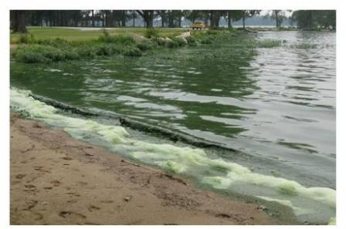
Questions?

Slide 13
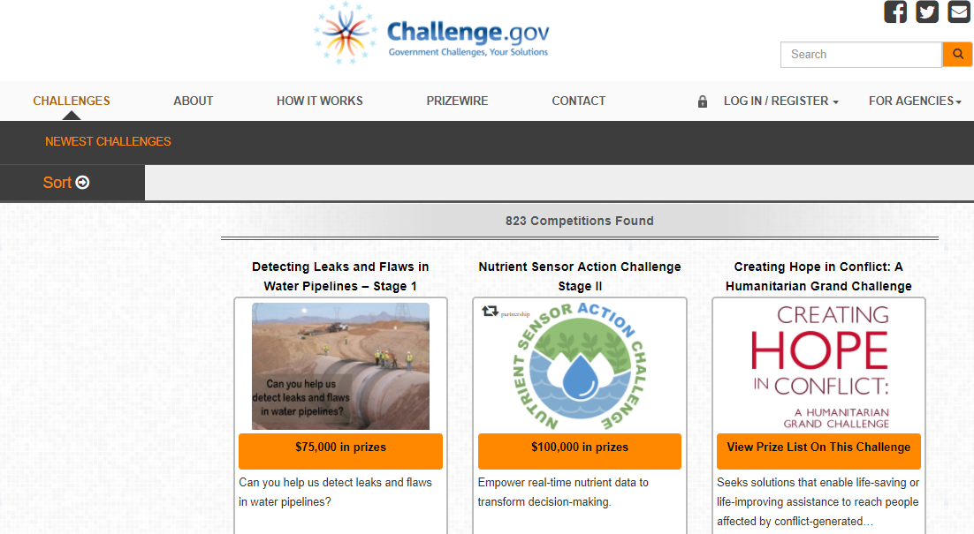
Challenge.gov Intro

Slide 14
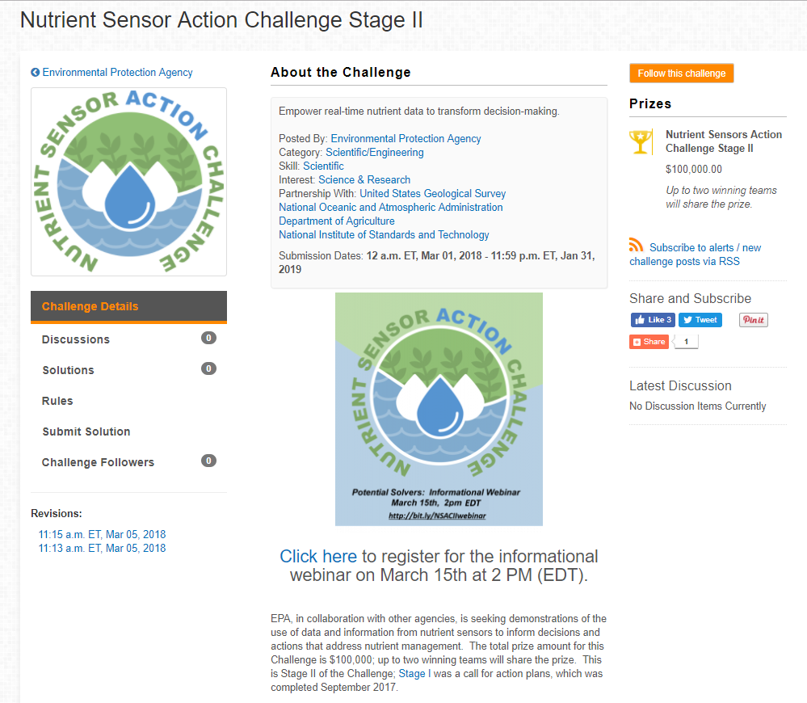
Anatomy of a Challenge
4
7
Key
Discussion board
Solutions (public/private)
Rules
Skills/interests
Key dates
Challenge details
Prizes offered
5
1
2
3
1
6

Slide 15
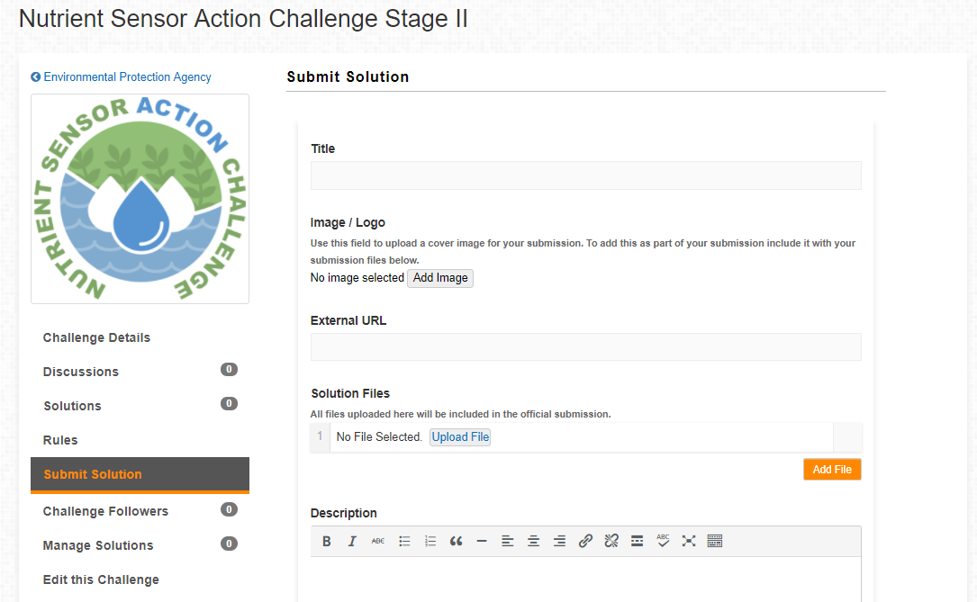
Anatomy of a Challenge
1
Key
Title
(Cover) image/logo upload
External URLs
Solution files upload - more than 15 file types accepted
Description/abstract
1
1
2
3
4
5

Slide 16
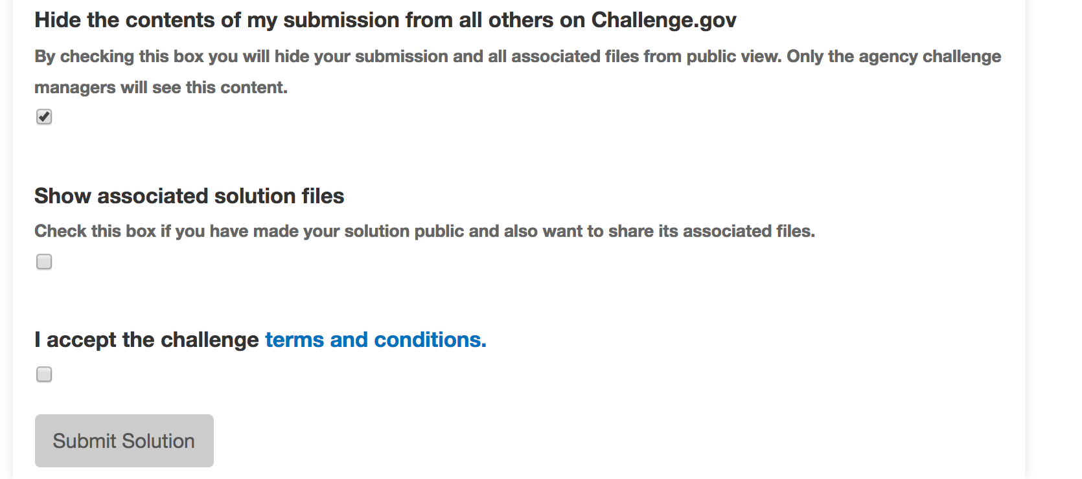
Anatomy of a Challenge
Additionally, all participants, or solvers, must click to accept the specified terms and conditions BEFORE uploading their entries.
Notes:
Add boxes

Slide 17

Thank you !
Questions?
www.challenge.gov/nutrient-sensor-action-challenge
#NutrientSensorAction

