Slide 1
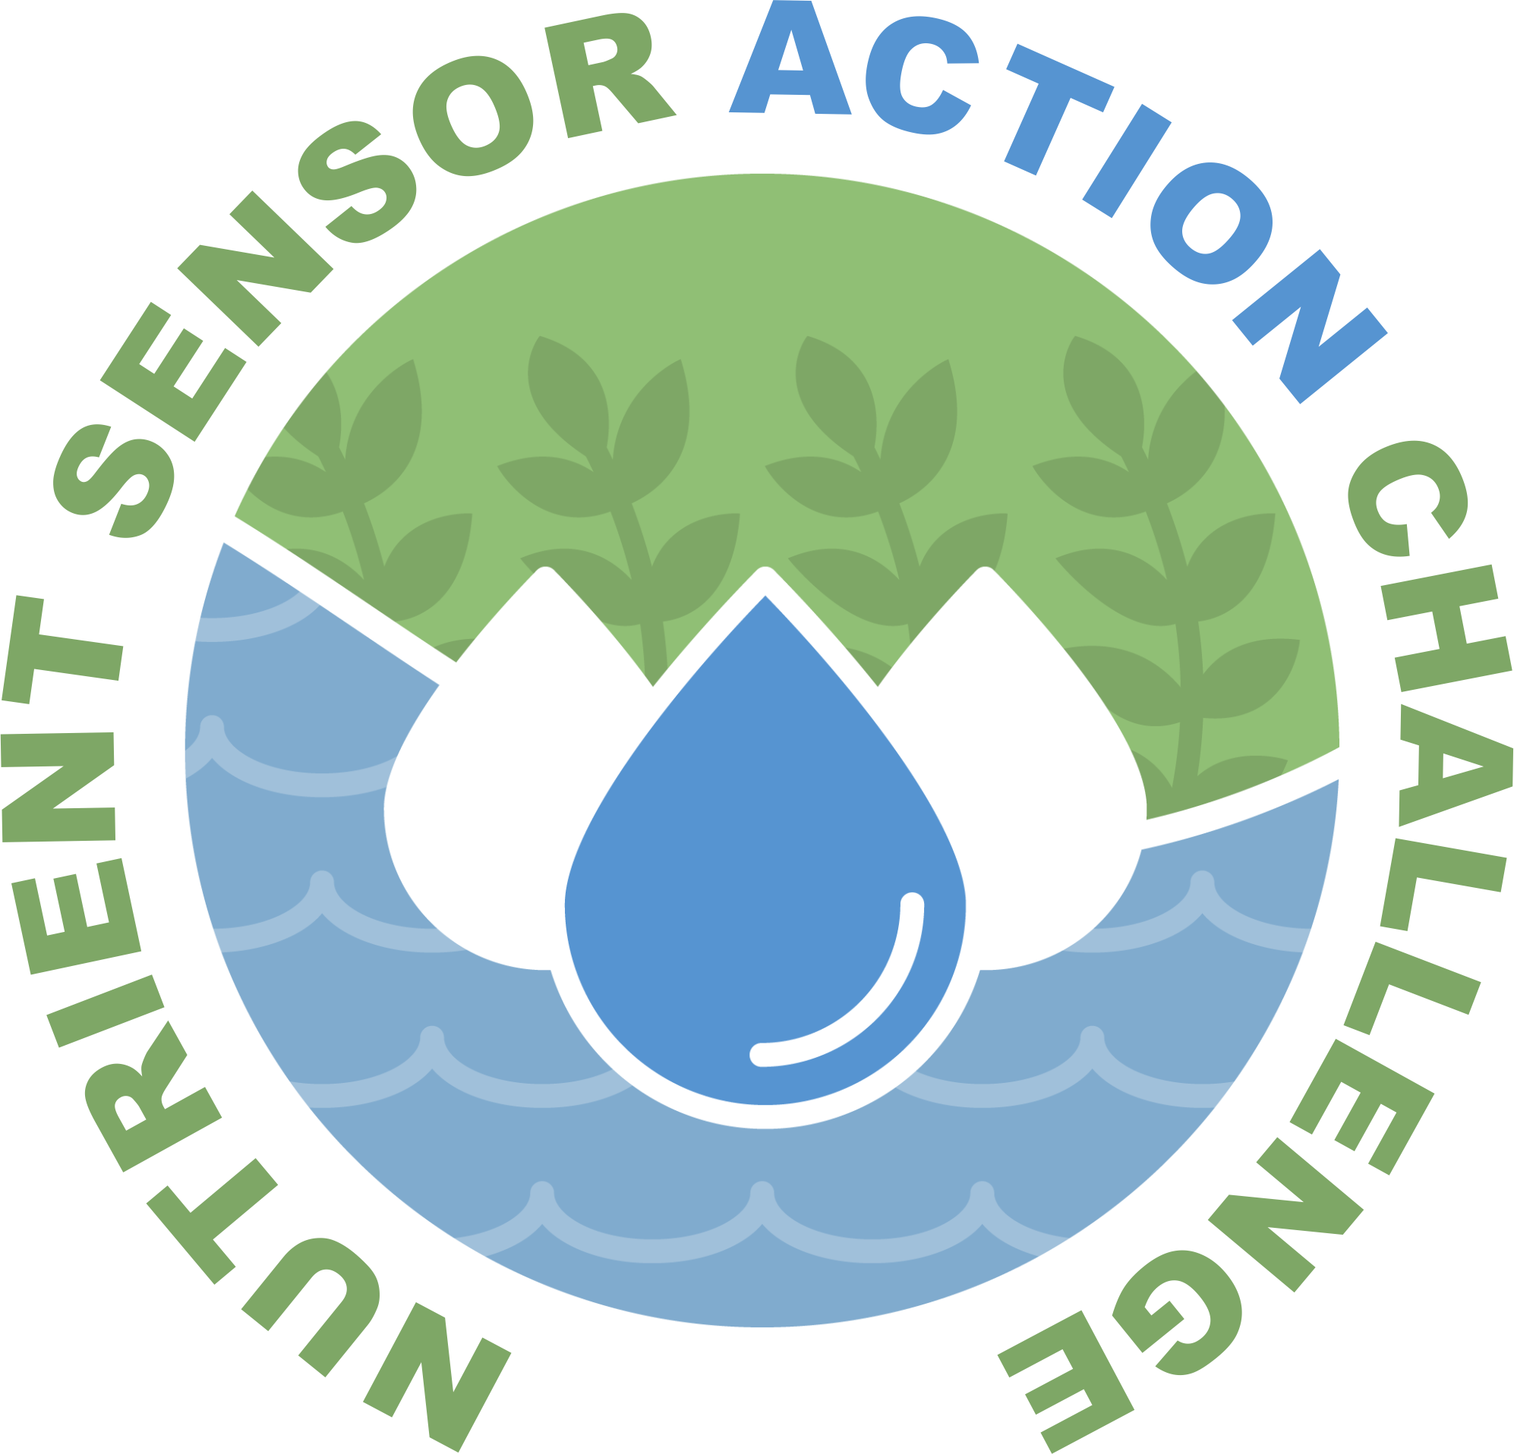
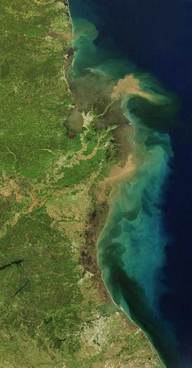






Nutrient Sensor Action Challenge Real time nutrient data to transform decision-making
Data Management Webinar
February 6, 2018, 2PM EST
Notes:
Remove ACT

Slide 2
Webinar Outline
Welcome and roll call
Data management requirements
Team Spotlight: UMCES/MDNR
What’s next
www.challenge.gov/nutrient-sensor-action-challenge

Slide 3
Projects | Organizers
Casco Bay Estuary Partnership (Maine) Columbia University (New York) League of Women Voters (Illinois) Maryland Association of Soil Conservation Districts (Maryland) Mystic River Association, USGS (Massachusetts) Ohio EPA, Great Lakes Environmental Center (Ohio) Thermo Fisher Scientific, UMASS (Massachusetts) University of Louisiana at Lafayette (Louisiana) University of Maryland, MDNR (Maryland) University of Michigan (Michigan) University of New Hampshire (New Hampshire) | EPA NIST USDA USGS NOAA IOOS
www.challenge.gov/nutrient-sensor-action-challenge
Notes:
Use for role call

Slide 4
Data Requirements
Data Standard
Interface
Access
www.challenge.gov/nutrient-sensor-action-challenge

Slide 5
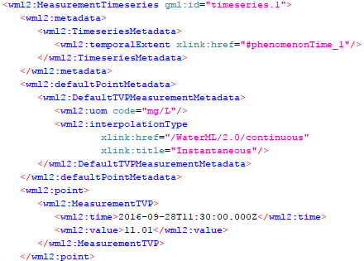
Data Requirements – WaterML
WaterML
Open standard
Built upon other industry
standards; standard
definitions
www.challenge.gov/nutrient-sensor-action-challenge
Notes:
One of the primary requirements for this challenge is the use of the WaterML data standard. Also known as Water Markup Language.
WaterML is an international standard which provides a common data exchange model for water observations with the intent of sharing the data across information systems. Its maintained by the Open Geospatial Consortium (OGC) ; which is an international voluntary consensus standards organization. Version 1.0 of the standard was released in 2009 and the second version, labeled 2.0 became official in 2012.
WaterML is an Open Standard which means it’s publicly available and not proprietary. Anyone can download, review and submit change requests, new requirements or comments on the standard so they may be considered in future updates to the standard. Being open also means consumers can use various programming languages (like Java and Python) and various products (like ones from 52 North, Kisters and others) for creating, editing and sharing data.
This type of openness typically helps in the overall adoption of such a standard. And as more people adopt the standard and publish their data using it, the value of the data begins to increase as it can be used to support secondary use cases.
WaterML is XML based format which allows that data to be processed using a variety tools and programming languages. That’s a snippet of WaterML next to the bullets on the slide – I believe that is a DO reading.
WaterML itself is built upon other OGC standards like the Observations and Measurements (O&M) and Geography Markup Language or GML. This reuse helps to enforce consistency for things such as definitions across various standards. For example, the definition for and observed phenomenon for an air sensor using the observation and measurement standard is the same definition as the observed phenomenon for a water sensor using the WaterML format. Having common definitions that mean the same thing across various standards help staff come up to speed more quickly on the standards themeseleves and helps to avoid incorrect use of data elements across standards.
As part of this challenge, the Challenge Administration Team plans to validate teams’ data to ensure it conforms to the WaterML format.

Slide 6

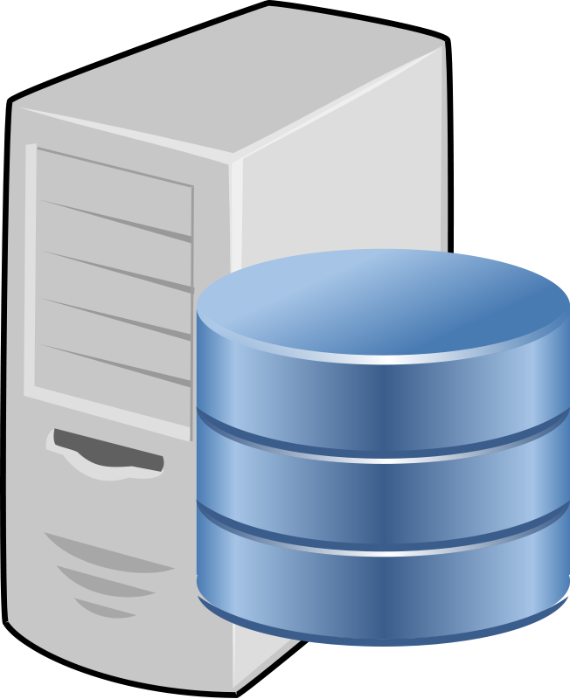
Data Requirements – Interoperability
Request
Response (WaterML)
Challenge Administration Team
Web Services
www.challenge.gov/nutrient-sensor-action-challenge
Notes:
Another primary requirement for this challenge is interoperability. For this challenge, web services have been selected to support the interoperability requirement. This means teams must implement web services that provide the ability to query observations and sensor metadata.
So, looking at the slide, the Challenge Administration Team will issue data requests to the implemented web services to retrieve data to determine if
existing standards that support interoperability are being used to expose data and
to determine if data is being returned in valid WaterML format.

Slide 7
Data Requirements – Interoperability
Request
Response (WaterML)
Challenge Administration Team
Web Services
Example Languages: Java, .Net, Python
Interface Standards: SOS,
SensorThings API
Example Products: RStudio, qGIS, ArcGIS
www.challenge.gov/nutrient-sensor-action-challenge
Notes:
Interoperability using existing industry interface standards is a key characteristic when supporting information exchange with a broad audience. Specifically, interface standards provide the specifications for how data is exchanged using web services.
Similar to the WaterML standard, web service implementation using interface standards such as the Sensor Observations Service (SOS) or SensorThings API allows the web services to be consumed using multiple programming languages and products.
As a developer, I appreciate when web service providers use standards as most of my developer tools can automatically generate code to match a standard. This really helps reduce my development time as I don’t have to develop the boiler plate code that connects to a web service, downloads and then parse the data. Typically most of that is handled by my developer tools which allows me to focus more on my analysis or application being built.
With that said, this challenge only requires teams to exchange data with the Challenge Administration Team. So during the challenge, the Challenge Administration Team will act as the “broader audience” and determine how interoperable the implemented solutions are. To do so, we may use multiple program languages or products so selecting an interoperable web service standard is a key decision for teams.
Let’s review some of the interface standards….

Slide 8


Data Requirements – Interoperability
Sensor Observation Service (SOS) - http://www.opengeospatial.org/standards/sos
OGC SensorThings API - http://www.opengeospatial.org/standards/sensorthings
USGS Instantaneous Values Web Service -
http://waterservices.usgs.gov/rest/IV-Service.html
Custom
Please note: Custom built web services are required to mimic capabilities offered by the OGC or USGS web services. The custom services should leverage another industry known standard. Specific instructions about how to query the custom web services will need to be provided to the Challenge Administration Team.
www.challenge.gov/nutrient-sensor-action-challenge
Notes:
As previously stated, interface standards provide the specifications for how data is exchanged using web services.
Based on this, the Challenge Administration Team has identified the following options for exposing data via web services for this challenge. The list is in order of the Challenge Administration Team’s
preference.
The current preference is for teams to use either the Sensor Observation Service or SensorThings API standards for exposing sensor data via web services. Both standards excel at interoperability and support the WaterML format.
The team also included USGS as an acceptable mechanism to expose observation data because of their longstanding support for providing water related data in an open manner and the fact that they support the WaterML data format.
The last option is a custom one. In this case, teams will need to indicate what standard they followed and how WaterML is supported. Because of the additional work required to setup a compliant web service offering, we encourage teams to use one of the OGC standards or work with the USGS one.

Slide 9
Data Requirements – Data Access
Data must be made available in WaterML format
Indicate the type of web service (SOS, USGS, etc.) on your registration form.
Teams must provide access to data via web services by November 1, 2018
Access can be secure
Challenge Administration Team
Web Services
www.challenge.gov/nutrient-sensor-action-challenge
Notes:
To review, the data access requirements for the challenge are
Data must be made available to the Challenge Administration Team compliant with the WaterML format
During registration, teams must indicate what type of interface standard they plan to use for their web services (SOS, SensorThings API, USGS, or custom)
In addition
Teams must provide the Challenge Administration Team access to their WaterML data via web services by November 1, 2018
And Please note,
Because this is a challenge and because some data maybe be sensitive, the web services are not required to be publicly available. So, teams can secure their service endpoints using a username and password as long as they provide authentication information to the Challenge Administration Team to access the services to retrieve data.

Slide 10
Data Requirements - Resources
WaterML - http://www.opengeospatial.org/standards/waterml
E-Enterprise Interoperable Watershed Monitoring Project –
A great project which shows the value of interoperability
https://e-enterprisefortheenvironment.net/our-projects/interoperable-watersheds-network
http://www.exchangenetwork.net/wp-content/uploads/2017/05/11.2-Session-11-2-Continuous-Monitoring-Data-Pilot-Young-K.pdf
www.challenge.gov/nutrient-sensor-action-challenge

Slide 11
Team Spotlight: University of Maryland Center for Environmental Science & Maryland Department of Natural Resources
[awaiting slides from Lora Harris]
www.challenge.gov/nutrient-sensor-action-challenge

Slide 12
What’s Next…
Stage II information posted to Challenge.gov
Stage II kick-off webinar (general public)
Letter of intent submission
Outreach
EPA webpage
Press release
Social media announcements

Slide 13
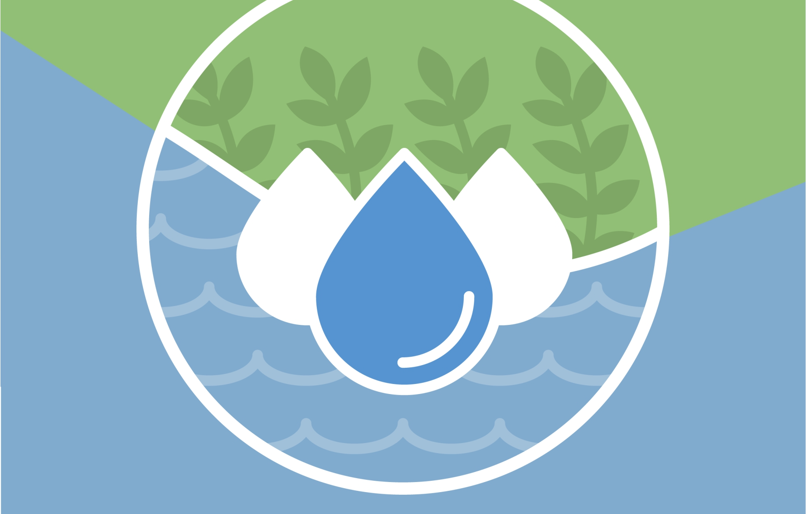
Questions?
Denice M. Shaw, Ph.D. Senior Innovation Advisor, EPA’s Office of Research and Development Shaw.Denice@epa.gov | 202-564-1108 www.challenge.gov/nutrient-sensor-action-challenge
#NutrientSensorAction

