Slide 1
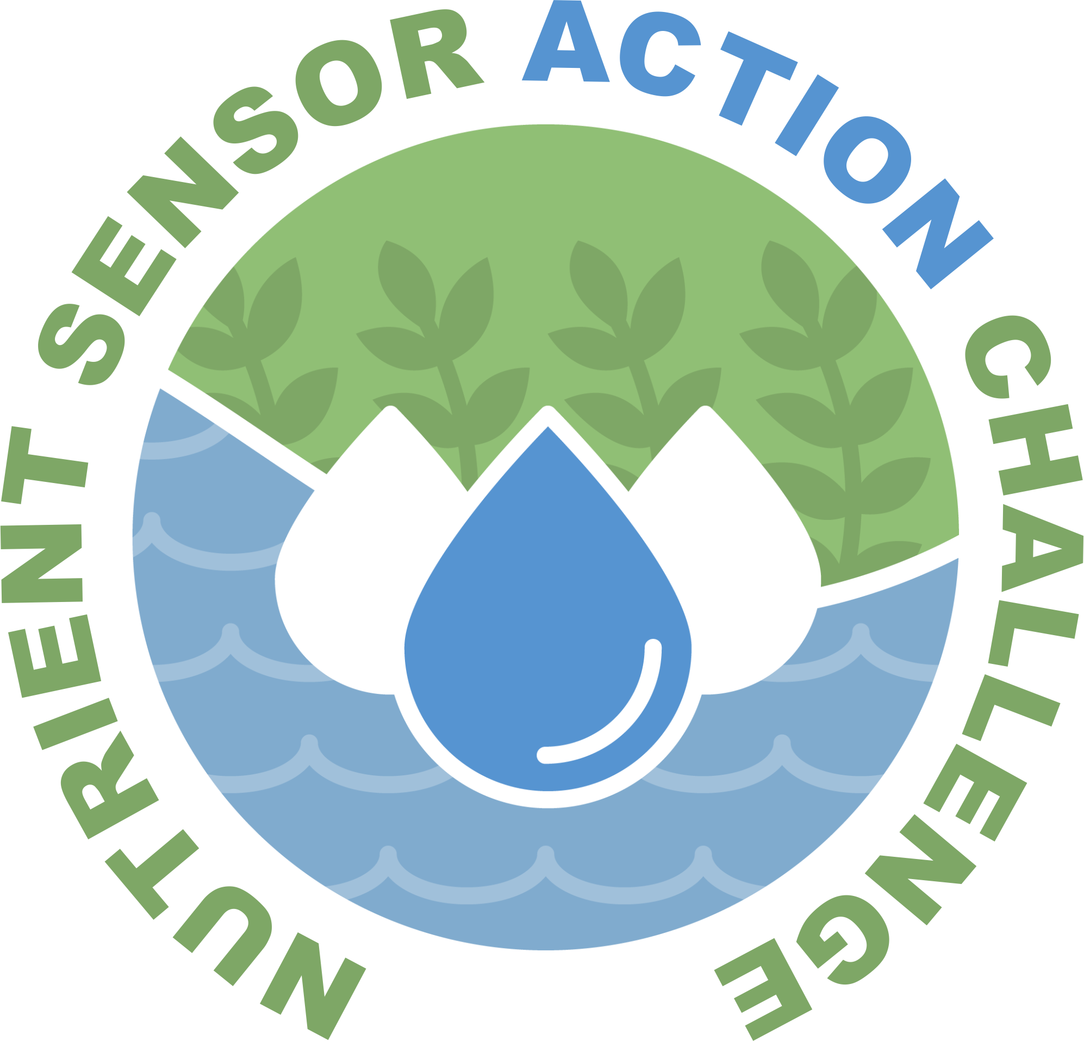
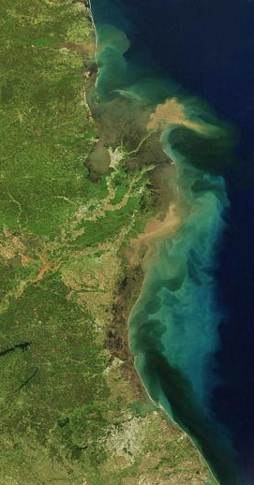

Nutrient Sensor Action Challenge Real time nutrient data to transform decision-making
Engagement and Communications Webinar
February 22, 2018, 2PM EST
Notes:
Remove ACT

Slide 2
Webinar Outline
Welcome and roll call
Stakeholder Engagement and Creating Impact with DC Design
Team Spotlight: Tom Johengen
What’s next
www.challenge.gov/nutrient-sensor-action-challenge

Slide 3
Projects | Organizers
Casco Bay Estuary Partnership (Maine) Columbia University (New York) League of Women Voters (Illinois) Maryland Association of Soil Conservation Districts (Maryland) Mystic River Association, USGS (Massachusetts) Ohio EPA, Great Lakes Environmental Center (Ohio) Thermo Fisher Scientific, UMASS (Massachusetts) University of Louisiana at Lafayette (Louisiana) University of Maryland, MDNR (Maryland) University of Michigan (Michigan) University of New Hampshire (New Hampshire) | EPA NIST USDA USGS NOAA IOOS
www.challenge.gov/nutrient-sensor-action-challenge
Notes:
Use for role call

Slide 4
Engagement and Communications
DC Design
Presentation by Libby Johnson/Durell Coleman

Slide 5
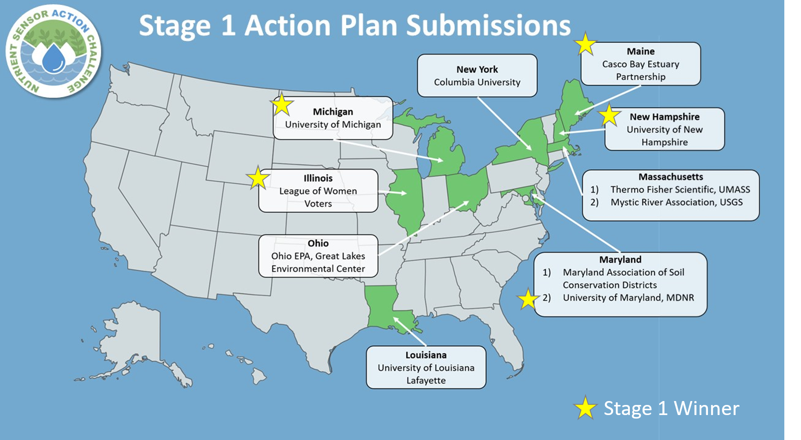
Team Spotlight: U. Michigan

Slide 6
What’s Next…
Launch Stage II - posted to Challenge.gov next week
Kick-off webinar – 3/15

Slide 7
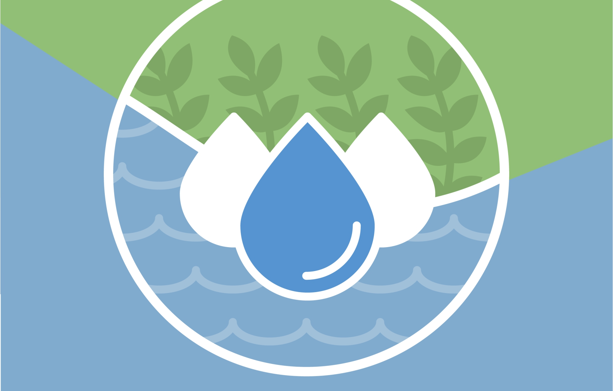
Questions?
Denice M. Shaw, Ph.D. Senior Innovation Advisor, EPA’s Office of Research and Development Shaw.Denice@epa.gov | 202-564-1108 www.challenge.gov/nutrient-sensor-action-challenge
#NutrientSensorAction

