Slide 1

Design Your Health, Advocacy for all.
Founded
January 18, 2017

Slide 2
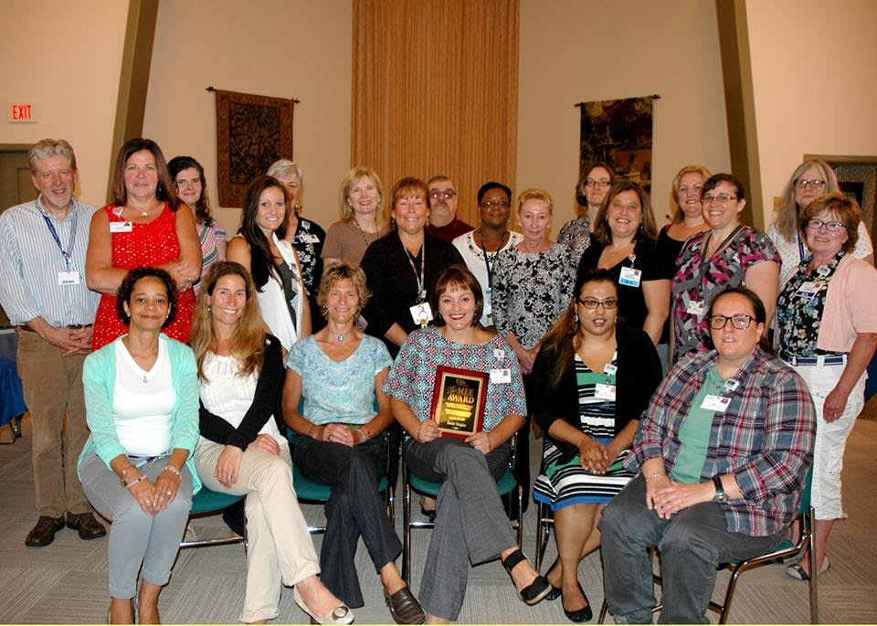
Founder’s
Missing: Carol Ann Tiberia, Amanda Blakeslee, Maria C., Tatianna A. Shamatti, Vamilla Persaud, Katie, Shampagne, and many more.

Slide 3
Contents
Founders
Concept
Mission Statement
Business Plan
Market Void
Purpose
Goals
Policy
Billing
Profit
Payers
Outreach
Referral
Assignment
Clinical Assessment
Discharge Plan
Employee Contract
Sign-on Agreement
Biography’s
In Memory Of

Slide 4
Concept

Slide 5
Mission Statement

Slide 6
Business Plan

Slide 7
Market Void

Slide 8
Purpose

Slide 9
Goals

Slide 10
Policy

Slide 11
Billing

Slide 12
Profit

Slide 13
Payers

Slide 14
Outreach

Slide 15
Referral

Slide 16
Assignment

Slide 17
Clinical Assessment

Slide 18
Client Goals

Slide 19
Discharge Plan

Slide 20
Reimbursement

Slide 21
Payment

Slide 22
Employee Contract

Slide 23
Sign-On Agreement

Slide 24
Biographies

Slide 25
Biographies

Slide 26
Biographies

Slide 27
Biographies

Slide 28
Biographies

Slide 29
Biographies

Slide 30
Biographies

Slide 31
Biographies

Slide 32
Biographies

Slide 33
Biographies

Slide 34
Biographies

Slide 35
Biographies

Slide 36
Biographies

Slide 37
Biographies

Slide 38
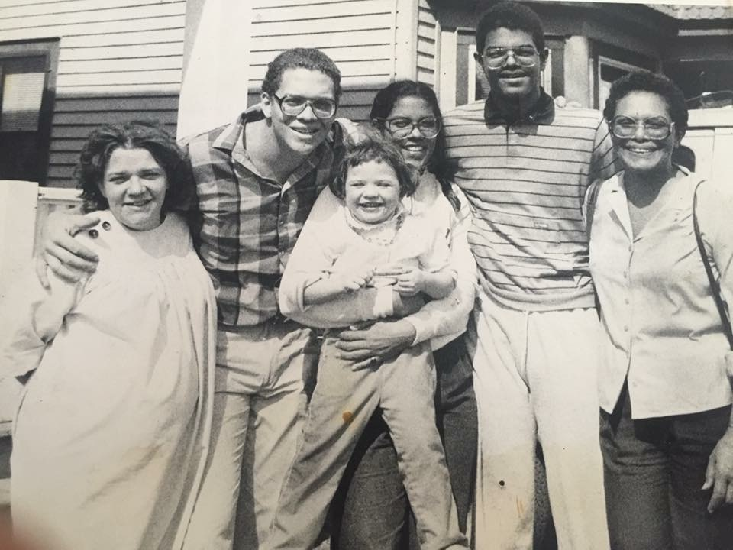
In Memory Of
Bruce Chandler Watson
&
Bruce Watson Jr.
Rest in Peace
September 2016

