Slide 1
Presentation to Patriot National, Inc.
SafeCheck
Harnessing the Power of Workforce Information
Dana Goldberg
October 8th, 2015

Slide 2

Workforce Environmental Scan
On the Move
On Demand
On Line
Notes:
Let’s take a quick look at an environmental scan of labor market trends and the composition of the American Workforce.
Note that data is several quarters off but directionally correct in the next few slides.

Slide 3
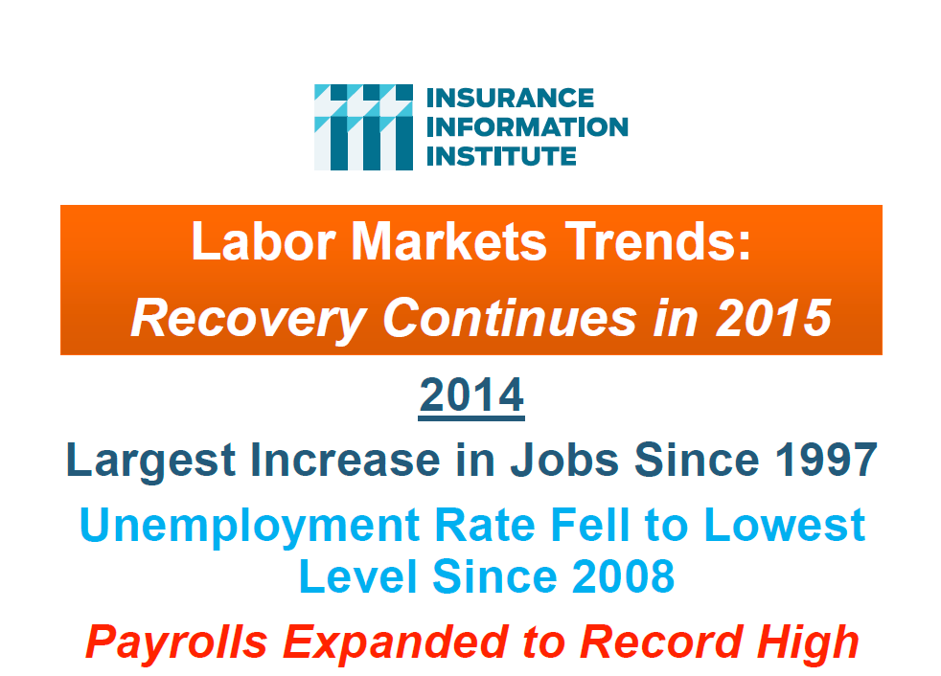
Notes:
Here’s a high level macro look labor market trends
(read subheads: Largest Increase in Jobs, etc.)

Slide 4

Notes:
Let’s focus on Key sectors critical to PC and comp

Slide 5
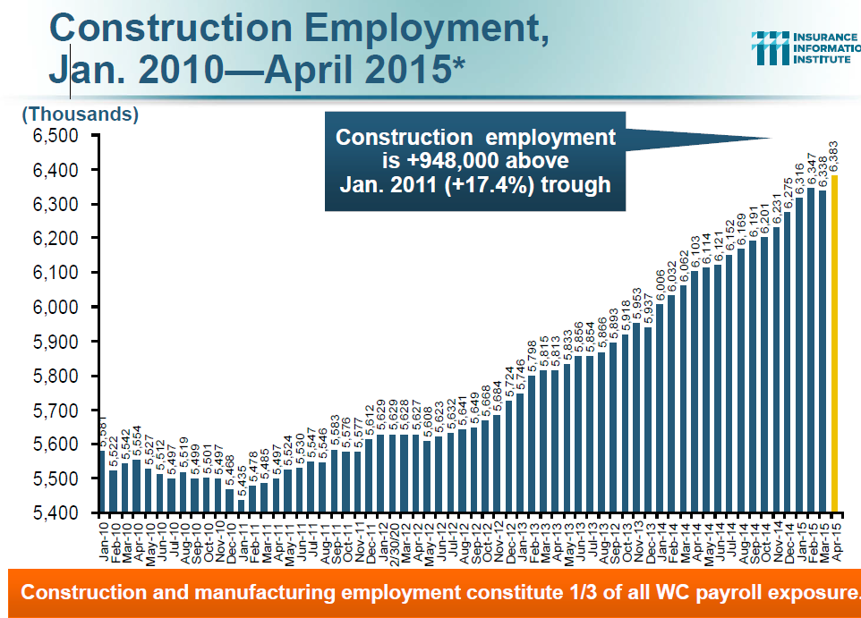
Notes:
The key take away here is not the number or strength of the recovery in the construction sector, but rather that Construction sector is on the rise.
Note that construction is also historically one of the classifications most prone to injury and construction workers sector offers one of the greatest opportunities for managing, tracking, controlling behavior visa vie the conceptual solution we offer today.

Slide 6
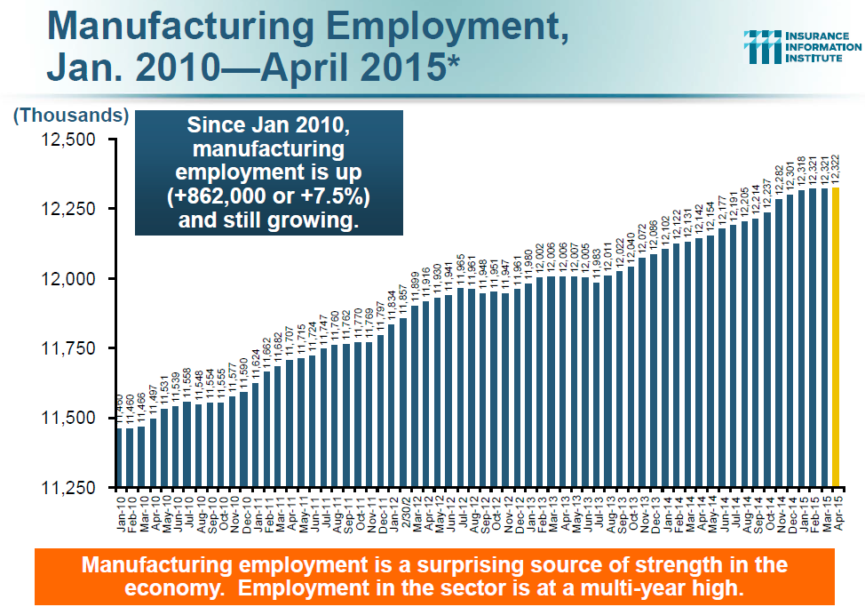
Notes:
By way of additional background, Manufacturing is surprisingly strong.

Slide 7
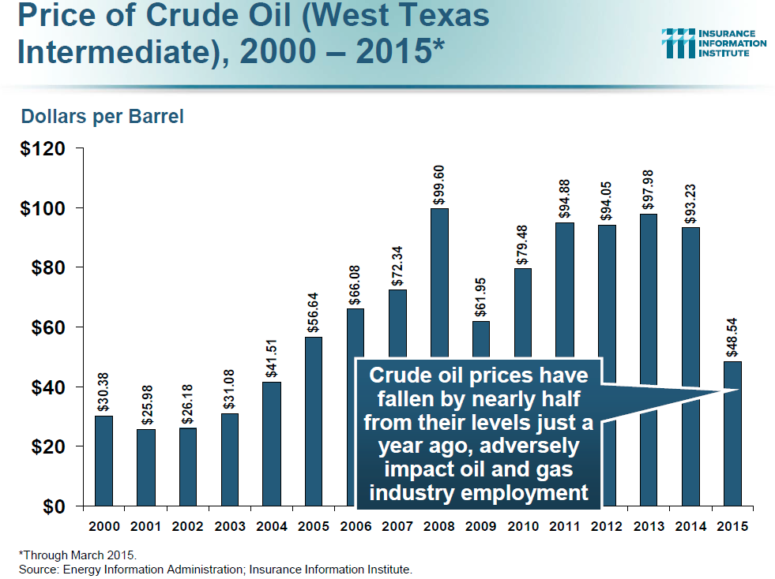
Notes:
America’s Energy Boom Has Been a Strong Driver of the Economic Recovery, but Prices Are Falling
Workers Comp Have Benefited from the Energy Boom, But Exposures Will Suffer as prices swoon

Slide 8
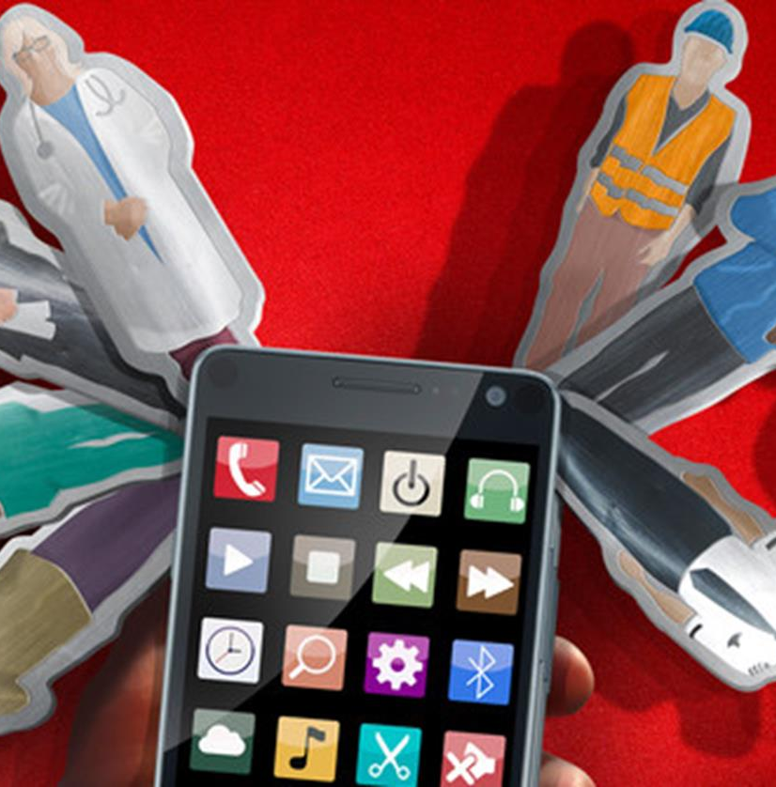
On-Demand Economy
…will transform the American workforce and the P/C Industry.
Notes:
Now that we have painted a broad picture of America’s labor market trends, let’s examine what’s happening within the actual workforce and identify potential revenue stream opportunities.

Slide 9
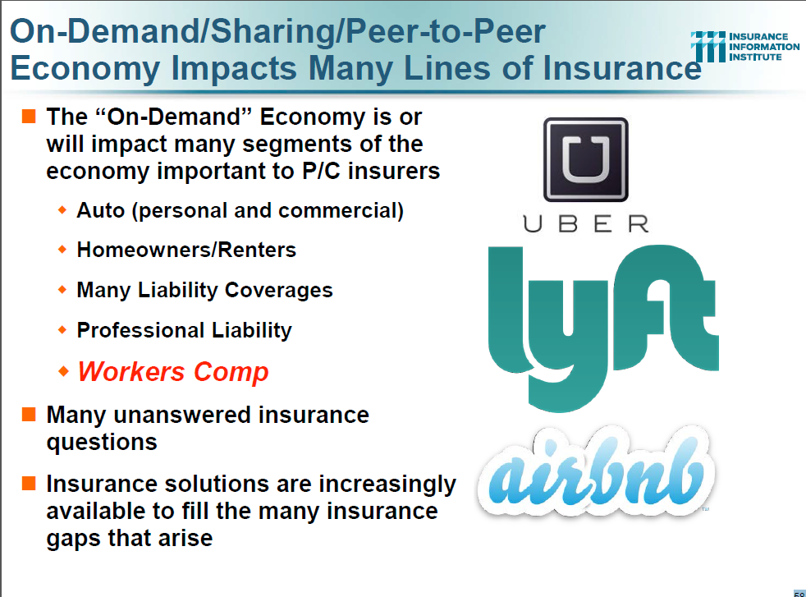
Notes:
Read content

Slide 10
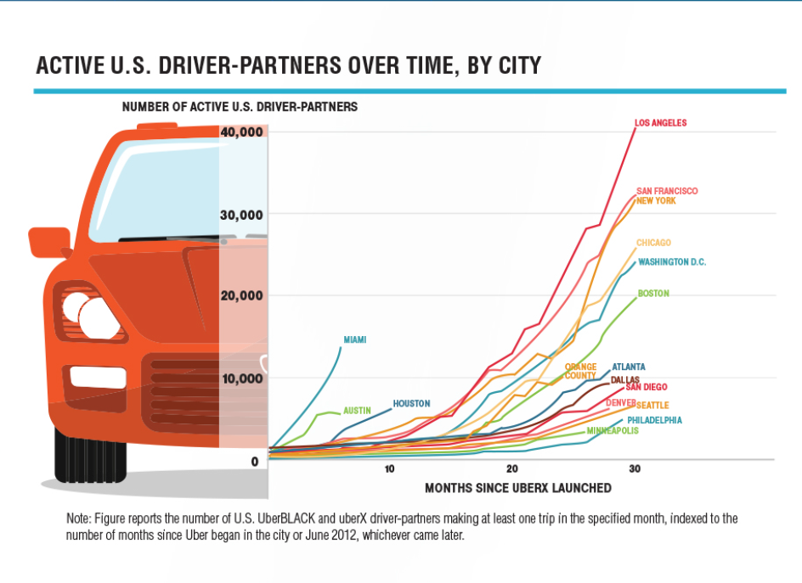
Notes:
Uber as an example of exponential growth

Slide 11
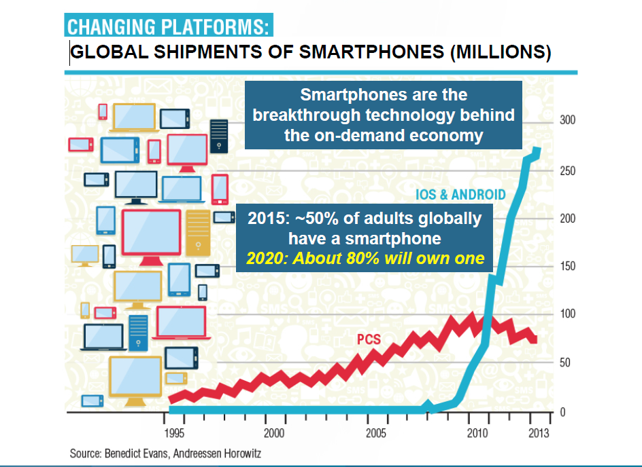
Notes:
Simultaneous exponential growth of changing platforms.
Add all this information together --- Smartphones and targeted apps hold the key to new opportunities.

Slide 12

SafeCheck Concept
The gateway to valuable employee behavior intel

Slide 13
The SafeCheck Concept
Imagine the value of every employer knowing
The confirmed identity of every employee (verified by thumbprint or eye scan)
The exact log in/log out time of work from every work site
The location of each employee at any time (verified by GPS)
The physical state of that employee ( verified by self attestation and/or biometrics wearables)
Simple idea, huge potential
Notes:
Now image the scenarios above (read them)

Slide 14
Value to Potential Customers
Insurers for
Analytics
Business intelligence
New product development (on demand workers, field workers, etc.)
Expanded Human Capital Mgmt. Services
Employers & Insurers for
Workers Comp mitigation
Liability mitigation
Time management, performance management
Compliance & Reporting
The Government for
Tracking legal workers
Ensuring identities
Protecting against terrorism
Creating/introducing quickly deployable, non invasive tracking & analytic capabilities

Slide 15
SafeCheck App
Purchase a mobile application contract scaled to employer needs. Every employee must use the application daily before beginning work. Application requires employee to answer a few key questions re:
Their identity (confirmed by thumb print or eye scan)
Their location (recorded via GPS)
Use of alcohol
Use of drugs
Identity
Location
Work readiness

Slide 16
SafeCheck App
Visits to health professionals in last 48 hrs.
HIPPA release
Other customizable questions
Application features:
Downloadable to mobile, tablet, or computer
Multilingual
Questions scalable to employer
Data feed to third party in play
Flexible
Scalable
Valuable data

Slide 17
Business Models
Multiple Models & Revenue Streams
Facebook Model - Free and sell the data
Insurer-Owned Product Model
Employer Model – Market directly to employer as independent entity
Licensing Model – Unlimited annual usage is licensed to Insurer
Uber Model New market development targeting on-demand workers
Safety tool Model -Demonstrates commitment of safe workplaces, especially re alcohol/drugs; mitigates liability; lowers wc claim costs related to substance abuse
Sample revenue streams mapped on core models
Multiple
Approaches
Audiences
Revenue Streams
Notes:
Example of possible revenue stream with FP&L
9,000 employees
Estimate half are not office employees and their needs align with SafeCheck product
Charge $3 per month per employee = $162,000 yr

Slide 18
Progress
Provisional patent obtained
Entity Incorporated
Influential advisors gathered
Key partners being assembled
Interest from multiple sources
Insurers
Government entities
Independent data gatherers
Private investors
Biometric companies
Partners for independent venture
Preliminary work complete
Momentum
Notes:
Explain what you’ve done & whom you have contacted (Don’t be specific)

Slide 19
Why Patriot National, Inc.?
Strong history and marketplace dominance for entrepreneurial ventures, forward thinking
Momentum in
Business Intelligence
Custom Development
Compliance
Predictive Analysis
Big Thinkers
History
Mindset
Momentum

