Slide 1
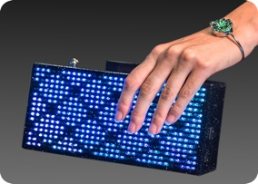





Creative Arts & Technology – One Bag, You Choose Your Look
Al
Linke, Co-Founder
Product & Biz Development
22 Years+ in IT
3 Funded Kickstarter Projects
What We Do
Creative Arts & Technology makes a wearable tech platform. Our first product is a programmable handbag that allows our users to change designs from their phone.
Erin
Linke, Co-Founder
Creative Director
US head for Chinese open
source hardware
manufacturer
The Challenge
Our customers want a unique handbag & experience. They’ve told us
the CAT Clutch gives them the most attention of any
accessory they’ve ever owned.
Compatibility
Business Model
Value Proposition
Strategic Partners
Market Size
One Bag, You Choose your Look
Change designs seamlessly from
your phone to match your
style or mood.
Hardware B2C
LED Designs App Store
Platform Licensing
White Label
TBD
$10B Global Evening Handbag Market
Estimated 2% Light Up
Handbag Market or $200M
Competitors
List competitors here
Differentiator
Cute Circuit, VanDerWaals
The only programmable handbag
that displays LED animations and
text in full color with a built-in
phone charger.
Fundraising & History
Raised $35K from Kickstarter and pre-orders in 2016, and self funded in 2017

Slide 2
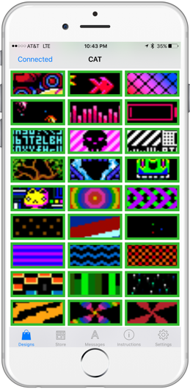
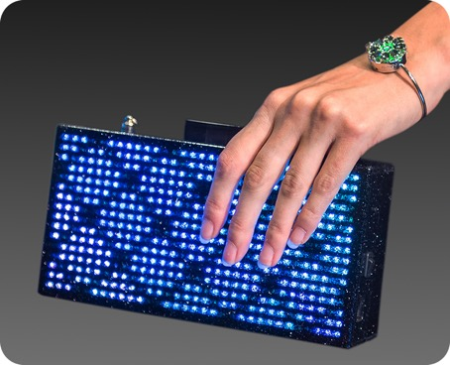
One Bag – You Choose Your Look
Features
iOS and Android Native Apps
Displays full color animations and messages
Vegan option
8 – 10 Hours Battery Life
Built in Phone Charger
Inside mirror and lipstick slot
30 second video http://bit.ly/2loFbRr

Slide 3
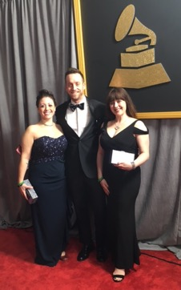
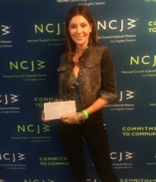
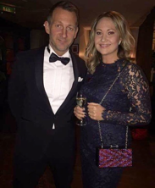
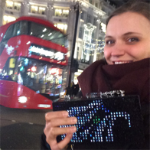
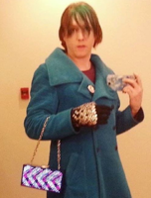
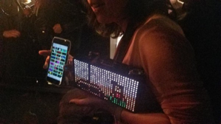
Customer Validation
“Nothing I have ever carried/worn has gotten this kind of attention”
“Hi Al, My clutch is awesome! Everybody Wants to steal it from me.”
“Thank you so much for my Cat Clutch. I am the belle of the ballroom in Marfa. Also I have a bunch of feedback on the clutch.”
“I have received the clutch and I got to say it is incredible. Thank you for creating the accessory, I absolutely love it!
“Hi Al, Just wanted to say I absolutely love my cat clutch! Took it to the Christmas party of one of the design companies I work for and everyone went absolutely mad for it!
“I’m LOVING the cat clutch!!! Ive taken it out SEVERAL times now and get a TON of compliments from both women and men. This bag definitely draws attention!

Slide 4
Start-Up Status
Raised $35K on Kickstarter + Pre-Orders in 2016 to fund initial manufacturing run of 100 LED Handbags
Completed UC Berkeley Lean Hardware Startup Accelerator in 2016
Completed Intel Startup Accelerator Program in 2016, included season 1 cast member of the America’s Greatest Makers Reality TV show
Pitch Video https://www.americasgreatestmakers.com/team/cat-clutch/
Shipped 100 Handbags in November 2016, customer validation complete
Asia manufacturing established with Foxconn in Taiwan
Additional revenue channels: white label, platform licensing, and LED design in app purchases
Currently enrolled in Retail Accelerator http://www.retailxelerator.com/, pitch day end of March ‘17

