Slide 1

MadeClear.io
The Infographic Style Privacy Policy Generator

Slide 2
Why Infographics
90% of information transmitted to the brain is visual, and visuals are processed 60,000X faster in the brain than text. (Sources: 3M Corporation and Zabisco)
Almost 50% of your brain is involved in visual processing. (Merieb, E. N. & Hoehn, K. (2007). Human Anatomy & Physiology 7th Edition)
People remember 80% of what they see, 20% of what they read and 10% of what they hear. (Lester, P. M. (2006). Syntactic Theory of Visual Communication)
It only takes us 150ms for a symbol to be processed + 100ms to attach a meaning to it. (Thorpe, S., Fize, D. & Marlot, C. (1996). Speed of processing in the human visual system)

Slide 3
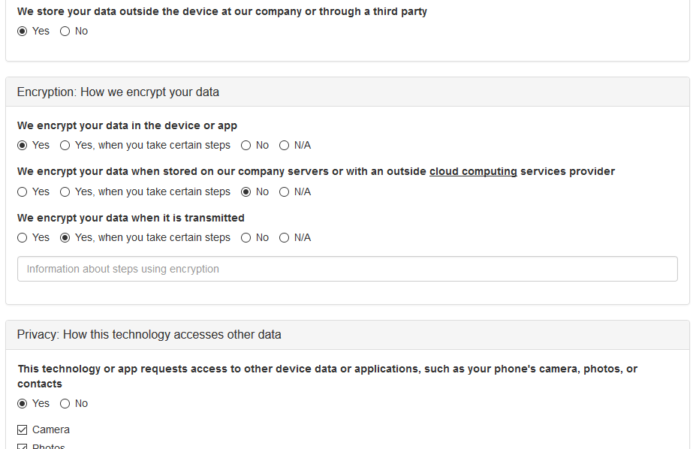
MadeClear Generator
Dynamically generated MPN
Clean and simple UX
Intuitive and intelligent form fields
Fully responsive display
Inline tooltip footnotes

Slide 4
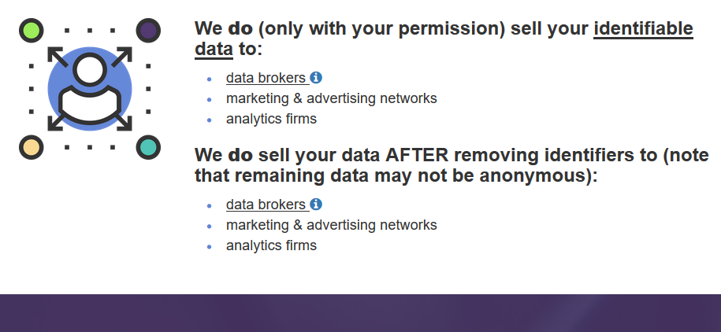
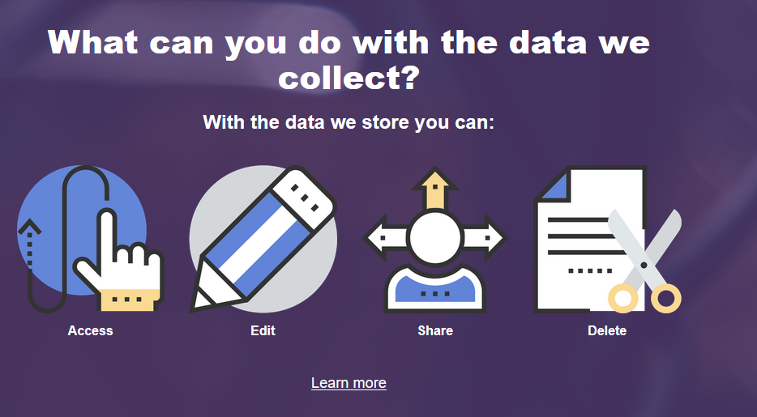
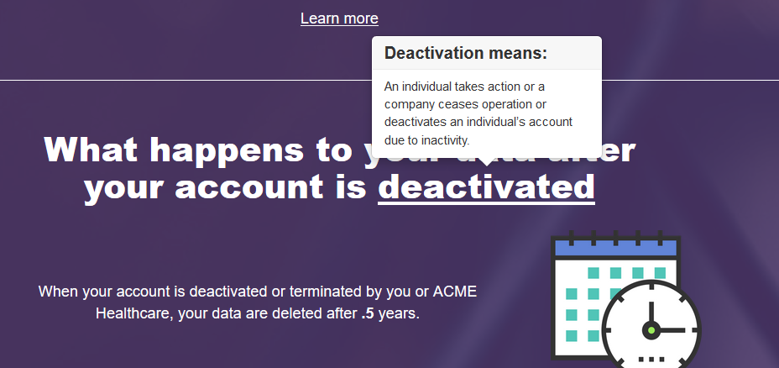
MadeClear Privacy Policy Design
Single-page scrolling experience
Visual “infographic” layout and design
Clear headers, evocative imagery and identifying iconography
Inline tooltip footnotes
Dynamically generated SEO friendly URLs
Scrollspy navigation for displaying progress

Slide 5
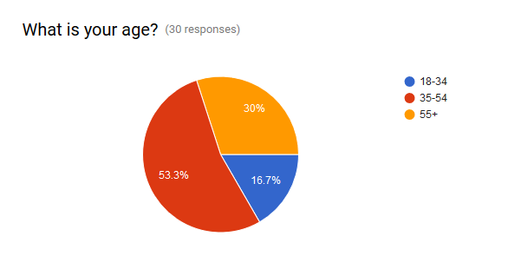
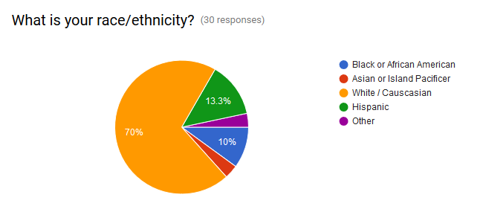
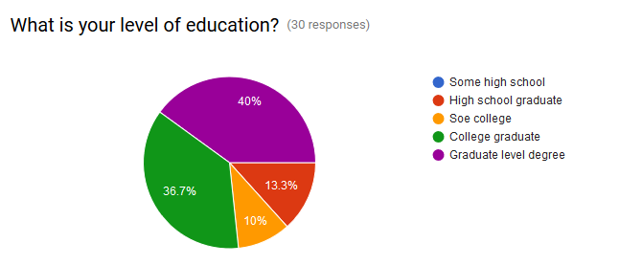
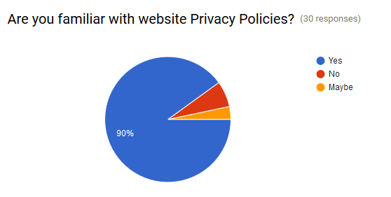
User Test Demographics
Notes:
User 1: Office worker taking public transit home.
User 2: Neighbor walking a few blocks late at night
User 3: Child taking bus from school.
User 4: Nurse driving home from work at 3 am.

Slide 6
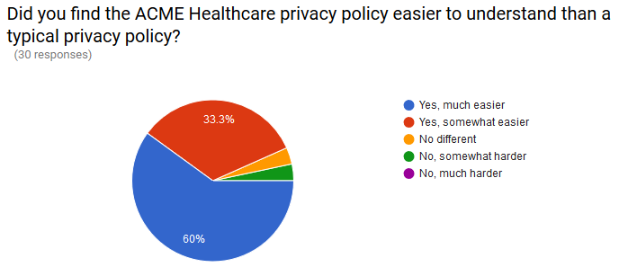
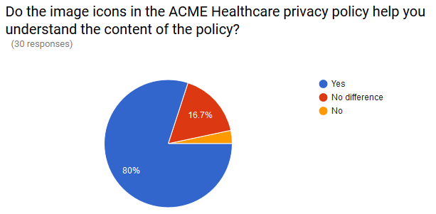
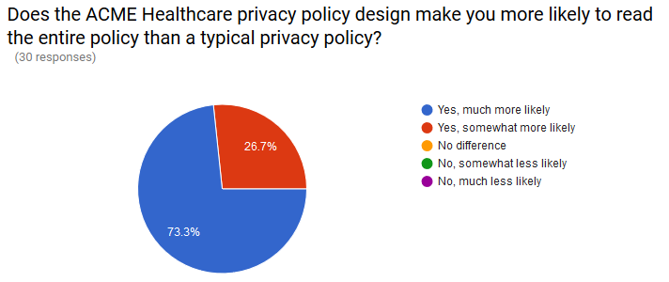
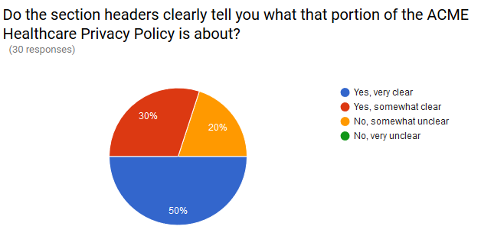
User Test Result Highlights
Notes:
User 1: Office worker taking public transit home.
User 2: Neighbor walking a few blocks late at night
User 3: Child taking bus from school.
User 4: Nurse driving home from work at 3 am.

Slide 7



User Test Findings
MadeClear makes privacy policies easier to understand.
MadeClear increase the likelihood users will read the entire privacy policy.
MadeClear’s use of imagery & iconography helps the users understand content.
Section headers needed improvement (addressed in current version).
Needed a visual cue for how much further a user had to scroll (addressed in current version).
MadeClear could benefit from MPV text being written in plainer language.
MadeClear could benefit from providing use case examples.
“I liked the breakdown of the information into clear sections. Helps make a dense subject more understandable.”
“I like that the content was broken up in chunks. It was easy to read the content on my phone.”
“Because I read it all, it actually concerned me more than the text heavy ones that I would be unlikely to read. Raised more questions in my mind about data collection.”
“I liked the "to whom we sell" section. Made me feel like I actually had some control “
“Easy to understand, not time consuming to read through. I’m more likely to actually read the policy rather than simply accepting terms in order to move forward.”
“Would it be possible to offer more reassurances of how data will be used? Maybe some examples of what couldn't happen?”
“I like the fact that you do not have to navigate. You just scroll down. I wish there was some way to know how much longer I had to go.“
“It was uncluttered and not dense. I'm more likely to read all or read carefully than other policies I've seen.”
Notes:
User 1: Office worker taking public transit home.
User 2: Neighbor walking a few blocks late at night
User 3: Child taking bus from school.
User 4: Nurse driving home from work at 3 am.

Slide 8
Technical Details
MadeClear is a fully responsive application built on the React framework that also leverages Redux and React Router. Firebase is used as a cloud database to store all of the submitted policy information which means the application logic, once compiled with Webpack, is purely front-end solution. In using Firebase the resource intensive aspect of the application has been built around a highly scalable and supported product.
Structure:
A complete React Redux application
Advanced browser history support with React Router Redux
Includes a full development environment as well as pre-configured linting, testing, and deployment to multiple environments
Code base strictly follows all lint requirements and in extension provides an excellent structure for future development
Firebase data storage and retrieval
Bootstrap CSS framework
Developed in JavaScript that is packaged and made available as a standalone script.
Available on GitHub at: https://github.com/ajveach/MadeClear

Slide 9
Product Roadmap
Design PrototypeTemplate
Implement MPN Language
Prototype Template Revisions
Develop MPN Generator
Support “My Policies”
Support Save/Edit/Delete
Support Multiple Templates
UX & Design
User Testing
Back-end DEV
MadeClear Prototype
Complete
Include Judging Feedback
Develop User Accounts
New Template UX & Design
MadeClear Product Release
Privacy Policy Snapshot Challenge

