Slide 1





Slide 2
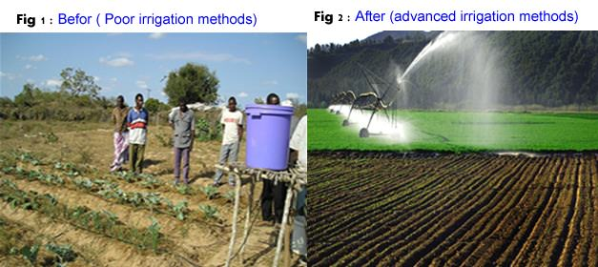
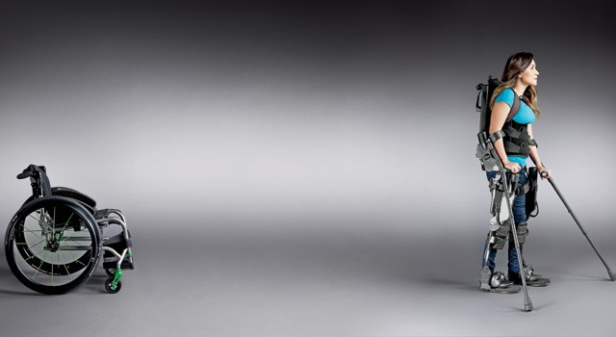


Slide 3
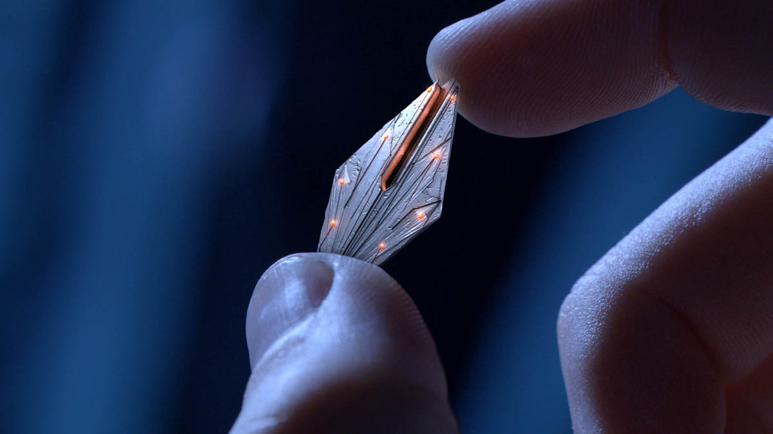
NANO CHIP SAVING A GIRL

Slide 4

How to Implement?

Slide 5

Nano chip in a chain
ext

Slide 6


Slide 7

How does it
work?

Slide 8

By
Bhavani Tejaswi

