Slide 1

HOW TO GET A 100% RESPONSE RATE
Fayette County Public Schools
Fayette County, Georgia

Slide 2

Step 1
Directly certify all eligible students for direct certification while processing applications that present a SNAP or TANF number on the application
Search students in the Georgia Online Network (GO Screen) or GaDOE School Nutrition Online (SNO) to see if student receives SNAP or TANF benefits
The GO Screen is real time and SNO is updated periodically
If student receives benefits, directly certify for free meals
This reduces the pool for applications pulled for verification

Slide 3

STEP 2
Once the verification sample has been pulled, a letter is mailed home DIRECTLY to parents on October 1st

Slide 4

STEP 3
After two days, first phone call is made
“Good afternoon Ms. Jones! This is Leo Riley with Fayette County School Nutrition Program. Have you received your verification notice? “
Now that we have reached out and touched base with the parents, the information is logged on a communication log for tracking.

Slide 5
Communication Log
The communication log includes the following information
Date
Parent/Guardian Spoken To
Issue/Concern
Resolution
Initials of verification specialist (I.E. LWR)

Slide 6

STEP 4
Two days later, a reminder call is given
Again, this call is being logged for
tracking purposes

Slide 7

STEP 5
If response has not been collected, then on October 14th, a second letter is sent out

Slide 8

STEP 6
If you still have not received a response, begin to call other family members from student information report (I.E. Infinite Campus) in an effort to reach parents.
Email and/or call parents, aunts, uncles, cousins, grandparents, guardians, etc.
Inform the recipient you are simply trying to reach the parent of the student
Be cautious with the information given
This is confidential information!

Slide 9

STEP 7
Call, call, call until they get tired of you calling
“Ms. Jones, it’s your favorite free and reduced specialist, Leo Riley. I still need your income verification. If it is easier, you are more than welcome to attach a copy in an email, fax, text, etc. You can also drop it at the school or central office! Thank you so much for helping us in this matter.”

Slide 10

Response
Ms. Jones, “Mr. Riley, just take me off this program!”
If the parent and/or guardian gives permission to take the student off of free or reduced meals, this is considered a response for verification
No further action is needed. Student is taken off of the free or reduced meal lunch program

Slide 11

Questions
If a question arises from a pay stub or income verification, call the company the parent and/or guardian works for
Speak with a manager or payroll
Always verify tips as part of the income
Verify employment with Human Resources
It is VERY important to verify frequency

Slide 12
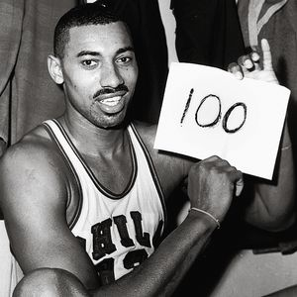
STEP 8
You win…. They responded! They got tired of hearing from you and you got 100% response rate!

Slide 13

STEP 9
Happy days are here again! We have 100% response!

