Slide 1
VERIFICATION
Best Practices
by
Betty Ann Champion

Slide 2
Verification Results:
Former District – 14,000 Students
2012: Approximately 85 applications selected, collected 81%
2013: I was only required to verify 1% due to the success rate of the year before.
Approximately 18 applications selected, collected 88%
2014: The School District went to 100% CEP so no verification needed.
Current District – 73,500 Students
2014: Former Free & Reduced Coordinator
288 applications selected, collected 34%
2015: My first year in the district
138 applications selected, collected 60%
2016: My second year in the district
136 applications selected, collected 64%

Slide 3
Verification is processed on October 1, I request the information to be returned by October 31.
Reminder letters are sent out and phone calls made around the third week of October to any non-responders.
The first week of November a second follow up letter is mailed, phone calls are made, and emails are sent.
Throughout the last two weeks calls are made and emails sent.
Note: If any Hispanic families are selected for verification we insure that the letters are mailed in Spanish and any phone calls that are made to them are in Spanish.

Slide 4
This is put at the top of the verification selection letters that are sent to each household
**PLEASE DO NOT DISCARD THIS LETTER**
WE MUST CHECK YOUR APPLICATION
CALL 336-370-3266 IMEDIATELY IF YOU HAVE QUESTIONS

Slide 5
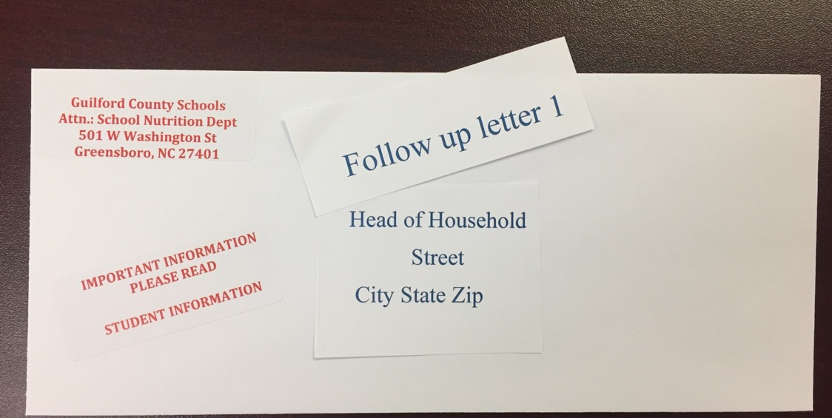
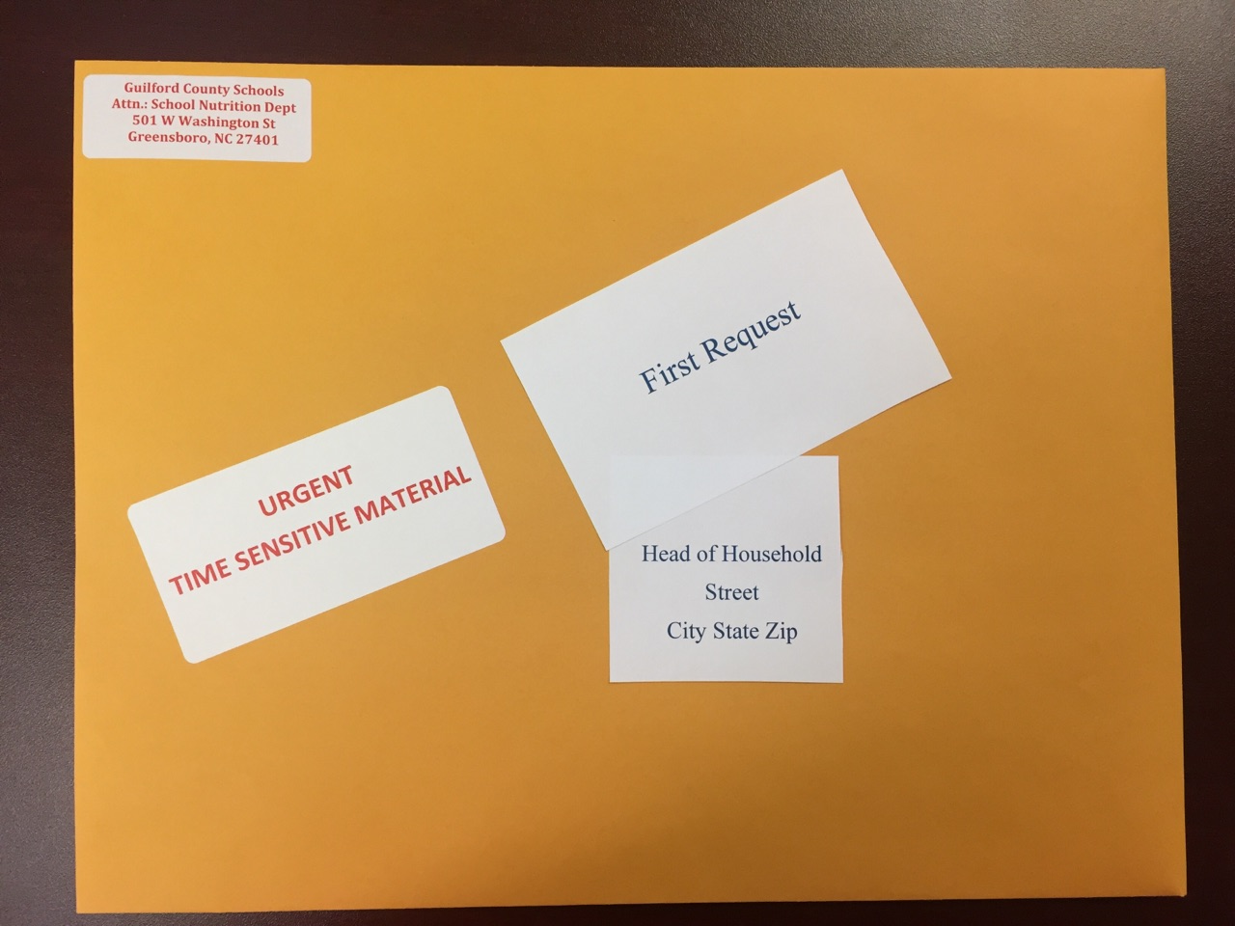
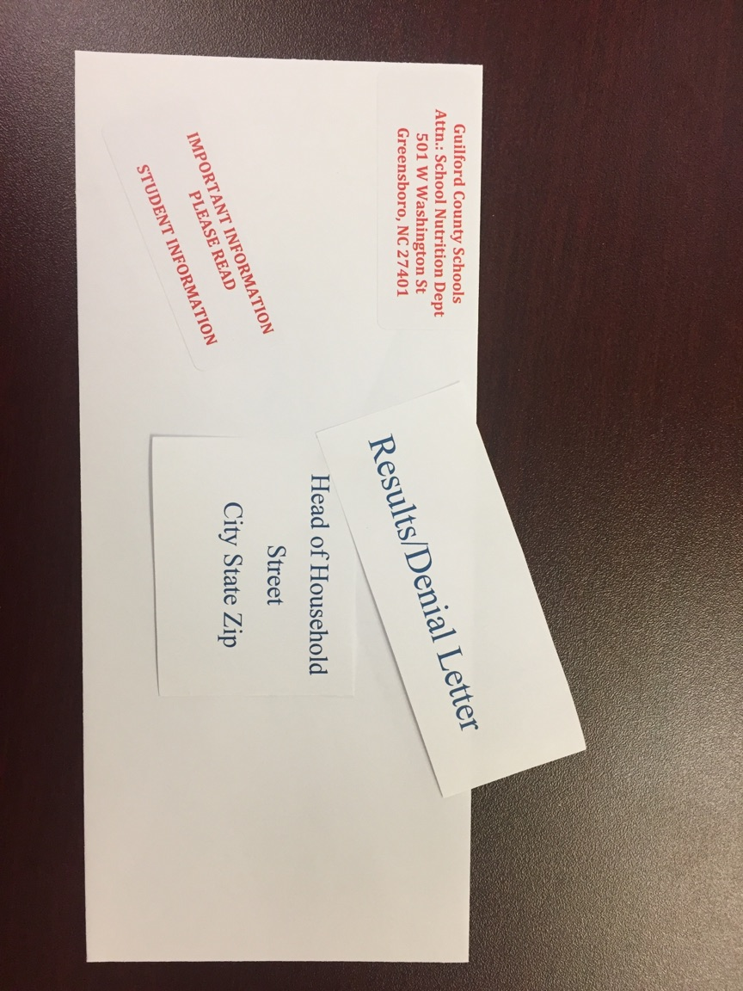
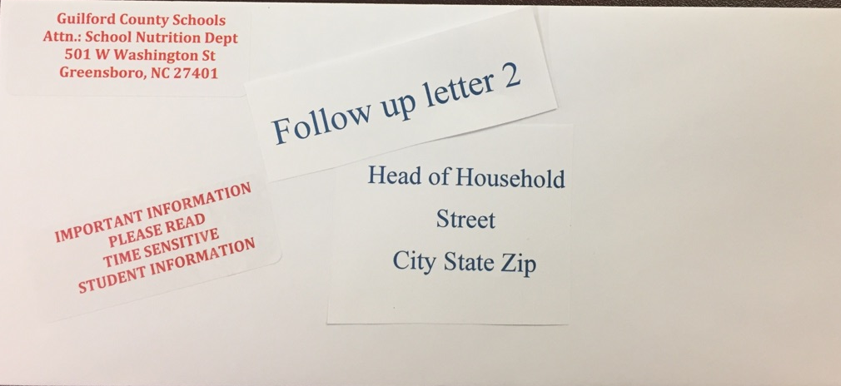
Examples of the envelopes that are sent out during Verification.

Slide 6
Coming in 2017-2018
Reaching out to households through continuous phone calls…
A call letting them know they have been selected for verification and to please check their mailbox for a letter.
Phone calls for the duration of verification for non-responders.
Phone notification to all households will be made on November 15 to let them know that they will be receiving follow up letters from the verification or denial letters.

Slide 7
Reaching households through You Tube video
(Subtitles included for multiple languages)
Each year the Guilford County School Nutrition Department is required by the United States Department of Agriculture to verify the information that is sent in on free and reduced applications. We randomly select 3% of all completed applications to verify. To verify your application just means we need to make sure all of the information on the application is true and correct. We do not want anyone to lose the free and reduced benefits they have. Please call 336-370-3266 if you have questions or concerns about the verification process. All information that you send in to our office is kept secure and confidential.
The Richard B. Russell National School Lunch Act requires the information requested in order to verify your children’s eligibility for free or reduced price meals. If you do not provide the information or provide incomplete information, your children may no longer receive free or reduced price meals. Pursuant to Section of 7 of the Privacy Act, disclosure of your Social Security number is not required. We do not need and are not requesting any Social Security numbers that may appear on documents you submit.
Non-Discrimination Statement: This explains what to do if you believe you have been treated unfairly. “In accordance with Federal civil rights law and U.S. Department of Agriculture (USDA) civil rights regulations and policies, the USDA, its Agencies, offices, and employees, and institutions participating in or administering USDA programs are prohibited from discriminating based on race, color, national origin, sex, disability, age, or reprisal or retaliation for prior civil rights activity in any program or activity conducted or funded by USDA.
Persons with disabilities who require alternative means of communication for program information (e.g. Braille, large print, audiotape, American Sign Language, etc.), should contact the Agency (State or local) where they applied for benefits. Individuals who are deaf, hard of hearing or have speech disabilities may contact USDA through the Federal Relay Service at (800) 877-8339. Additionally, program information may be made available in languages other than English.
To file a program complaint of discrimination, complete the USDA Program Discrimination Complaint Form, (AD-3027) found online at: http://www.ascr.usda.gov/complaint_filing_cust.html, and at any USDA office, or write a letter addressed to USDA and provide in the letter all of the information requested in the form. To request a copy of the complaint form, call (866) 632-9992. Submit your completed form or letter to USDA by:
(1) Mail: U.S. Department of Agriculture, Office of the Assistant Secretary for Civil Rights, 1400 Independence Avenue, SW, Washington, D.C. 20250-9410; (2) Fax: (202) 690-7442; or (3) email: program.intake@usda.gov.
This institution is an equal opportunity provider.”

Slide 8
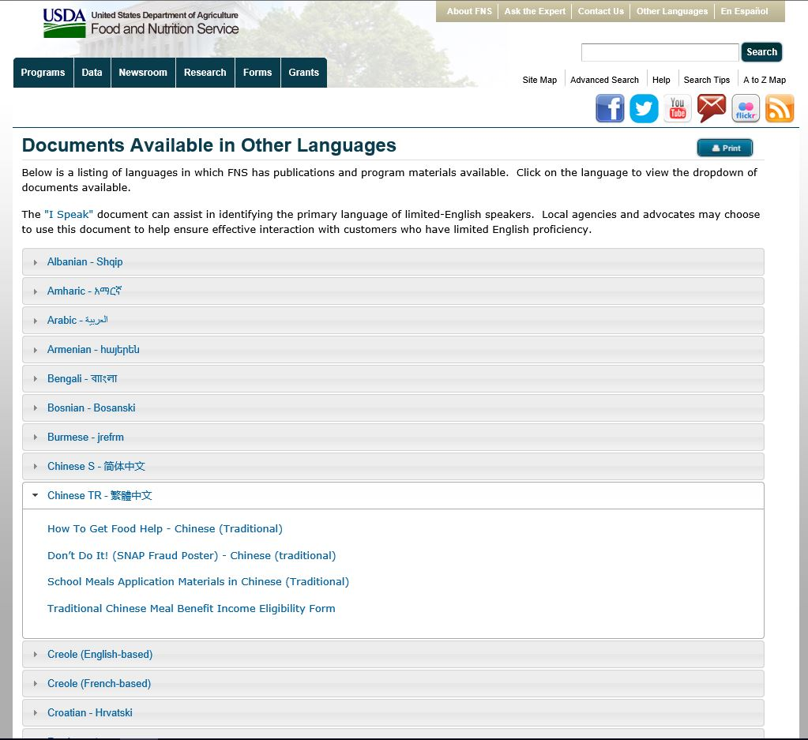
USDA Resources
The following web address is to the application portion of the website:
https://www.fns.usda.gov/school-meals/applying-free-and-reduced-price-school-meals
In the top right corner you can click on other languages and this will bring up the chart shown below.

Slide 9
Below is just a portion of a Verification Selection letter in Chinese. The USDA website is a very useful tool for all school districts. It is especially helpful for communities that have multiple languages.
我们必须审查您的申请表
您必须发送我们所需要的信息，或于 [name] 之前联系 [date]，否则您的儿童（们）将停止获得免费或优惠校餐。
学校：_______________________________________________________________________________日期：______________________
尊敬的 _________________________________________________：
我们正在审查您的免费和优惠校餐申请表。联邦法规要求我们这样做，以确保只有合格的儿童才能获得免费或优惠校餐。您必须给我们发送信息，以证明 [name(s) of child(ren)][is/are]合格的。
如可能，请发送副本，而不是原件。如果您发送了原件，只当您要求时才会将它们发回。
1．如果当您申请免费或优惠校餐时或自此之后的任何时候，您在享受 [State SNAP] 、 [State TANF] 或 [FDPIR] 的福利，请给我们发送以下各项之一的副本：
载有认证日期的 [State SNAP] 或 [State TANF] 或 [FDPIR] 的认证公告。
载有认证日期的发自 [State SNAP] 或 [State TANF] 或 [FDPIR] 的函件。
不要发送您的EBT卡片。

Slide 10
80 – 85%
Response Rate
My 2017-2018 Goal….

Slide 11
Online Resource:
United States Department of Agriculture
Food and Nutrition Services
https://www.fns.usda.gov/
For questions or comments you may contact me at:
Betty Ann Champion
Guilford County Schools-North Carolina
School Food Services
336-370-3249
champib@gcsnc.com

