Slide 1

Partner Organization Info & Launch Meeting
Weds, March 1 @ 9:30 a.m.
Thurs, March 2 @ 3:30 p.m.

Slide 2
Welcome!
Agenda:
Meet & greet / Introductions
Palmetto Project – Mission and Background
Family Supply Network
Goals & Mission
Program Model
Memorandum of Understanding (MOU)
Upcoming dates & deadlines
Questions and Answers

Slide 3

Meet & Greet - Introductions
Introduce yourself! Include:
Name
Position title
Organization / Agency
Mission
Geographical region and client base served

Slide 4
Palmetto Project – Mission and Background
Mission Statement: Identify innovative strategies to address the social and economic challenges facing our state, and put them into action.
Background: Founded in 1984, operate statewide
Focus areas:
Health and Access to Healthcare
Families, Children, and Schools
Civic Participation
Community Engagement

Slide 5

Palmetto Project – Mission and Background
Families Helping Families

Slide 6
Palmetto Project – Mission and Background
Families Helping Families
Holiday program was Lowcountry-wide partnership bringing together the generosity of local families, faith communities, businesses and community groups to aid area families in need
Continues to operate in Midlands area - Columbia

Slide 7
Family Supply Network – Program Goals
Problem:
Low-income, homeless, and other vulnerable families and individuals in the greater Charleston area have difficulty securing basic household and hygienic essentials.
Notes:
FHF was designed due to a problem that we saw in this community, and what we continue to see is that…
We also saw that these families need support not only at Christmas time. They need support year-round

Slide 8
Family Supply Network – Program Goals
Problem:
Low-income, homeless, and other vulnerable families and individuals in greater Charleston have difficulty securing basic household and hygienic essentials.
Household and hygiene products cannot be purchased with SNAP benefits (Food stamps)
Feeding America: “In Short Supply” basic needs report:
“74%, the majority of low income families reported skipping washing dishes or doing laundry in effort to compensate for the lack of household goods”.
LINK: http://www.feedingamerica.org/hunger-in-america/our-research/in-short-supply/in-short-supply-executive.pdf
Notes:
Coping strategies

Slide 9
Family Supply Network – Program Goals
Problem:
Low-income, homeless, and other vulnerable families and individuals in greater Charleston have difficulty securing basic household and hygienic essentials.
Household and hygiene products cannot be purchased with SNAP benefits (Food stamps)
Feeding America: “In Short Supply” basic needs report:
“74%, the majority of low income families reported skipping washing dishes or doing laundry in effort to compensate for the lack of household goods”.
Example of coping strategies faced by low-income families
LINK: http://www.feedingamerica.org/hunger-in-america/our-research/in-short-supply/in-short-supply-executive.pdf
Notes:
Coping strategies

Slide 10
Family Supply Network – Program Model
Operate as centralized “bank”
Collect & redistribute household and hygienic supplies
Organize drives and fundraisers in order to gather items and funds for bulk purchasing
Utilize volunteers for event, sorting and inventory

Slide 11
Family Supply Network – Program Model
Operate as centralized “bank”
Collect & redistribute household and hygienic supplies
Organize drives and fundraisers in order to gather items and funds for bulk purchasing
Utilize volunteers for event, sorting and inventory
Products distributed to individuals & families in need in Berkeley, Charleston, Dorchester counties
Distribution / partner network of agencies, social workers, etc.
Collect unused / unwanted products for redistribution
Notes:
Several other organizations working with a similar model springing up in past decade in different metropolitan areas

Slide 12
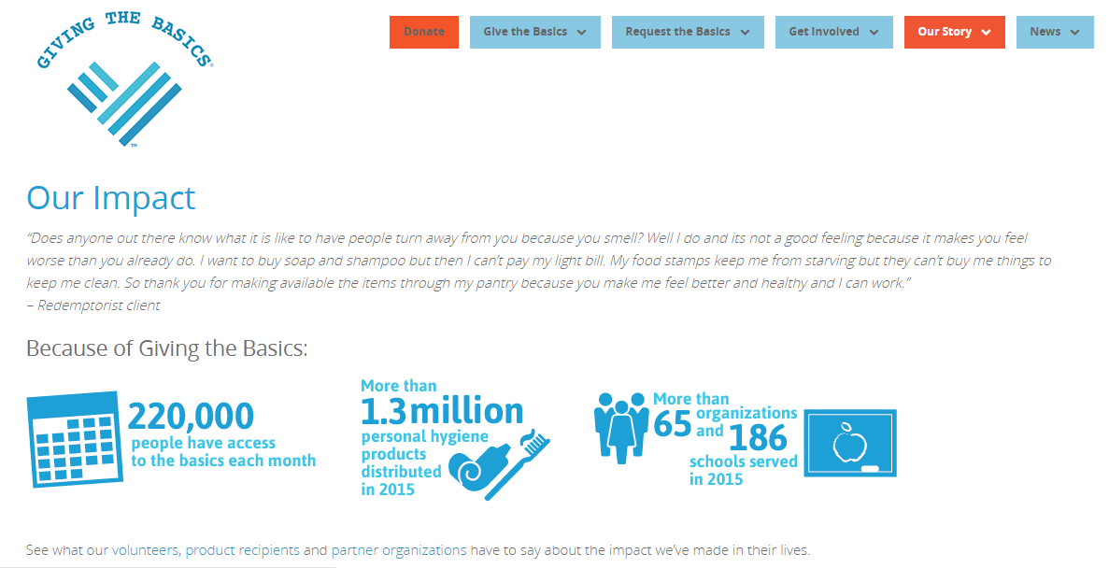
Family Supply Network – Program Model
EXAMPLE: Giving the Basics - Kansas City, MO
source: http://www.givingthebasics.org/our-story/our-impact

Slide 13
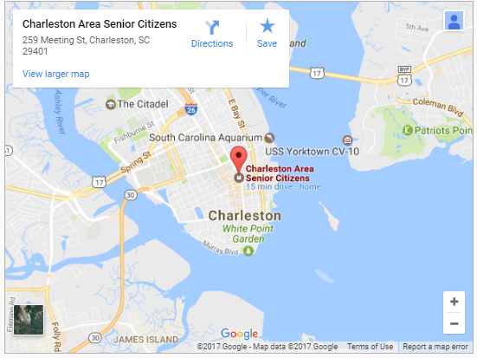
Family Supply Network - Storage Location
Storage & operational space generously donated by Charleston Area Senior Citizens (CASC); will use for 2017-2018
Notes:
Generous donation; thankful for their partnership. They have storage closet space and work area for sorting, inventory, donation drop-offs
If program is successful and continues to expand, we may well out-grow this space – at the end of this next year, we will re-evaluate and determine if we need to move and rent our own warehouse space

Slide 14
Program Cycle (Quarterly)
1. Request needs @ beginning of cycle
2. Update caseload, and report distribution
3.Report unwanted/ unused products
Work towards meeting needs/requests and securing those items
(organizing drives & fundraisers)
Distribute @ the last 2 weeks of program quarter
(Storage location)
Take inventory near the end of the distributing period
Notify partner organizations of available products.
Notes:
For 2017-2018, we plan to operate on a quarterly distribution cycle
If possible, next year we will expand to larger # of organizations and move towards a 2-month cycle, if needed

Slide 15
Program Cycle (Quarterly)
1. Request needs @ beginning of cycle
2. Update caseload, and report distribution
3.Report unwanted/ unused products
YOU
YOU
Work towards meeting needs/requests and securing those items
(organizing drives & fundraisers)
Distribute @ the last 2 weeks of program quarter
(Storage location)
US
Take inventory near the end of the distributing period
Notify partner organizations of available products.
Notes:
For 2017-2018, we plan to operate on a quarterly distribution cycle
If possible, next year we will expand to larger # of organizations and move towards a 2-month cycle

Slide 16
Requesting Needs - What to Expect
Plan to create Google Form for quarterly requests
Numbers and types of products
Approximate # families/individuals with product needs
Total caseload
We will provide helpful (rule of thumb) tips to make sure you are prepared to request the correct amount of items.

Slide 17
Clients Served - Guidelines
Use best judgement; we are not vetting clients individually!
Use 150% Federal Poverty Level as a guideline
2015 levels:
$17,655/year for individual
$36,375/year for family of four

Slide 18
Anticipated Items Collected
Feminine hygiene products
Dental hygiene products
Bath & shower supplies
Razors & shaving cream
Deodorant
Lotion
Cleaning supplies
Toilet paper
Dish soap, dishwasher detergent, laundry detergent
(Hope to expand list in the future)
Notes:
We know that many organizations have needs like socks, diapers (child and adult), shirts, → Goodwill waiver / credits
We want to do fewer items well, rather than collecting a bunch of miscellaneous items that take space on our shelves but never find a match @ an organization

Slide 19
Family Supply Network – Program Goals
Goals:
Improve overall health, productivity, and wellbeing of clients
Greater efficiency and coordination of services among nonprofit service providers
Increased community involvement through volunteerism, donations, and advocacy
Notes:
Big picture; these are our hopes
providing products gives a safety net to families in need, allowing them to focus on bigger goals
Saves nonprofit agencies’ time & resources
Get community involved, increase social awareness of difficulties faced by low-income & vuln. fams/indivs

Slide 20
Memorandum of Understanding (MOU):
Review and discuss sections
1-Year Agreement
May 1st: deadline to sign on for first distribution quarter

Slide 21
Upcoming dates & deadlines
Mon, March 27 - Sat, April 1: “Spring Cleaning” Drive
Monday, 3/27: Kickoff party @ Palmetto Project, 4 - 7 p.m.
Tuesday, 3/28: Fundraiser night @ Avondale Wine and Cheese (West Ashley), 6 - 8 p.m.
Thursday, 3/30: Happy hour fundraiser @ The Shelter Kitchen + Bar (Mt. Pleasant), 5 pm – 8 pm
Friday, 3/31: Drop-off time @ Charleston Area Seniors, 12 p.m. – 4 p.m.
Saturday, 4/1: Harris Teeter drive @ Houston Northcutt Blvd. Harris Teeter, Mt. Pleasant, 9 a.m. - 1 p.m.
Saturday, 4/1: Wrap-up count & sorting event @ Charleston Area Seniors, 2 - 4 p.m.
OTHER EVENTS & TIMES TBD

Slide 22
Upcoming dates & deadlines
May 1: Deadline to sign & return MOU for first distribution quarter (March – May 2017)
May 7: Deadline to submit needs requests for first dist. quarter
End of May: first distribution
Pick-up times & @ CASC: TBD
June 15: Deadline to submit needs request for second dist. Quarter (June – August 2017)

Slide 23

Questions and Answers
Notes:
Roundtable discussion: we want to make job easier; does this process sound reasonable? Will it be helpful?
If you have emergency needs, what is the best way to get those products into your hands?
This is a pilot program; We want ongoing feedback - let us know if this will be a beneficial system so that we can hopefully expand geographically

Slide 24
Thank you!
Contact information:
Daniel Gehle - AmeriCorps VISTA, Program Coordinator
email: dgehle@palmettoproject.org
phone: 843-714-5158 (work cell)
843-577-4122 ext. 121 (office)
Shelli Quenga - Director of Programs
email: squenga@palmettoproject.org
phone: 843-224-7875 (work cell)
843-577-4122 ext. 119 (office)

