Slide 1

small data lab @ Cornell Tech
Demo / Screen shots
August 2017

Slide 2
INTRODUCTION TO PUSHCART
A PLATFORM TO CREATE & SUSTAIN
HEALTHY GROCERY SHOPPING HABITS
Passively collected grocery & restaurant data linked to item-level nutrition statistics. Plug-and-play compatible with different services, chains, and delivery companies.
CLEAR VISUALIZATIONS
Tailored intuitive presentations of the nutritional content of a grocery cart
Benchmarked against personal goals and evidence-based recommendations (e.g. MyPlate)
DATA
A stream of objective, high frequency, household-level data on food choice and diet to test novel, configurable feedback rules & modules

Slide 3
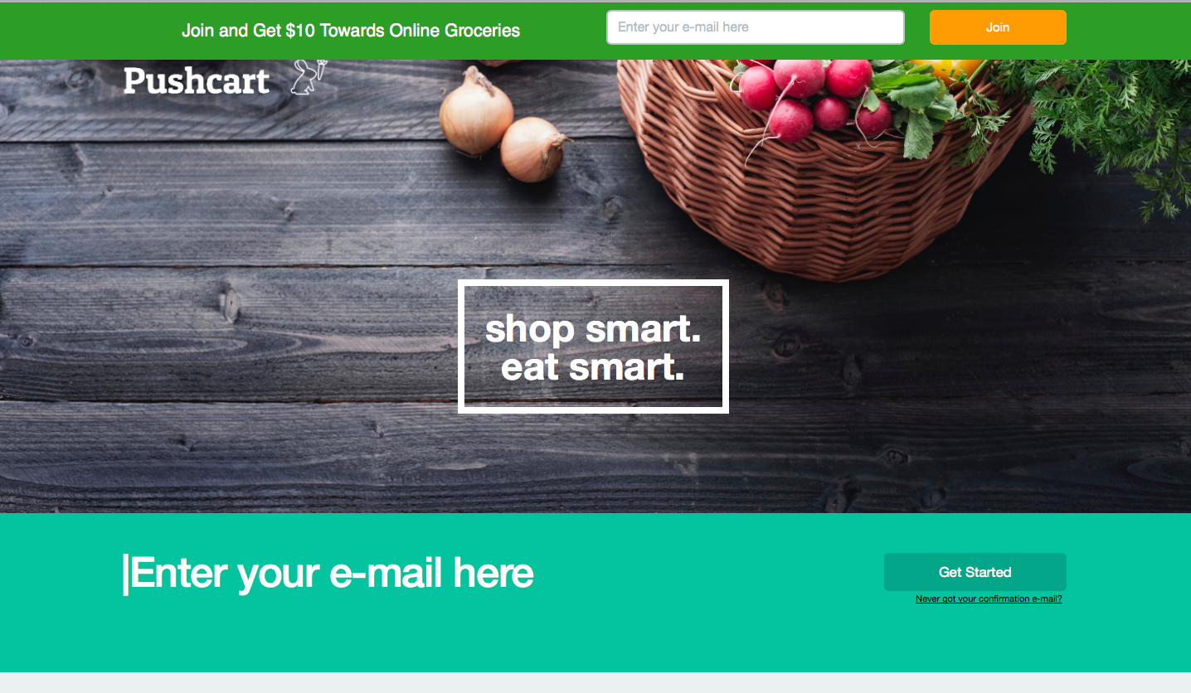

Slide 4
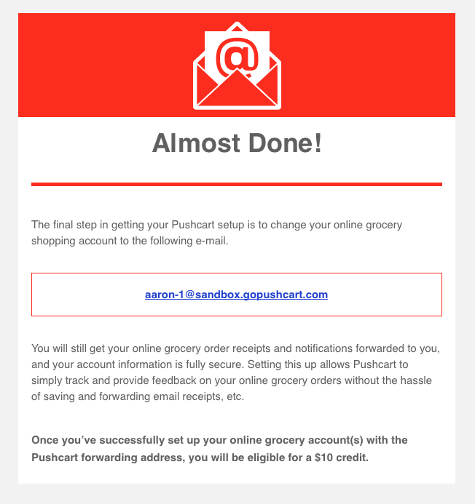
ONBOARDING EMAIL 2: POINT EMAIL RECEIPTS TO PUSHCART

Slide 5
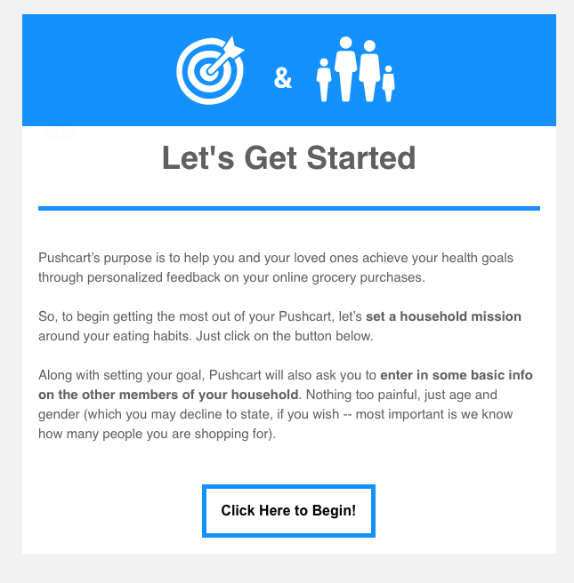
ONBOARDING EMAIL 3: GOAL SETTING & DEMOGRAPHICS

Slide 6
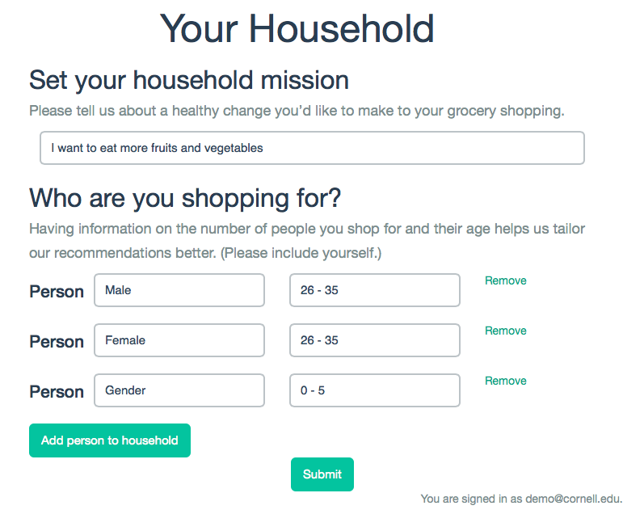
GOAL SETTING & HOUSEHOLD DEMOGRAPHICS

Slide 7

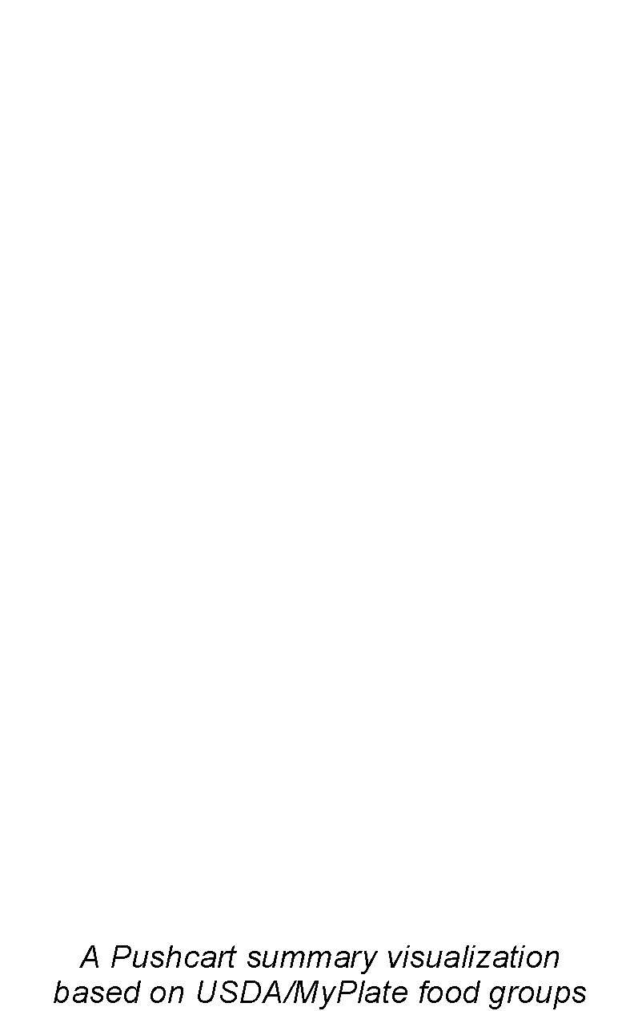
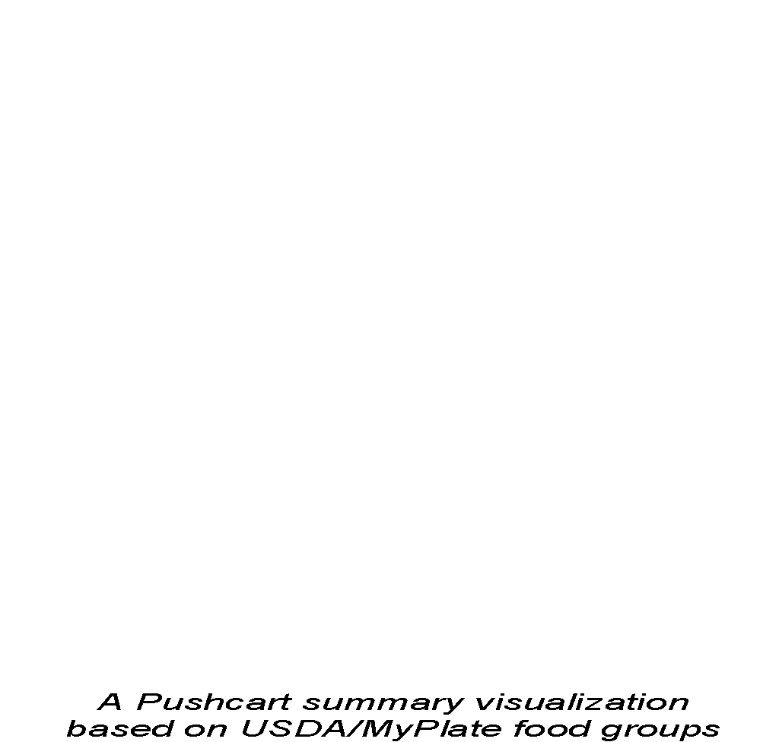
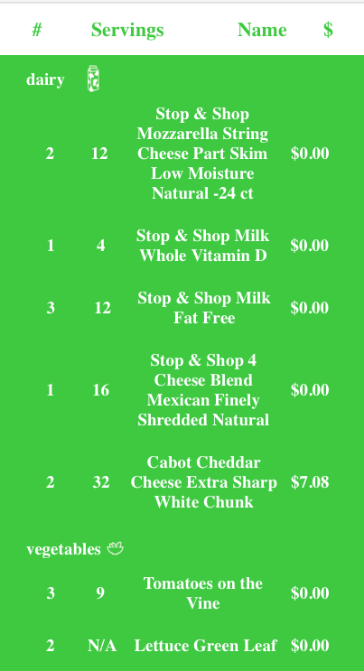
FEEDBACK EMAIL 1: VISUALIZATION OF GROCERY RECEIPT

Slide 8
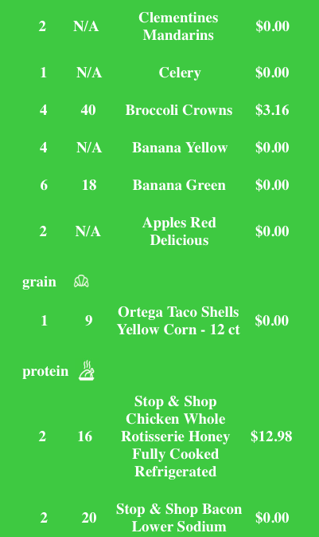
FEEDBACK EMAIL 1 CONT’D

