Slide 1

Enhanced Care Coordination for High Quality Neonatal Care 22 Dec 2017
“Smart, Safe,
Superior care for newborn babies”
www.vitalstarthealth.com

Slide 2

Introduction
Vital Start
Provider of SaaS based digital toolset for smart, safe, superior neonatal care
SwaddleTool
Flagship product for opioid withdrawal management in newborns
Penn Center for Innovation (PCI) startup
AppItUP competition winner
Executive Team
Founders are practicing physicians at CHOP
CEO is a Wharton alum and experienced technology executive
Notes:
23% increase in NICU Admissions
4th Highest Infant Mortality Rate 6.9/1000
US ranks worst in Maternal Health
http://time.com/3847755/mothers-children-health-save-the-children-report/
The State of the World's Mothers 2015 report, a global index that ranks the best and worst places to be a mother based on the latest available data on indicators like political status, economics, education, children's well-being and maternal health, ranks the U.S. at No. 33 of 179 surveyed countries—down two spots from last year.
The U.S. ranked No. 42 on children's well-being, No. 61 on maternal health and No. 89 for political status—or the participation of women in national government. Among the other statistics, the report finds that an American child under the age of 5 is nearly just as likely to die (6.9 per 1,000 live births) as one in Bosnia and Herzegovina, Serbia, Slovakia or Macedonia.
Of the 25 capital cities of wealthy countries surveyed, the report finds Washington, D.C., had the highest rate of infant mortality (7.9 deaths per 1,000 live births as of 2012). In comparison, cities like Stockholm and Oslo had rates below 2.0. Washington's rate fell in 2013, to 6.6, but a number of major American cities have had rates much higher. In 2011, Detroit's rate was reported at 12.4, and in Cleveland, it was 14.1.
http://www.bbc.com/news/business-31052665
http://transform.childbirthconnection.org/wp-content/uploads/2013/01/Cost-of-Having-a-Baby1.pdf
http://jamanetwork.com/journals/jamapediatrics/fullarticle/2381545

Slide 3

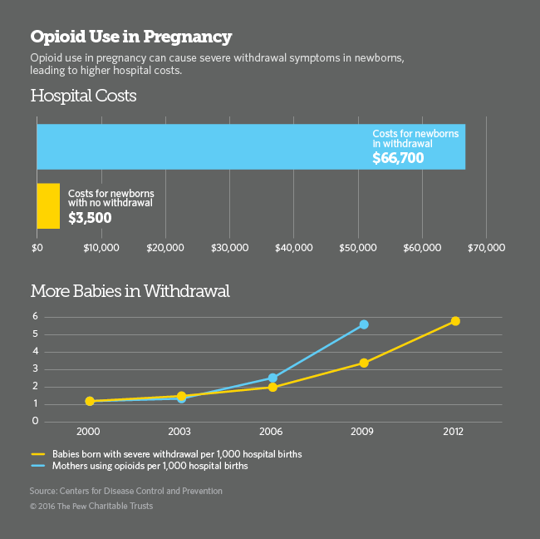

Neonatal Abstinence Syndrome (NAS)
300 % Growth: Unintended consequence of the opioid crisis
Multi-symptom Disorder:
Central Nervous System (tremors, high-pitched cry, can lead to seizures),
Metabolic, Vasomotor, Respiratory (sweating, sneezing) and
Gastrointestinal Disturbances (loose stools, poor feeding)
Reuters: Video of baby suffering from NAS http://www.reuters.com/investigates/special-report/baby-opioids/
Notes:
http://www.pewtrusts.org/en/research-and-analysis/blogs/stateline/2016/03/25/demand-surges-for-addiction-treatment-during-pregnancy
From GAO, Oct 2017 Report to Congress on newborn health: ”Prenatal opioid use can take various forms, including (1) the use of prescriptions for pain management, such as fentanyl and oxycodone; (2) medication-assisted treatment for opioid addiction, such as methadone and buprenorphine; (3) prescription drug misuse or use disorder (such as using an opioid without a prescription, using a different dosage than prescribed, or continuing to use an opioid when it is no longer needed for pain); and (4) illicit opioid use, such as heroin use. These types of prenatal opioid use are not mutually exclusive. A 2014 study found that almost 22 percent of pregnant Medicaid beneficiaries filled a prescription for an opioid during their pregnancy.14 Medication-assisted treatment—an approach that combines the use of certain medications and behavioral therapy—is generally considered by HHS and medical specialty societies to be the standard of care for treating pregnant women with opioid use disorders, depending on the individual and her circumstances.”
http://www.gao.gov/assets/690/687580.pdf

Slide 4

Problem
Complicated treatment with scoring and potential pharmacological & social intervention
Training required for care staff
Lack of standardized/evidence based care – manual process
Multiple care sites: Clinical care transition and community focused coordination required
Total Cost in 2012 approx. $1.5 Billion*
80% Medicaid
Providers losing money on NAS patients
2.5 Times
Higher Readmissions
10-40% of NICU patients
23
Days
ALOS
*Centers for Disease Control (CDC), 2012

Slide 5

Problem further complicated by current NAS Patient Journey
Monthly/bi-monthly NAS follow-up until
9-12 months
Periodic NAS follow-up until 5 years
Newborn Rooming-in /Well Nursery Care
Home/ Foster Care
NICU
Hospital + Non-hospital care + Follow-up
Fragmented care
Vulnerable newborns requiring optimal care across the continuum
NAS Rehab. /
Treatment Centers
NAS Treatment Center*/ Rehab.
Outpatient** care
Care transition
Relapse or longer treatment transition, post acute care
* On-site or external inpatient care site
**Methadone/phenobarbital treated infants
Notes:
http://www.gao.gov/assets/690/687580.pdf
https://www.goodshepherdrehab.org/services/good-shepherd-pediatrics/inpatient-pediatric-unit/neonatal-abstinence-syndrome-nas
https://www.childrens-specialized.org/about-us/specialty-pediatrics-blog/unique-treatment-approach-to-nas
From Backes_Outpatient Management:
Occupational/physical therapy/developmental evaluation – NAS Clinic
• Initial meeting
– Introduction/comments
– Learning barrier
– Cultural, religious, social considerations
– Current services
– Care giver concerns
• Evaluation – Bayley III (Scales of Infant and Toddler Development, 3rd Ed)
– Muscle tone and strength
– Sensory, behavior or social concerns
– Oral motor skills
– Pain assessment
– Fine motor skills
– Gross motor skills
– Cognitive skills
– Receptive language skills
– Expressive language skills
Short and Long Term Follow-up
• Readmits
• Seizures
• Hepatitis B, C exposure – cirrhosis
• SIDS
• GERD
• Diarrhea
• Eye abnormalities – nystagmus
• Growth
• Development
• Nutrition
• Behavioral – ADD/CD/ODD
• Learning

Slide 6

Current approach Insufficient Total babies born annually: 4 million Total NAS babies annually: 22,000 Takeaways: -Need for value based care approach -Lack of automated, measurable care coordination across continuum - Need for cost savings with improved quality of care for long term impact **
$1.5 Billion costs of care annually, mostly NICU
Fragmented care, manual clinical process, lack of adherence
Need for care coordination with quality care across continuum
2012
2017
LOT increased*
Costs, ALOS in hospital reduced through case management
Long term effects not clear
Goal:
Measurable quality outcomes, Improved LOT, Reduced costs of care, Social ROI
* Unites States Government Accountability Office Report to Congresses on Newborn Health, October 2017
Notes:
https://www.ncbi.nlm.nih.gov/pmc/articles/PMC5633652/
*Pennsylvania Health Care Cost Containment Council (PHC4)
Understanding PHC4 2015 data* as an example:
NAS related newborn hospitalizations days in PA =28,000
Total hospital costs: $20 million
Hospital ALOS = 12
Does not include non-hospital care, post acute care, follow-up costs,
Initial market is PA/ NJ to leverage Penn/CHOP local advantage
PA, 2015 data:
141,948 births
2015:Incidence rate: 16 out of 1000
NAS babies based on incidence: 2272 approx.
Understanding PHC4 2015 data* as an example:
NAS related newborn hospitalizations days in PA =28,000
Incidence rate: 16 out of 1000
Total hospital costs: $20 million
20% of babies using hospital care: then 455 babies hospital NAS costs = 20 million
Rest babies = 2317
Costs average for non-hospital care is $700, ALOS = 30
Total costs for these babies is $48 million
Additional care costs estimated at (based on distribution**):
Total non-hospital costs: $48 million
NAS Follow-up visit costs: $4 million
Total NAS costs across the continuum: $72 million

Slide 7
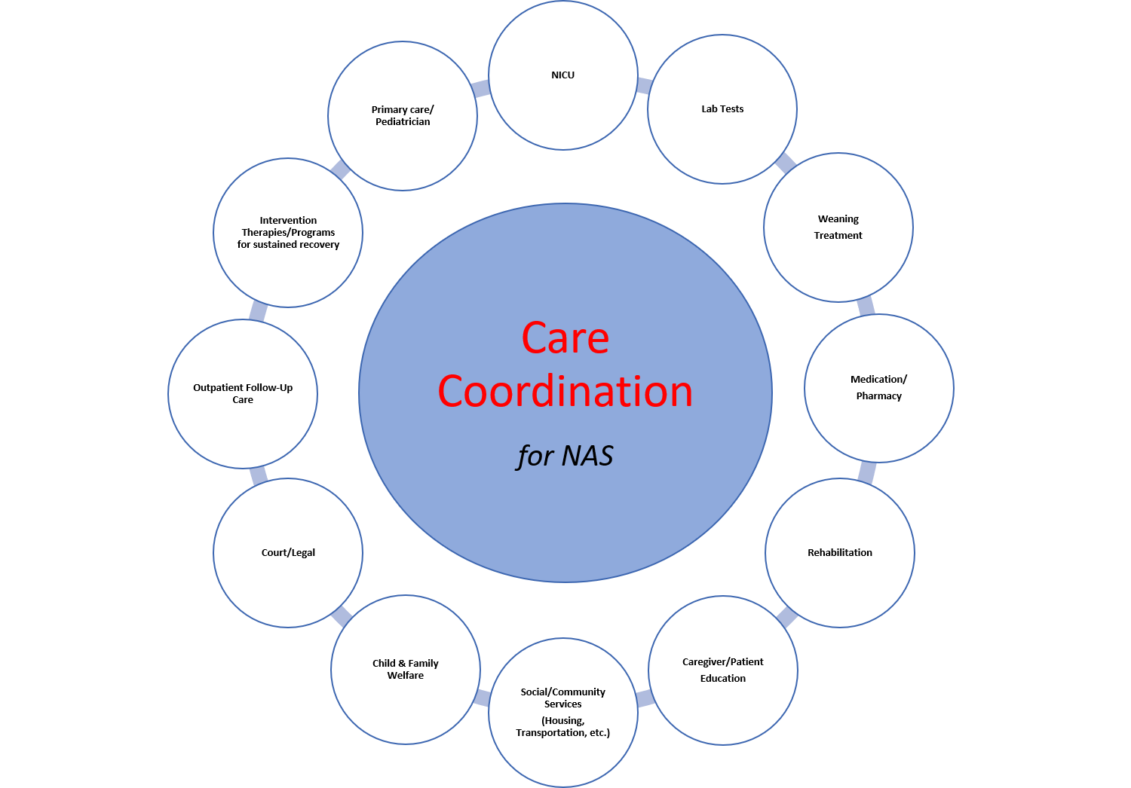


Solution:
SwaddleTool
Enhanced Care Coordination
For
Neonatal/pediatric population
Starting with
“Opioid” babies suffering from NAS
Enabling
Providers, Employer, MCOs
To meet Meaningful Use &Triple Aim of
Quality Care Experience,
Improving Population Health,
Reducing Costs per capita
* https://www.integration.samhsa.gov/integrated-care-models/Medicaid_HH_and_Patient_Centered_Medical_Homes.pdf
Notes:
https://www.ahrq.gov/professionals/prevention-chronic-care/improve/coordination/index.html
Patient centered Whole Person care
Evidence based Clinical Decision support
Tracking of integrated across care transitions
Quality & Performance based, optimal care
Technology focused: analytics, tele-health, care coordination
Niche – neonatal/pediatric care

Slide 8

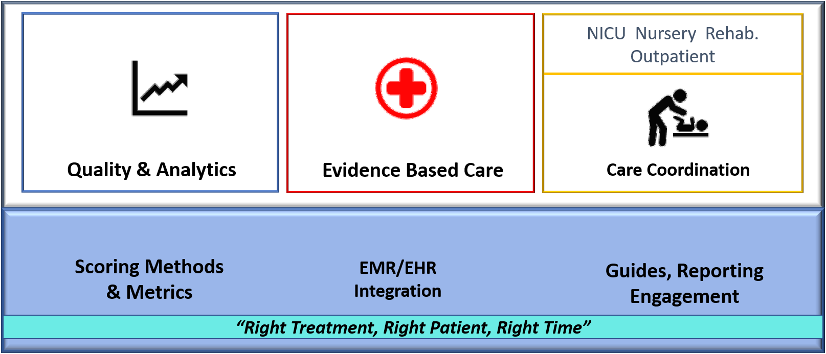
Value Proposition
Niche, neonatal/pediatric focus
Superior care quality & experience
Shared measurement system
Evidence based clinical software tools
Tracking for appropriate use, adherence
Lowers overall costs of care
Automation of care coordination
Tele-health
Enables optimal care navigation across continuum
Patient registry (extend to mother-baby)
Recommendation engine through analytics
Seamless sharing of reports/alerts
Notes:
* Pennsylvania Patient Safety Authority report, "Addressing the Rise in Neonatal Abstinence Syndrome: A Multifaceted Approach”, 2015
Superior Care Quality & Experience
Reduces hospitalization & readmissions
Lowers overall costs of care
Community connections & engagement
Adherence, appropriate use criteria
Enables optimal care navigation across continuum
Population health analytics
Shared measurement system (Collective Impact)

Slide 9
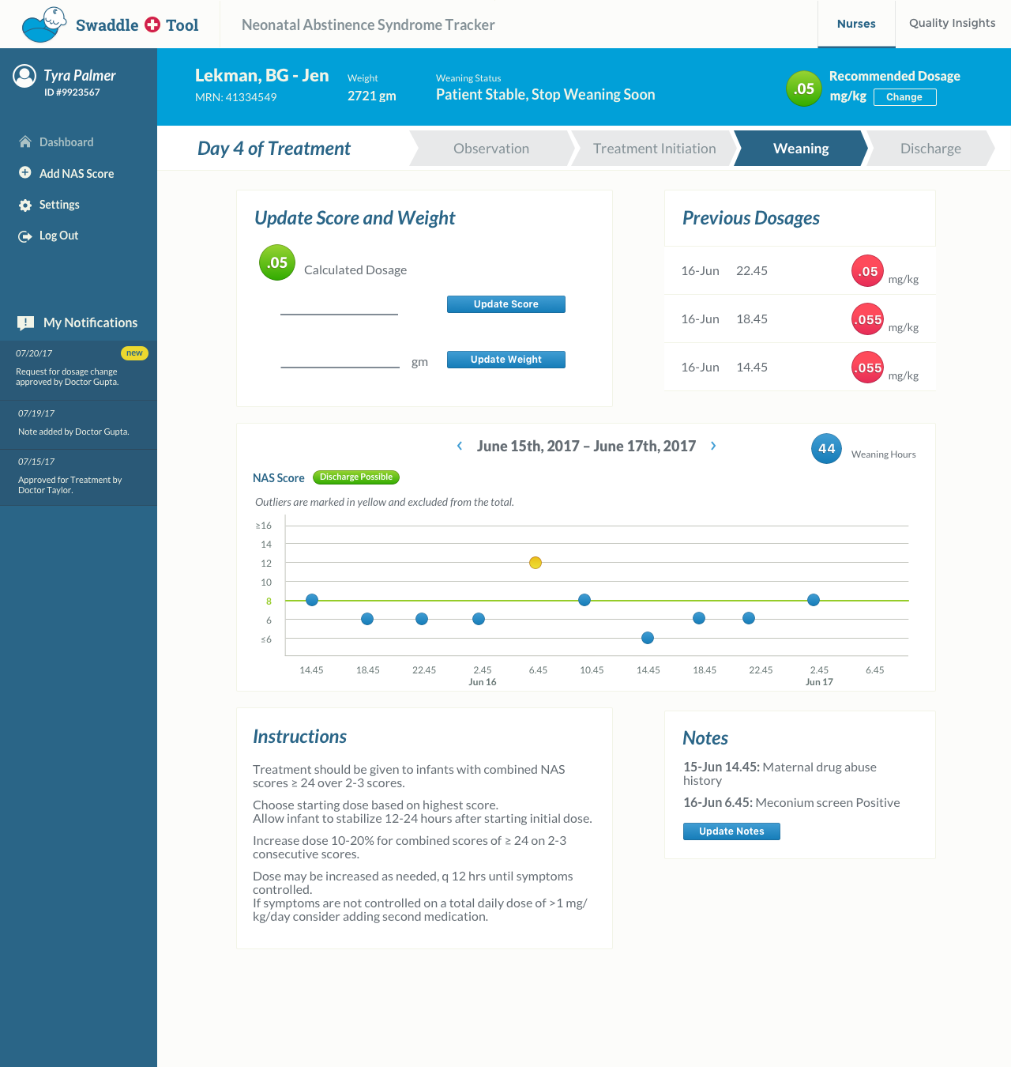
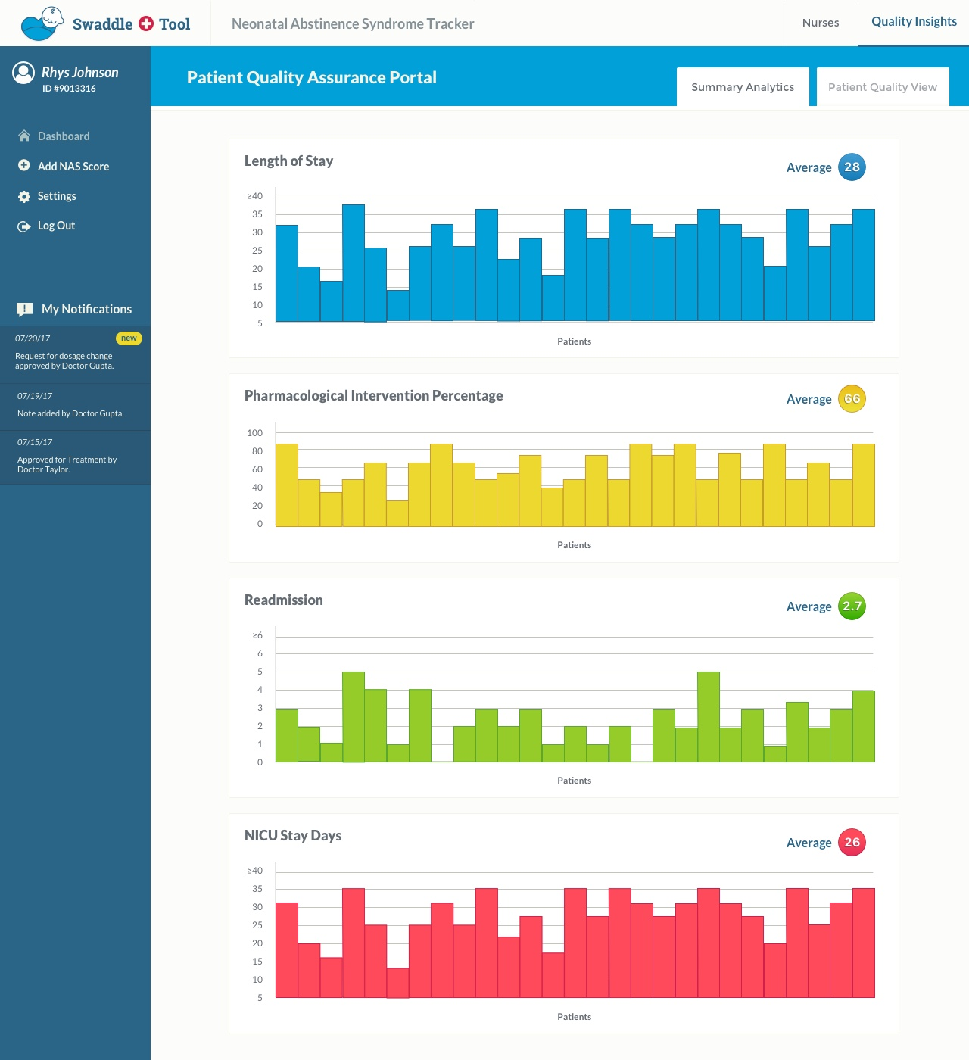
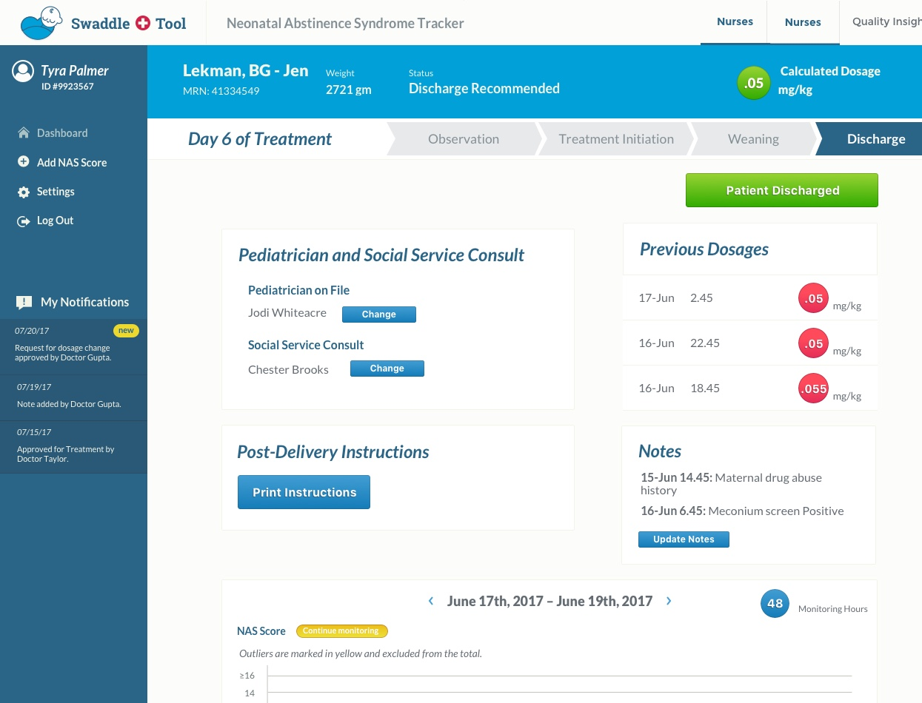
Product
Development
MVP (at proof of concept stage):
Cloud based, HIPAA compliant B2B care coordination application
Episode focused, evidence based care
Treatment tracker with adherence and treatment restart avoidance
Summary Analytics
Collaborative care navigation across transitions
Treatment summary alerts/reports
Patient registry
Notes:
Promotes non-pharmacological invention based on appropriate use criteria

Slide 10
ENTITY | MOM/ CAREGIVER | NURSE/CLINICAL STAFF | CARE PROVIDERS ( Hospitals, NAS treatment centers, Outpatient clinics, ACOs) | EMR/EHR | PAYER (Medicaid, MCO) | CASE MANAGERS | EMPLOYER (Medicaid/County is purchaser )
KEY ACTIONS/ GOALS | Caring for infant | Clinical care, Patient follow-up | Quality care, Tool integration with EMR, training | Patient record access & interfacing | Reimbursement across care continuum | Care/utilization management | Insurance purchaser, quality healthcare for those with low income
BENEFITS | Positive outcomes, Treatment tracking, Shared decision making, Visibility | Ease of use, Notifications, Tracking, Summary analytics, Evidence based decision support | Stop revenue leakage by reducing costs of care Measurable outcomes, Analytics Automation Improved Quality & efficiencies, Same tool across care sites, Star/ HCAPHS ratings impact | Value-added service to their customers, Population health, Analytics and revenues | Appropriate use, Reduce costs, Improve quality , adherence, Next generation approach to case management NCQA/HEDIS measures | Reduce hospital stay, Cost control Shared decision making ability, Automation | Whole Person Care, Measurable outcomes, social ROI Integrated delivery, Easier transitions of care, Population health
INFLUENCE | User | User | Partner/ Customer | Partner/ Competitor/ Customer | Partner/ Customer | Partner/ Customer/ Competitor | Partner/Customer
RISK | High | Medium-High | High | Low | High | Medium-High | High
S
T
A
K
E
H
O
L
D
E
R
S
I
M
P
A
C
T

Slide 11
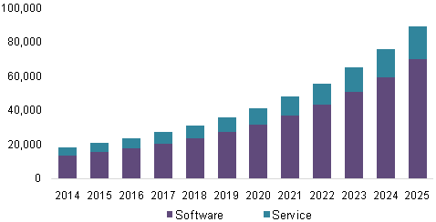
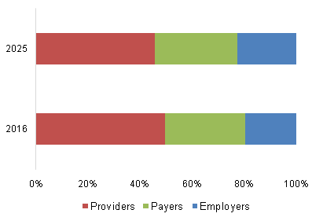
Market Demand Care coordination/ population health market is gaining momentum Focus: Neonatal/pediatric niche, Shared Measurement system for Whole person care, Mental/behavioral health impact
Care coordination/ Population health market to grow to $89.5 billion by 2025 – Grandview Research
Employer segment showing the most growth over time
Business Model
Gain sharing of performance based incentives
Notes:
According to Rock Health, $200 million invested in care coordination in 2016
According to Sage Growth Partners *:
“2013 to 2018 CAGR 26% (comprised of solutions and population healthcare) to reach $40.6 billion, driven by the reforms of the ACA, demand for improved quality of care, and government incentives or PHM program adoption”
* https://sage-growth.com/wp-content/uploads/2016/05/SGP-Quarterly-Report_5.19.16_11.pdf

Slide 12
Innovative model
Shared measurement System
Measurable Outcomes
Social sector collaboration
Short, medium, long collective goals
Recommendation engine
Analytics for predicting optimal care plan, interventions, recovery coaching/monitoring
Short, medium, long collective goals
Mother-Baby cohort view
Stable home, stable family, stable health for baby
Cross-cohort coordination, reports/alerts
Notes:
* Pennsylvania Patient Safety Authority report, "Addressing the Rise in Neonatal Abstinence Syndrome: A Multifaceted Approach”, 2015
Superior Care Quality & Experience
Reduces hospitalization & readmissions
Lowers overall costs of care
Community connections & engagement
Adherence, appropriate use criteria
Enables optimal care navigation across continuum
Population health analytics
Shared measurement system (Collective Impact)

Slide 13
Next Steps Funding for implementation and commercialization Partnerships and collaboration: pilots, promotion, sponsorships
Product-Market fit Analysis:
Pilot with ACO, potential settings include:
Health Home/ Opioid Collaborative
Center for Excellence initiative
Opioid Task force initiative
Population health data & analytics for these babies/children (up to 5 years)
Showcase measurable impact through collective impact models of care
Notes:
Comorbidities?

Slide 14

Leadership Team www.vitalstarthealth.com
Founders:
Mary Ellen Vajravelu, MD is a fellow in Pediatric Endocrinology at the Children’s Hospital of Philadelphia (CHOP). She is pursuing a Master of Science in Health Policy at the University of Pennsylvania and is a fellow of the Leonard Davis Institute of Health Economics. She is a fellow of the Center for Healthcare Improvement and Patient Safety, through which she is receiving training in Quality Improvement. Her current research focuses on hypoglycemic disorders in infants and children.
Carrie Hufnal, MD is a neonatologist at the Children’s Hospital of Philadelphia and Associate Director of the CHOP Newborn Care Network. She has expertise in Quality Improvement and has led several QI initiatives across the Network. She helped to create the newborn blood sugar screening guideline at CHOP and led its implementation at hospitals throughout the CHOP Newborn Care Network.
CEO:
Kirthika Parmeswaran, is a technology innovation executive with extensive experience in R&D, products, solutions and strategy. She holds an Executive Masters in Technology Management (EMTM) from University of Pennsylvania, Wharton School of Business and a Masters in Computer Science from Washington University in St. Louis.
Advisors:
Lisa Wittmer, PhD is the COO & Head of Portfolio Development at AMO Pharma with extensive experience in pharmaceutical products. She is currently the Entrepreneur-in-Residence at PCI Ventures*. She has a doctorate from Washington University School of Medicine in St. Louis and has been a Howard Hughes Medical Institute Fellow at Duke University School of Medicine.
Ryan Mendoza, manages a portfolio of IT, physical sciences, and hardware companies at PCI Ventures* and advises on growth, business strategy, and fundraising. Prior to PCI Ventures, Ryan was SVP of Engineering and co-founder of Graphene Frontiers, a nanotechnology startup company. He has a M.S. in Electrical Engineering with a focus on nanoscale electronic systems from the University of Pennsylvania, and a B.S. in Electrical Engineering from the University of Southern California.
For further information, contact: Kirthika@vitalstarthealth.com
* Penn Center for Innovation (PCI) is the technology incubator for University of Pennsylvania

Slide 15
BACKUP

Slide 16
Market Voices
Providers losing money treating Medicaid/MCO NAS babies
Social determinants of health impact, largely Medicaid
Payer/MCO cannot request provider to adopt a clinical solution even if it is more efficient
Developmental delays, seizures potentially possible leading to chronic disease management
Case managers told us we need to wean in 14 days
Fee-per-service, per diem payment model
Babies may need foster care, maternal wraparound services needed
Inpatient Pediatric Rehab/ NAS Treatment centers do post acute care, weaning, follow-up check-ups for NAS babies
Case management resources used to control costs, ALOS
with clinical pathway guidelines still using pen-paper (error-prone)
Lack of communication/
collaboration across stakeholders

Slide 17
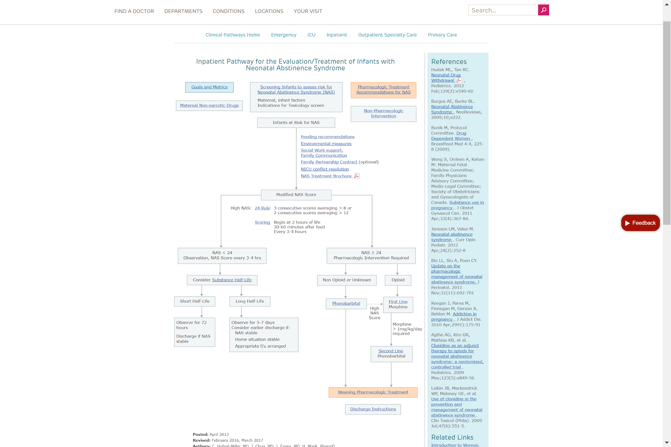
NAS Clinical Pathway, Children’s Hospital of Philadelphia

Slide 18
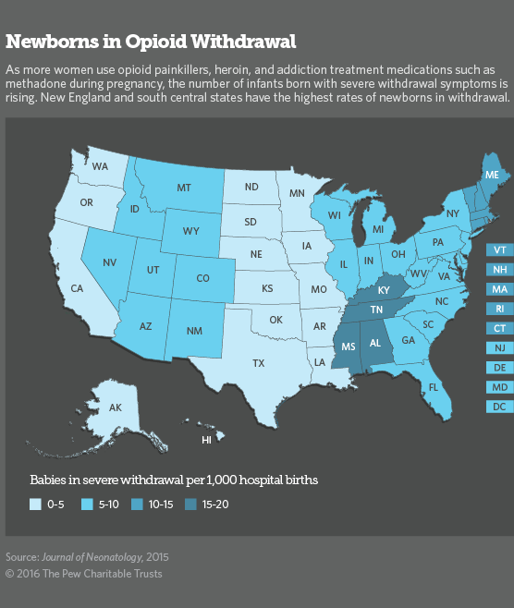

Statistics reg. NAS “opioid” Babies

Slide 19
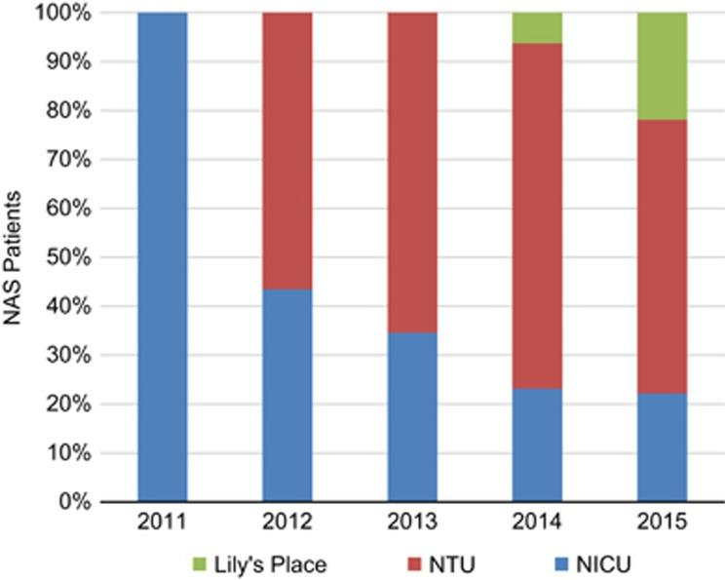
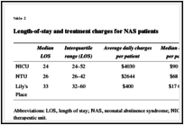
2017 article on NAS treatment strategy: https://www.ncbi.nlm.nih.gov/pmc/articles/PMC5633652/

