Slide 1

Boosterville® Sell Local. Buy Local. Boost Local.®
@boosterville
Ph: 317-689-8585
pam@boosterville.com
www.boosterville.com
Notes:
Thank:
SpeakEasy
PitchFeast
SBA

Slide 2
But first,
a favor…

Slide 3
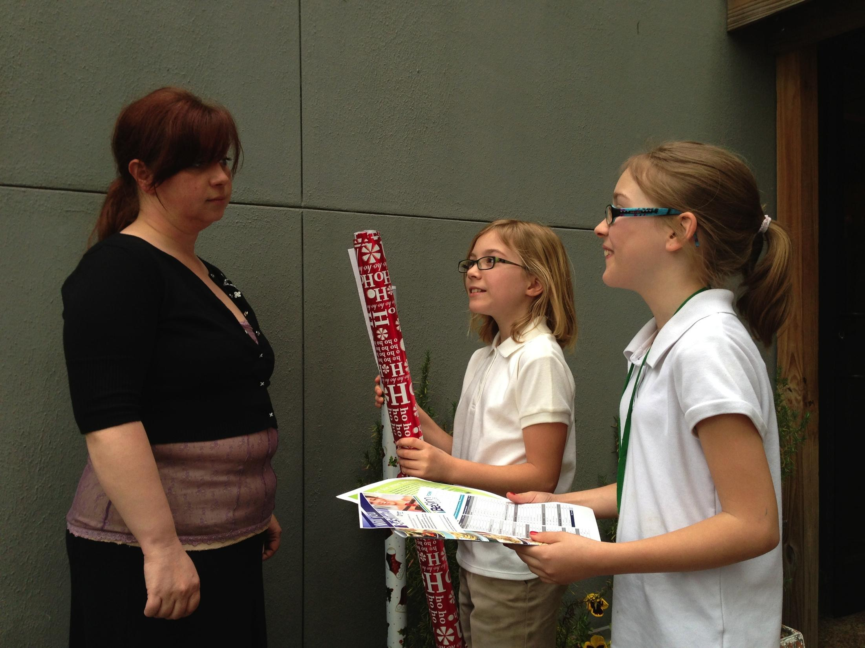
$1.4B Raised
$3.5B Sales
Boosterville®
Notes:
The primary fundraising activity for schools is brochure sales of junk that no one really wants or needs -- but it raises money for the children, so people buy it anyway.
Last year, the Association of Fund Raising Distributors and Suppliers (AFRDS) reported that $1.4 billion was raised for schools by children selling $3.5 billion of overpriced wrapping paper, stale nuts, and cookie dough, with $2.8 billion (80%) coming directly out of the pockets of the parents and extended family members of the children.
And 2/3 of the parents sell this junk at work.

Slide 4
Local Merchants = $0
90% Want To Help
Consider retail’s impact in the USA:
Notes:
None of these sales benefitted local merchants.
The Wells Fargo Small Business Index survey has found that 90% of local businesses want to help the schools in their communities – they want to support charitable causes.
These are the same businesses that are hit up year-round for donations of money, gift certificates or products for school activities, silent auctions, and team sponsorships. They donate, knowing that they get very little in return.
But they are completely cut out of participating in the economic impact of school fundraising.
School fundraising today is outdated with very little innovation in the past 60 years and …

Slide 5

Indiana’s #1 Industry: RETAIL*
616,600 jobs $23 Billion GDP
Across the USA:
Retail supports 1 in 4 American jobs – (42 Million Jobs)
3,793,621 Retail Establishments
$2.6 Trillion in Total GDP Impact
*including restaurants

Slide 6
Workforce Has Changed
74% of employed women work full-time
70% of working women have children < 18
Need to maximize impact of volunteer hours: Tutor/mentor instead of sort orders, chase down bad checks and process deposits.

Slide 7
So What Is
Boosterville?
Notes:
Enlist Merchants
Recruit Supporters
Benefit Nonprofits

Slide 8
Technology for Fundraising
Merchants donate % of purchase
School promotes merchants
School supporters buy from merchants
School gets donation

Slide 9
Eliminate fundraiser volunteer time (7 million hours/year)
Buy what you want and need and support local merchants
Redirect 7 million volunteer hours to classroom time
Notes:
Enlist Merchants
Recruit Supporters
Benefit Nonprofits

Slide 10
Business Model
1% of total raised for nonprofit
Extra 1% Campaign Purchases ($30/mo cap)
Future:
Promoted targeted ads
monetization of anonymized data
Notes:
The Boosterville platform is performance-based for nonprofits and businesses – there is no subscription fee. Our revenue comes as a portion of the purchase transaction, as stated above.

Slide 11
K-12 School Projections: Indiana, Midwest, USA
 | 2016 INDIANA | 2017 MIDWEST (8) | 2018 USA - 50
Public Ed Foundations | 80 | 640 | 4,000
K-12 Schools | 400 | 3,200 | 132,183
Active Users | 8,000 | 64,000 | 2,643,660*
Merchants | 2,000 | 16,000 | 100,000
Revenues | $720,000 | $5,760,000 | $36,000,000
Expenses | $450,000 | $675,000 | $1,143,000
Net | $270,000 | $5,085,000 | $34,857,000
*TOTAL K-12 ENROLLMENT: 54,876,000 – www.edreform.com
Notes:
There are 132,000 K-12 schools in the US – many with multiple organizations each raising $10,000 - $20,000 per year through a variety of fundraising activities. Our research shows we can expect an average of 100 users per engaged organization (parents, older students, teachers, staff). The 2018 projection of active users represents engagement from 56,145 nonprofit organizations.

Slide 12
Boosterville also benefits:
faith-based organizations
senior services centers
sports leagues
marching bands
humane societies
ANY of:
1,500,000 US 501(c)3 charities

Slide 13

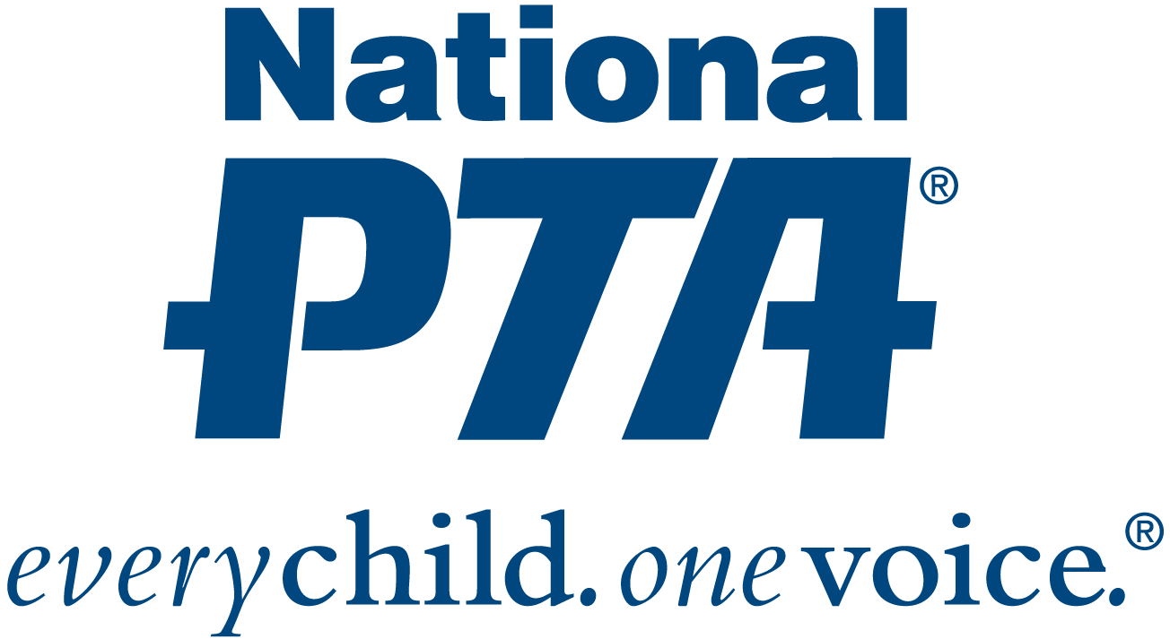
Go-to-Market Strategy
Notes:
Our go-to-market strategy focuses on the decision makers of our two distinct sets of customers – schools and businesses. We have made a strategic investment with National PTA to gain insight and introductions to partners within their 25,000+ local organizations.
Once students reach high school, fundraising shifts towards support of the students’ extra-curricular activities. We are talking with Music for All and USLacrosse to get access to high school marching bands, orchestras, and choirs, as well as club sports.
For merchants, we are pursuing national and state restaurant, lodging, and hospitality associations to target restaurants and locally owned franchises.
Our biggest channel for onboarding the local merchant is through the local school supporter. We provide collateral such as web links, printed material, and videos to empower local school supporters to get the message out and onboard their favorite restaurants and retailers, as well as the businesses they themselves own.

Slide 14
Boosterville® Sell Local. Buy Local. Boost Local.®
@boosterville
Ph: 317-689-8585
pam@boosterville.com
www.boosterville.com

