Slide 1

Crystal McDonald | Co-Founder & CEO
InnovateHER – Confidential
Notes:
\

Slide 2

The Hiring Process Is Tough
For employers and job seekers in high-turn industries, the hiring process
Burdensome Ineffective Costly
Notes:
For employers and job seekers in high-turn indus

Slide 3
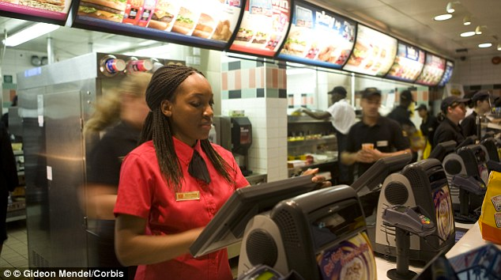
Hourly-Wage Labor Market
80
Million
62%
55%

Slide 4

Hourly – Wage Market Spend
27
Million
PT Workers
$32
Billion
60%
Turnover
$5,500
Cost to Hire

Slide 5


Slide 6

Business Case
450 Room Hotel
27,000
Apps
13,500
Interviews
900
Hires
Cost = $4.9 Million
Time = 6,750 Hours

Slide 7
Hiring Process
Post opportunity
Source & recruit candidate
Schedule 1st interview
Host 1st interview
Schedule 2nd interview
Host 2nd interview
Deliberate
Extend offer
Conduct background screen
Train new employee
Complete hiring

Slide 8
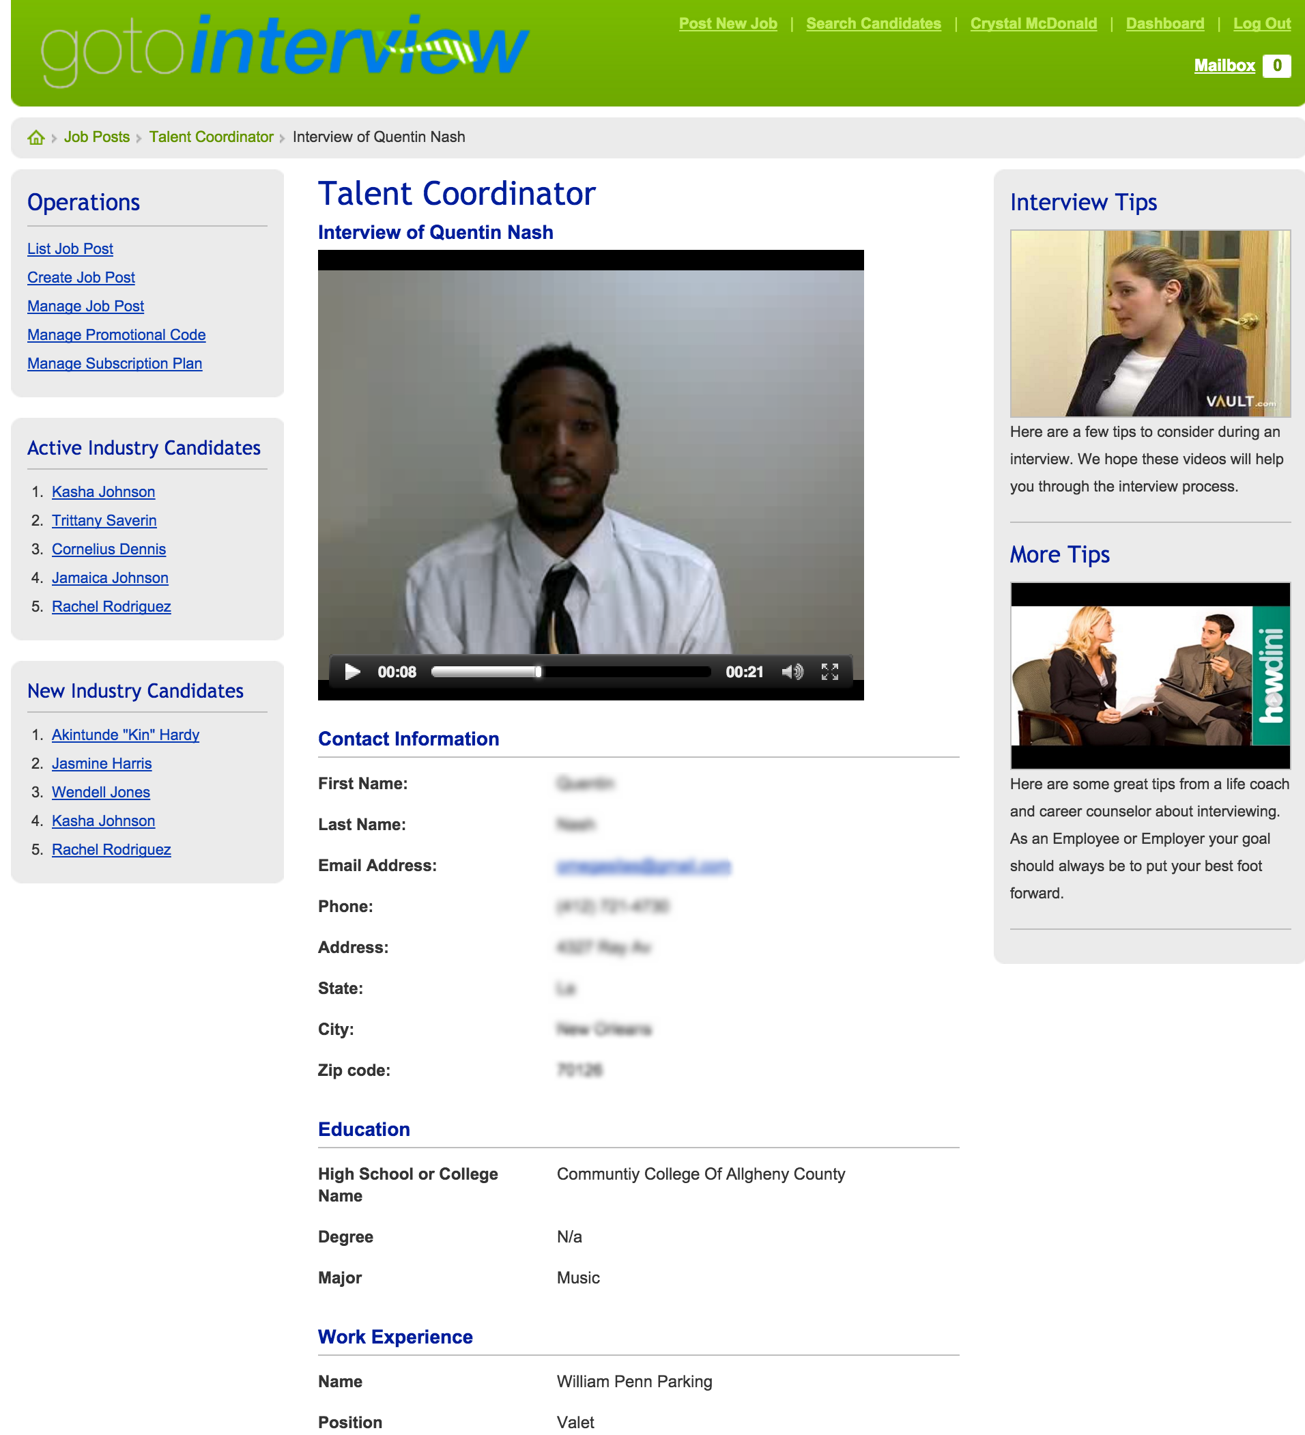
We Make It Easy
Job Seekers
Easy & Free Online Resume
Interview 24 Hours A Day
High Employer Visibility
Employers
Increase Human Resources ROI
Review Interviews On Demand
Access to Candidate Pool

Slide 9
Scalable Business Model
Subscription Based
Small employers, high-turnover, full access to
platform, priced based on number of job postings
Enterprise
Medium employers, high-turnover, customized professional services, priced based on scope and scale of work
Software Licensing
Large employers, high-turnover, API, priced based on scope and scale of work

Slide 10




The Competition
Job Seeker Pool
Salary
Hourly
No Job Seeker Pool

Slide 11









Experienced Team
CRYSTAL
Co-Founder & CEO
10+ Years of Recruiting, Marketing, Business Development, Fundraising & Sales Experience
ERIC
Chief Technology Officer
Technology Expert, 20+ Years of UX, Design, & Development Experience at a Fortune 500 Company
TODD
Co-Founder
10+ Years Multi-Unit Franchise Owner, Finance & Banking

Slide 12

Traction
6,500 Users
6 States
Sales Pipeline: 3 National Brands
Next Generation GoToInterview
Winner Rise of the Rest Pitch Competition w/ Steve Case, Founder – AOL

Slide 13









Our Customers
Call-to-action
for investor(s)

Slide 14


Keep In Touch
crystal@gotointerview.com
angel.co/gotointerview
twitter.com/go2interview

