Slide 1
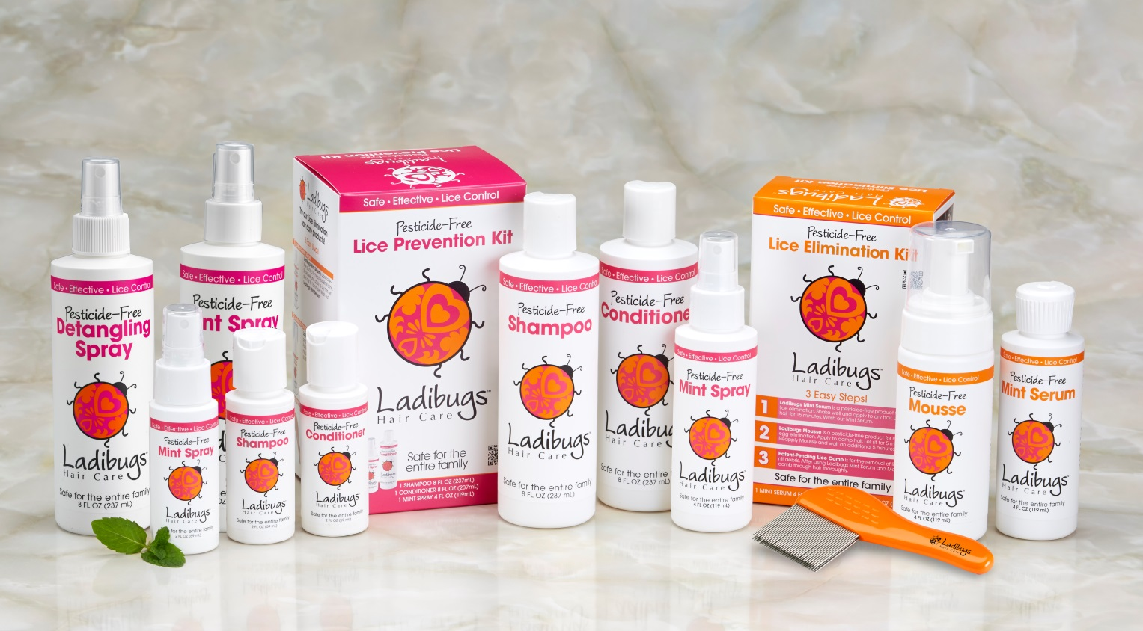
Ladibugs Inc.

Slide 2
Contents
Products/Pricing
Manufacturing
Distribution
Capital to Find growth
Sales

Slide 3
Summary
Ladibugs offers effective products to prevent and eliminate lice and nits in the 12 million people annually, specifically young families, who are affected with head lice.
The company serves the people, caregivers and parents who seek effective yet safe, pesticide free treatment for both lice and nits.
The company offers clinic services to treat head lice on site and a product line for the prevention and elimination of lice. There is also a 24/7 phone line to assist with any questions concerning lice.

Slide 4
Summary Cont.
Ladibugs is the most effective and safe treatment for common and resistant lice. The products are vegan, sulfate free, paraben free and phthalate free. Ladibugs is a one time treatment.
The Ladibugs capabilities include the following:
Scalable manufacturing
Successful treatment of over 10,000 patients with no re-treatment needed
Sold in over 10,000 salons and stores nationwide and internationally
Competitively priced for mass distribution

Slide 5
Summary Cont.
Ladibugs products are effective unlike the traditional chemical preparations for lice treatment that may cause chemical burns and scalp irritation with very little efficacy and require multiple treatments as they only treat the live louse.
The market for lice treatment is estimated at 350 million dollars per year in the US alone. There is a rapidly growing demand for “all natural” products with proven efficacy across all sectors. Ladibugs is targeting this growing group of consumers who seek safe treatments for head lice.

Slide 6
Product and Pricing Strategy
Ladibugs Product line consists of the following Prevention and Elimination Products:
Shampoo
Conditioner
Mint Spray
Detangling Spray
Mint Serum Mousse
Patented Comb
Pricing: Competitively priced for mass distribution from $8-$45. Treats both lice and nits from day 1 versus competitive treatments requiring treatment on day 1 and again on day 7.

Slide 7
Manufacturing: Scalable Contractors
Product Manufacturing: Kapra Cosmetics
Chemist on staff to develop and test products
Scalable to larger volumes
Quality control and integrated inventory
Domestic and international shipping capability
Formula investment buyout is met by current sales and volume
Comb Manufacturing: Wessen Industries, China
Included in Elimination kit and sold separately
Large volume discount target of $1 per comb

Slide 8
Distribution Strategy Current distribution in US, Canada, UK New Zealand and Australia. Potential interest from the European Market.
Channel Hair Salon | Current Great Clips: 3500 doors Regis: 250 doors Kids Hair: 13 doors | Potential Ulta: 715 doors Sally Beauty: 2800 doors JCPenney: 500 doors
Mass Retail | Target: 1375 doors | Walmart: 5249 doors
Drug |  | CVS: 7600 doors Decision made 12/15 Walgreens: 8173 doors Meeting on 12/3/15
Grocery |  | Super Valu: 1582 doors Kroger: 2774 doors Hy-Vee: 240 doors Albertsons: 2400 doors

Slide 9
Promotions
Marketing Dollars: Fall National Show i.e. Dr. Oz, Ellen, Today Show, Good Morning America.
Optimize Search Engine
Mommy Blogger Program giving 1.3 million impressions
Endorsements and Professional Recognition
Participation at Cosmo-Prof and Expo West

Slide 10
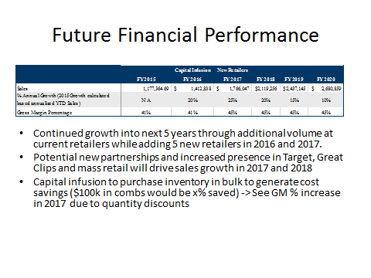
Sales

Slide 11
Projections
Potential Accounts to be acquired by Ladibugs:
Ulta
BSG, Salon Centrics
JC Penney
Beauty Schools
Premier Beauty
Four Store
Ratner
Projected 2016 sales: 1.5 million

Slide 12
Current Investor
Mary Rudquist: $150,000 at 7.5%. Prefers to keep her current percentage in the company.

Slide 13
Strategic Investor Options
-Minority Ownership
-Loan with payback
-Distribution Partnership

