Slide 1
Cloud Computing
One Cloud Does Not Fit All: Adopting a Secure Cloud for Government
Scott Renda
Office of E-Government and Information Technology
Office of Management and Budget
May 13, 2014

Slide 2
Global Cloud Trends
Amazon web services projected value of $50B by 2015¹
Spending on public cloud services to grow nearly 20% in 2014 to $158B²
Public cloud spending to reach $244B by 2017³; 23.5% CAGR⁴
Cloud growth is led by IaaS and PaaS segments (at annual growth rates of 45% and 33%, respectively)⁵
By 2017 the top 6 PaaS platforms will host 80% of new cloud all apps⁶
Cloud growth ~ 14M jobs worldwide by 2015/1M+ in the U.S.⁷
¹ Evercore Partners.
^{2, 3} Gartner.
^{4,7} IDC.
^{5,6} R. Jennings, Techtarget.com.
Notes:
20% public cloud spending growth from Gartner Report 1Q2014 Update
Global trend figures from IDC.
CAGR/AGR – compounded annual growth rate/annual growth rate per IDC
Projections for total cloud spending includes software, services, and cloud infrastructure.
2014 figure and 2017 forecast of “public cloud” services from Gartner $244B by 2017
Amazon projection by Evercore Partners, cited in readwrite.com (11/21/13)
Other commercial cloud growth estimates include:
IBM cloud revenue grew by 70% in the 1st half of 2013 while total revenue declined 3.3%
Oracle cloud revenue grew by 50% in the 1st quarter of 2013 while total revenue dropped 1%
6) PaaS growth projections by Roger Jennings of Techtarget.com

Slide 3
Rapidly Changing Cloud Market
HP and Cisco – Investing over $1B over the next 2 years to develop and offer cloud computing products and services
Microsoft – Bought high-performance cloud computing company GreenButton, a US and New Zealand-based HPC company
Google – Announced massive price drops for its cloud computing services and storage
Notes:
30% lower pricing for Google Compute and App Engine
85% price reductions for BigQuery, a database for doing big data analysis
68% price cuts for cloud storage (to $0.026/month per gigabyte and $0.20/month per gigabyte/DRA

Slide 4
“Cloud First” Shift from Asset Ownership to Service Provisioning
Default to cloud-based solutions whenever a secure, reliable, cost-effective cloud option exists
Continually evaluate cloud solutions across IT portfolios, regardless of investment type or lifecycle stage
Agnostic on deployment model or service delivery type
Address how cloud drives business/mission needs first

Slide 5
Cloud Spending Trends
*Industry Projections
Projected Industry 5-Year CAGR for US public cloud growth shows the highest growth in the IaaS segment [38% for IaaS; 18% for SaaS; 13% for PaaS]
USG agency cloud spending to date (and for FY 2015) has been highest in the SaaS segment
¹ Source: Gartner
Notes:
1)
2)

Slide 6
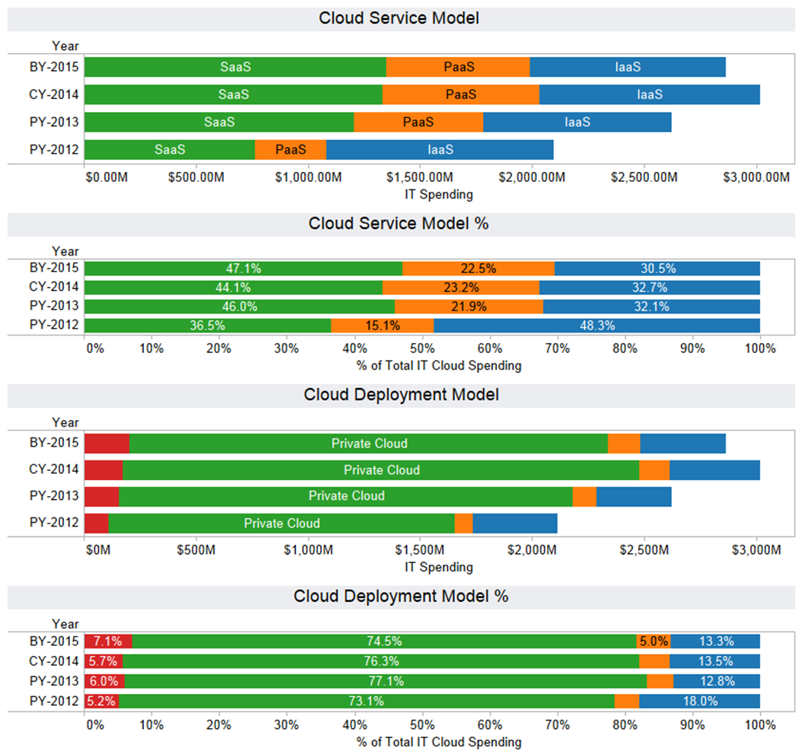
USG Cloud Trends, Cont.
Total Cloud Budget for BY 2015 is $3B (<5% Total IT Budget for 2015)
About 75% of agency cloud spending is for private clouds
Hybrid clouds represent only 5% of cloud spending
Nearly half of all cloud services provided by agencies is for SaaS

Slide 7
Drivers of Cloud Adoption Data, Data, and More Data
Big Data
30% growth in spending on technology and services in 2014 (IDC)
“Data-optimized cloud platforms” are on the rise
Social Networks
Commoditization (standard offerings from CSPs)
60% of Fortune 500 considering deployment of social-enabled solutions by 2016 (IDC)
Mobile Apps
Driving PaaS adoption
By 2017 ~ 50% of mobile app development will use cloud (Gartner)
Data Centers
Continued growth in cloud-dedicated data centers
Software defined everything
Notes:
Talk to’s:
Infrastructure – Social networking, collaboration, mobility, multimedia applications, and Big Data are straining the pillars of traditional IT like never before
Agility – Cloud services must be capable of managing many different types of applications all at the same time
Scale – Ability to scale in response to the volume, variety and velocity of data that is stored, analyzed and distributed
Data Sources:
1) Growth figures on Big Data and Social Networking Cloud Offerings from IDC.
2) 2017 estimate for mobile app dev using cloud from Gartner

Slide 8
Cloud Adoption Trends¹
Over 45% of organizations consider themselves to be beyond the pilot phase
32% of organizations indicate they have developed formal cloud computing plans as part of their overall IT and business strategy
24% percent consider their enterprises to be “heavy” cloud users at this time
Only 6% of organizations said cloud was the “default platform” for new applications. Only 18% of the enterprises said they rely “heavily” on cloud for new projects
39% of executives surveyed expect their enterprise’s application portfolio will be touching the cloud by 2015
¹ Hosting and Cloud Study 2014: Hosting and Cloud Go Mainstream, Survey conducted of 2,041 executives across the globe by 451 Research, released by Microsoft, March 2014.

Slide 9
Cloud Mythbusting
Perception | Reality
Cloud is all about lower total cost of ownership (TCO) | Cloud benefits are numerous – innovation, collaboration, new service creation, costs savings, sustainability, et al
Running mission critical applications in the cloud is not safe and secure | FedRAMP provides a standardized way to safely and securely buy cloud
You lose control of your data in the cloud | Cloud require consumers to approach contract management differently, however, no reason not to own your data
Cloud = virtualization | Virtualization is an enabler of cloud, not cloud in of itself
Everything works better in the cloud | Business processes are key to maximizing cloud benefit

Slide 10
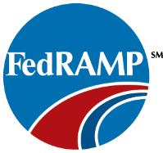
What is FedRAMP?
A Government-wide program that provides a standardized approach to security assessment, authorization, and continuous monitoring for cloud products and services
This approach uses a “do once, use many times” framework that will save cost, time, and staff required to conduct redundant agency security assessments

Slide 11
Cloud Planning Key Considerations
Factors to consider in cloud type, and deciding on what to send to the cloud:
Cost
Platform maturity
Volume of data or network bandwidth requirements
Connectivity and availability
Public CSP’s support
Security
Notes:
Talk to’s:
Cost – it could be vastly cheaper and faster to prototype something in the cloud than to acquire and install new hardware in your data center – for example high performance computing, where running temporary applications in the cloud can save money by avoiding or forestalling the expense of infrastructure additions
Volume of data and bandwidth requirements for certain applications may make it not well suited for use in a cloud – could be better to just retain the workloads in a private cloud/data center for performance reasons
Connectivity – using a public cloud will increase reliance on external network providers and that means potential outages that could leave your employees/customers without access to important applications
Support - If the cloud provider is Intel-based, and your organization is not running on windows or Linux then public cloud is probably not a good fit.
Support - There are conversion costs associated with applications that run on certain servers (like HP UX web servers) in data centers if they are not immediately portable to the cloud
Security – Systems that require specialized configurations, strict security, or dedicated hardware etc., may not thrive well in a hybrid cloud

Slide 12
Going Private? Trends May be Deceiving
Industry data¹ showing private cloud heavily outpacing public cloud is more a question of definition than actual adoption trends
Enhanced virtualization environments have often been mislabeled as private clouds²
Over 90% of private clouds are still believed to be falling short of the core requirements³
Vast majority of dollars spent on IaaS is influenced by developers, and not necessarily by IT operations⁴
^{1,2,3} Forrester survey, Adoption Profile: Private Cloud In North America, Q3 2013.
⁴ Lydia Leong, Gartner, “Cloud Pundit: Massive Scale Computing”, November 2013.
⁵Amazon Web Services.
Notes:
Developers leaning towards public cloud and services because of the agility it provides
Private cloud vendors may repurpose technology as cloud to protect existing investments

Slide 13
Benefits of Hybrid Clouds
Financial considerations – Can help with “auto-scaling” and avoid large cash outlays to acquire new assets that are not needed for continual use
Logical – may be the best “starting point” for what approach to pursue
Leverage – public cloud component can be used for disaster recovery and COOP capabilities
Load balancing – ability to move workloads from private to public cloud and back again as needed
Scalability – can use computing resources to react faster than normally in a “fixed” private cloud or traditional data center environment (e.g., pay-as-you-go models)
Testing – facilitates IPv6 testing for critical customer-facing apps (public cloud front end talks IPv6 while the private cloud back-end communicates via IPv4) without costly changes to infrastructure
Notes:
Talk to’s:
Hybrid Clouds are a great way to merge a private cloud (e.g., traditional data center presence) with the benefits of a public cloud
Many organizations also need automation but they cannot always find the time to implement it in their own data centers. Hybrid clouds can help by adding automation and monitoring tools while helping to justify the initial implementation work.

Slide 14
Cloud PaaS Growth Driven by Mobile, Open data, and APIs
Recent policies:
Executive Order, Making Open and Machine Readable the New Default for Government Information¹
OMB M-13-13, Open Data Policy-Managing Information as an Asset²
Making information resources accessible, discoverable, and usable by the public…Data.gov³:
88K agency data sets available
409 web APIs released
140 mobile apps released
Web Application Programming Interfaces (APIs) are increasing the demand for Cloud PaaS:
Standardized and predictable platforms
Allows for broader use of cloud platforms across the enterprise
Quickly scale to accommodate unpredictable demand
^{1,2} Executive Order and OMB Memorandum issued May 9, 2013.
³ Data.gov data as of April 2014.

Slide 15
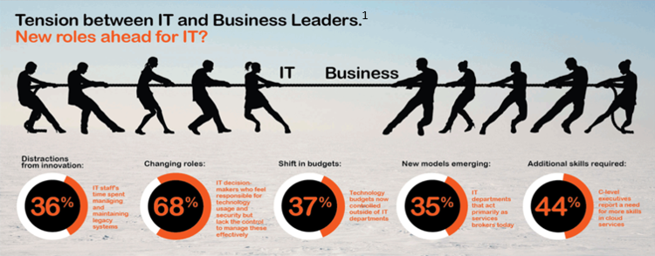
Cloud Impact on Role of CIO
Cloud Services Broker - Over 1/3 of IT organizations act primarily as services brokers, and data shows this trend is expected to grow rapidly¹
Recent poll of industry CIOs indicates top 3 CSPs SLA metrics:
Response time/quality for every end user interaction
Availability based on deep, continuous monitoring
Real-time SLA reporting
¹Avanade, survey of over 1000 global business and IT leaders, commissioned February 2014.
Notes:
1) SLA metrics - CIOs in Avanade’s survey responded that these were the top 3 SLA metrics that they would like to see Cloud Service Providers deliver

Slide 16
Cloud Ecosystem in 2020 ∞as a Service
New generation of CIOs
“Partner Maps” will replace traditional IT infrastructure diagrams
Greater proliferation and use of modular software
Server, storage, and switch provisioning will move out of the hands of developers and become automated
Low-power processors will be everywhere
Data centers will become cloud “ecosystems” with super fast interconnects
Marketplace characterized by more specialized clouds
Notes:
CIOs – there will be a new generation of CIOs raised in the cloudy as a service world. The expectation will be that everything is available “as a service”
Partner maps – more highly abstracted space where software is written in such a way that it goes thru filters before interacting with hardware
Modular software – this will dominate and also include components that “float around” in and out of various service providers – this will also make assuring good SLAs for complex software application a challenge
Infrastructure and software of Data centers will organize around tasks, rather than the other way around
Low power chips - LP chips will be everywhere. Not just be ARM-(Intel is already working on driving down the power used by Atom chips.
Faster interconnects – CTO of Fujitsu Technology Solutions predicts that by 2020 we can expect communications at data centers to be running at speeds in the low hundreds of gigabits per second. – very rapid “commoditization” of high end interconnect technologies allowing information to be passed around DCs at a higher rate than ever. Cloud datacenters will become more like a living and breathing organism with different states…they combination of abstracted software and commoditized hardware will make them function more like ecosystems, with hardware controlled from a single point, growing and shrinking according to workloads
Cloud providers will offer specialized cloud services for specific functions, rather than to try to provide a broad spectrum everything cloud.

