Slide 1
User Research Findings

Slide 2
Overview
Background
Study goals
Methodology
Participants
Findings
Recommendations

Slide 3
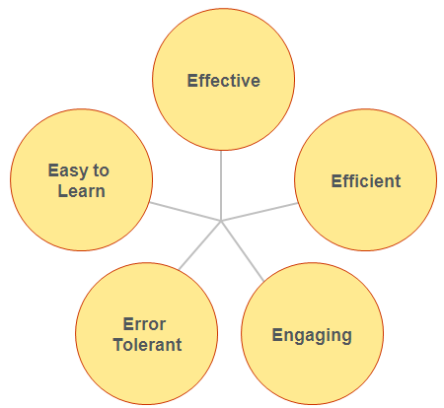
Background
What is a Usable Site?
Usable sites allow users to:
Find what they need
Recognize and understand what they find
Use the information to accomplish their goals.

Slide 4
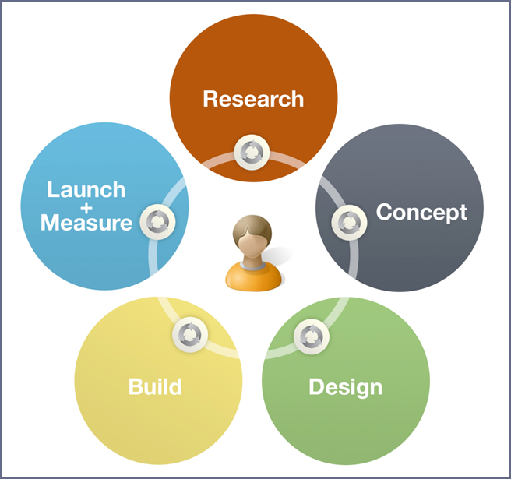
Background
UCD helps create products that are relevant to users and easy to use by focusing on user needs at every stage of development.

Slide 5





Background
[ADD image of the product you are testing here]

Slide 6
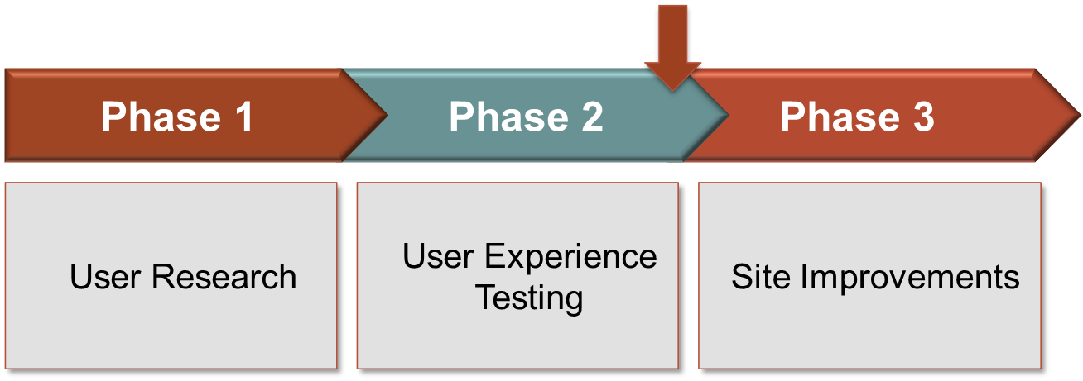
Background
User Research Data-driven understanding of key audiences and their top tasks on our site
User Experience Testing Watch key audiences interact with our site; identify usability issues
Site Improvements Implement recommendations; test improvements to ensure effectiveness

Slide 7

Background
[Briefly review the data sources you examined to complete your user research and explain how the user research informed your study design]

Slide 8
Goals
[Go over the goals for the usability study.]

Slide 9
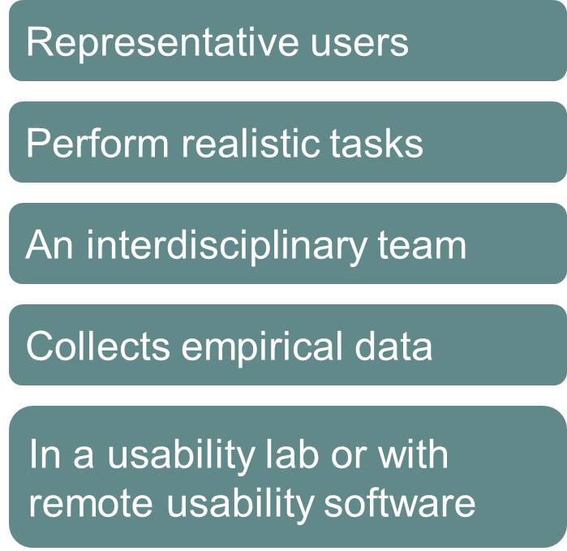
Methodology
A usability study is a research activity in which:

Slide 10
Study Participants
[Table with the main characteristics of each study participant (gender, age, job, etc.). Remember to use participant codes instead of participant names to protect anonymity.]

Slide 11
Findings
[Detail your main findings in this section. Generally findings are organized by category; for example:
Positive findings
Success metrics (graphs/tables of success rates by scenario/participant; System Usability Score, NetPromoter score)
Navigation and information architecture issues
Search issues
Language and content issues
Design issues
Perceptions and consequences
Typically, plan 1-2 slides per finding. Your findings pages should include participant quotes and counts – e.g. X out of X participants went here instead of here – to illustrate your findings.]

Slide 12
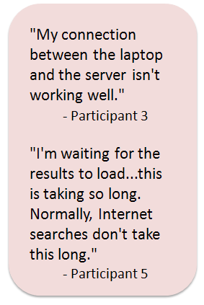
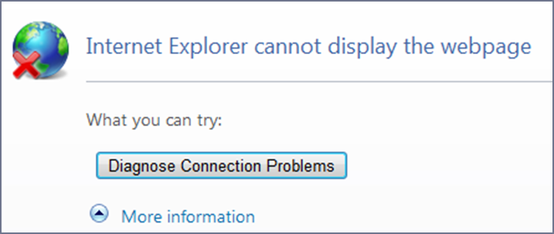
Findings - EXAMPLE
Users experience technical problems on the site
5 out 6 users experienced technical problems.
The site doesn’t work properly in some browsers. IE experienced the most hiccups.
Performance slowed when search returned a high number of results.

Slide 13
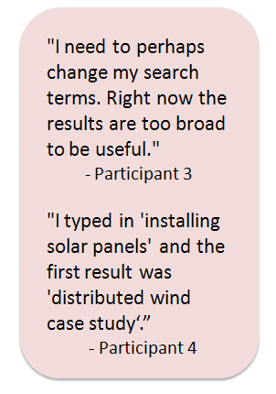
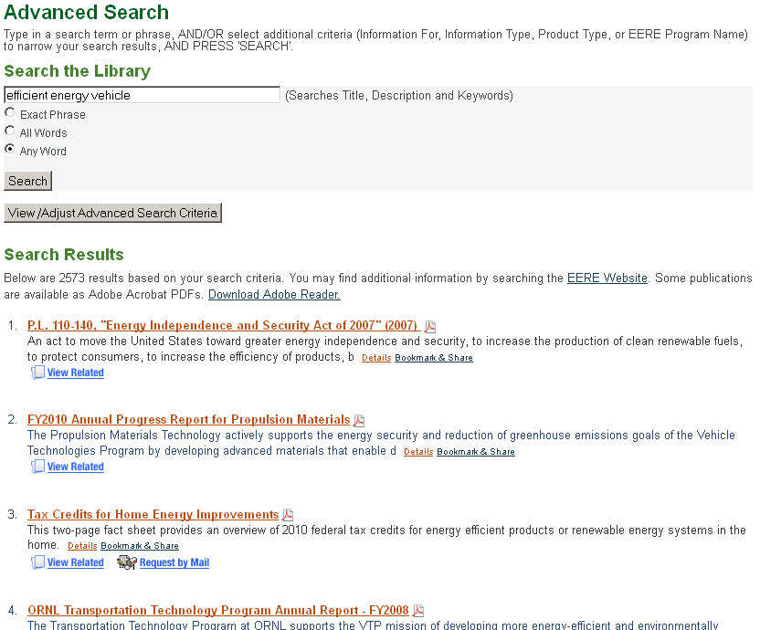
Findings - EXAMPLE
Search results are overwhelming and not helpful
“Too many choices to pick from.”
Top results are not relevant.

Slide 14
Recommendations
[Detail your main recommendations for improving the site in this section. Provide screen shots of sites that are good examples of each recommendation where possible.]

Slide 15
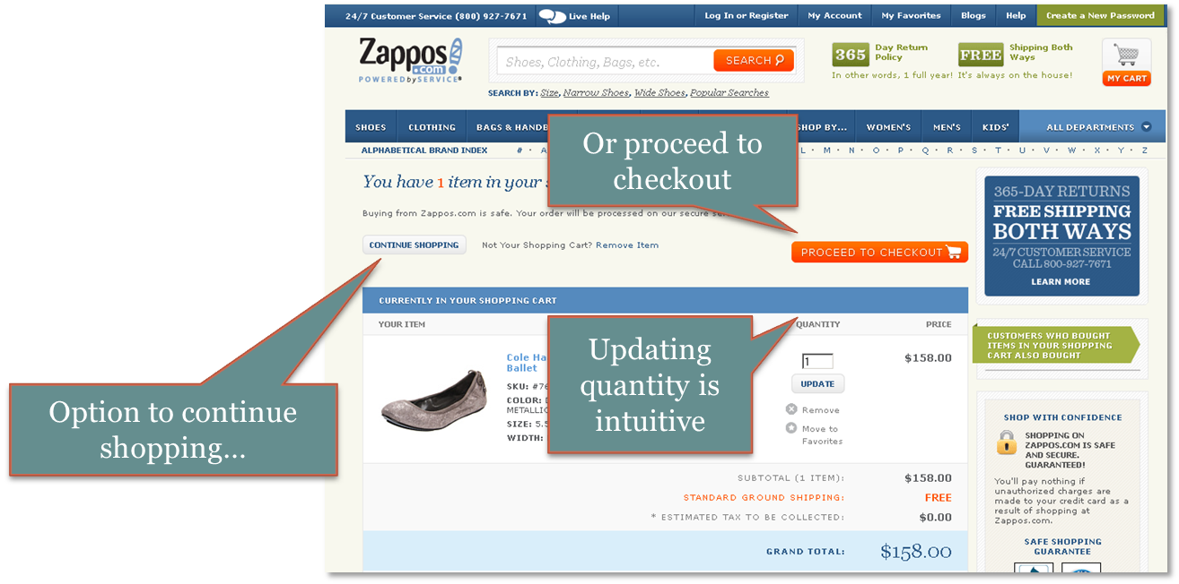
Recommendations - EXAMPLE
Make the publication ordering process more intuitive
Flexible: Consider allowing users to order more than 5 publications
Familiar: Use an ordering model that is familiar to users

Slide 16

Questions & Discussion
[Questions and discussion]

