Slide 1
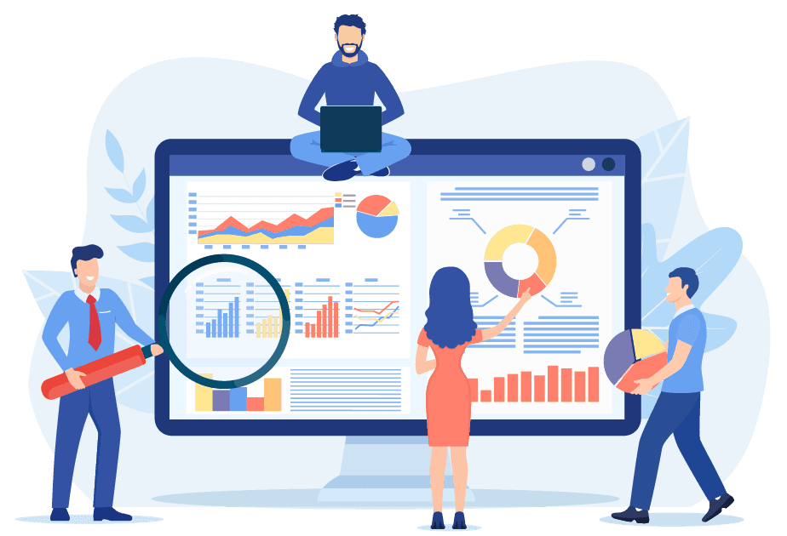

How to access DAP and find your agency data
Guide to the Digital Analytics Program (DAP)
January 2024
Notes:
Hello and welcome to Digital.gov’s “How to access DAP and find your agency data in GA4”, a part of the Guide to the Digital Analytics Program video series. The goal of the Digital Analytics Program (DAP) learning talks is to provide short, targeted videos to help federal practitioners who are DAP users complete specific tasks. This talk focuses on how to access DAP and find your agency data.
Alt text: Title card image of business people working on data analytics for the web. In yellow text, the first line says, Guide to the Digital Analytics Program (DAP). Below in white text, the second line has the video title (How to access DAP and find agency data) and recording date (January 2024). In the bottom left corner, is the white Digital.gov logo which consists of three ribbons joined together in an hexagon to resemble the shape of a capital letter D, followed by the domain and program name, Digital.gov.

Slide 2
What you’ll learn
An introduction to the Digital Analytics Program (DAP)
How to use custom reports
How to log in
Request support and connect with other practitioners
Notes:
In this talk, you’ll learn:
A brief introduction to DAP
How to log in
How to use custom reports to find governmentwide and agency-specific data
Information on requesting support and connecting with other practitioners

Slide 3
Disclaimer
All references to specific brands, products, and/or companies are used only for illustrative purposes and do not imply endorsement by the U.S. federal government or any federal government agency.
Notes:
A quick disclaimer before we begin the talk. All references to specific brands, products, and/or companies are used only for illustrative purposes and do not imply endorsement by the U.S. federal government or any federal government agency.

Slide 4
An introduction to the Digital Analytics Program (DAP)
Notes:
Now let’s jump in and talk about an introduction to DAP.

Slide 5
What is DAP?
GSA provides DAP as a no-cost, shared service for federal agencies.
DAP is a comprehensive, easy-to-use web analytics tool for public-facing federal websites and digital services.
Since 2012, DAP has provided agencies with access to Google Analytics. It is a scalable solution for measuring a broad range of .gov and .mil websites across the federal government.
Use DAP to better understand user behavior and improve your websites and digital services.

Slide 6
Introduction to DAP
Why use DAP?
Notes:
Why should you use DAP?

Slide 7

Agencies are required to participate in GSA’s government-wide Digital Analytics Program (DAP). Participation in DAP does not preclude agencies from using other web analytics services.
— Office of Management and Budget in M-23-22, Delivering a Digital-First Public Experience
Visit digital.gov/resources/delivering-digital-first-public-experience for more information.
Notes:
Participation in DAP is a requirement of the Office of Management and Budget (OMB).
Check out Digital.gov’s requirements for delivering a digital-first public experience to learn more about the policy framework in 21st Century Integrated Digital Experience Act and OMB Memo M-23-22.
Visit digital.gov/resources/delivering-digital-first-public-experience for more information.

Slide 8
Introduction to DAP
Who can access DAP, and how?

Slide 9
Requesting access to DAP
Any federal employee or contractor who works for a participating agency may request access to DAP
Email dap@gsa.gov to request access to DAP
Your agency point of contact must approve access before the DAP team grants it
Visit digital.gov/guides/dap/gaining-access-to-dap-data for more information.

Slide 10
How to log in

Slide 11
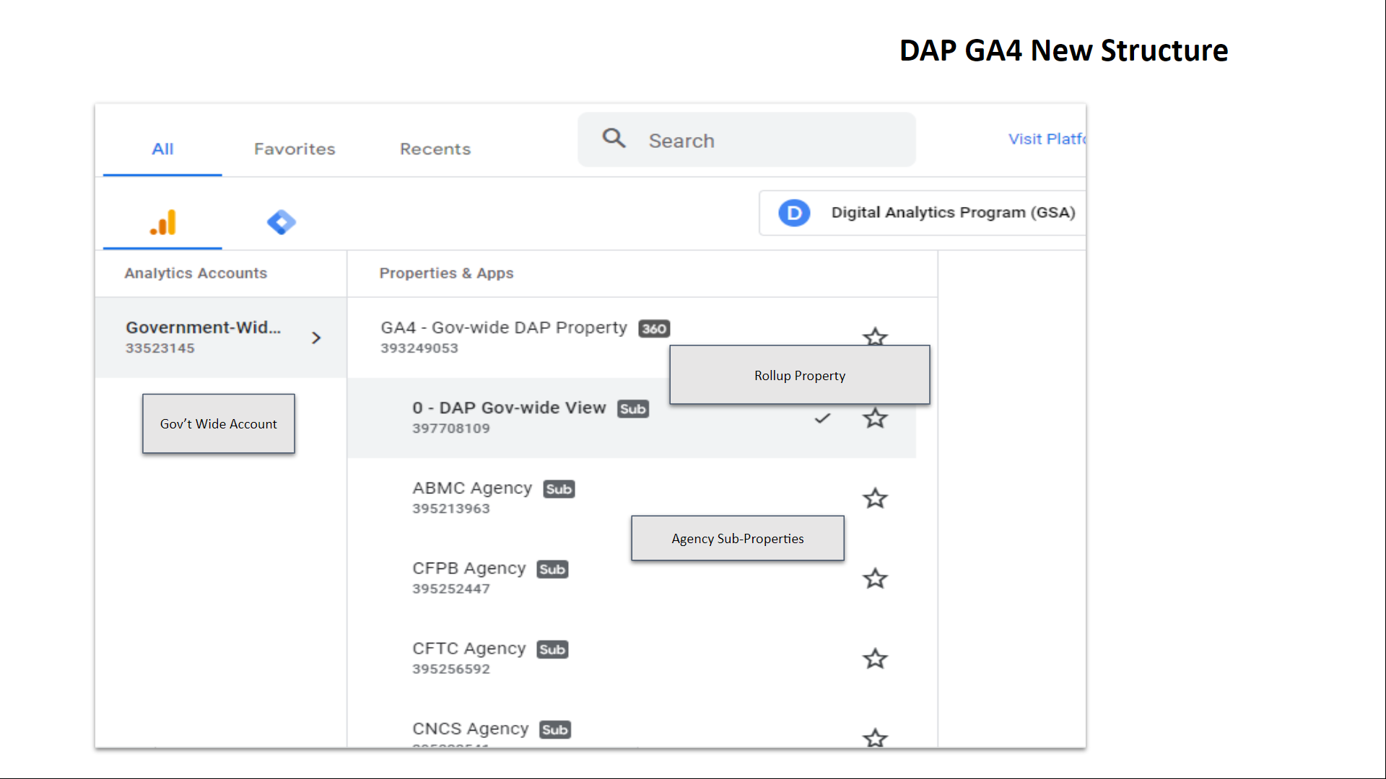
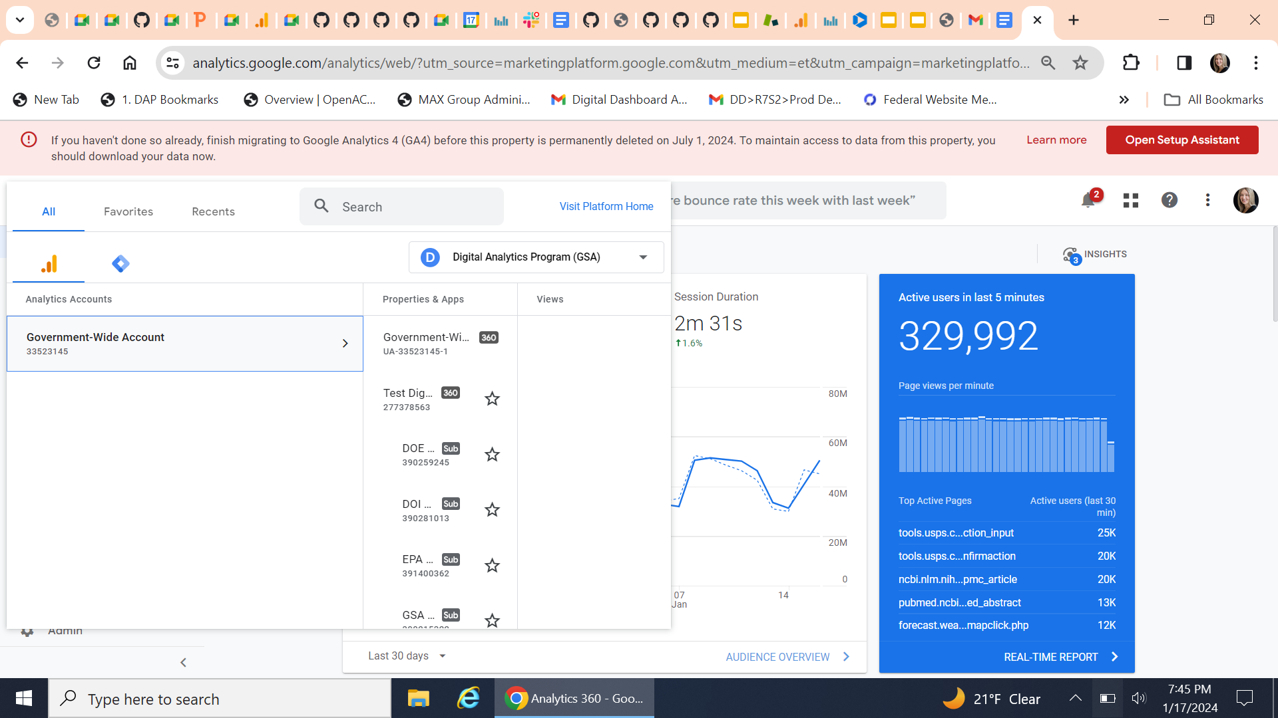
Logging into DAP
1. Go to google.com/analytics.
2. Select Government-Wide Account.
Notes:
After your request access is granted, the DAP team will email you instructions on how to log in:
Go to https://www.google.com/analytics and login with their credentials.
When logged in, you’ll see the “Government-Wide Account.” The ID is 33523145.
Select “GA4 - Gov-wide DAP Property” to see the hierarchy of the “Gov-wide DAP View” sub-property and agency-specific sub-properties.
Agency-specific sub-properties are established at the department level. The data for bureaus and sub-agencies are collected and reported inside these department-level sub-properties. For example, CDC is within HHS and IRS is within Treasury.
To view the government-wide data, use the “DAP Gov-wide View” sub-property.
To view your agency’s data, select its sub-property.

Slide 12
Data availability
The DAP team launched its custom Google Analytics 4 code in August 2023.
Therefore, all data in DAP is available as of August 1, 2023.
Notes:
Note: If your agency is not using a centrally hosted DAP code, then your DAP GA4 data availability will depend on when your agency implemented the DAP code independently.

Slide 13
How to use custom reports
Notes:
In DAP GA4, agency-specific data is filtered by a corresponding, dedicated sub-property. However, even inside each agency sub-property, there may be many different websites and pages.
To help you get started with DAP reporting, we have created a set of basic custom reports to deliver website traffic and usage metrics as well as user behavior trends. In this talk, we will review three reports:
Agency Metrics
Domains Report
All Pages Report

Slide 14
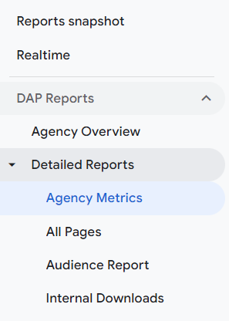
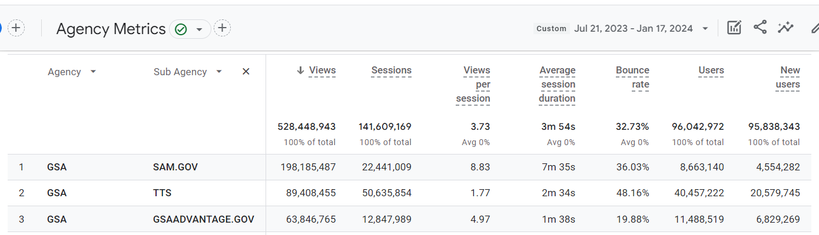
Finding agency data: Agency Metrics report
Views, sessions, users, and other metrics by agency and sub-agency
Notes:
Agency Metrics is the first DAP custom report located on the left navigation bar, under the “Reports” tab. Once in the “Reports” tab, click on “DAP Reports”, and choose “Agency Metrics” under the Detailed Reports category (see example on the slide). The Agency Metrics report provides a high-level summary of page and screen views, sessions and related metrics for the agency and sub-agency.

Slide 15
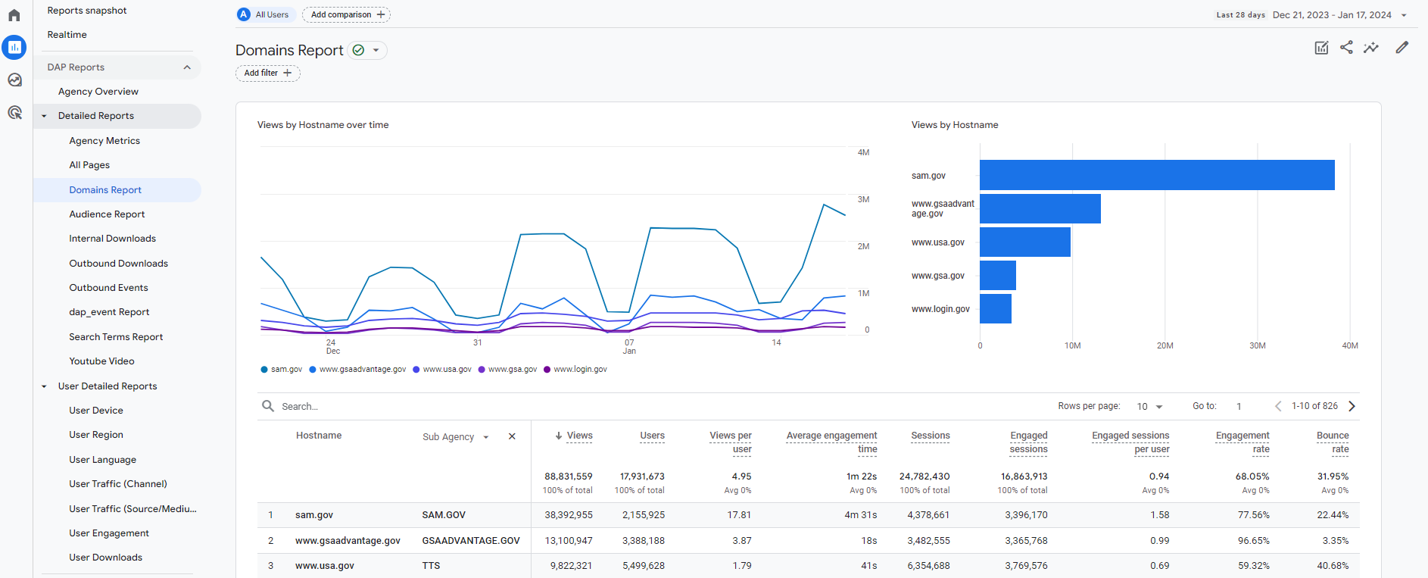
Finding agency data: Domains report
Views, sessions, users, and other metrics by hostname and sub-agency
Notes:
The next report is the Domains report, located on the left nav bar under “Detailed Reports”. This is a more detailed custom report compared to Agency Metrics, and it shows metrics by hostname (domain) and sub-agency. The goal of the report is to make it easier for agencies to see metrics by website and a corresponding sub-agency. Users can utilize the search feature below the chart to find a specific domain/website of interest.

Slide 16
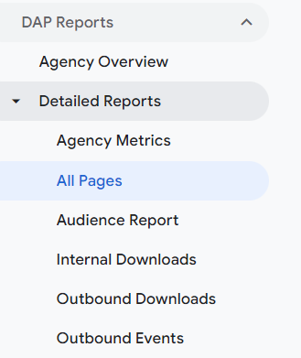
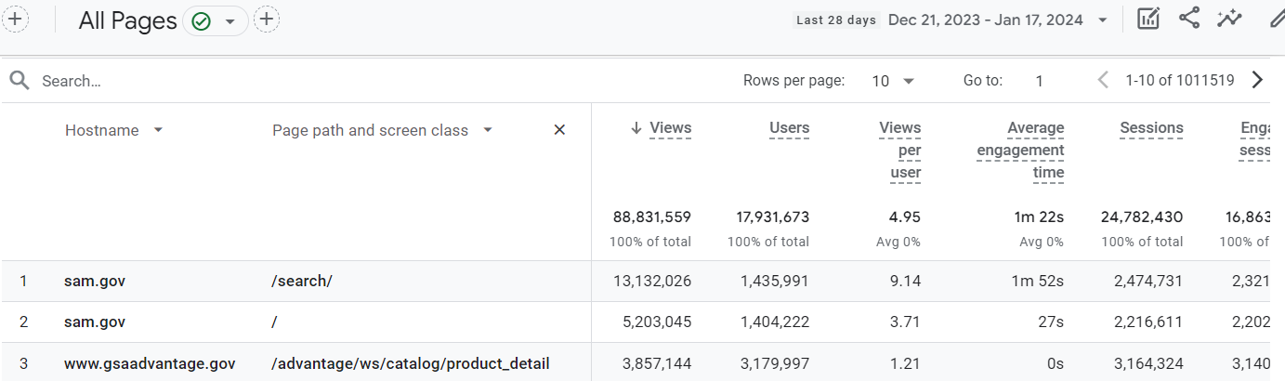
Finding agency data: All Pages report
Views, sessions, users, and other metrics by hostname and page path and screen class
Notes:
The third and last report in this video is the All Pages report, also located on the left nav bar under “Detailed Reports”. This is the most detailed custom report that provides metrics by hostname (domain) and the full page path, giving users the full URL so they can track metrics for individual web pages.

Slide 17

Filtering results: All Pages report
How to filter results
To find a specific page or directory, use the search bar to filter results.
This example shows results for the keyword advantage in the All pages report for GSA.
Notes:
You can use the search feature using keywords from the webpage of interest to narrow down results for a specific domain or website. See, for example, the keyword “advantage” to narrow down result to gsaadvantage.gov pages only.

Slide 18
Request support and connect with other practitioners

Slide 19
Links to bookmark
Guide to the Digital Analytics Program (DAP)
https://digital.gov/guides/dap
DAP code and documentation https://github.com/digital-analytics-program/gov-wide-code
Public reporting
https://analytics.usa.gov
Notes:
Slide 19, Links to bookmark.
For answers to frequently asked questions in the DAP guide, visit digital dot gov slash guides slash dap.
For more detailed information on how to implement the DAP code, visit github dot com, slash digital, dash analytics, dash program, slash gov, dash wide, dash code.
And to learn about public data reporting, go to analytics dot usa dot gov.

Slide 20
Request support from the DAP team
Email us at dap@gsa.gov
Notes:
Request support from the DAP team. Email us at dap@gsa.gov.

Slide 21
Join the Web Analytics Community
digital.gov/communities/web-analytics-and-optimization
Notes:
Join the Web Analytics Community at https://digital.gov/communities/web-analytics-and-optimization/.

Slide 22
Key takeaways
Agencies must participate in GSA’s government-wide Digital Analytics Program (DAP).
We’re here to help! Email the DAP team at dap@gsa.gov to request access and other support.
Use custom reports to get the most out of DAP.
Visit Digital.gov to browse the Guide to the Digital Analytics Program and join the Web Analytics community.
Notes:
Thank you for watching this talk about how to access DAP and find your agency data. After listening to this talk, we hope you walk away with four key takeaways.
First, agencies must participate in GSA’s government-wide Digital Analytics Program (DAP). Second, agencies should use custom reports to get the most out of DAP GA4. Third, email the DAP team at dap@gsa.gov to request access and other support. Last but not least, remember that we’re here to help! Take advantage of the online documentation at digital.gov/guides/dap and join the Web Analytics community at digital.gov/communities.

