Slide 1

How to find information on user devices, regions, and languages
Guide to the Digital Analytics Program (DAP)
January 2024
Notes:
Hello and welcome to Digital.gov’s “How to find information on user devices, regions, and languages in GA4”, a part of the Guide to the Digital Analytics Program video series. The goal of the Digital Analytics Program (DAP) learning talks is to provide short, targeted videos to help federal practitioners who are DAP GA4 users complete specific tasks. This talk focuses on how to find information on user devices, regions, and languages. These reports provide information about the devices users are on when visiting federal websites, what regions they are in, and the language settings in their browsers. You can use this data to improve users’ experience with websites and digital services.
Alt text: Title card image of business people working on data analytics for the web. In yellow text, the first line says, Guide to the Digital Analytics Program (DAP). Below in white text, the second line has the video title (How to access DAP and find agency data) and recording date (January 2024). In the bottom left corner, is the white Digital.gov logo which consists of three ribbons joined together in an hexagon to resemble the shape of a capital letter D, followed by the domain and program name, Digital.gov.

Slide 2
What you’ll learn
Devices users are on when they visit your website
Language settings in browsers used to visit your website
Regions where users visit your website
Request support and connect with other practitioners
Notes:
In this talk, you’ll learn how to find information on the:
Devices users are on when they visit your website
Regions users are in when they visit your website
Users language settings in browsers when they visit your website
You’ll also know how to request support and connect with other practitioners.

Slide 3
Disclaimer
All references to specific brands, products, and/or companies are used only for illustrative purposes and do not imply endorsement by the U.S. federal government or any federal government agency.
Notes:
A quick disclaimer before we begin the talk. All references to specific brands, products, and/or companies are used only for illustrative purposes and do not imply endorsement by the U.S. federal government or any federal government agency.

Slide 4
Data availability
The DAP team launched its custom Google Analytics 4 code in August 2023.
Therefore, all data in DAP is available as of August 1, 2023.
Notes:
Note: If your agency is not using a centrally hosted DAP code, then your DAP GA4 data availability will depend on when your agency implemented the DAP code independently.

Slide 5
How to use
custom reports
Notes:
To help you get started with DAP GA4 reporting, we created a set of basic custom reports to deliver website traffic and usage metrics as well as user demographics and engagement reports.

Slide 6
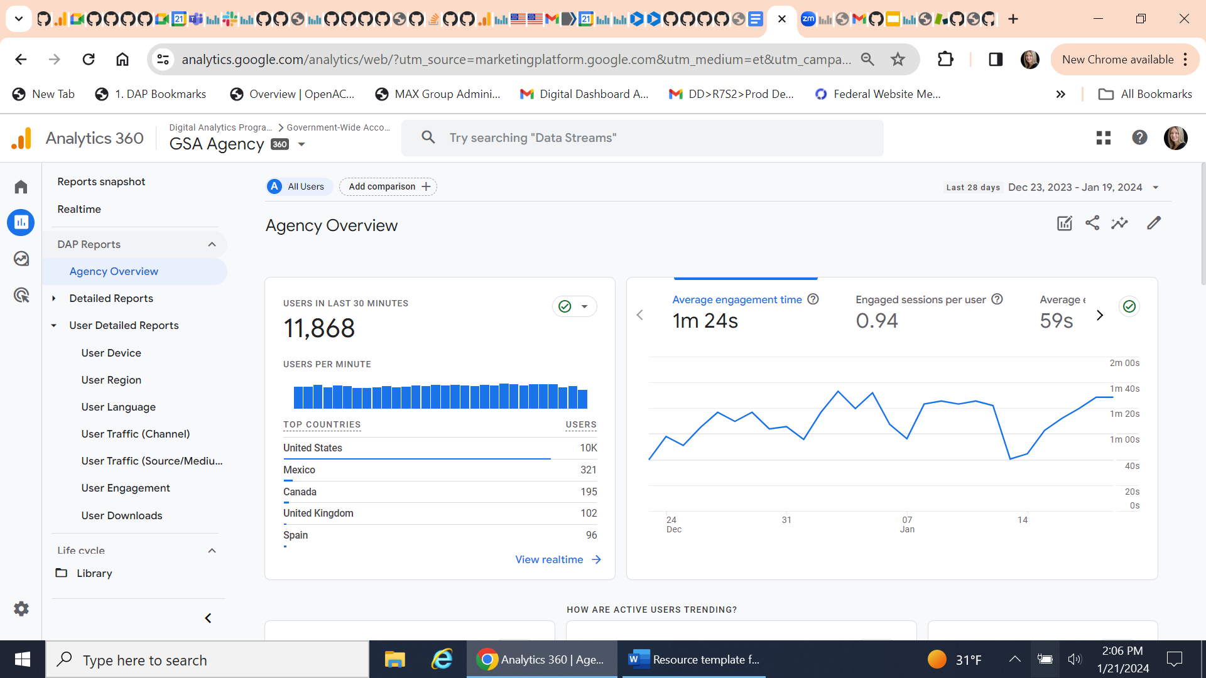
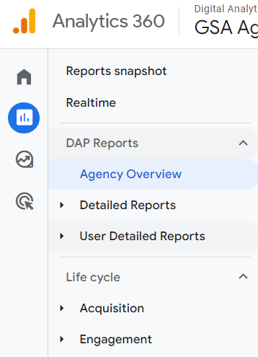
User detailed reports
Notes:
The “User Detailed Reports” are located on the left navigation bar under “DAP Reports.” There are several custom reports in the User Detailed Reports section. In this video, we will review the user detailed reports for:
User Device
User Region
User Language

Slide 7
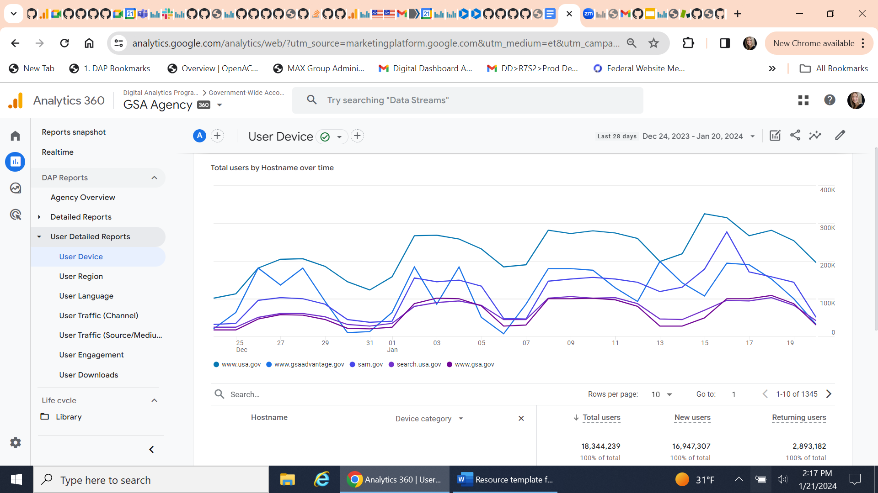
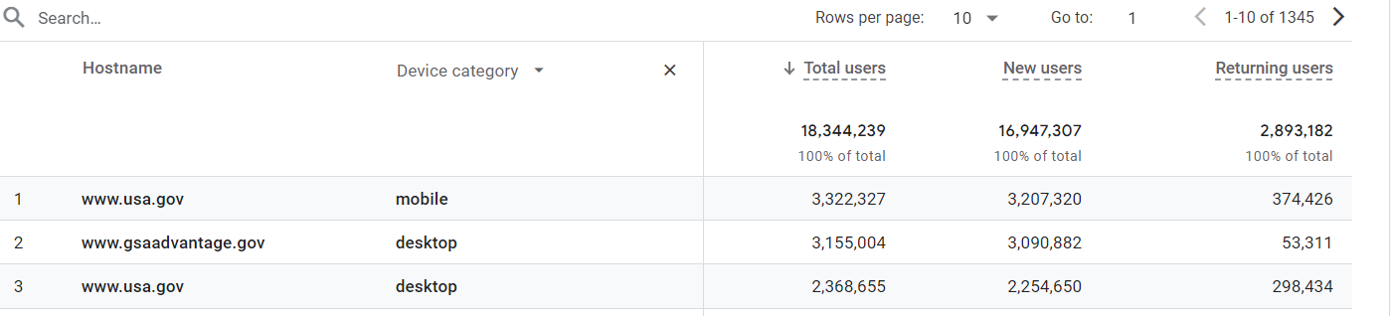
User detailed reports: User device
Report insight
What devices are users on when they visit my websites?
Notes:
The User Device report delivers metrics for total users, new users and returning users across two dimensions: hostname (website) and device category (for example, desktop, mobile, tablet, smart TV). You can use this report to identify what devices visitors are on when visiting government websites and use this information to continuously improve user experience with websites and digital services.
Also note that you can use the search feature below the chart to narrow down the hostnames to zoom into a specific domain or website by device category.

Slide 8
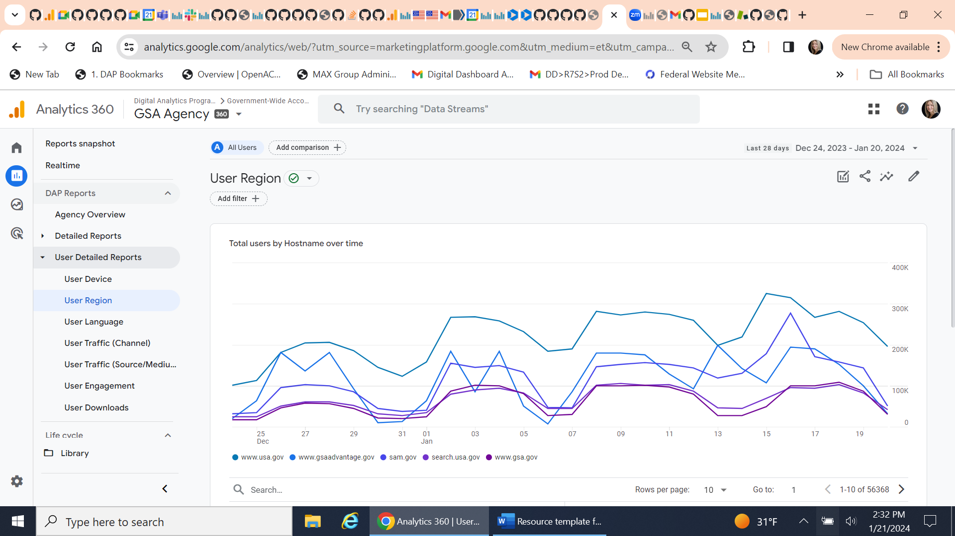

User detailed reports: User region
Report insight
What are the top regions where users visited my website?
Notes:
The next report is the User Region. The User Region report delivers metrics for total users, new users and returning users across two dimensions: hostname (website) and Region (state). The goal of this report is to show the regions visitors were in when visiting government websites. Agency users can utilize the search feature below the chart to narrow down the hostnames and find a specific domain/website of interest.

Slide 9


User detailed reports: User language
Report insight
What are the top language settings in browsers used to visit my website?
Notes:
The third report is User Language. The User Language report delivers metrics for total users, new users and returning users by two dimensions: hostname (website) and Language. It shows top language settings in browsers that users used when visiting government websites. Agencies can use this report to determine the level of multilingual content needed to reach their target customers.
Use the search feature below the chart to narrow down the hostnames and find a specific domain or website.

Slide 10
Request support and connect with other practitioners

Slide 11
Links to bookmark
Guide to the Digital Analytics Program (DAP)
https://digital.gov/guides/dap
DAP code and documentation https://github.com/digital-analytics-program/gov-wide-code
Public reporting
https://analytics.usa.gov
Notes:
Slide 11, Links to bookmark.
For answers to frequently asked questions in the DAP guide, visit digital dot gov slash guides slash dap.
For more detailed information on how to implement the DAP code, visit github dot com, slash digital, dash analytics, dash program, slash gov, dash wide, dash code.
And to learn about public data reporting, go to analytics dot usa dot gov.

Slide 12
Request support from the DAP team
Email us at dap@gsa.gov
Notes:
Request support from the DAP team. Email us at dap@gsa.gov.

Slide 13
Join the Web Analytics Community
digital.gov/communities/web-analytics-and-optimization
Notes:
Join the Web Analytics Community at https://digital.gov/communities/web-analytics-and-optimization/.

Slide 14
Key takeaways
Find information on devices, regions, and languages in the user detailed reports.
We’re here to help! Email the DAP team at dap@gsa.gov to request access and other support.
Use this information to make data-informed decisions and improve user experience.
Visit Digital.gov to browse the Guide to the Digital Analytics Program and join the Web Analytics community.
Notes:
Thank you for watching this talk about how to find information on user devices, regions, and languages. After listening to this talk, we hope you walk away with four key takeaways.
First, you can find information on devices, regions, and languages in the user detailed reports. Second, be sure to use this information to make data-informed decisions and improve user experience. Third, email the DAP team at dap@gsa.gov to request access and other support. Last but not least, remember that we’re here to help! Take advantage of the online documentation at digital.gov/guides/dap and join the Web Analytics community at digital.gov/communities.

