Slide 1

How to find information on traffic, engagement, and downloads
Guide to the Digital Analytics Program (DAP)
January 2024
Notes:
Hello and welcome to “How to find information on traffic, engagement, and downloads”, a part of the Guide to the Digital Analytics Program video series hosted by Digital.gov. The goal of the Digital Analytics Program learning talks is to provide short, targeted videos to help federal practitioners who are DAP users complete specific tasks. This talk focuses on how to find important information on your website traffic, user engagement, and file downloads.
Alt text: Title card image of business people working on data analytics for the web. In yellow text, the first line says, Guide to the Digital Analytics Program (DAP). Below in white text, the second line has the video title (How to access DAP and find agency data) and recording date (January 2024). In the bottom left corner, is the white Digital.gov logo which consists of three ribbons joined together in an hexagon to resemble the shape of a capital letter D, followed by the domain and program name, Digital.gov.

Slide 2
What you’ll learn
The channels, sources, and media for your website’s traffic.
Email the DAP team at dap@gsa.gov to request access and other support.
How to identify high- performing pages and the files downloaded by users.
We’re here to help! Visit Digital.gov to browse the Guide to the Digital Analytics Program and join the Web Analytics community.
Notes:
In this talk, you’ll learn how to find information on the:
The channels, sources, and medium for your website’s traffic
How to identify high-performing pages and the files downloaded by users.
You’ll also know how to request support and connect with other practitioners.

Slide 3
Disclaimer
All references to specific brands, products, and/or companies are used only for illustrative purposes and do not imply endorsement by the U.S. federal government or any federal government agency.
Notes:
A quick disclaimer before we begin the talk. All references to specific brands, products, and/or companies are used only for illustrative purposes and do not imply endorsement by the U.S. federal government or any federal government agency.

Slide 4
Data availability
The DAP team launched its custom Google Analytics 4 code in August 2023.
Therefore, all data in DAP is available as of August 1, 2023.
Notes:
Note: If your agency is not using a centrally hosted DAP code, then your DAP GA4 data availability will depend on when your agency implemented the DAP code independently.

Slide 5
How to use
custom reports
Notes:
To help you get started with DAP GA4 reporting, we created a set of basic custom reports to deliver website traffic and usage metrics as well as user demographics and engagement reports.

Slide 6
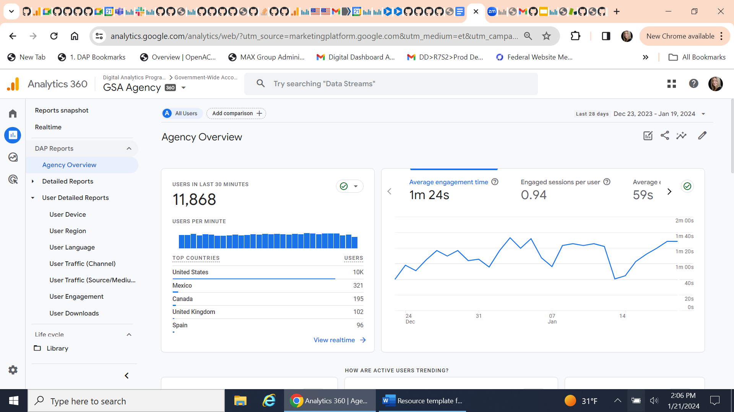
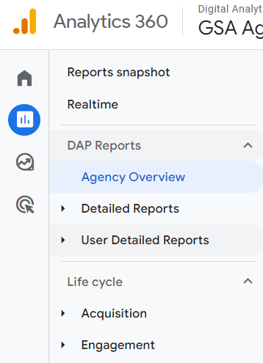
User detailed reports
Notes:
The “User Detailed Reports” are located on the left navigation bar under “DAP Reports.” There are several custom reports in the User Detailed Reports section. In this talk, we will review the user detailed reports for:
User Traffic (Channel)
User Traffic (Source/Medium)
User Engagement
User Downloads

Slide 7
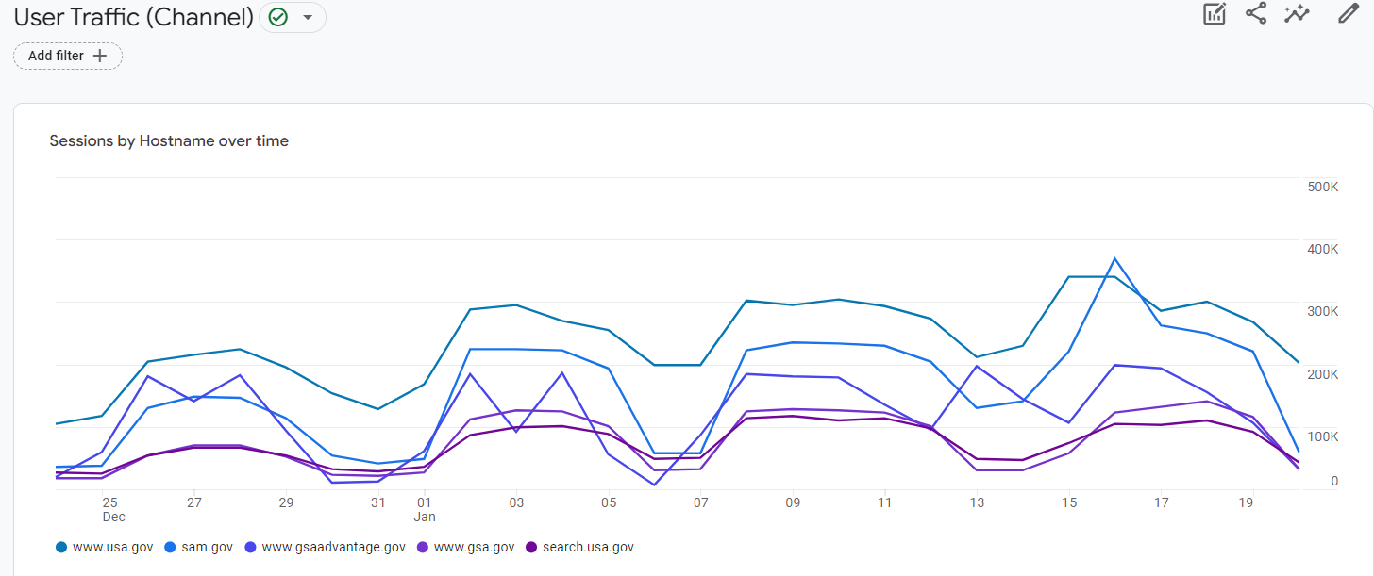
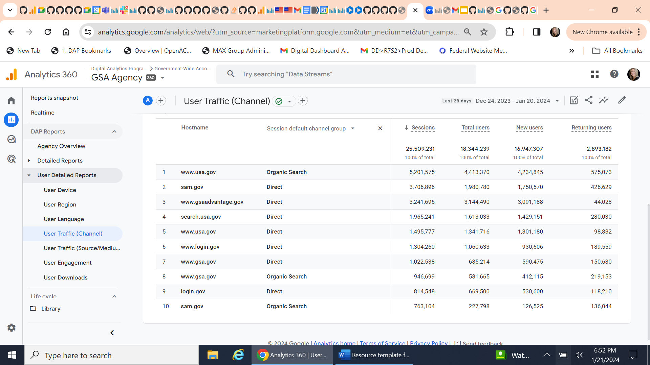
User detailed reports: User traffic (channel)
Report insight
What are the top referring channels for my websites?
Notes:
This report delivers metrics for total sessions, total users, new users and returning users across two dimensions: hostname (website) and channel group. Examples of channel groups include, direct traffic, organic search, paid search, email, and social media. This report shows how visitors get to your websites so you can identify your website’s top referring channels.

Slide 8


User detailed reports: User traffic (source/medium)
Report insight
What are the top referring sources and media that users use to find my websites?
Notes:
The next report is User Traffic by Source/Medium. It’s a more detailed report of the User Traffic by Channel. This report goes into the referring source, providing metrics for total sessions, total users, new users and returning users across two dimensions: hostname (website) and a specific referring source and medium. For example, google, an organic search, govdelivery and email. This report shows referrers by channel and medium that bring visitors to your websites.
Also note that you can use the search feature below the chart to narrow down the hostnames and find a specific domain or website.

Slide 9
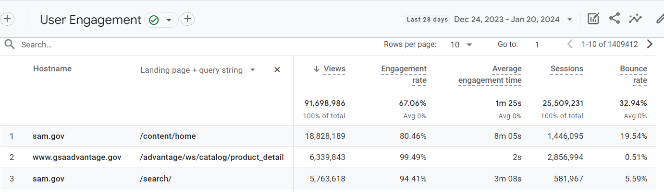
User detailed reports: User engagement
Report insight
What are the high- performing pages? How can I optimize lower performing pages?
Notes:
This next report is called User Engagement. This report gets into user interaction and behavior metrics. This is an important report. It allows you to identify high-performing pages, optimize underperforming ones, and make data-informed decisions to enhance user experience and increase conversions.
What is engagement? According to Google Support, “an engaged session is a session that lasts more than ten seconds, has a conversion event, and/ or at least two pageviews or screenviews.”
There are five metrics in this report
First, total views, which is the number of times a page or app screen was viewed,
Second, engagement rate, which is the percentage of sessions that lasted longer than ten seconds, had a conversion event, or had at least two pageviews or screenviews,
Third, bounce rate, which is the percentage of sessions where a user did not engage with a page.
Fourth, average engagement time, which is the average time a user engaged during a session
And lastly, total sessions.
There are two dimensions used in this report: hostname (website) and Landing Page + Query String.
What is Landing Page + Query String? It is a dimension that shows the first page a visitor lands on (including any string parameters in the URL) when they visit your website and how they engage with it.
As always, you can use the search function to narrow down the hostnames and find a specific domain or website.

Slide 10
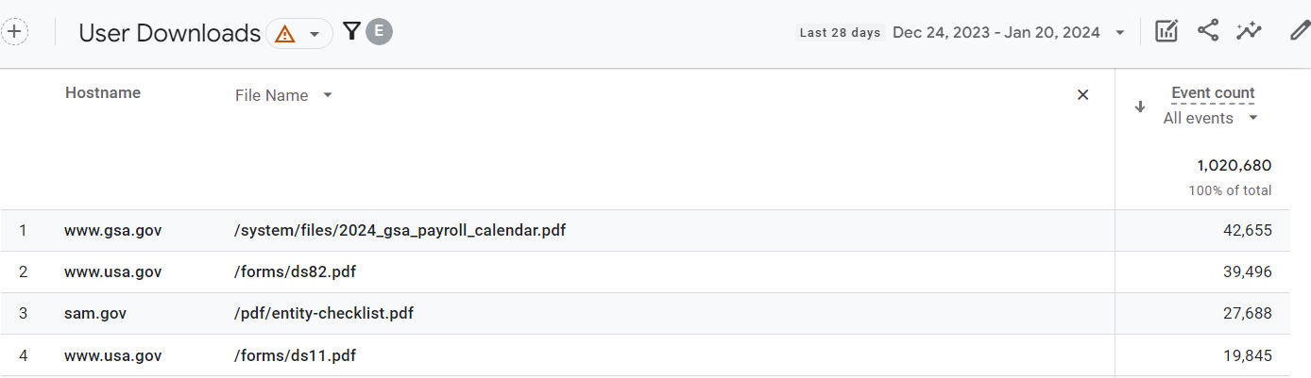
User detailed reports: User downloads
Report insight
What are the files that users download the most (or least) on your websites?
Notes:
The final report is called User Downloads. The report shows the total number of file downloads by hostname, file name and file type in a given date range.
You can use the search to find a specific domain, website, or file name.

Slide 11
Request support and connect with other practitioners

Slide 12
Links to bookmark
Guide to the Digital Analytics Program (DAP)
https://digital.gov/guides/dap
DAP code and documentation https://github.com/digital-analytics-program/gov-wide-code
Public reporting
https://analytics.usa.gov
Notes:
Slide 12, Links to bookmark.
For answers to frequently asked questions in the DAP guide, visit digital dot gov slash guides slash dap.
For more information on how to implement the DAP code, visit github dot com, slash digital, dash analytics, dash program, slash gov, dash wide, dash code.
And to learn about public data, go to analytics dot usa dot gov.

Slide 13
Request support from the DAP team
Email us at dap@gsa.gov
Notes:
Request support from the DAP team. Email us at dap@gsa.gov.

Slide 14
Join the Web Analytics Community
digital.gov/communities/web-analytics-and-optimization
Notes:
Join the Web Analytics Community at digital dot gov, slash communities, slash web, dash analytics, dash and, dash optimization

Slide 15
Key takeaways
Find information on your website traffic, user engagement, and file downloads.
We’re here to help! Email the DAP team at dap@gsa.gov to request access and other support.
Use this information to make data-informed decisions and improve user experience.
Visit Digital.gov to browse the Guide to the Digital Analytics Program and join the Web Analytics community.
Notes:
Thank you for watching this talk to learn how to find information on your website traffic, user engagement, and file downloads.
After listening to this talk, we hope you walk away with four key takeaways.
First, you can find information on traffic, engagement, and downloads in the user detailed reports.
Second, be sure to use this information to make data-informed decisions and improve user experience.
Third, email the DAP team at dap@gsa.gov to request access and other support.
Last but not least, remember that we’re here to help! Take advantage of the online documentation at digital dot gov, slash guides, slash dap and join the Web Analytics community at digital dot gov, slash communities.

