Slide 1

USWDS Monthly Call
September 2023

Slide 2

Hi!
Thanks for being here!

Slide 3
Agenda
Site launches
USWDS 3.6.1
Mission, vision, and polestar
Q&A

Slide 4
Site launches

Slide 5
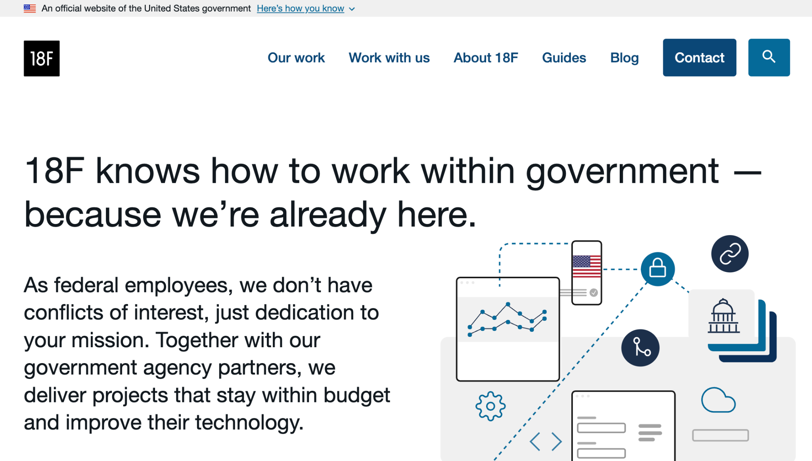
18F
18f.gsa.gov

Slide 6
Great work!

Slide 7
USWDS 3.6.1
Small but mighty

Slide 8
Key improvements in USWDS 3.6.1
Stacked responsive table reads properly in Safari
Tile borders are less distracting
Wrapping breadcrumbs now wrap properly
Improved display of tooltip
Improved image display in the open banner
Fixed a rare mobile menu bug in Safari

Slide 9
USWDS 3.6.1
Out next week

Slide 10
Mission, vision, and polestar
2023 and beyond

Slide 11
Anne Petersen
they/them
Experience Design Lead
USWDS

Slide 12
USWDS turns eight next week

Slide 13
September 28, 2015

Slide 14
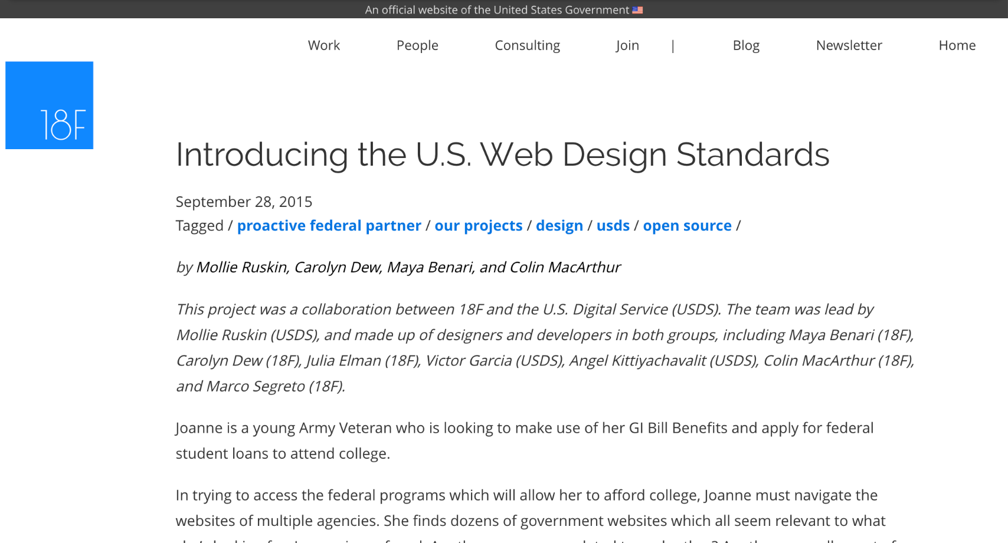
Hello world.
We introduce ourselves for the first time.

Slide 15
“Is it possible to create a shared set of tools to provide consistent, beautiful, and easy-to-use government websites?”

Slide 16
Our first design principles
Make the best thing the easiest thing.
Be accessible out of the box.
Design for flexibility.
Reuse, reuse, reuse.

Slide 17
January 2018
The standards becomes the design system

Slide 18
December 2018
21st Century Integrated Digital Experience Act

Slide 19
January 2020
New website standards

Slide 20
We needed a mission and vision.
But why?

Slide 21
Our mission and vision was meant to give us stability through all this change

Slide 22
USWDS Mission 2020
USWDS is a design system for the federal government. We make it easier to build accessible, mobile-friendly government websites.

Slide 23
USWDS Vision 2020
We envision empowered agency digital teams who share solutions and
use effective human-centered
design practices.

Slide 24
Did we do it?

Slide 25
Is this still the whole story?

Slide 26
Does it still express our
values and value?

Slide 27
Does it help guide our decisions?

Slide 28
Does it still inspire?

Slide 29
Yes and no.

Slide 30
Commonality

Slide 31
Value over time

Slide 32
The design system should deliver value over the lifetime of a service.

Slide 33
Easier to update

Slide 34
Easier to get new improvements

Slide 35
Easier to change

Slide 36
Easier to stay up to date

Slide 37
The biggest value comes after the service is launched

Slide 38
And we’re in it for the long term

Slide 39
What will the future look like?

Slide 40
Together, we will shape it

Slide 41
Common things

Slide 42
Familiar, easy-to-use government services

Slide 43
We had an opportunity to take a fresh look

Slide 44
We did.

Slide 45
Our approach

Slide 46
Shared definitions

Slide 47

The process felt like this sometimes

Slide 48
Mission

Slide 49
Make it short.

Slide 50
Vision

Slide 51
Polestar

Slide 52
Jargon and clarity

Slide 53
Would anyone you just met understand?

Slide 54
Does it sound like us?

Slide 55
Be real

Slide 56
Does it sound like only us?

Slide 57
Be specific

Slide 58
Is there a shelf-life?

Slide 59
Avoid specific technologies

Slide 60
Some exact words or phrases we wanted to avoid
Playbook
Template
Standards
Sustainable
Code
Mobile
Continuous improvement Universal design
Design system
Agile

Slide 61
Who? What? How? Why?

Slide 62
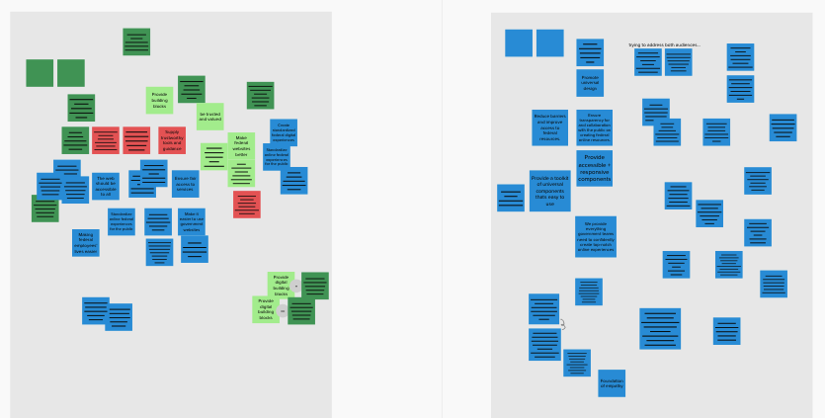
A field of virtual sticky notes

Slide 63
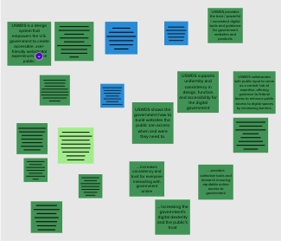
A field of fewer virtual sticky notes

Slide 64
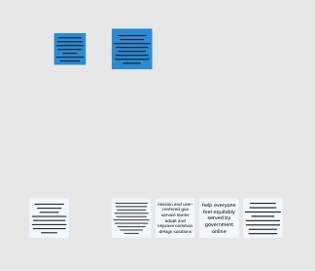
A field of even fewer virtual sticky notes

Slide 65
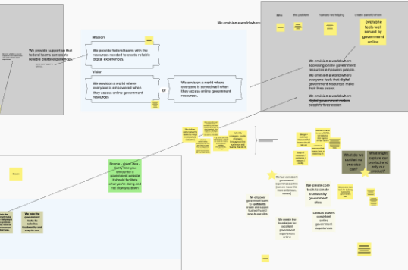
A field of arrows and boxes and also virtual sticky notes

Slide 66
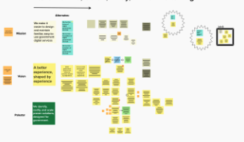
A field of virtual sticky notes, plus labels and frames around some notes

Slide 67
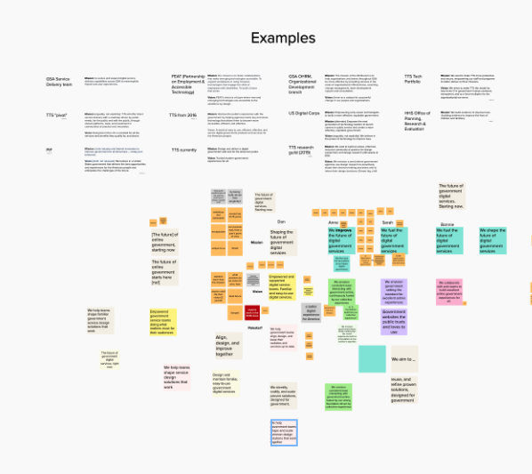
A section labeled “examples” with many differently colored sticky notes below

Slide 68
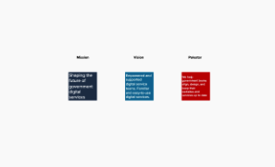
Three colored stickies with labels, still unreadable

Slide 69
What did we find?

Slide 70
Who are we?

Slide 71
Some words that express who we are
Design
System
Product
Government
Standards
Community
Resource
Reference
Product
Styleguide
Open
Library
Service
Template
Model

Slide 72
Our identity
The design system for the federal government

Slide 73
“The”

Slide 74
The only government design
system developed for use
across the entire federal government

Slide 75
Why do we exist?

Slide 76
Some action words that express what we do
Design
Guide
Teach
Connect
Improve
Coordinate
Align
Shape
Make
Accelerate
Adopt
Fuel
Maintain
Update
Define

Slide 77
Some descriptive words that express how we want to be
Honest
Open
Consistent
Responsive
Reliable
Clear
Thoughtful
Curious
Trustworthy
Straightforward
Humane
Fair
Effective
Bold

Slide 78
Not just our team but our community

Slide 79
Bit by bit.
Improvement by improvement.

Slide 80
Our mission
Shaping the future of government digital services

Slide 81
What’s in that future?

Slide 82
Some descriptive words that describe our best future
Empowered
Centered
Familiar
Reliable
Collaborative
Simple
Trustworthy
Supported
Easy-to-use
Integrated
Equitable
Open
Common
Valuable
Better

Slide 83
“Development isn’t a collection of things, it’s a process that yields things.”

Slide 84
Not sustainable without people and process

Slide 85
Not sustainable without hard work and support

Slide 86
Not sustainable without new change and creativity

Slide 87
Our vision
Empowered and supported
digital service teams. Familiar and easy-to-use digital services.

Slide 88
What are we doing?

Slide 89
Some action words that describe our activities
Help
Teach
Support
Test
Validate
Simplify
Develop
Design
Identify
Publish
Maintain
Research
Update
Improve
Refine

Slide 90
And what do we help teams do?
Design
Build
Maintain
Contribute
Grow
Change
Explore
Listen
Research
Communicate
Align
Save
Refine
Optimize
Update

Slide 91
Our polestar
We help government teams align, design, and keep their websites and services up to date

Slide 92
The work before and after the work

Slide 93
USWDS mission, vision, and polestar
Mission
Shaping the future of government digital services
Vision
Empowered and supported digital service teams. Familiar and easy-to-use digital services.
Polestar
We help government teams align, design, and keep their websites and services up to date

Slide 94
What happened to [blank] ?

Slide 95
What’s next?

Slide 96
Thank you.

Slide 97
Onward

Slide 98
Q&A

Slide 99
Next month
October: Product values and new component proposals
#uswds-public
github.com/uswds
designsystem.digital.gov

