Slide 1

USWDS Monthly Call
October 2024

Slide 2

Hi!
Thanks for being here!

Slide 3
Agenda
Featured sites
Product updates
Product and engineering values
Q&A

Slide 4
Featured sites

Slide 5
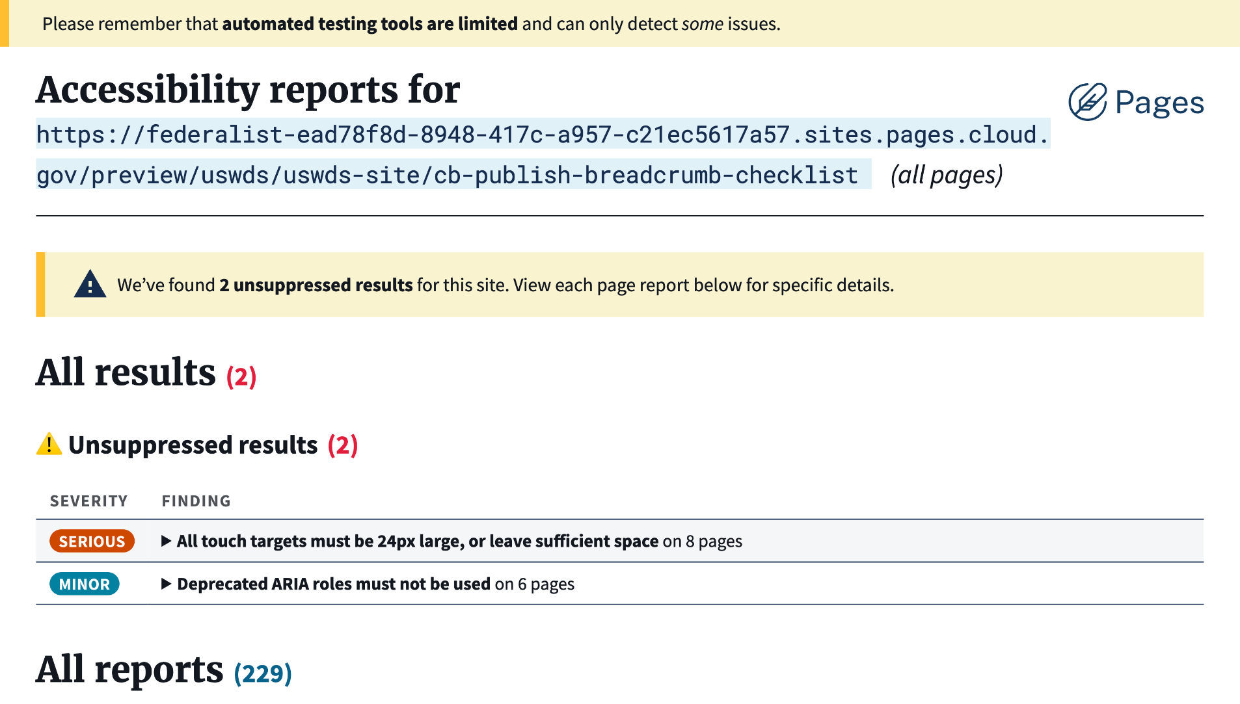
Cloud.gov Pages Automated Accessibility Scans
pages.cloud.gov
Notes:
TK

Slide 6
Great work!

Slide 7
Product updates

Slide 8
USWDS 3.9.0
Out now!

Slide 9
Moving to regular monthly release cycles
Release every month, based on what's ready

Slide 10
On-deck for November release:
A fix for an inconsistency in the internal JavaScript for Modal
An update to the styling of row headers in the Table component to match those for column headers
Simplified screen reader instructions in Combo box and Time picker.
And probably more…

Slide 11
New accessibility test pages
Breadcrumb, Pagination, In-page navigation, Side navigation
Next: Time picker, File input, Memorable date

Slide 12
Public discussions
New component proposals: CUI banner, Heatmap, Toast
New pattern proposals: Pre-filled form
New discussions: Mobile design system
Accessibility: Going beyond visual design
Q&A: September monthly call

Slide 13
Web components
Now available: web-components 0.0.1-alpha: Banner Beta 1, Link Beta 1
In development: Banner Beta 2, Link Beta 2, Identifier Beta 1, Input Pre-Alpha, Card Pre-Alpha
And a stencil.js sandbox for compatibility testing

Slide 14
Sunsetting v1 documentation site
Decommissioning at the end of 2024

Slide 15
Product and engineering values

Slide 16
Matt Henry
he/him
Engineering Lead USWDS

Slide 17
Anne Petersen
they/them
Experience Design Lead USWDS

Slide 18
Why values?

Slide 19
USWDS just turned nine

Slide 20
September 28, 2015

Slide 21
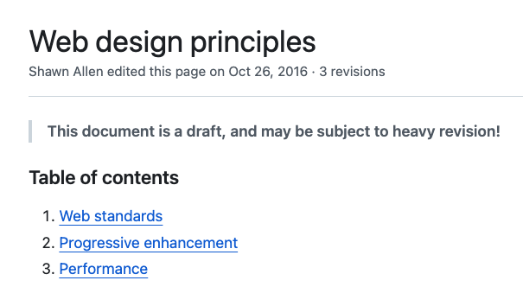
Our first design principles

Slide 22
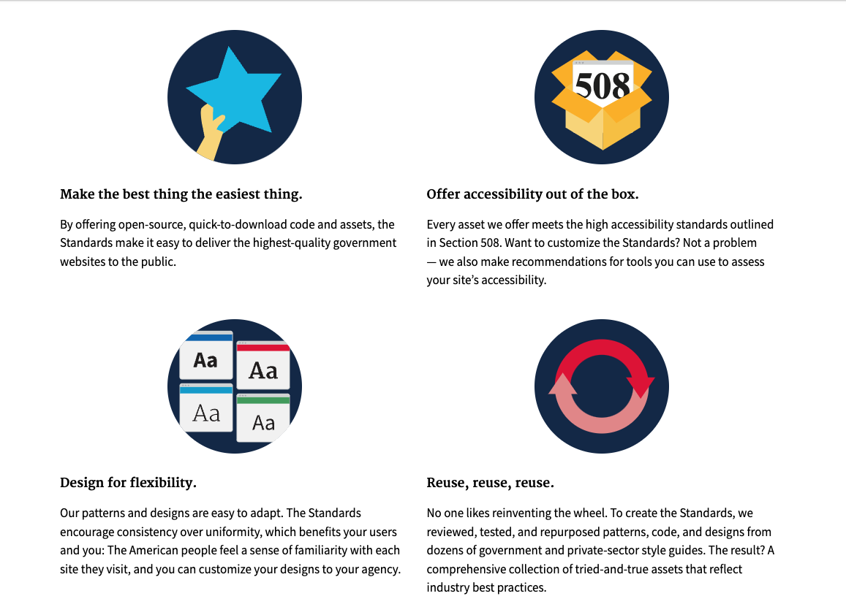
Our next design principles (1)

Slide 23
Our next design principles (2)
Make the best thing the easiest thing.
Be accessible out of the box.
Design for flexibility.
Reuse, reuse, reuse.

Slide 24
Our current design principles
Our current design principles
Start with real user needs.
Earn trust.
Embrace accessibility.
Promote continuity.
Listen.

Slide 25
Our current design principles (2)
Our current design principles
… are for everything that uses USWDS

Slide 26
Our current design principles (3)
Our current design principles

Slide 27
But what about USWDS itself?
But… what about USWDS itself?

Slide 28
How do we make USWDS-specific decisions
How do we make USWDS-specific decisions?

Slide 29
To serve the public. To support you.

Slide 30
September 2023
new mission, vision, polestar

Slide 31
Mission, Vision, Polestar
Mission
Statement of purpose; the why
Vision
What problems do we want to solve, for who?
Polestar
How do we work to get there?

Slide 32
Our mission
Shaping the future of government digital services

Slide 33
Our vision
Empowered and supported
digital service teams. Familiar and easy-to-use digital services.

Slide 34
Our polestar
We help government teams align, design, and keep their websites and services up to date

Slide 35
We have to make decisions

Slide 36
How?

Slide 37
Building on research with the public

Slide 38
Building on research with you

Slide 39
Building on current technological developments

Slide 40
Building on expectations

Slide 41
Multiple reasonable options

Slide 42
Decide based on the information available

Slide 43
Decide based on the values that guide us

Slide 44
Other teams may make different decisions

Slide 45
And that’s totally reasonable

Slide 46
Our context is different

Slide 47
USWDS is foundational*
*beneath all else; “the lowest load-bearing part of a building, typically below ground level”

Slide 48
These decisions are hard*
*all else depends on it

Slide 49
Product values

Slide 50
Service principles are for everyone…

Slide 51
…how do we work in the
service of these principles?

Slide 52
Our current product values
Put user needs first.
Make it easy to do the right thing.
Accessibility is fundamental.
Start from existing solutions.
Be consistent, not static.
Share what we do.

Slide 53
A kind of nervous system

Slide 54
USWDS Product Values
Compliance is the baseline.
Design is adaptation.
Strengthen connections.
Easier earlier.
Be a good steward.

Slide 55
USWDS Product Value
Design is adaptation.

Slide 56
Design is adaptation.
Build for building.
Work from existing solutions.
Be consistent, not static.
Support design.

Slide 57
We favor choices that help discover new solutions.

Slide 58
USWDS Product Value
Compliance is the baseline.

Slide 59
Compliance is the baseline.
Government focus, government responsibility.
Start with compliance, but go further.
Strengthen and shape best practices.
Support mission focus.

Slide 60
We favor choices that help teams meet and exceed requirements.

Slide 61
USWDS Product Value
Strengthen connections.

Slide 62
Strengthen connections.
Develop a working language.
Lower the barriers to contribution.
Work in the open.
Meet teams where they are.
Support reusability.

Slide 63
We favor choices that improve communication.

Slide 64
USWDS Product Value
Easier earlier.

Slide 65
Easier earlier.
Flatten the learning curve.
Provide good defaults.
Add complexity later.
Support the next step.

Slide 66
We favor choices that enable the beginner.

Slide 67
USWDS Product Value
Be a good steward.

Slide 68
Be a good steward.
We’re here for the long haul.
Make the case.
Collect and scale expertise.
Support the process.

Slide 69
We favor choices that take a long-term perspective.

Slide 70
Engineering values

Slide 71
The grain of the web

Slide 72
What does it mean to build with the grain of the web?

Slide 73
HTML Content
CSS Appearance
JavaScript Behaviors

Slide 74
Embrace a lack of control

Slide 75
Conventions, norms, and expectations

Slide 76
But why?

Slide 77
Resilience

Slide 78
Fail gracefully

Slide 79
JavaScript can trade resilience for power

Slide 80
Performance

Slide 81
“Get this documen-”
“Here it is!”

Slide 82
The critical path

Slide 83
JavaScript can trade performance for power

Slide 84
Speed is a best-case scenario

Slide 85
Accessibility

Slide 86
Semantic HTML is the foundation of good accessibility

Slide 87
Enter ARIA

Slide 88
With great ARIA comes great responsibility

Slide 89
JavaScript can trade accessibility for power

Slide 90
What, in practical terms, does this mean?

Slide 91
USWDS Engineering Values
Embrace the platform.
Support UX with developer experience.
We’re a layer.
Write plain-language code.

Slide 92
USWDS Engineering Value
Embrace the platform.

Slide 93
Embrace the platform.
Help the platform do its job.
Use progressive enhancement.
Avoid lock-in.
Support open standards.

Slide 94
We favor choices that work with the grain of the web.

Slide 95
USWDS Engineering Value
Support UX with developer experience.

Slide 96
Support UX with developer experience.
User experience shapes the tools.
Performance matters.
Make accessibility easier, not invisible.
Support repairability.

Slide 97
We favor choices that prioritize the end user experience.

Slide 98
USWDS Engineering Value
We’re a layer.

Slide 99
We’re a layer.
Be a dependency not a fork.
Our opinions cascade.
Use semantic versioning.
Support different tech stacks.

Slide 100
We favor choices that are thoughtful about our impact.

Slide 101
USWDS Engineering Value
Write plain-language code.

Slide 102
Write plain-language code.
Write for reading.
Embrace the idiom.
Documentation first.
Support other developers.

Slide 103
We favor choices that open our code to more contributors.

Slide 104
What’s next?

Slide 105
We gotta be practical.

Slide 106
Where we’re coming from can tell you where we’re going.

Slide 107
The future looks interesting.

Slide 108
Q&A
Notes:
DW

Slide 109
Next month
November: The next generation of USWDS
#uswds-public
github.com/uswds
designsystem.digital.gov

