Slide 1

USWDS Monthly Call
August 2024

Slide 2

Hi!
Thanks for being here!

Slide 3
Agenda
Product updates
Community questions
Design Kit
Web Components beta
Q&A

Slide 4
Featured sites

Slide 5
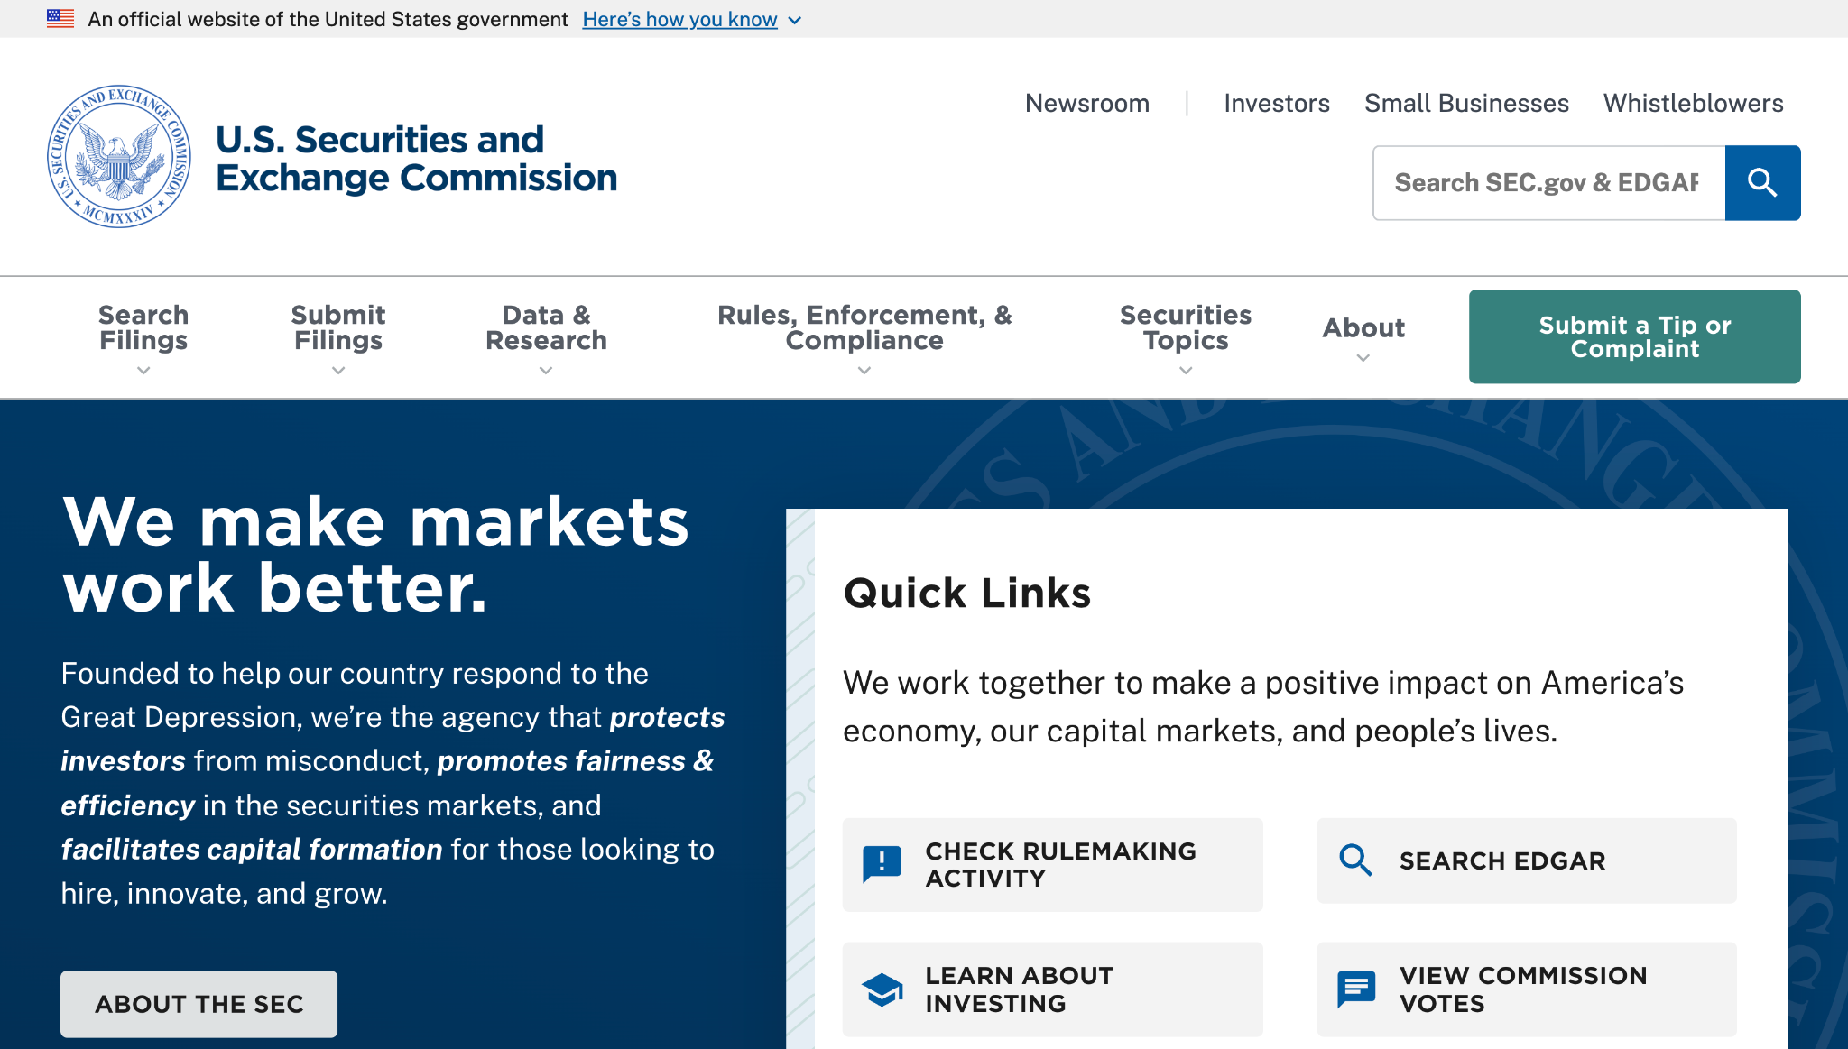
U.S. Securities and Exchange Commission
sec.gov

Slide 6
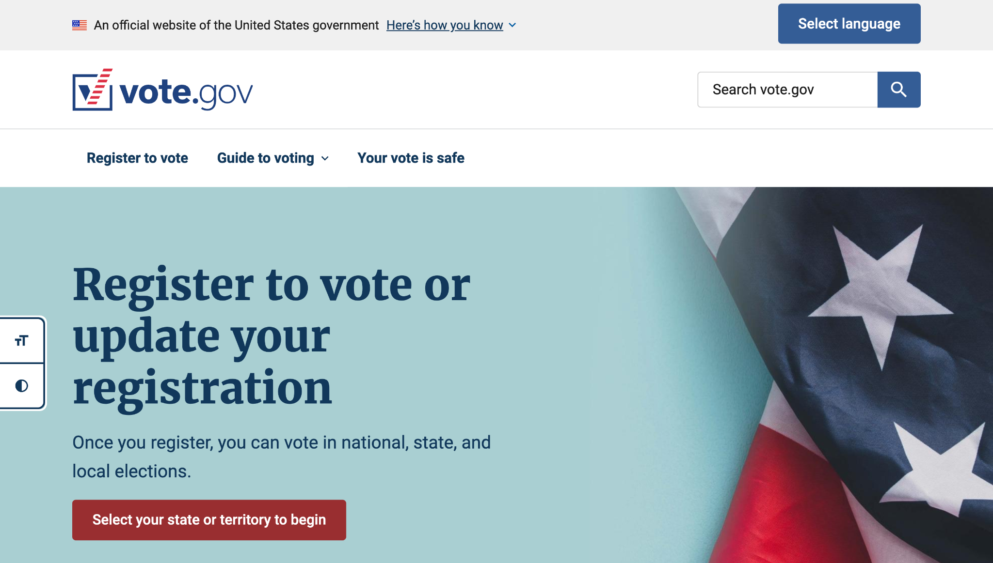
Vote.gov
vote.gov

Slide 7
Great work!

Slide 8
Product updates

Slide 9
USWDS 3.8.2
Out now

Slide 10
Addresses a non-exploitable vulnerability

Slide 11
USWDS Compile 1.2.0
Coming next week

Slide 12
USWDS 3.9.0
Coming soon

Slide 13
Key improvements in USWDS 3.9.0
Fixes a tab order bug in the mobile header
Fixes a keyboard/mouse interaction issue in date picker
Improves performance of input mask
Improves legibility of pagination links
Adds ability to add a custom breakpoint to utilities

Slide 14
USWDS 3.9.0
Available by the end of August

Slide 15
New accessibility test pages
Identifier, Footer, Header, List
Next: Checkbox, Radio button, Combo box

Slide 16
Anne Petersen
they/them
Experience Design Lead USWDS

Slide 17
Usability research updates
Latest “Zebra” round findings
Survey: tell us about yourself and your team

Slide 18
Public discussions
New component: Step indicator track-status variant
New component: Step indicator vertical variant
Continued new component: Tabs
Progress on new component: Glossary (more later)
Accessibility: Proving visitors’ humanness
Q&A: June monthly call

Slide 19
Component proposals

Slide 20
👂
Updates on component proposals

Slide 21
💡
Is this a good addition?

Slide 22
📖
Let’s do the research.

Slide 23
❔
Guiding questions

Slide 24
Support

Slide 25
WCAG requirement? Level? Clear purpose? User need? Existing solution in USWDS?

Slide 26
Lack of support

Slide 27
Do benefits outweigh risks? Is it needed? Is it being used elsewhere?

Slide 28
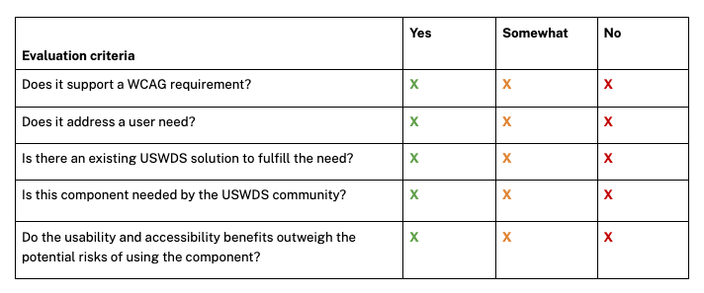
A sample evaluation criteria table

Slide 29
💍
Commitment

Slide 30
Public discussion (part two)
New component: Step indicator track-status variant
New component: Step indicator vertical variant
Continued new component: Tabs
Progress on new component: Glossary
Accessibility: Proving visitors’ humanness
Q&A: June monthly call

Slide 31

Conditionally approved!
Glossary

Slide 32
New!
(The process is still part of the product…)

Slide 33
👂
Other questions

Slide 34
New design kit
Beta version of Figma assets
All references to specific brands, products, and/or companies are used only for illustrative purposes and do not imply endorsement by the U.S. federal government or any federal government agency.

Slide 35
Demo (Design Kit)

Slide 36

USWDS Beta Design Kit
Design tokens as variables
Attribute-powered components
Mode-based fonts and themes
Extensive examples and guidance
More to come!

Slide 37
USWDS Web Components Beta

Slide 38
What makes a Beta release?
Our release maturity model

Slide 39
How do I get involved in the Beta?
Documentation and communication

Slide 40
Amy Leadem
she/her
Engineer USWDS Contractor

Slide 41
Matt Henry
he/him
Engineering Lead USWDS

Slide 42
Demo (Web Components)

Slide 43
Follow our work
github.com/uswds/ web-components

Slide 44
What’s next?
Button, Accordion, Card, Text Input, Modal

Slide 45
Fall 2024
A dozen components in a stable Beta

Slide 46
Onward

Slide 47
Q&A

Slide 48
Next month
September: Web Component performance
#uswds-public
github.com/uswds
designsystem.digital.gov

