Slide 1
Federal User Experience Survey: 2014
Conducted by:
Jonathan Rubin, GSA User Experience Program
Jean Fox, Bureau of Labor Statistics

Slide 2
Federal User Experience Survey
Done on behalf of Federal UX community
Conducted August + Sept 2014
101 respondents; increase from 66 in 2013
Open to Feds + .gov/.mil embed contractors
Anonymous, with agency ID
Here are the results from the 2013 Survey
Notes:
next year - big promote around it

Slide 3
UX Survey: Goals
Customer Research
Grow UX community
Identify training needs
Locate UX labs and determine needs
Locate leaders and partners
Share aggregate results

Slide 4
What fed agency do you work in?
Responses from 35 agencies
Most responses (4+) from GSA, HHS, OPM, Commerce
Also: NASA, LOC, Armed Forces, NARA, SSA, USPS, etc.
Notes:
Full list:
Administrative Conference of the United States (ACUS)
American Battle Monument Commission (ABMC)
Broadcasting Board of Governors
Consumer Product Safety Commission (CPSC)
Department of Agriculture (USDA)
Department of Commerce (DOC)
Department of Commerce (DOC)
Department of Defense (DOD)
Department of Education (ED)
Department of Energy (DOE)
Department of Health and Human Services (HHS)
Department of Homeland Security (DHS)
Department of Labor (DOL)
Department of State (DOS)
Department of the Interior (DOI)
Department of the Treasury (TREAS)
Department of Transportation (DOT)
Department of Veterans Affairs (VA)
Environmental Protection Agency (EPA)
Federal Communication Commission (FCC)
Federal Reserve System
Federal Trade Commission (FTC)
General Services Administration (GSA)
Government Accountability Office (GAO)
Government Printing Office (GPO)
Library of Congress
National Aeronautics and Space Administration (NASA)
National Archives and Records Administration (NARA)
National Credit Union Administration (NCUA)
Office of Personnel Management (OPM)
Peace Corps
Social Security Administration (SSA)
U.S. Census Bureau
U.S. Postal Service (USPS)

Slide 5
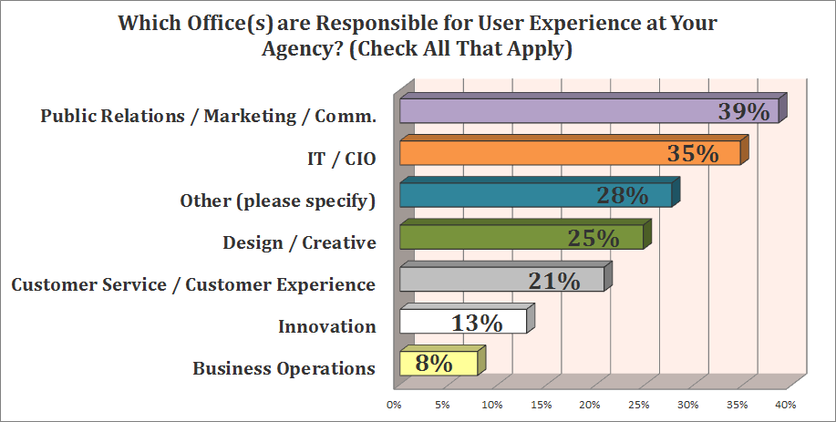
Notes:
Other answers:
program offices
Center for Survey Measurement
Comms
Research
Applications Systems Development
Online services
Customer Engagement and Communications
Health Informatics

Slide 6
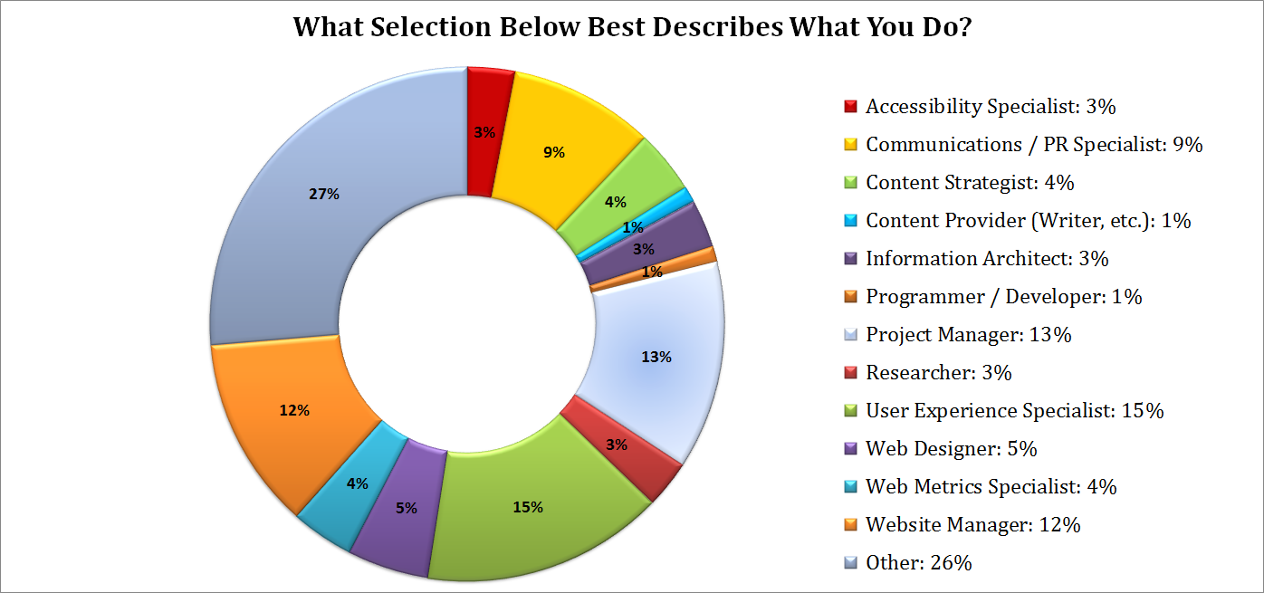
Other
UX
Notes:
“Other” Answers:
Marketing
Everything
Deputy Director, Digital Communications Division
Policy analyst
Content Manager
Project Manager
All of the above
Used to be in IT (Collaboration Services Manager)
Manager of web and mobile application development
I fulfill multiple of the functions on my team on a daily basis.
web design and HTML coding
I advise and basically oversee the darn thing
Manager with oversight of an internal web site
Human Resources
Couldn't check one because I fill several of these roles -- Content Strategist, Provider, Project Manger, UX, Metrics, Website Manager -- we don't have separate jobs for those here.
Program Analyst (and designer)
web content editor and management
508 Coordinator
Contracting Officer - Reverse Auction and BPAs
UXD
Human-Centered Design Instructor and Project Manager as well as Operation Manager for The Lab
Content Strategist/Editor/User Experience Specialist
Product Manager and Design
Content Strategist/UX Specialist
Graphic Design (web & other)
IT Trainer
Program Manager
Senior IT leader
Statistician / Survey Methodologist
Webmaster

Slide 7
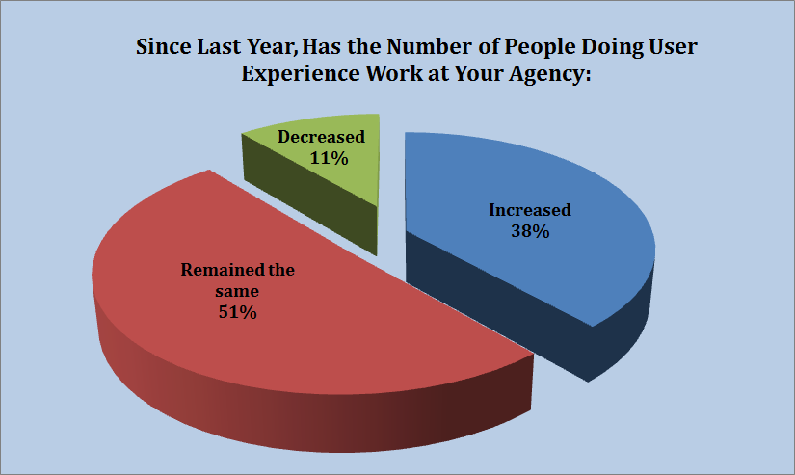

Slide 8
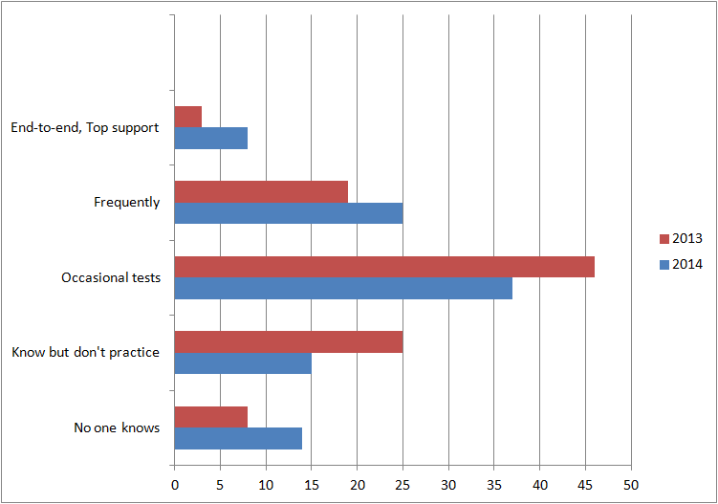
How widespread is UX at your agency? - 2014
Notes:
here’s what it looks like in 2014

Slide 9
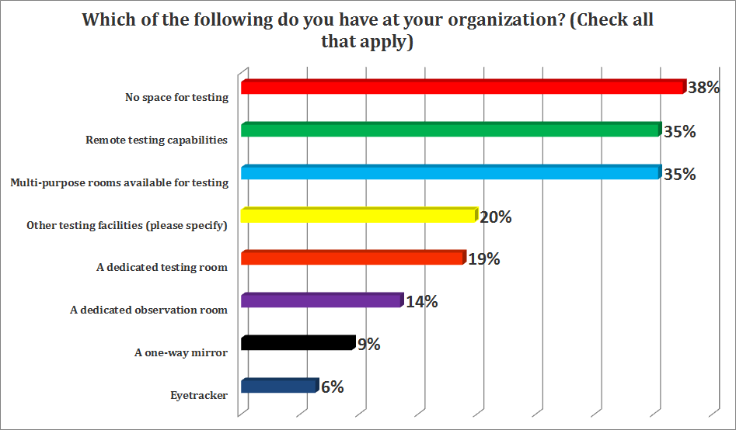

Slide 10
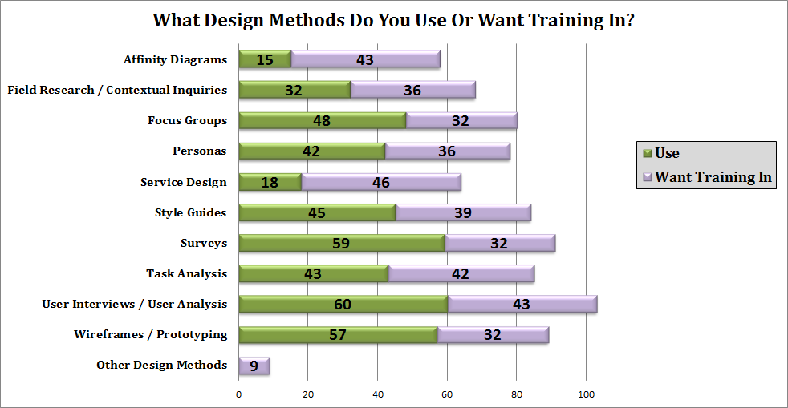
Notes:
“Other” Answers:
UX conferences, Responsive Design, Incorporating UCD into Agile, UCD contract writeup, management and oversight, UCD people management
Agile Method
open to anything
Human Centered Design -
Educating client stakeholders on value of UX and the difference between UX design and software development roles
Mixed methods that combine research methods accross different disciplines such as outcome evaluations from the field of evaluation with UX..

Slide 11
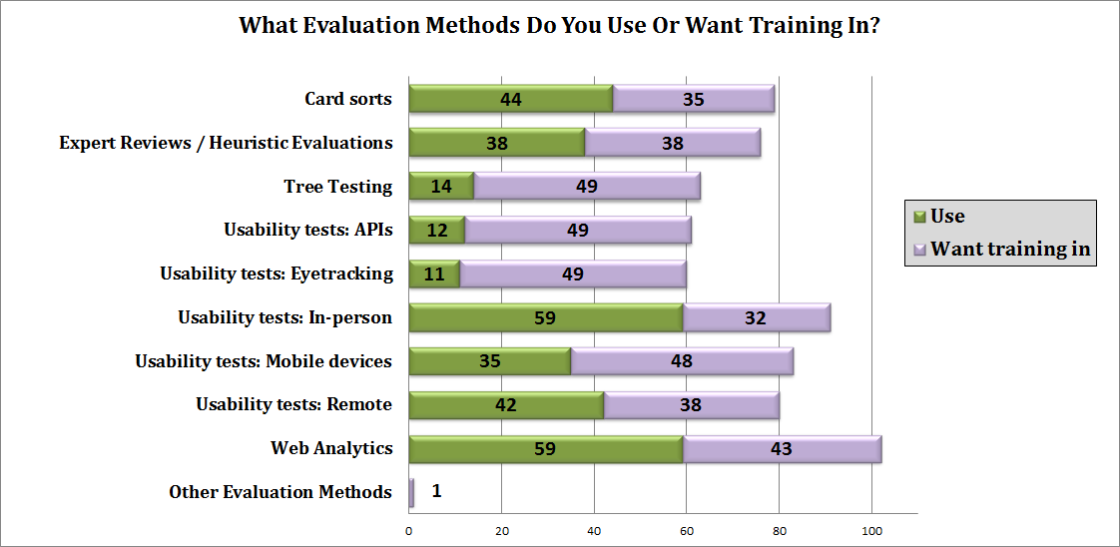

Slide 12
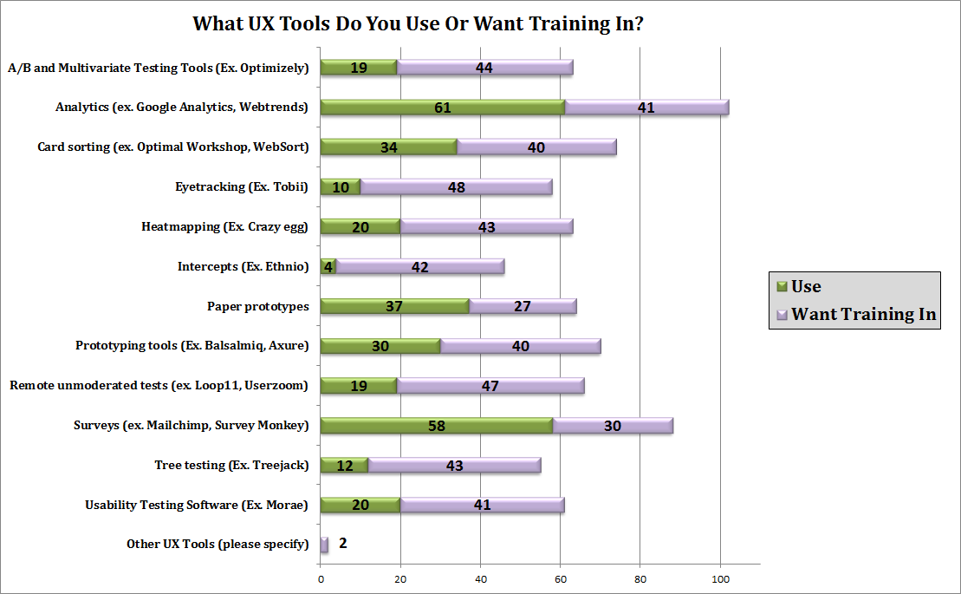

Slide 13
Training Needs: Summary
UX Strategy & Management | UX Design methods | UX Evaluation | UX Tools
UX awareness | Customer Experience / Service Design | A/ B testing | Eyetracking
Integrating UX into production cycle | Journey mapping | API Usability | Prototyping
Institutionalizing UX / top-level support | Contextual research / User interviews | Mobile testing | Card sorting
Agile | Prototyping | Tree / IA Testing | Online testing tools
Paperwork Reduction Act (PRA) |  | Usability testing | Screensharing

Slide 14
How can we help your mission?
Create reference documents and templates
Offer web-based and Classroom training
Provide access to usability lab
Help peer review systems
Support UX tests via trained UX staff
Create Materials to help them “sell” UX

Slide 15

What are the biggest obstacles to improving UX at your agency? (Check all that apply)
Limited staff resources: 77%
Lack of awareness about UX: 44%
Lack of support from management: 34%
Belief that UX methods take too long: 28%
Don’t know how to do UX work: 26%
Belief that UX methods are not valid: 10%
Other: 20%
Notes:
Last year’s responses:
71% - No resources
61% - No time
58% - UX not built into production cycle
53% - Difficulty showing UX ROI
35% - People aren’t aware of UX
4% - Tried UX and failed

Slide 16
What are the biggest obstacles to improving UX at your agency?
Other: 20%
  For surveys, limited by paperwork reduction act
  Lack of formal integration into Waterfall and Agile
  Constant confusion/argument between IT and Communications (it lies with them, no it lies with us...end up leaving out capabilities entirely)
  Clearance process
  Lack of time and training (7 responses)

Slide 17
What methods are effective at promoting UX at your agency?
(Check all that apply)
Getting UX into the agency’s standard development process: 63%
Discussing UX during team meetings: 56%
Promoting UX Success Stories: 51%
Providing training on user experience: 51%
Discussing user experience during informal conversations: 47%

Slide 18
What methods are effective at promoting UX at your agency?
(Check all that apply)
Working with a senior-level user experience “champion”: 45%
Marketing UX within your agency (presentations, lobby displays, email blasts, etc.): 35%
Other: 9%
  Management is not interested, they're afraid of what the results may show
  We do this to a limited degree with our own agile 'codeathons’
  Data showing improved performance

Slide 19
Additional Comments & Suggestions
The biggest problem in this agency is that UX isn't understood.
Consider expanding UX for multilingual platforms
I would love to use this information to map out this growing community and create resources that would help us better access each other
Peer review and best practice documents
Promote standard position descriptions for UX to management and HR.

Slide 20
Summary: Federal UX community
UX “owned” by different departments
UX duties + titles vary
Size of UX teams range from 0 to 20
UX sphere is growing - resources, staff, expertise
There are 8 UX labs in the greater DC area - HHS, Census, National Cancer Institute, Bureau of Labor Statistics, National Institute of Standards and Technology, Office of Personnel Management, U.S. Patent and Trade Office, Social Security

Slide 21
Summary: UX community needs
No testing space
Need help getting managers to buy into UX
Help with Paperwork Reduction Act (PRA)
Help integrating UX into project plan
Create templates to help people get started
Help UX labs with new techniques and tools
Provide web-based training to people outside DC
Training needs: Agile, 508, interviews, CX, service design, mobile, IA testing, and lots more

