Slide 1

USWDS Monthly Call
December 2024

Slide 2

Hi!
Thanks for being here!

Slide 3
Agenda
Product updates
USWDS & FWS
Q&A

Slide 4
Product updates

Slide 5
USWDS 3.11.0
Out now!

Slide 6
Notable updates in USWDS 3.11.0
Added more consistent table headers. Now any <th> element will get proper header styling, not just column headers.
Fixed display of focus outlines in the identifier. Now focus outlines don’t get clipped.
Added a more modern CSS reset. We’ve left IE11 behind with a simpler CSS reset.

Slide 7
USWDS Compile 1.2.1
Out now!

Slide 8
New accessibility test pages
Process list
Summary box
Collection
Icon list
Button group
Next: Date picker, Date range picker, Alert, Site alert

Slide 9
USWDS for Figma
New Beta with better layer naming

Slide 10
Public discussions
Active discussions: Providing support for user preferences
Accessibility: HTML titles and accessibility
Q&A: November monthly call

Slide 11
Component and pattern proposals
Tabs component: Will proceed
Prefill information pattern: Will proceed
Toast component: Will not proceed

Slide 12
USWDS Elements Beta
Interop progress!

Slide 13
USWDS and the Federal Website Standards

Slide 14
Renata Phillippi
she/her
Program Lead Federal Website Standards

Slide 15
Federal website standards

Slide 16
What we’ll discuss
Background
Pilot
Standards

Slide 17
Standards background

Slide 18
1.75 billion
web sessions per month

Slide 19
80 million
hours of interactions with the public

Slide 20
57%
traffic from mobile

Slide 21
60%
of federal websites are not accessible to all people

Slide 22
45%
of federal websites are not mobile friendly

Slide 23
2%
of federal government forms have been digitized for the web

Slide 24
Enter 21st Century IDEA (1 of 2)
What is it? It’s a law passed in 2018 that requires that all executive branches of government:
Modernize their public facing websites and digital services
Digitize services and forms
Accelerate use of e-signatures
Improve customer experience
Standardize and transition to centralized shared services

Slide 25
Enter 21st Century IDEA (2 of 2)
What does that mean?
Accessible to people of diverse abilities
Consistent visual design and agency brand identity
Content that is authoritative and easy to understand
Information and services that are discoverable and optimized for search
Secure by design, secure by default
User-centered and data-driven design
Customized and dynamic user experiences
Mobile-first design that scales across varying device sizes

Slide 26
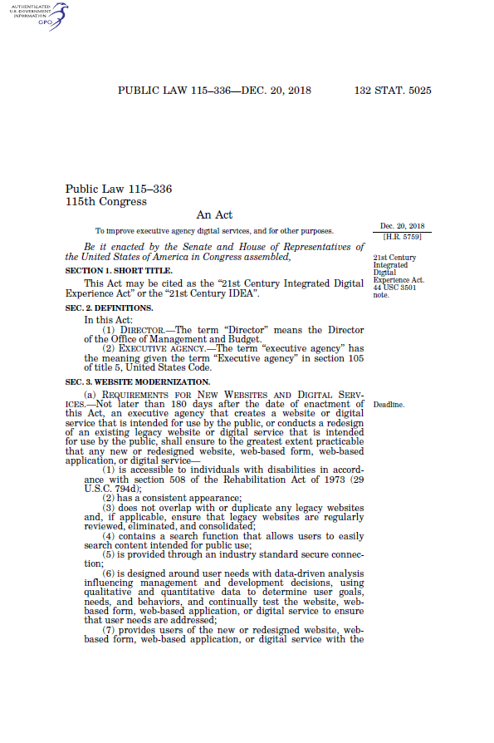
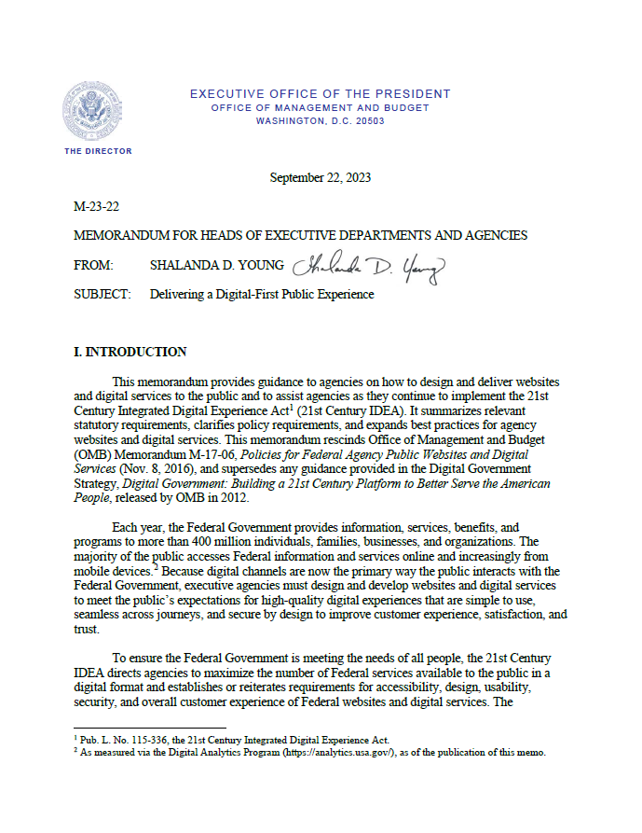
Building on the law with policy guidance
THE LAW
21st Century Integrated Digital Experience Act (2018)
THE POLICY GUIDANCE
M-23-22
Delivering a Digital-First Public Experience
(2023)

Slide 27
The pilot

Slide 28
Propose an initial set of evidence-based, auditable standards that will help agencies meet the public’s expectations for digital experiences
Goal of the pilot

Slide 29
How are we doing that?
Started with a list of about 30 potential standards
Used RICE (Reach, Impact, Confidence, and Effort) scoring to get the list to 8 standards
Asked for agency partners (mix of agency and Digital Council — VA, USAID, SSA, State, Air Force, CMS, DHS, Cloud.gov Pages)
User research with the public and with agencies
Desk research about industry best practices
Build prototypes, test for content and feedback, iterate
Propose a new standards program

Slide 30
Standards

Slide 31
Definition of a standard
Federal website standards are actions that will help agencies meet the public’s evolving expectations for digital experiences. The standards:
Are evidence-based
Are auditable
Lead to a consistent experience

Slide 32
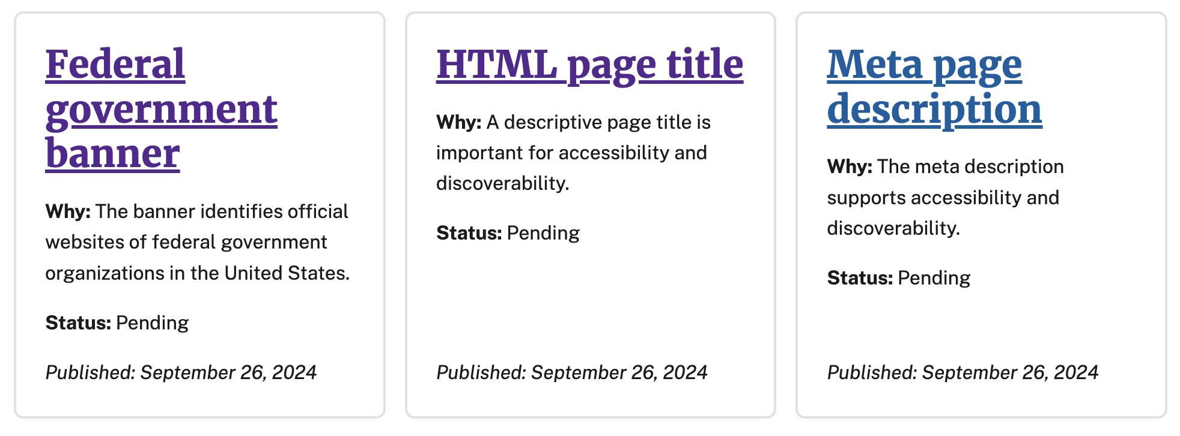
Launch
We launched a website (standards.digital.gov) with 3 standards.

Slide 33
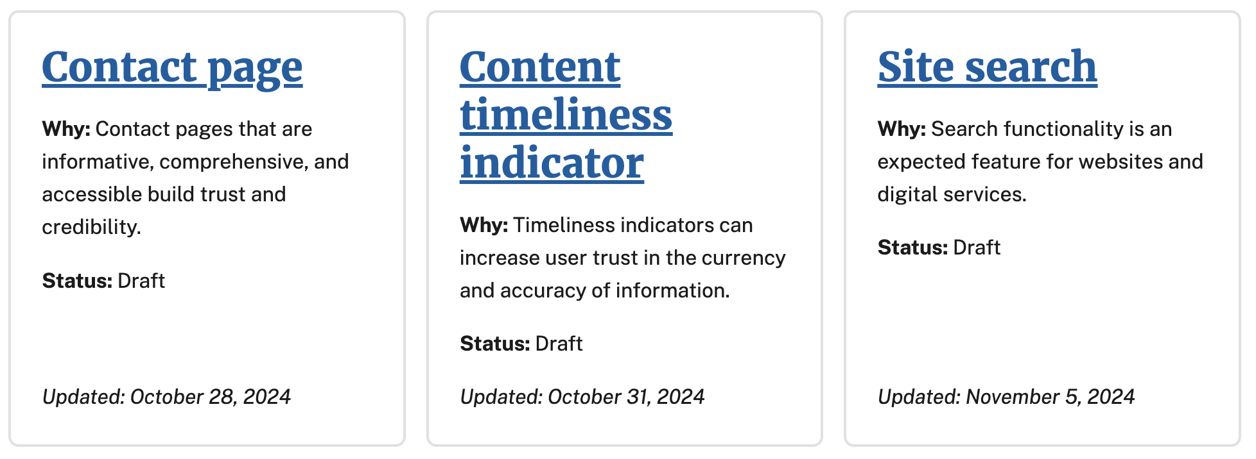
Draft standards
Standards that will become pending standards after a period of review.

Slide 34
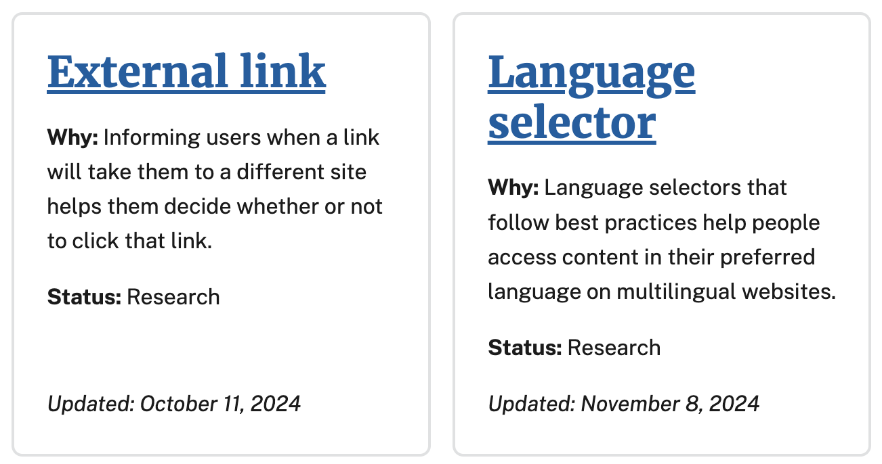
Standards in research
These standards are still being researched and developed.

Slide 35
How to contact the team
Website: standards.digital.gov
GitHub discussions: github.com/GSA-TTS/federal-website-standards/discussions
Email: website.standards@gsa.gov
Office hours may continue to be available in the future

Slide 36
Thank you!

Slide 37
Q&A

Slide 38
Next month
January: New to USWDS? Start here!
#uswds-public
github.com/uswds
designsystem.digital.gov

Slide 39
Disclaimer
All references to specific brands, products, and/or companies are used only for illustrative purposes and do not imply endorsement by the U.S. federal government or any federal government agency.

