Slide 1

User Experience Community of Practice
Cultivating a
dynamic career in UX
Date: September 19, 2023 Time: 2:00 pm, ET
1
Notes:
Alt Text: “Title card graphic for the event has a dark blue background with multi-colored round shapes on the right side. In white text, the first line says, User Experience Community of Practice. The section below has the title of the event in yellow bold text, Cultivating a dynamic career in UX. Below in white text, says Date: September 19, 2023. The next line in white text says, Time: 2:00 pm, ET. In the bottom left corner, is the blue Digital.gov logo which consists of three ribbons joined together in an hexagon to resemble the shape of a capital letter D, followed by the domain and program name in black bold text, Digital.gov.”

Slide 2
Jaime Kern General Services Administration Natalie Buda Smith Library of Congress Special guest Michelle Zager TEI, Department of the Treasury Special guest and moderator Carlos Alvarado Library of Congress
2

Slide 3
What is a dynamic career?
Today’s economy continues to shift from traditional employment patterns towards increasingly dynamic and often ephemeral lifecycles.
A dynamic career is an incremental career path, that responds to change with self-reflection, designed for creativity and growth. An approach for an ever-changing business landscape, with evolving roles and demands.
3

Slide 4
Why is developing a dynamic career important?
Change is certain, prediction that many of the jobs in 2030 are not yet established
We work in the home not from the home, the hybrid workplace is still evolving
Continuous and disruptive technology changes
Economic, cultural, and social change
4

Slide 5

Let’s learn about you: poll question 1
How many career changes have you made?
Same career
One change
Two changes
Three or more
5

Slide 6
Let’s learn about you: poll question 2
What career stage are you in currently?
Undecided on career path
Just starting my career
Establishing my career
Thinking about making a change
Maturing my career
Transitioning out of my career
6

Slide 7
Qualities of a dynamic career Natalie Buda Smith Library of Congress
7

Slide 8
Top job skills for resilience in 2023, according to MIT
Adaptability
With potential disruptive change ahead, pay close attention to trends, and be ready to reinvent yourself professionally. Continue pivoting and enhancing your skill set in relevant areas.
Critical thinking
Critical thinking empowers individuals to become better problem-solvers. Critical thinking is a highly sought-after skill in the workplace. A critical thinker can analyze solutions to a problem, probing its strengths and weaknesses and comparing it to other alternatives. This process of deliberation leads to a selection of good alternatives and also a clear understanding of why a certain choice was made.
Communication
The ability to communicate effectively, whether through data storytelling or good writing and speaking is a well sought out skill set in any industry.
Source: https://www.jwel.mit.edu/
8

Slide 9
Four literacies for a dynamic career in addition to specific technical skill according to MIT
Digital literacy
Financial literacy
Civic and Cultural literacy
Organizational literacy
Source: https://jwel.mit.edu/human-skills-matrix
9

Slide 10
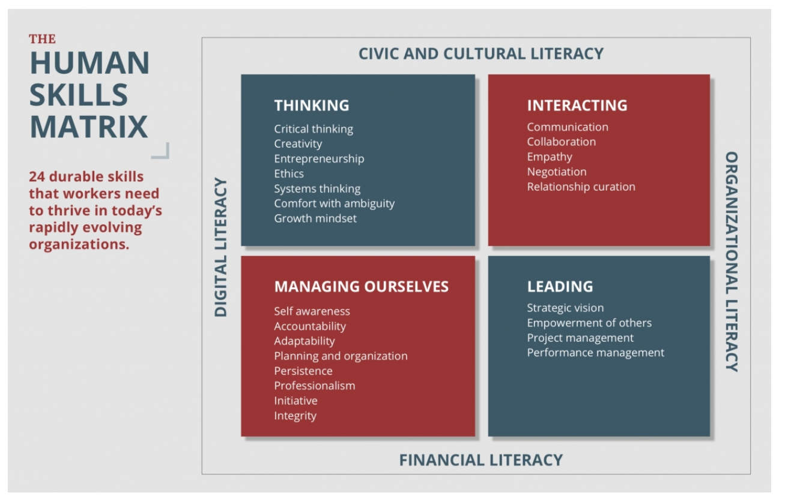
The Human Skills Matrix
10
Source: Diagram from The Human Skills Matrix | MIT J-WEL
https://jwel.mit.edu/human-skills-matrix

Slide 11
Look to the strategic and directional plans for organizational literacy
Annual reports can demonstrate where improvement is needed or expected
Strategic plan goals and objectives demonstrate where investments will be made, or the top priorities
Executive orders and laws such as the 21st Century Integrated Digital Experience Act (21st Century IDEA)
Connect to gaps, goals, and initiatives directly by including in regular work or joining initiatives; or indirectly by gaining and sharing knowledge in those areas
11

Slide 12
Successful habits of a dynamic career
Increase skills and ability to respond to change
Career path design and introspection
Complementary and parallel pursuits, in and out of the workplace
Habitually capture ideas and experiment
View career as a series of initiatives or projects
Continuously seek feedback from peers and managers
Cultivate professional network and a personal brand
12

Slide 13
Special guest Michelle Zager TEI
13

Slide 14
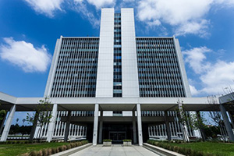
Where the story begins
14

Slide 15
Job crafting
Resources for Adding a “Task”
USA Jobs
External Listings
Your Network
15

Slide 16
Archetypes/personas
Draw from:
Your own experience
Other federal employees doing similar work
Academics
Literature review
Open Opportunities: focus groups, surveys
(https://openopps.usajobs.gov/)
16

Slide 17
Specific considerations for a dynamic career in user experience Carlos Alvarado Library of Congress
17

Slide 18
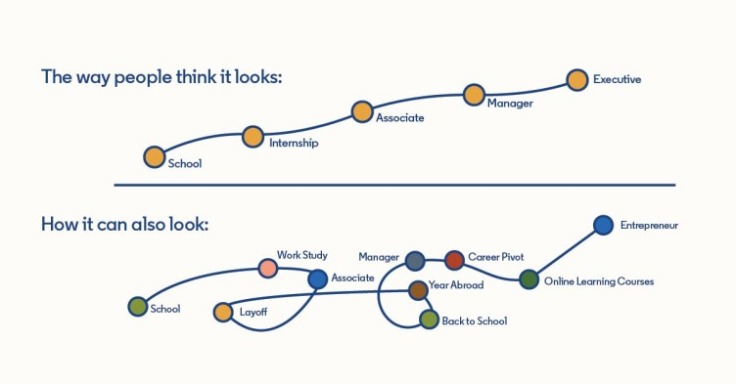
Experiment and push your boundaries
Career paths are rarely linear but there are usually common threads
What interests you at a fundamental level?
Source: Career Paths Are Never as Straightforward as We Believe: Introducing The Path
https://www.linkedin.com/pulse/career-paths-never-straightforward-we-believe-path-ryan-roslansky/
18

Slide 19

Organizational gaps
Often organizational gaps can be a place for professional opportunities
Taking ownership of a project
Career benefits
Organizational benefits
Team benefits
19

Slide 20
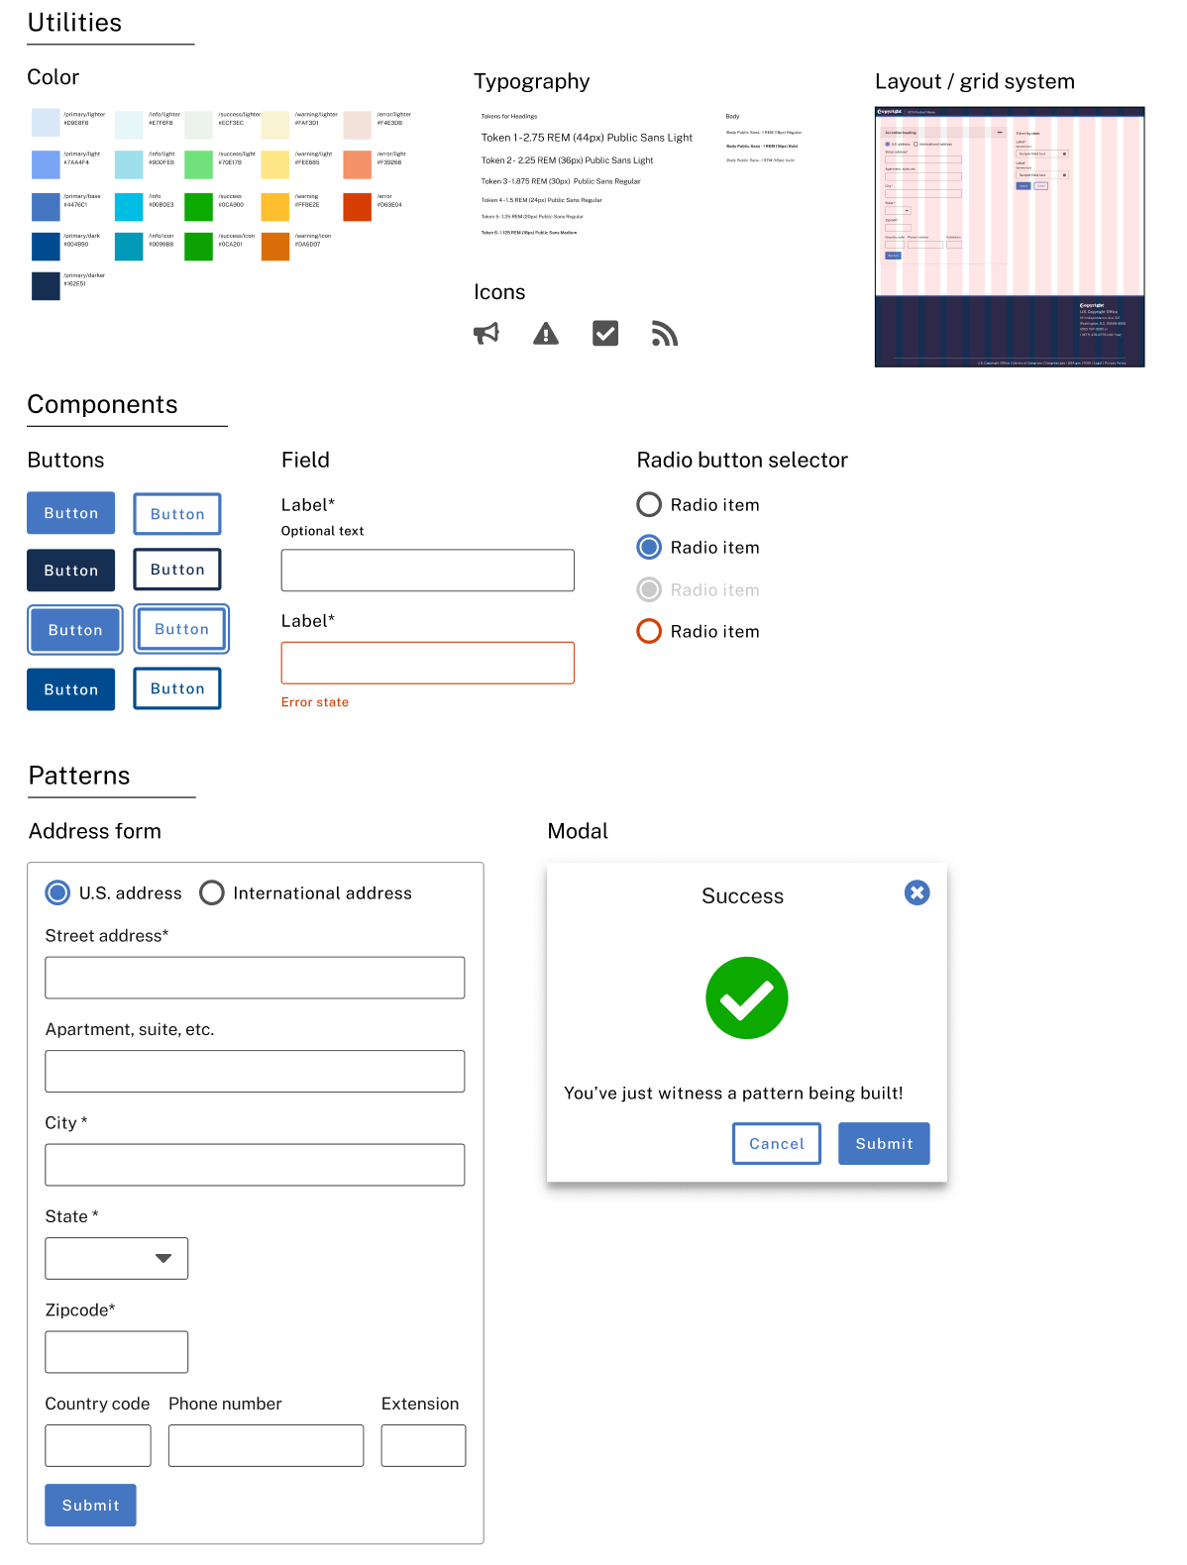
Creating a design system
Identify the organizational gap
Create buy-in and excitement for the initiative
Start solving the problem and bring others along
20

Slide 21
Identify an opportunity
UX research - never led a usability study?
Sit in on one and take notes
No clearly defined UX research practice or design principles in your organization?
Take the initiative
No design system?
Explore the possibilities of building one or leveraging another design system – U.S. Web Design System (https://designsystem.digital.gov/)
21

Slide 22
Federal and professional resources Jaime Kern General Services Administration
22

Slide 23
Resources and communities
Digital.gov
Digital.gov’s Communities of Practice
Many including: Open Data, Robotic Process Automation, Federal Technology Investment Management, Innovation
Open Opportunities on USAJobs
Federal Mentorship and Leadership Program on MAX.gov
Digital.gov LinkedIn groups
Local professional associations
23

Slide 24
Questions? Moderator Carlos Alvarado Library of Congress
24

Slide 25
Thank You
Jaime Kern, UX CoP Co-Lead
Natalie Buda Smith, UX CoP Co-Lead
Michelle Zager, TEI
Carlos Alvarado, Library of Congress
25
Notes:
Presenter's Name
Presenter's Name

