Slide 1

USWDS Monthly Call
March 2024

Slide 2

Hi!
Thanks for being here!

Slide 3
Agenda
Site launches
Product updates
Building with USWDS
Q&A

Slide 4
Site launches

Slide 5
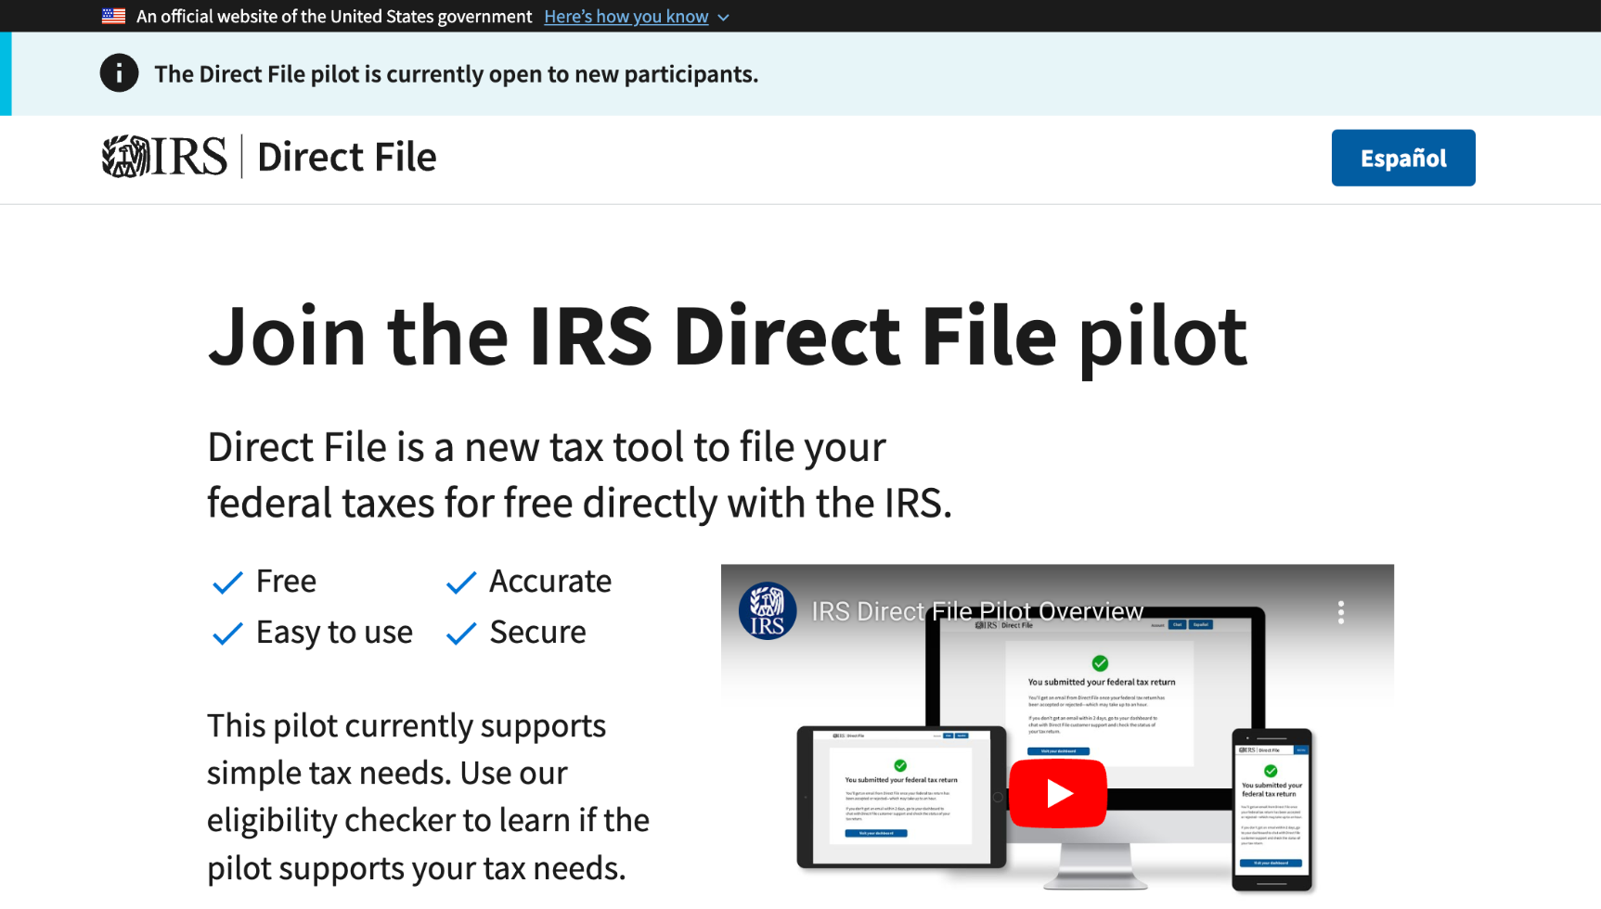
IRS Direct File Pilot
directfile.irs.gov
Notes:
TK

Slide 6
Great work!

Slide 7
Product updates

Slide 8
USWDS 3.8.0
Out now

Slide 9
Component discussions
Common feedback
CUI banner
Glossary
Spinner
Tabs
Toast
Toggle
Quote with attribution
Skipto
Sidebar primary navigation

Slide 10
Accessibility tests
Out now: Icon, Table, Typography
Coming up: Character Count, Prose, Tag, Tooltip

Slide 11
Federal employee? Want to participate in UX research?
designsystem.digital.gov/about/research/recruitment/general-fed

Slide 12
Building with USWDS
Theming, styling, extending

Slide 13
James Mejia
hem/him
Front-end engineer
USWDS Contractor

Slide 14
Charlie Mahoney
he/him
Front-end engineer
USWDS Contractor

Slide 15
What we’ll cover:
Tokens
Theme settings
Functions and mixins
Overrides and customization
Color contrast
Stylesheet structure

Slide 16
Demo

Slide 17
When building with USWDS:
Use USWDS tokens whenever possible
Get familiar with settings
Override Sass with project classes
Build with existing components
Experiment with confidence

Slide 18
Try it for yourself
github.com/uswds/uswds-tutorial

Slide 19
Q&A
Notes:
DW

Slide 20
Next month
April: Web component intro
#uswds-public
github.com/uswds
designsystem.digital.gov
Notes:
DW

