Slide 1

USWDS Monthly Call
June 2024

Slide 2

Hi!
Thanks for being here!

Slide 3
Agenda
Featured sites
Product updates
Web Components first look
Q&A

Slide 4
Featured sites

Slide 5
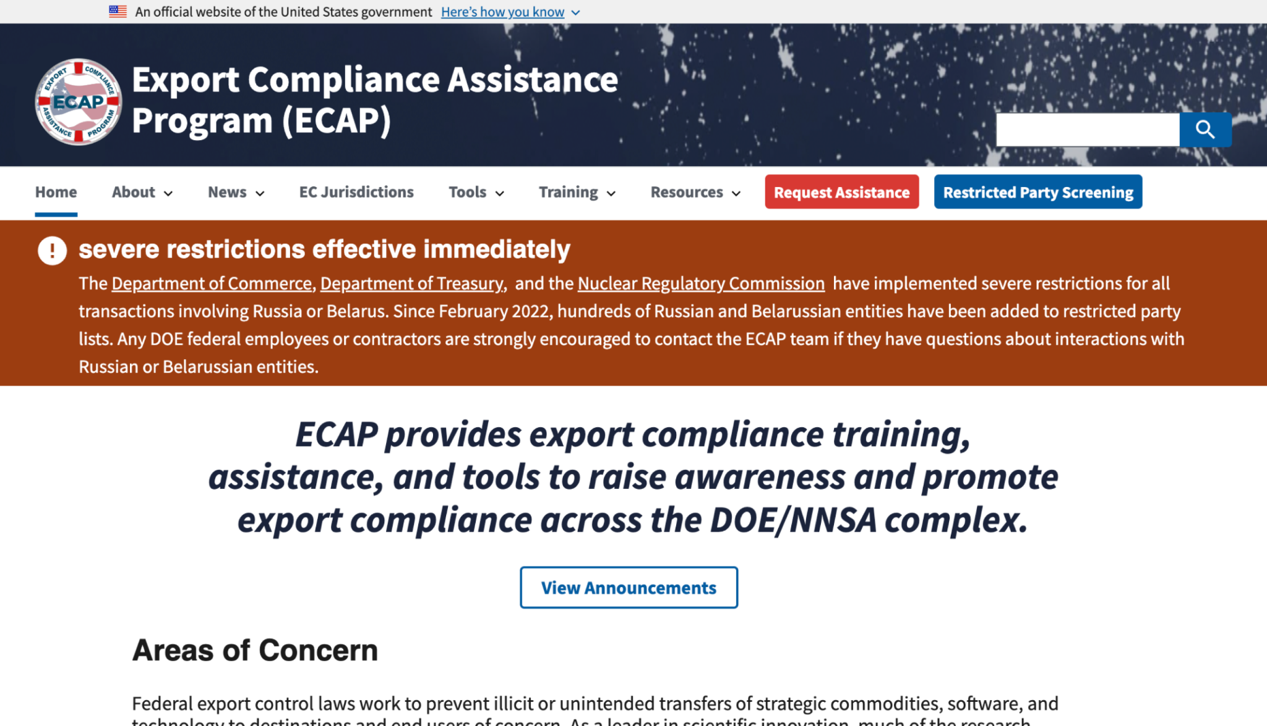
Department of Treasury Export Compliance Assistance Program
nnsa.nsis.anl.gov/ecap
Notes:
TK

Slide 6
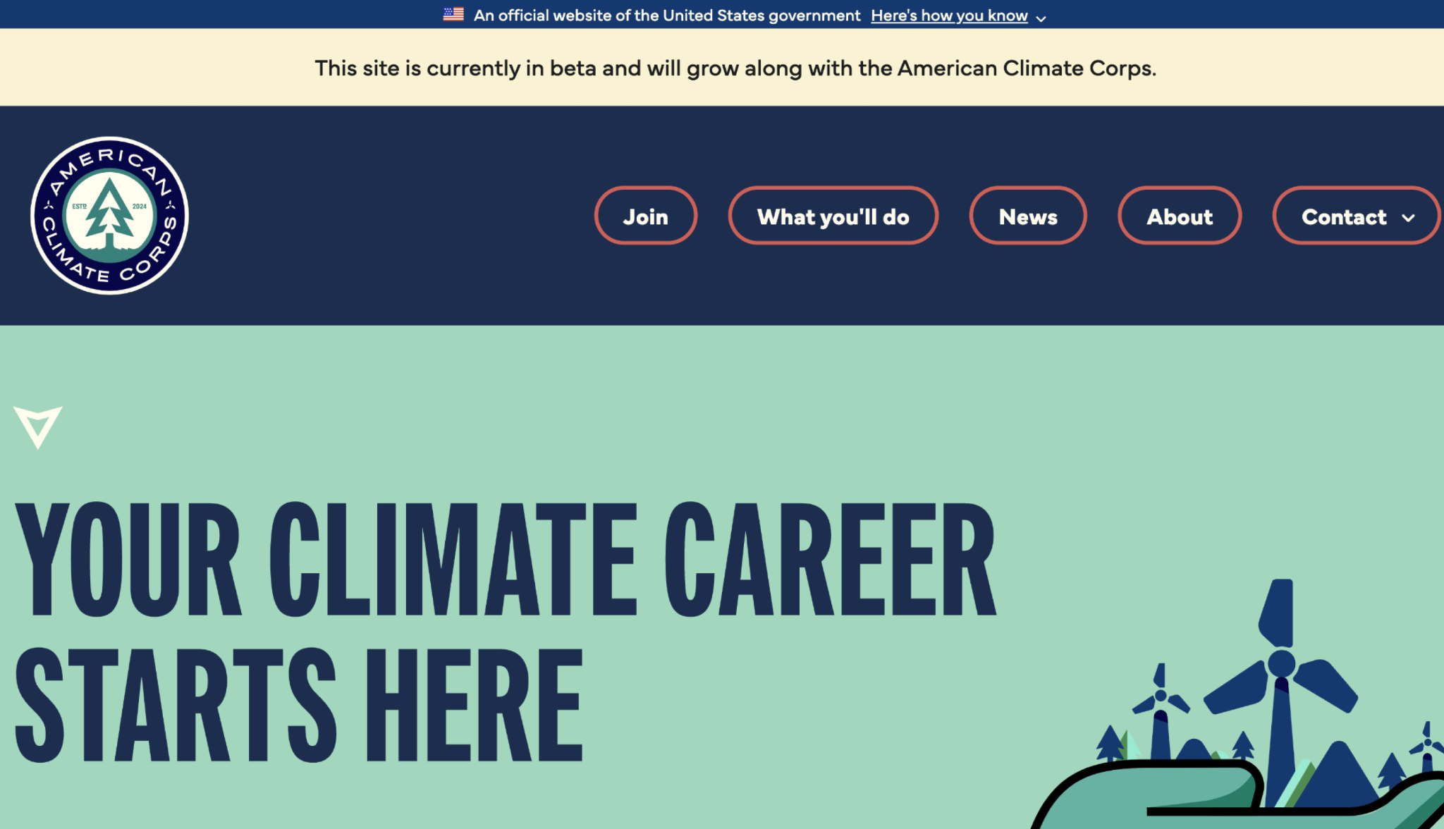
American Climate Corps
acc.gov
Notes:
TK

Slide 7
Great work!

Slide 8
Product updates

Slide 9
USWDS 3.8.1
Out now

Slide 10
Key improvements in USWDS 3.8.1
a11y: Updated the Tooltip to allow users to hover
a11y: Updated Tooltip to close with the escape key
Fixed an Input Mask initialization bug
Improved styling of nested Button Groups
Fixed a bug that added garbled some parts of the Spanish translation of the Identifier

Slide 11
Public Discussions
New component: Chat
New component: Glossary
Accessibility: Using static and interactive Tags
Q&A: May monthly call

Slide 12
Usability research update
USWDS Top Tasks performance

Slide 13
Top Tasks tested
Browsing components
Finding component guidance
Finding pattern guidance
Finding examples of sites that use USWDS
Getting design kits

Slide 14
Background & setup
45-minute moderated usability testing sessions
7 participants, mostly designers
Novice to intermediate proficiency with USWDS
7 different agencies
After learning USWDS users’ top tasks, we wanted to test their performance.
How easy or difficult is it for people to complete these tasks on our site?

Slide 15
Findings
Most challenging tasks
Browsing components
Finding pattern guidance
Mixed success
Finding component guidance
Most successful tasks
Finding examples of sites that use USWDS
Getting design kits

Slide 16
Top takeaway
The way we name things doesn’t always match user expectations

Slide 17
What’s next?
Getting new issues on our project board

Slide 18
Accessibility test update
Banner, Search, Select, Text Input, Tooltip
Next: Header, Footer, Identifier

Slide 19
A first look at USWDS Web Components

Slide 20
Alpha stage:
Value exploration over refinement

Slide 21
Simplicity:
Easy installation and no compilation requirements

Slide 22
Encapsulation:
Reliable performance wherever you use a component

Slide 23
Configuration:
An attribute-based approach to extension and theming

Slide 24
Platform orientation:
Built with native solutions that support the web as a platform

Slide 25
James Mejia
he/him
Engineer USWDS Contractor

Slide 26
Matt Henry
he/him
Engineering Lead USWDS

Slide 27
Demo

Slide 28
Follow our work
github.com/uswds/uswds-next

Slide 29
What’s next?
Button, Accordion, Card, Text Input, Modal

Slide 30
Fall 2024
A dozen components in a stable Beta

Slide 31
Onward

Slide 32
Q&A
Notes:
DW

Slide 33
Next month
July: Summer break!
#uswds-public
github.com/uswds
designsystem.digital.gov
Notes:
DW

