Slide 1
YouTube Video SEO
Randy Abramson, Director of Video Growth
February 2017

Slide 2
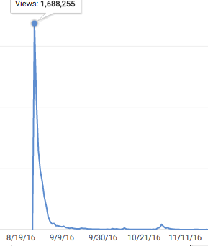
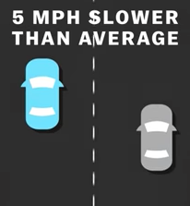
Video SEO Goal: To Maximize the Value Of Your Great Content
With viral videos, we often see an an enormous initial jolt of views for great content, followed by a steep drop off.
With better SEO, we hope to see a more gradual decline and more long tail views.
“Why you shouldn't drive
slowly in the left lane”

Slide 3
But Is Search Really a Thing For YouTube Video?
Consider:
YouTube is the second largest search engine (right behind Google)
YouTube is owned by Google...hmmmm…
Search drove 21% of all YouTube views for Polygon in 2016

Slide 4
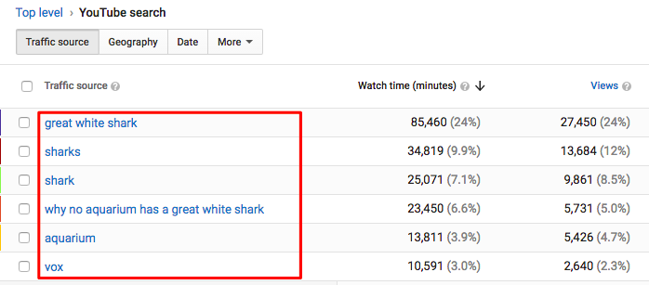
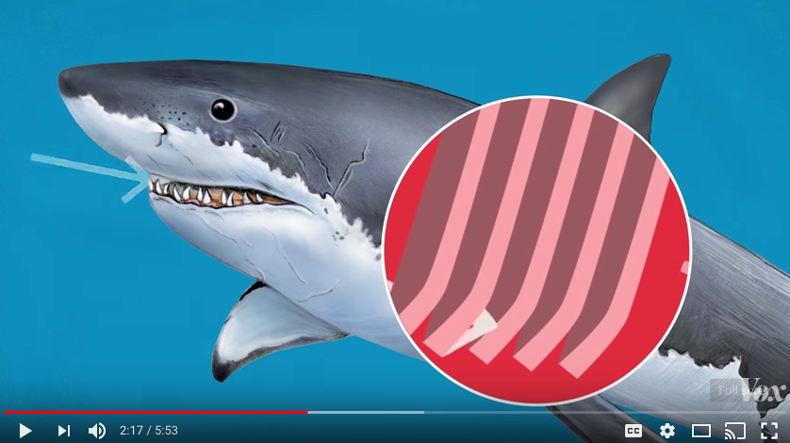
But Is Search Really a Thing For YouTube Video? (contd)
4. YouTube lets you actually see what words are driving views based on the keywords users found your video with. (creator studio > analytics > traffic sources > YouTube search)
Vox: Why no aquarium has a great white shark

Slide 5
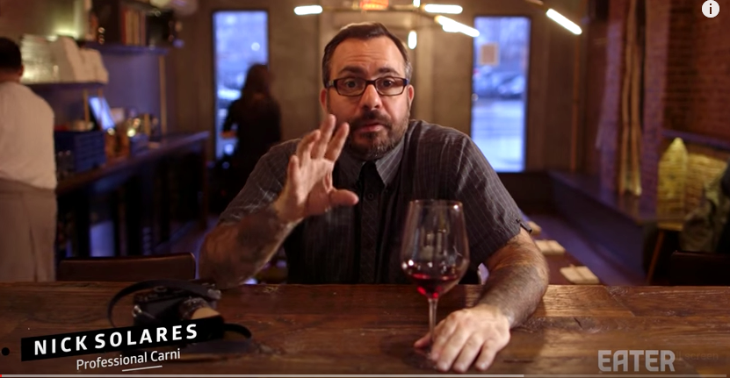
YouTube Search and Video Views - What a Pair!
General and Specific Terms in titles, tags and descriptions
can drive views over time!!!
For the “What the Most Expensive Steak In the World Tastes Like” clip, the general term ‘steak’ drove 21K views in 2016. But a specific term like ‘akita beef’ drove 1,200 views. This is Money For Nothing and long tail success!

Slide 6
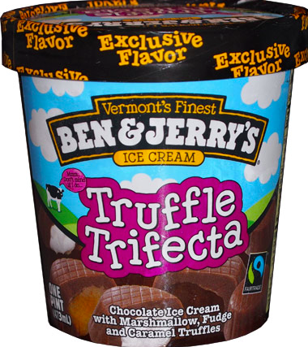
OK...YouTube Search Is a Thing. What Is YouTube Looking For?
Believe it or not, as sophisticated as YouTube is, the platform doesn’t really know what your video is about.
You can tell YouTube what your video is about by optimizing around the YOUTUBE TRIFECTA™:
Titles
Tags
Description

Slide 7
Recommendation: Repeat Keywords In Your Title, Tags and Descriptions - but NEVER spam
Title:
2. Tags:
3. Description:

Slide 8
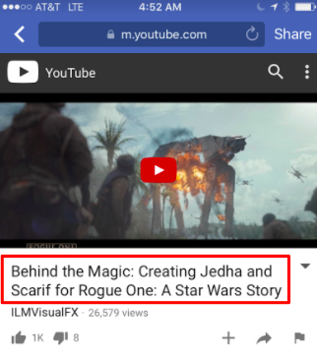
Title Tips
Front load your most relevant keywords to catch user attention in search
Be descriptive!
70 character limit including spaces (71-100 will be truncated in snippet display)
Use a “| [your brand]” or “| [series name]” at the end of your title (best practice from YouTube)
5. Type into YouTube search or use
Google trends to pick rising terms
Example above-
Good: keyed in on “STAR WARS” term
Could be better: Use “special effects” in title

Slide 9
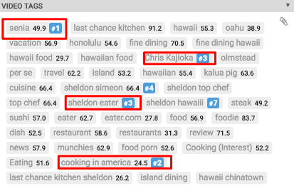
Tag Tips
Pro Tip!
The free VidIQ extension for
Chrome lets you see the tags of your videos and your competitor videos! Use this to get tag ideas and even see how specific terms rank in search!
Be generous but relevant with tags. It’s not uncommon for publishers to have 20 or more tags
Put your most relevant tags first and get more general at the end
Remember - repeat keywords from your description and title!
Don’t put in ‘typo’ tags, but abbreviations and nicknames are encouraged!
Include the name of your brand as a tag (make it a default)
Don’t forget to use talent names, names of places, etc.

Slide 10
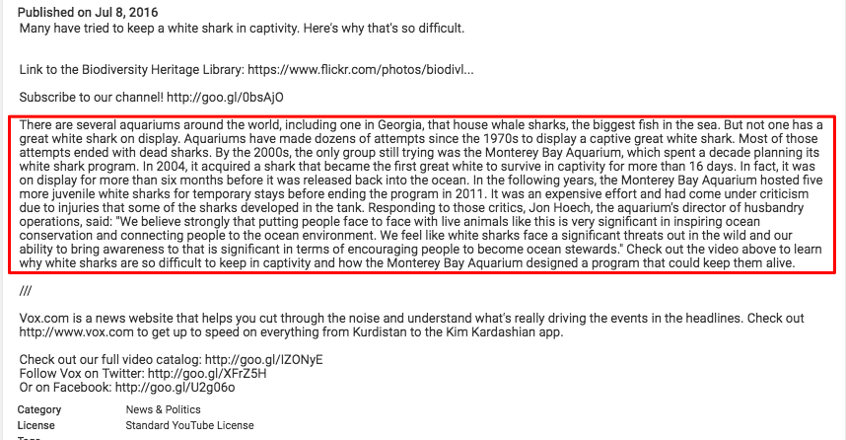
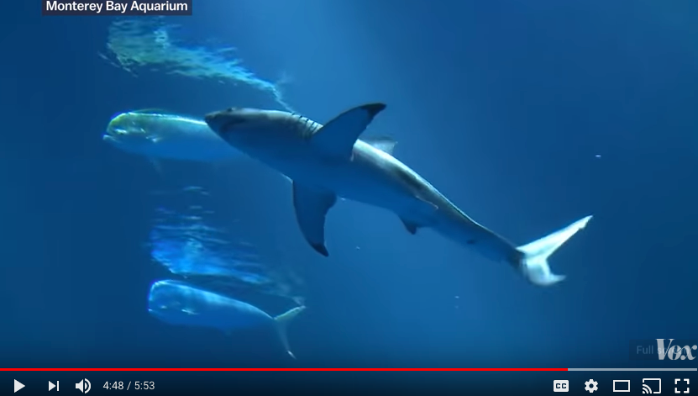
Description Tips
You have 5,000 characters to play with in the description field, but make sure your first 157, the characters that show in your search result snippet, are very descriptive
The 5,000 limit will include any ‘default’ description you set in the YouTube console
Be descriptive! Answer the basics: Who, What, Where, When, Why
A complete description includes:
Specific info about your clip
Links to your social platforms
Links to relevant clips/playlists
Info about your channel
Why no aquarium has a great white shark
https://youtu.be/QMbHLF_zwjs

Slide 11
Thank you!
Contact: Randy Abramson, Director of Video Growth
randy.abramson@voxmedia.com
Slack: @randyabramson

Slide 12
Appendix - Is VidIQ For You?

Slide 13
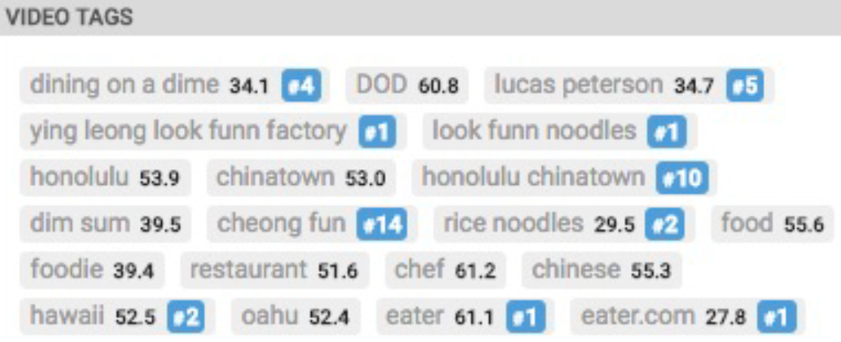
I want to easily see tags on all clips and drag and drop the order of my own tags
VidIQ might be for you!

Slide 14
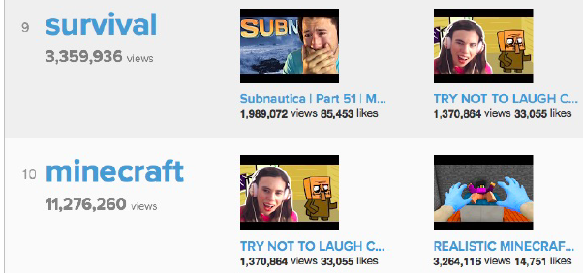
I want to see what keywords are driving the most views across YouTube
VidIQ might be for you!

Slide 15
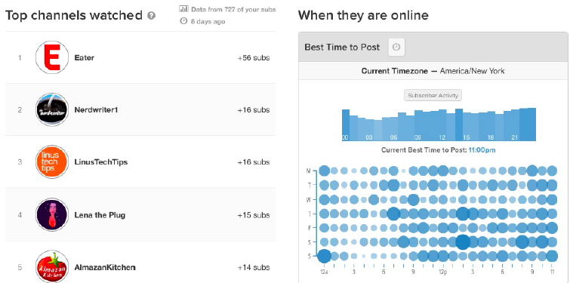
I want to know more about my audience, like when they are online and what other channels they watch
VidIQ might be for you!

Slide 16
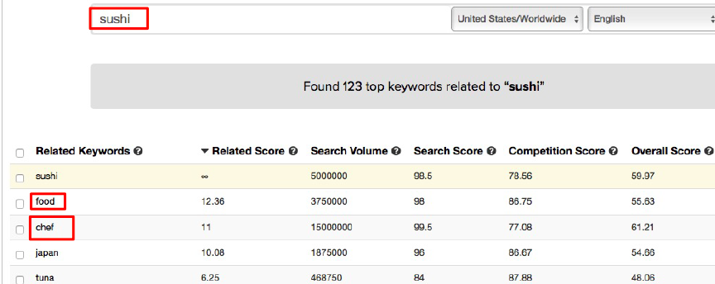
I want to find other keywords that are related to my video
VidIQ might be for you!

Slide 17
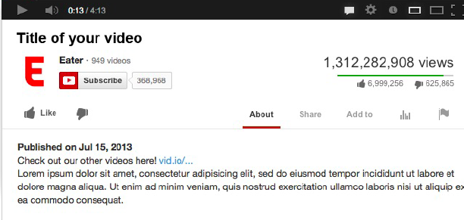
I want to change add a link and specific text to the footer of all of my clips descriptions in bulk
VidIQ might be for you!

Slide 18
I want a tool that will make some high level recommendations for me across my channel
VidIQ might be for you!

Slide 19
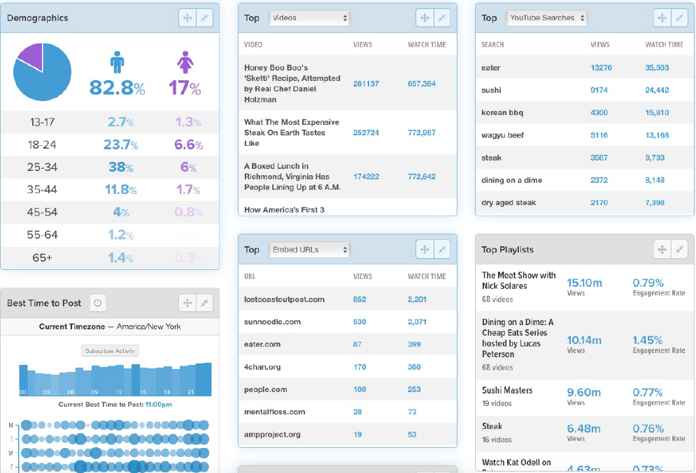
I’m looking for a dashboard view of my YouTube analytics
VidIQ might be for you!
VidIQ costs $40/month and allows you to optimize 50 videos during that time

