Slide 1
A Framework for
Data Quality
Rolf R. Schmitt, PhD
Bureau of Transportation Statistics
November, 2020
Notes:
The Federal Committee on Statistical Methodology prepared A Framework for Data Quality to introduce the rapidly expanding community of data program managers and analysts to a comprehensive range of data quality threats, and to recommend strategies for documenting data quality so that potential users understand the fitness of the data for their intended uses.
The Federal Committee on Statistical Methodology is an interagency committee dedicated to improving the quality of federal statistics. FCSM was created by the Office of Management and Budget to inform and advise OMB and the Interagency Council on Statistical Policy on statistical issues. Members include senior statisticians, economists, data scientists, and others from throughout the Executive Branch who are appointed by the Chief Statistician of the United States.
A work group of FCSM members prepared the Framework for Data Quality, and the full FCSM reviewed and approved the report.

Slide 2
A brief history
Chamberlin on data quality tradeoffs
Program evaluation research
Total survey error
The Information Quality Act of 2001
The Evidence Act, Federal Data Strategy, CNStat research on blended data
ICSP policy and charge to FCSM
FCSM workshops and preliminary report
Notes:
Data quality has been an issue since people started counting things. The president of the University of Wisconsin, T.C. Chamberlin, touched on tradeoffs in data quality when he wrote in 1890: “It may be better, in the gross affairs of life, to be less precise and more prompt. Quick decisions, though they may contain a grain of error, are often better than precise decisions at the expense of time.”
While statisticians sought to capture broader concepts of data quality in measuring total survey error, program evaluation research in the 1970s expanded the range of data collection strategies and the variety of data quality threats to consider. The Information Quality Act of 2001 reflected this broader view of data quality.
We enter the 2020s with the Foundations for Evidence-Based Policymaking Act reemphasizing program evaluation research, the Federal Data Strategy placing a focus on data quality, and the National Academies’ Committee on National Statistics investigating the challenges of blending data from multiple sources.
Against this backdrop, the Interagency Council on Statistical Policy determined that a common framework for discussing data quality was needed and directed FCSM to explore data quality issues. FCSM responded by holding a series of workshops, preparing a series of case studies, and the producing the current Framework report.

Slide 3
A Framework for Data Quality
Builds on experience of the Federal Statistical System
Explains for a broad audience the importance of understanding data quality to determine fitness for purpose
Organizes the many elements of data quality around the structure of the Information Quality Act
Provides strategies for documenting and reporting data quality
Notes:
The current report builds on the experience of the 13 principal federal statistical agencies and other components of the Federal Statistical System. The federal statistical agencies have a deep understanding of data quality related to surveys, and their experience is not limited to surveys. The statistical agencies in the Department of Agriculture have extracted data from remote imagery for years, which involves challenges not unlike interpreting X-rays in the health field. The Census Bureau, the Bureau of Labor Statistics, and others have extensive experience with administrative records as a data source. The System of National Accounts at the Bureau of Economic Analysis is one of the ultimate blended datasets.
The Framework for Data Quality attempts to translate this diverse experience for the data managers and analysts of today who reside inside and outside the traditional Federal Statistical System. We all face common data quality threats, whether we are statisticians or from other disciplines. This Framework report provides a way of organizing the seemingly endless variety of data quality threats around the structure provided by the Information Quality Act of 2001.
The Framework report concludes with strategies for documenting and reporting data quality so that everyone can understand fitness for use: how far can we take the data before we are likely to misguide decision makers?

Slide 4
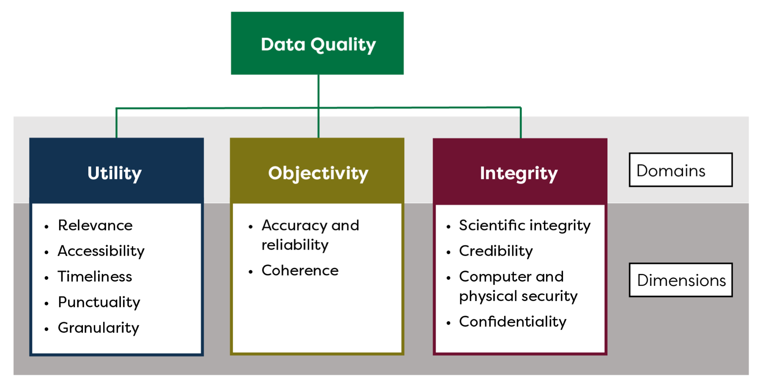
Organizing threats to data quality
Notes:
The Information Quality Act organizes data quality threats into 11 dimensions clustered into 3 domains. The dimensions are interrelated and one can waste hours debating over which dimension belongs in which domain. The important aspect is that this scheme is comprehensive and assures that all threats to data quality are considered somewhere.

Slide 5
Factors that affect data quality
Provides an inventory of threats to each dimension of data quality and examples of ways to manage the threats
Covers all types of data
Surveys
Administrative records
Sensor data
Integrated/blended data and estimates
Touches on special topics such as geographic data
Notes:
The framework based on the Information Quality Act provides a useful inventory of data quality threats that should be considered in the development of a database or in analysis of data.
This report provides examples for how to manage many of the threats to data quality, but it is not exhaustive on how to adjust for data quality problems since many of the corrective strategies are specific to individual subjects.
The report does attempt to cover all types of data, from survey data to administrative records to data from sensors to estimates based on blended or integrated datasets. No data are without quality threats. Surveys are prone to sampling bias, respondent error, and other problems. Administrative records are subject to clerical errors and imprecise record matching. Sensor data, ranging from satellite imagery and X-rays to mobile phone tracks and engine monitoring technology, can be thrown off by broken or mis-calibrated equipment. Blended data are subject to biased modeling assumptions, and quality threats of the constituent parts may be exacerbated or offset by the blending process.
The report also touches on special quality considerations involving geographic data.

Slide 6
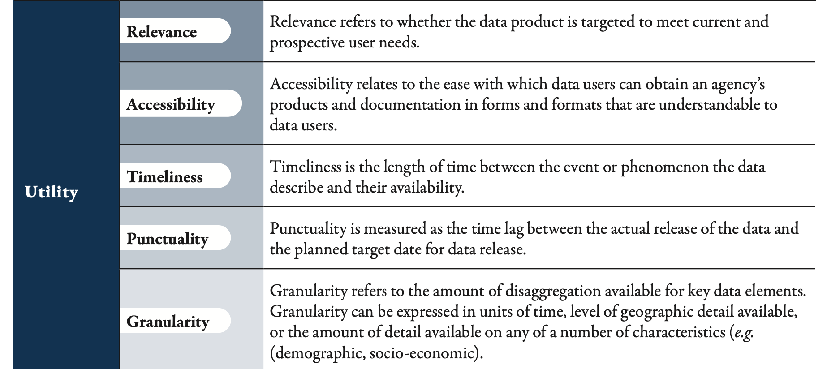
Organizing threats to data quality
Notes:
While accuracy is the aspect of data quality that typically comes to mind, the Information Quality Act guides us first to utility. A completely accurate measure has no value if it is too late or quantifies something of no interest.
Utility raises several questions. Are the data relevant? Can users get to the data and understand what they got? Are the data timely and do the data arrive punctually on the expected schedule? Does timeliness matter if you are taking a motion picture of a still life? Do the data have enough geographic, temporal, or categorical detail to avoid drowning in a lake with an average depth of 2 feet?
Implicit to accessibility of data to users are discoverability and preservation. These are common considerations in library science that are often overlooked in data science, but these considerations are essential when the user is seeking historical data to analyze a long time-series.

Slide 7
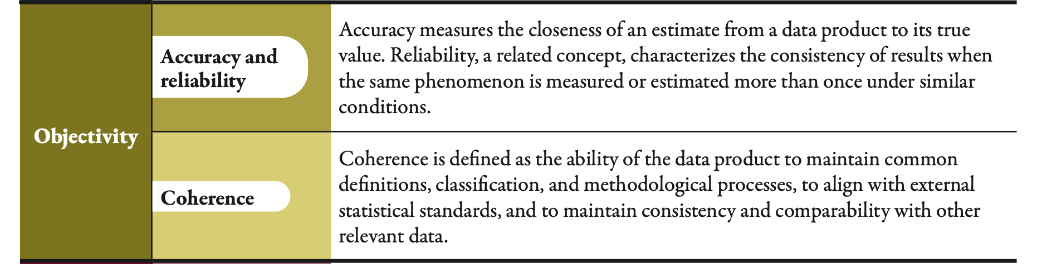
Organizing threats to data quality
Notes:
The traditional data quality dimensions, accuracy and reliability, fall under the domain of objectivity. These dimensions include a host of specific threats to data quality, many of which are thoroughly treated by statisticians with measures of variance and sampling error based on a long tradition of statistical theory.
Objectivity also includes coherence, which involves comparability of measures over time and conformance with statistical standards that enable comparability with other datasets.

Slide 8
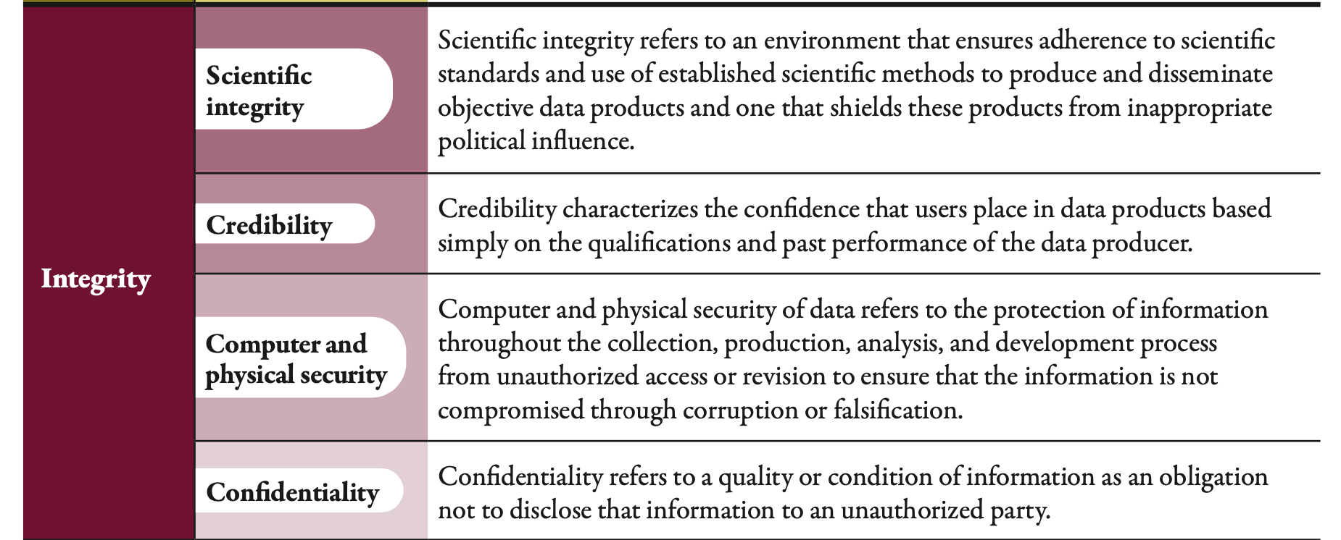
Organizing threats to data quality
Notes:
The last set of data quality issues, combined as integrity, involve the confidence of data users in the scientific integrity and credibility of data and analysis, the confidence of data providers in the physical security of the data, and the confidence of respondents in the protection of confidentiality.

Slide 9
With respect to the quality of integrated/blended data
Quality of integrated/blended data is often different than the sum of the qualities of its parts
Offsetting versus exacerbating quality problems
Estimating the aggregate quality
Comparisons of competing estimates
Sensitivity analysis
Notes:
Blended or integrated data bring additional challenges to understanding data quality. Each component of a blended dataset has quality threats, and the process of blending data has additional quality threats. Attempts to identify all of the individual quality threats and the interactions of those threats quickly turns into a herculean task. And the quality of blended data is not just the sum of the parts.
Sensitivity analysis provides one approach to assessing data quality by telling us how much possible error in individual components affect the blended total. When we have more than one way to blend data, we can also compare the competing results for quality assessment. The Weather Service uses this approach when it overlays competing forecasts of hurricane tracks, each forecast based on blended data, in a cone of uncertainty.

Slide 10
Reporting data quality
Avoids past emphasis on large and resource-consuming data quality profiles
Applies to managers of data collection programs and to analysts
Three audiences
The data program manager / analyst
The power user
The occasional user or decisionmaker
Notes:
When it comes to documenting and reporting data quality, veterans of earlier efforts to create formal data quality profiles remind us of the enormous effort that went into those profiles. Documenting after the fact was onerous, and effort to create data quality profiles rarely lasted more than one cycle. While formal data quality profiles are useful for evaluating and redesigning major data programs, they do not fit the working environment of most data stewards, whether the stewards are managers of data collection programs or managers of the resulting databases or analysts who are turning data into estimates. To consider best ways to document and explain data quality, the Framework report considers three audiences.
First is the data steward, or more precisely, the successor to the data steward. Datasets often outlive their creators, and the successor to the program manager or analyst needs to know what his or her predecessor did to deal with data quality. This documentation does not have to be carefully structured and well written, but it should be complete.
The second audience is the power user, who needs to understand enough about data quality to incorporate the data effectively into sophisticated models and analyses.
The third audience is the occasional user or the big boss who just wants the number without explanation, but who will listen an elevator speech that captures the major strengths and weaknesses of the number and help the decision maker avoid overextending the number with unfortunate consequences.

Slide 11
Reporting data quality
The cultural change for program managers and analysts: consider all threats and note how you address each relevant threat to inform your successor
The manager’s notes provide a cornerstone for technical documentation for power users
The elevator speech: describe in a few words how likely the data will misguide a decision
Notes:
Documentation of data quality after the fact is a pain, but documentation can be a simple and easy act of keeping notes while developing the data and considering whether a data quality threat is important and what to do about the important quality threats. As the program manager or analyst goes through the data quality threats for a given dataset, many threats may be quickly dismissed as unimportant, some will involve countermeasures, and others will be intractable and become a limitation of the final dataset. Noting why the quality threat is unimportant usually takes a sentence or phrase, why the threat is important but cannot be corrected takes a few sentences, and why the threat is important and how it was countered takes a paragraph. This approach to documentation should take little effort, and the notes will be a gold mine for the next person who has to understand and manage the data.
Documentation of data quality as part of instructions for power users does take significant effort and writing skill, but that effort is reduced when detailed notes are available to the author of the user manual.
The most challenging form of communicating data quality is the table footnote or elevator speech for occasional users and decision makers who just want a number. What key points does the data user need to know so that the number does not misguide understanding or decisions? Preparation of the elevator speech takes an understanding of how the number is going to be used and how good the number needs to be for that use.

Slide 12
Lessons and future work
The Information Quality Act provides a useful framework for examining data quality
Data quality tradeoffs change over time
Covid-19 put a premium on timeliness over deliberative vetting of accuracy
More work is needed
Strategies for developing and updating data quality standards
Additional tools to measure quality in blended data sets
Best practices for identifying quality of data obtained from sources that lack transparency and from advanced (AI) algorithms
Tools for harvesting data quality notes into metadata and into effective caveats for power users
Effective labeling of carefully vetted data versus experimental data
Communicating data quality while building trust
Other …
Notes:
The framework based on the Information Quality Act is a good starting point for identifying aspects of data quality that may require corrective actions and trade-offs, but it does not prescribe what countermeasures to take or how to weight each aspect. Those depend on the specific subject and potential uses of the data.
Indeed, the relative importance of each aspect of data quality is not constant. After years of careful attention to accuracy at the expense of time, the Federal Statistical System was reminded by Covid-19 that timeliness can outweigh precision for some statistics. While areas like precision medicine require very precise data, rough indicators delivered quickly best serve decision makers and the public who are trying to understand general conditions in times of dramatic change. We are embracing Chamberlin’s advice from 130 years ago.
FCSM hopes that this report is a good starting point for considering data quality, but recognizes that additional work is needed to understand and communicate data quality.

Slide 13
Conclusion
All data have problems, but do the problems matter for the decision at hand?
Data managers should consider all possible data quality problems, deal with problems that can reasonable be addressed, and document how they dealt each problem for their successors
Include data quality in guides for power users and summarize the problems for an elevator speech to tell occasional users how far they can take the data without misguiding decisions that have important consequences
Notes:
The Framework report should help us recognize that all data--whether from a survey or an administrative record or a monitoring device--have data quality problems, and that we have a responsibility to consider all potential threats to data quality and note how we deal with those threats as we prepare our data and analyses. The notes will be invaluable to our successors and will provide building blocks for instructions to power users.
Our biggest challenge is to anticipate how our data will be used and understand how well our data will serve that use so that we can tell occasional users what they need to know about the data in the brief time that we have their attention.

Slide 14
For the details
The full report is available at: https://nces.ed.gov/fcsm/pdf/FCSM.20.04_A_Framework_for_Data_Quality.pdf
Information about the Federal Committee on Statistical Methodology is posted at: https://nces.ed.gov/fcsm/
Notes:
The Framework report is a snapshot of our current understanding. FCSM hopes that the report is useful, and we look forward to your comments and suggestions for making the report better.

