Slide 1
Imputation Methods for Missing Prices in the PPI Survey
Yoel Izsak
Monica Moleres
Bureau of Labor Statistics
November 2, 2021

Slide 2

PPI at BLS
The Producer Price Index (PPI) program measures the average change over time in the selling prices received by domestic producers for their output. The prices included in the PPI are from the first commercial transaction for most products and some services.
Data collection consists of a voluntary survey for probability selected production companies in over 500 different industries
Survey Units report monthly, data is considered missing if we do not receive an item’s price for a month

Slide 3
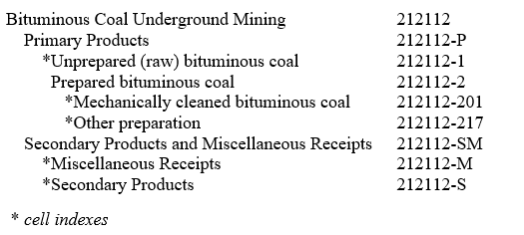
Industry and Cell Structure
Current Method: Cell Mean Imputation
Cell Indexes: the index for lowest level grouping of items in each industry
Each Cell Index is aggregated up the tree structure (seen below) to compute the industry index
Tree Structure
ok

Slide 4
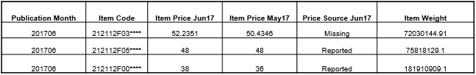

Cell Mean Imputation
$$Weighted Price Change of Reported Prices: \frac{(48 ∗ 75818129.1 + 38 ∗ 181910909.1)}{(48 ∗ 75818129.1 + 36 ∗ 181910909.1)}=1.035$$
$$Apply Cell Price Change to Missing Price: 50.4346∗1.035=52.2351$$

Slide 5
Missing Data Mechanisms
Missing at Random (MAR): Missing Price related to Observed Variable
Missing Not at Random (MNAR): Missing Price related to Price
Missing Completely at Random (MCAR): Missing Price related to No Variable

Slide 6
Imputation Methods
Random Forest (RF)
-> mice(data, m = 20, method = "rf")
Amelia (AMELIA)
-> amelia(data, m = 5, p2s = 1, idvars = c("ITEM"), noms = c("REGION", "MAJORPRODUCER"), bounds = bounds, empri = .01*nrow(data))
MICE Predictive Mean Matching (MICE)
-> mice(data, m = 5, method = "pmm")
MI Predictive Mean Matching (MI)
-> mi(data, n.iter = 20, n.chains = 10, max.minutes = 20)
MICE Classification and Regression Trees (CART)
-> mice(data, m = 5, method = "cart")

Slide 7

Simulated Data Sets
Take all of the items with reported prices to use as the control dataset – approximately 60% of the data
Simulate prices with 40% missing data, simulated missing using variables found to influence if a price is missing
Run imputation methods on the simulated datasets, then compare to the control dataset later
Metric of precision: Root Mean Square Error of the industry index
$RMSE= \sqrt{\frac{{\sum_{i=1}^{n}{\left(Imputed−Observed\right)}}^{2} }{N}}$

Slide 8

Variable Selection Process
Step 1. Exclude variables with no possible way of predicting price, also duplicate variables
Example: Street Address, Company Name have no relation to Price Change

Slide 9

Variable Selection Process
Step 2. Certain variables are not feasible to use in specific software packages, due to run time
Example: Over 500 current product codes, some software packages crashed

Slide 10
Variable Selection Process
Step 3: Which combination of variables produces the lowest RMSE compared to the control data
Compare index estimates from imputed datasets to those produced by the control dataset

Slide 11
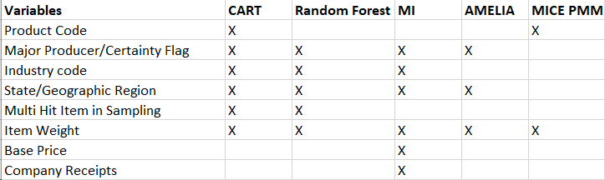
Variable Comparison
Variables

Slide 12
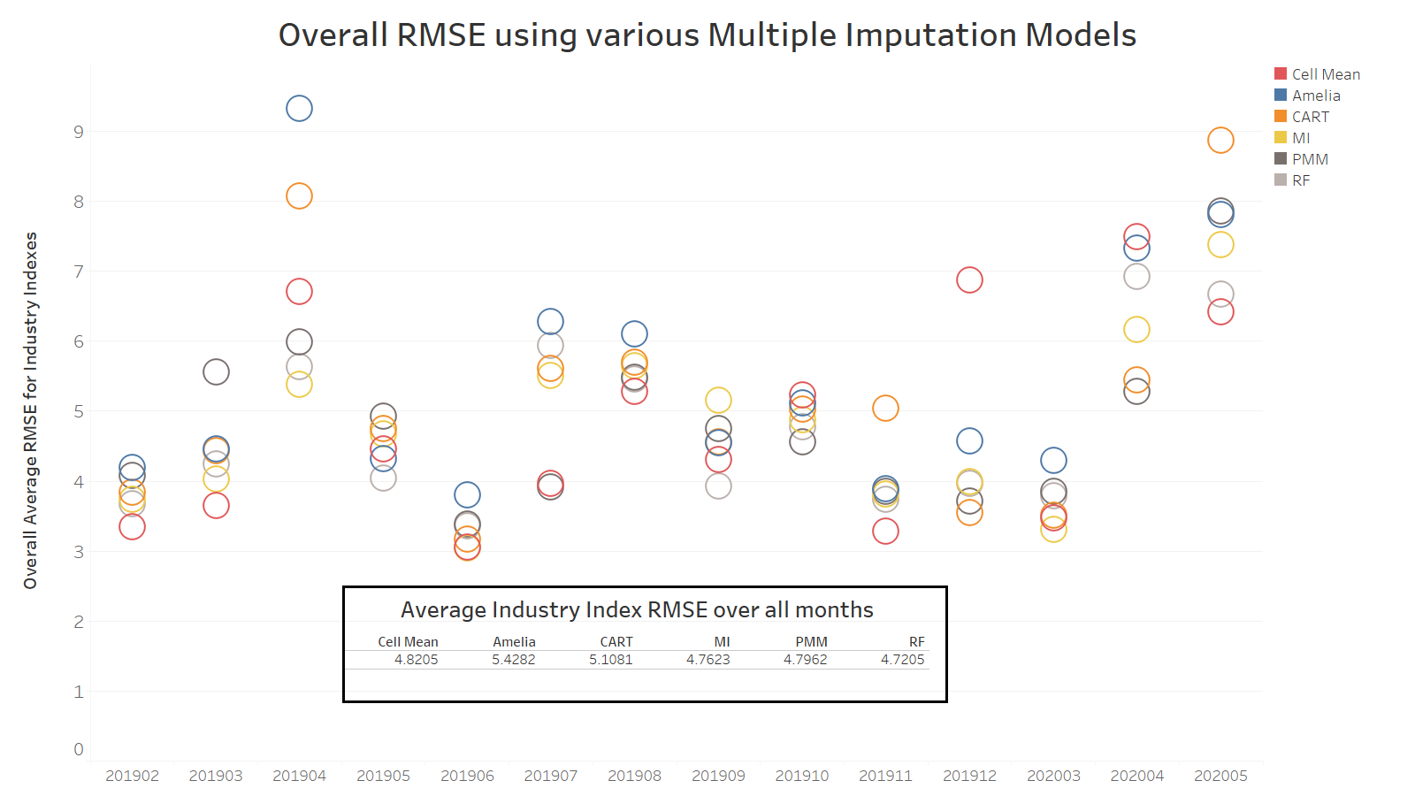

Slide 13
Improve upon Cell Mean
Overall, there was not enough evidence to suggest that switching imputation methods would be beneficial for our data
Problems:
1. No minimum threshold for calculating cell mean. With only 1 reported price in a cell, all other items will exactly follow that single price
2. If we have no good prices for a month, aggregate (higher level) index cells are used, and this works poorly
ok

Slide 14
Possible Solutions
Problems:
1. No minimum threshold for calculating cell mean. With only 1 reported price in a cell, all other items will exactly follow that single price
Institute a minimum threshold such as number of reported prices or percentage of reported weight
2. If we have no good prices for a month, aggregate (higher level) index cells are used, and this works poorly
Instead, use Random Forest to impute prices for that cell

Slide 15
Proposed Initial Solution
CMRF:
Step 1: Add in 2 reported price minimum and increase the percent reported weight threshold to 25% reported weight.
Step 2: If conditions fail, use Random Forest

Slide 16
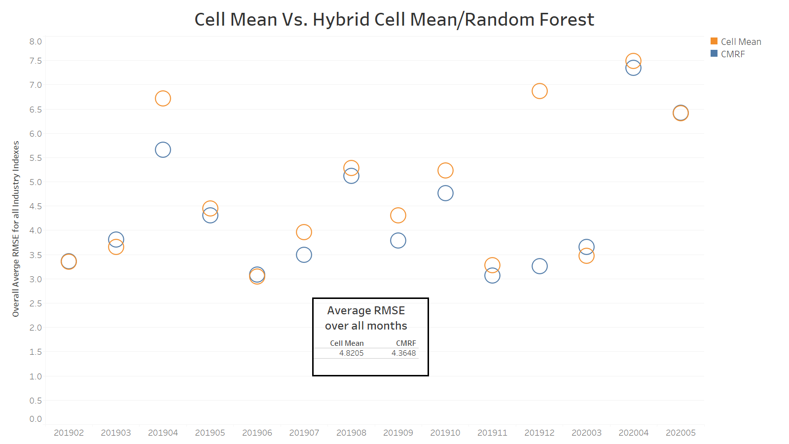

Slide 17
Further Exploration
Do we need both the reported price number minimum and reported percentage weight minimum?

Slide 18
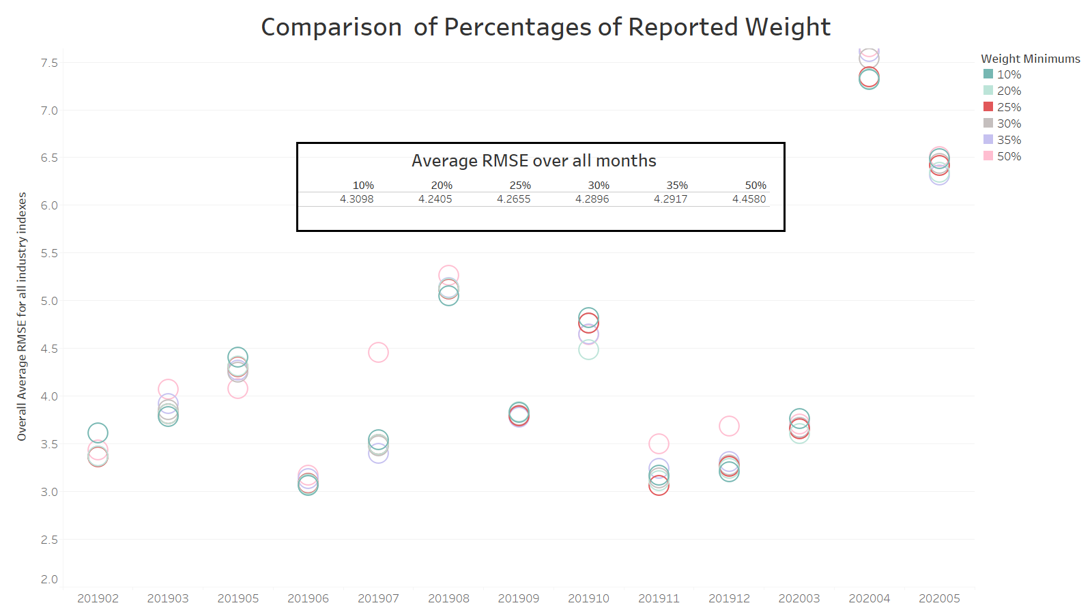

Slide 19
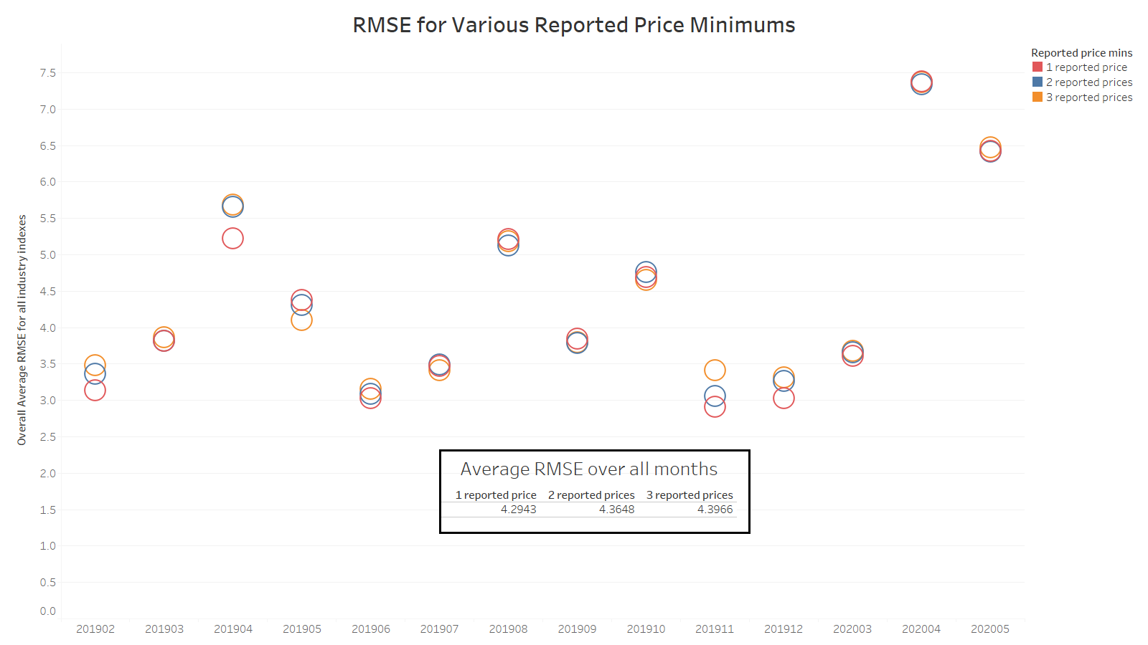

Slide 20
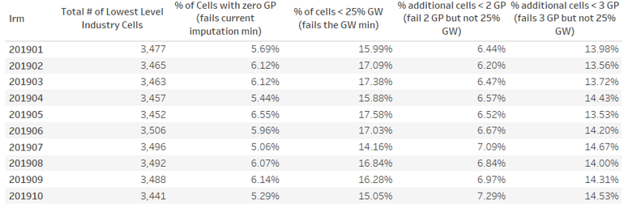
Change in Criteria
Decided to drop reported price minimum down to one, two good prices only affect an additional 6% of cells

Slide 21
Current Recommendation
Cell Mean Random Forest:
Step 1: Instate a minimum 20-25% reported item weight threshold
Step 2: If threshold is not met, use Random Forest to impute prices
So far we have run these processes on industry indexes, commodity index results in the works

Slide 22
References and Further Reading
1. Missing Data Mechanisms
https://www.theanalysisfactor.com/missing-data-mechanism/
2. PPI Concepts and Methods
https://www.bls.gov/opub/hom/pdf/ppi-20111028.pdf
3. Missing Data, Imputation, and Regression Trees
http://pages.stat.wisc.edu/~loh/treeprogs/guide/LZZZ20.pdf
4. Imputation of Missing Data
https://stefvanbuuren.name/fimd/sec-problem.html

