Slide 1
Aiding a Holistic View of Businesses Through Intensive Respondent Research
Federal Committee on Statistical Methodology Research & Policy Conference
Virtual
November 2-4, 2021
Diane K. Willimack
Methodology Director for
Measurement & Response Improvement
Economic Statistical Methods Division
Any views expressed are those of the author and not necessarily those of the U.S. Census Bureau. The Census Bureau has reviewed this data product for unauthorized disclosure of confidential information and has approved the disclosure avoidance practices applied. (CBDRB-FY22-ESMD006-004).

Slide 2
In-Scope Economic Surveys
Manufacturing
Manufacturers’ Unfilled Orders Survey (M3UFO)
Trade
Annual Wholesale Trade Survey (AWTS)
Services
Multisector
Annual Survey of Manufactures (ASM)
Annual Retail Trade Survey (ARTS)
Services Annual Survey (SAS)
Annual Capital Expenditures Survey (ACES)

Slide 3
CURRENT Collection Strategy: INDUSTRY-BASED
HYPOTHETICAL COMPANY
ASM & M3UFO
For each Manufacturing plant:
Revenue
AWTS
For the Wholesale portion of the enterprise:
Revenue
ACES
For each Industry the company had operations:
Capital Expenditures
ARTS
Expenses
Inventory
For the Retail portion of the enterprise:
Revenue
Expenses
Inventory
Expenses
Inventory

Slide 4
Why is this a problem?
Measurement error
Definitions
Lack of harmonized questions/content
The “unit” problem
Reporting unit vs. unit of analysis
Availability of data at different levels
Burden
Mismatch between requested data and recorded data
Respondent’s access to data

Slide 5
Research Questions:
Definitions: how do businesses define themselves relative to the Census Bureau definitions?
Accessibility: how accessible are key data points at varying business units?
Burden: how resource intensive is gathering data at these varying business units?

Slide 6
Record-Keeping Studies (RKS) – Two Phases
Phase I
Focus on accounting practices and purposes
Carried out during autumn 2019
29 in-person interviews
Phase II
Focus on “units” and data accessibility
Carried out during winter 2020-2021
30 remote/virtual interviews

Slide 7
In-Scope Businesses and Respondents
Eligibility Criteria:
Sampled in at least two in-scope surveys
In at least two industrial sectors
More than one establishment
 | Phase 1 | Phase 2
Total Number of Completed Interviews | 29 | 30
Number of Industries
Three or fewer | 23 | 25
Four or more | 5 | 5
Number of establishments
30 or fewer | 10 | 19
31 or more | 18 | 11

Slide 8
RKS Phase I: Structure of Business & Records
Interview Protocol
Key Findings
Chart of Accounts
Assets
Liabilities
Income
Expenses
What does your business do?
Line of business
Industry classification = NAICS
The Mainstay -- Consolidated financial reports
Consolidated figures reliable and reportable
Serve as anchors for breaking out details
NAICS is artificial
Distinction among classifications
Different questionnaires = different industries (4- or 6-digit NAICS)
Mismatch: Recorded data ≠ Requested data
Rs dislike deciding how to map their data to the survey questions.

Slide 9
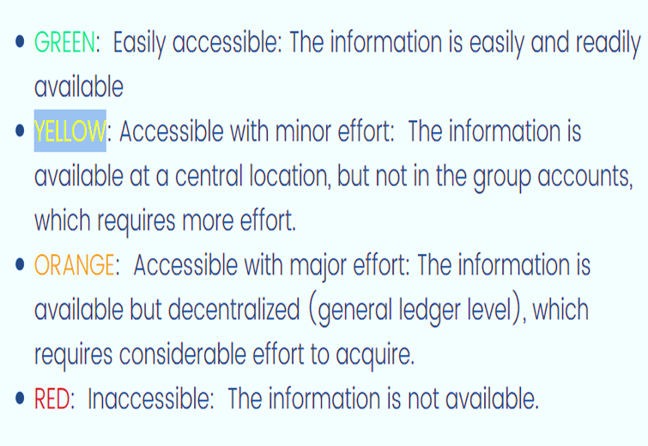
RKS Phase II: Data Accessibility
Interview Protocol
Accessibility X Unit X Topic
Definitions & Equivalencies
Company
Establishment
Line of business
NAICS
“General” = 4-digit
“Detailed” = 6-digit
Color-coding

Slide 10
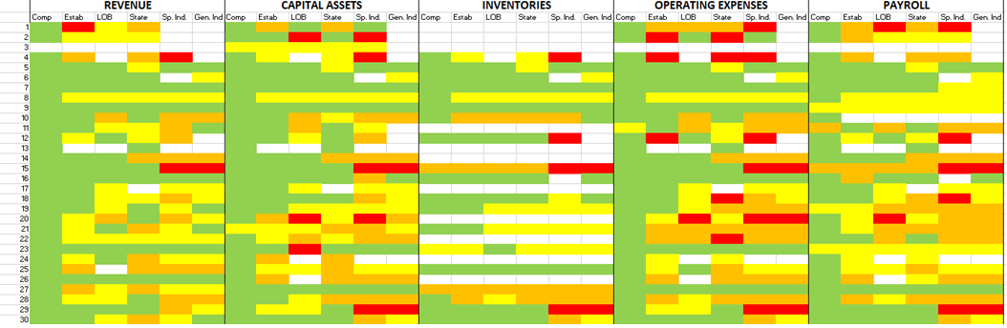
Results: Color-coded Accessibility X Unit X Topic

Slide 11
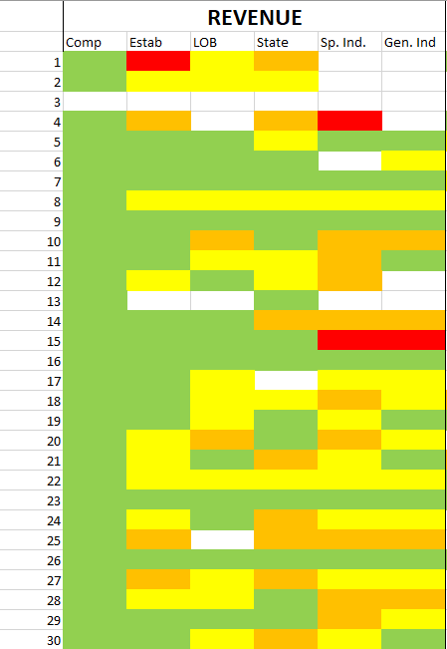
Revenue: Accessibility X Unit
REVENUE
 | GREEN | YELLOW | ORANGE | RED | X
COMPANY | 29 | 0 | 0 | 0 | 1
ESTABLISHMENT | 15 | 9 | 3 | 1 | 2
LINE OF BUSINESS | 13 | 10 | 2 | 0 | 5
STATE | 13 | 8 | 7 | 0 | 2
SPECIFIC INDUSTRY | 6 | 7 | 9 | 2 | 6
GENERAL INDUSTRY | 9 | 9 | 4 | 1 | 7

Slide 13
NEW Collection Strategy: TOPIC/ACCOUNT-BASED
HYPOTHETICAL COMPANY
Total Revenue
Enterprise Level for:
Total Expenses
Enterprise Level for:
End-of Year Inventory
Enterprise Level for
Retail
Wholesale
Wholesale
Manufacturing
For each plant
Manufacturing
Retail
Manufacturing
Wholesale
Retail
For each plant
For each plant

Slide 14
Next Steps for Respondent Research: Cognitive Testing
Primary research questions:
Understand respondents’ preferences regarding organization of the modules and their content
Evaluate alignment of the module topics and with respondent’s record keeping practices
Learn about respondents’ strategies for compiling the data for the questionnaire, with an eye towards identifying difficulties and mismatches between recorded and requested data, along with how those mismatches are resolved
Assess the capabilities of respondents answering via spreadsheet upload for establishment-level collection
Assess respondent burden

Slide 15
Next Steps for Respondent Research: Pilot Testing
Phase I: Intensive Pretesting
N = 100 production cases
Personal recruitment, online pilot survey instrument, Response Analysis Survey, record check study and debriefing interviews.
Phase II: Wider Roll-Out
N = 500 non-production cases and nonresponding production cases.
Phone recruitment (production cases), email and mail invitation (all), pilot survey, Response Analysis Survey, debriefing interviews and record check study.
October 2021 – April 2022
March – September 2022
Phase III: Systems Checks and Final Testing
N = Up to 2,000 non-production cases + responding Phase I cases
Full contact strategy, pilot survey, Response Analysis Survey, debriefing interviews, statistical analyses.
November 2022 – December 2023

Slide 16
Acknowledging the Respondent Research Team
Melissa Cidade
Kristin Stettler
Demetria Hanna
Rebecca Keegan
Aryn Hernandez
And We Thank Alumni:
Erica Marquette
Struther Van Horn
For questions or
additional information,
contact:
Diane K. Willimack
Team Lead diane.k.willimack@census.gov

