Slide 1
Session A-4 Discussion – Data Quality: Communication of Uncertainty in Official Statistics Jeffrey M. Gonzalez Economic Research Service 2021 Federal Committee on Statistical Methodology Research and Policy Conference Tuesday, November 2, 2021
Disclaimer: The findings and conclusions in this presentation are those of the authors and should not be construed to represent any official USDA or U.S. Government determination or policy.

Slide 2
Outline
Background on themes of FCSM
Discussion of presentations
Evaluating Uncertainty in Multiple Dimensions of Data Quality (Eltinge)
Brief Summary
Relevance to themes
Additional considerations
More Fully Capturing Uncertainty Associated with Official Estimates (Young)
Tailored Transparency: Public Trust vs. Reproducibility (Miller)
Concluding remarks

Slide 3
Trust as the Cornerstone of Federal Statistics and Evidence Building
Federal data inform and improve our decisions, policies, and lives.
Question: What does it take to build trust?
Communication
Helpfulness
Honesty
Transparency
Question: Why do we need trust in official statistics?
Credibility for the role that the Federal Statistical System plays in data collection and outcomes research
Fosters a culture and society that values data and evidence-based policymaking

Slide 4
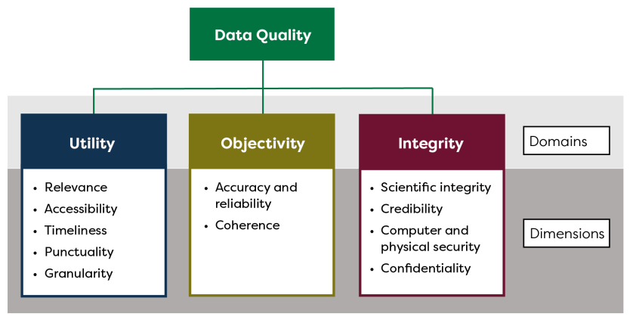
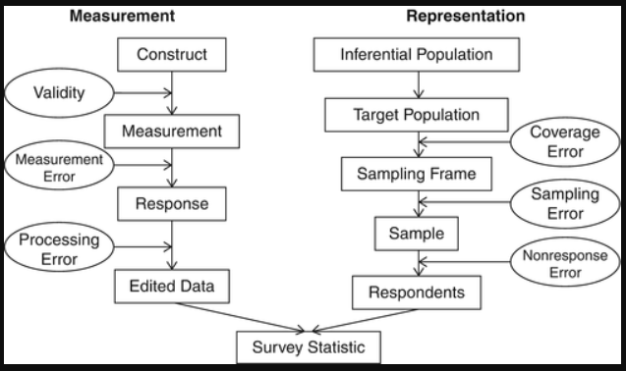
Communication of Uncertainty in Official Statistics
Inherent connection between trust in Federal Statistics and data quality.
Citation: Federal Committee on Statistical Methodology. 2020. A Framework for Data Quality.
Adapted from Groves et al 2009 Survey Methodology, 2nd Edition

Slide 5
Evaluating Uncertainty in Multiple Dimensions of Data Quality (Eltinge)
Brief summary
Provides a comprehensive introduction to the multiple dimensions of data quality, with distinctions between quantifiable and qualitative components
Illustrates concepts and poses a series of questions about quality components with an application to the integration of multiple data sources
Relevance to themes
Framework and questions give practitioners a model, or process, to systematically consider potential threats to the utility, objectivity, and integrity – all which impact trust
Openness about each data source, integration methods, and trade-offs being made
Additional considerations
Extensions of “backbone and bridge” beyond supplemental surveys as “bridges” to crowd-sourced or other data sources compiled by a third party
All dimensions of data quality matter, but incorporating errors for all inputs and production steps may be unfeasible

Slide 6
More Fully Capturing Uncertainty Associated with Official Estimates (Young)
Brief summary
Focus on the accuracy dimension of total survey error and quantifies errors due to sampling, nonresponse, undercoverage, misclassification, and calibration
Application to the 2017 Census of Agriculture to improve upon the 2012 methods by incorporating the impact of calibration and rounding in all measures of uncertainty
Relevance to themes
Communication and transparency about standard error calculations
Inaccuracies can impact confidence in the data product and can erode users' trust
Additional considerations
Models are imperfect characterizations and can be subject to some level of subjectivity, potential conflicts with objectivity as a domain of data quality
Accounting for and understanding the relative importance of other sources of uncertainty (e.g., linkage, editing, and imputation) is critical for reducing the overall error

Slide 7
Tailored Transparency: Public Trust vs. Reproducibility (Miller)
Brief summary
Discusses issues related to disclosure of statistical and survey information from legal/regulatory and Federal Statistical System perspectives
Outlines a procedure for tailored disclosure that considers different purposes and audiences for the documentation
Relevance to themes
Recognition that an aspect of effective communication is understanding the audience
Transparency relates to accessibility and utility
Additional considerations
Focus on disclosure/dissemination of data products and statistical information to data consumers/users, applications of tailored transparency in survey recruitment
Transparency may be at odds with making undesirable features more salient

Slide 8
Concluding remarks
All data products have strengths and weaknesses across each dimension of data quality
Honest and transparent documentation enables appropriate use of the data products and reinforces credibility and utility, impacting trust
Implementation of best practices helps build and maintain trust and involves understanding the threats to each dimension and their trade-offs
Best practices and examples of applications of these concepts exist
FCSM-20-04 A Framework for Data Quality (ed.gov)
Data Quality and Data Comparisons in the Consumer Expenditure Surveys (bls.gov)
Session F-2: Examination of the Data Quality Properties of USDA and Proprietary Databases (Milburn)

Slide 9
Jeffrey M. Gonzalez Research Mathematical Statistician Economic Research Service Jeffrey.Gonzalez@usda.gov
Thank you!

