Slide 1
A Meta-Analysis of the Impact of Number of Contact Attempts on Response Rates and Web Completion Rates in Multimode Surveys
Ting Yan
Westat
November 2, 2021

Slide 2
Multimode surveys
Multimode surveys are on the rise
Using multiple modes to contact and to collect data from potential respondents
Benefits (de Leeuw 2018; Tourangeau 2017):
Improving coverage
Increasing response rates
Reducing cost
Improving measurement
COVID-19

Slide 3
This talk
Focuses on multimode surveys using mail and web to collect data from potential respondents
Using a meta-analytic approach to quantifying two benefits (de Leeuw 2018; Tourangeau 2017):
Improving coverage
Increasing response rates
Impact of design features on response rate
Reducing cost
Impact of design features on percent of web completes
Improving measurement

Slide 4
Types of web and mail multimode designs
Concurrent
Web and mail are offered to respondents at the same time
HINTS 5 Web Pilot (Westat, 2019): Web option condition
1st contact: web login + paper questionnaire
2nd contact: Postcard reminder
3rd contact: letter reminder with web login + paper questionnaire
4th contact: letter reminder with web login + paper questionnaire

Slide 5
Types of web and mail multimode designs
Sequential mail and web
Paper questionnaire is offered first and web is offered later
Lewiston and Clarkston Quality of Life Survey (Smyth et al. 2010)
1st contact: pre-notification letter
2nd contact: paper questionnaire
3rd contact: postcard reminder
4th contact: paper questionnaire + web login

Slide 6
Types of web and mail multimode designs
Sequential web and mail
Web is offered first and paper questionnaire offered later
2015 VA Survey of Veteran Enrollee’s Health and Use of Health Care (Westat, 2015): Hard-to-interview control condition
1st contact: pre-notification letter
2nd contact: invitation letter with web login
3rd contact: IVR reminder
4th contact: letter reminder with paper questionnaire
5th contact: Postcard reminder
6th contact: letter reminder with paper questionnaire

Slide 7
Impact of design features of multimode surveys
Type of design
Number of contacts
Was a pre-notification letter sent?
Was incentive offered?
Was email used to reach sampled persons?
Timing of the second mode

Slide 8
Meta-analysis
Searched for experimental studies that varied design features
Key words: multimode, mixed mode, multiple modes of data collection, web, mail, paper, sequential, concurrent, choice, push-to-web
Reviewed studies for eligibility
Has to be empirical studies
Has to include experiments
Has to include sufficient information on design features, sample size, response rate, number of web completes or percent of web completes
Retained 29 papers for coding
38 studies
113 estimates

Slide 9
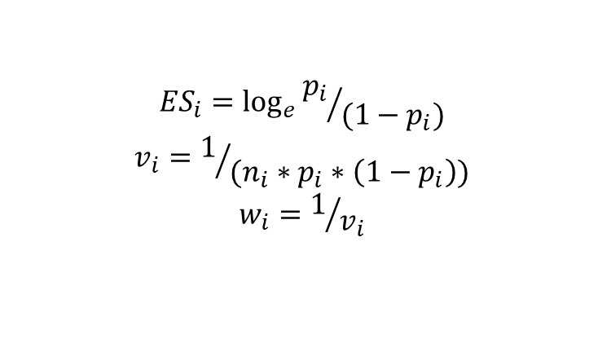
Meta-analysis (2)
For each eligible study,
Coded design features (e.g., type of multimode design etc)
Entered or manually calculated
Response rate
Percent of interviews completed on web
Calculated effect size (and variance)
Logit transformation of response rate and web completion rate
$${ES}_{i}=\log_{e}{{p_{i}}/{(1−p_{i})}}$$
$$v_{i}=1/{(n_{i}∗p_{i}∗\left(1−p_{i}\right))}$$
$$w_{i}=1/{v_{i}}$$

Slide 10
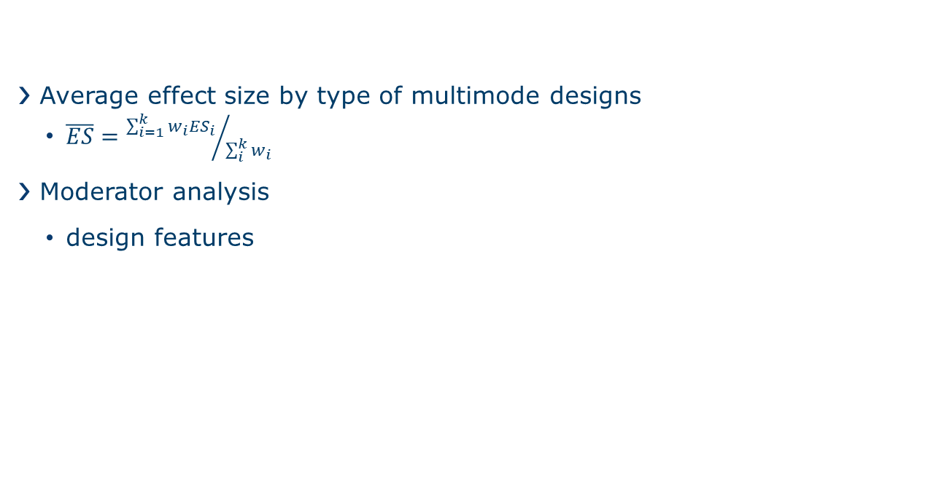
Meta-analysis (3)
Average effect size by type of multimode designs
$\overline{ES}={\sum_{i=1}^{k}{{w_{i}ES}_{i}}}/{\sum_{i}^{k}{w_{i}}}$
Moderator analysis
design features

Slide 11
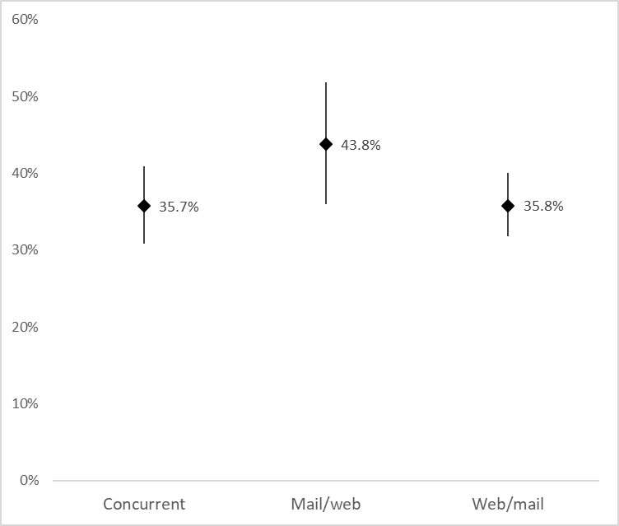
Results: Response rates by type of multimode designs
Concurrent mail/web designs:
28 effect sizes nested in 17 studies nested in 14 papers
Sequential mail/web:
15 effect sizes nested in 11 studies nested in 10 papers
Sequential web/mail:
70 effect sizes nested in 34 studies nested in 26 papers

Slide 12
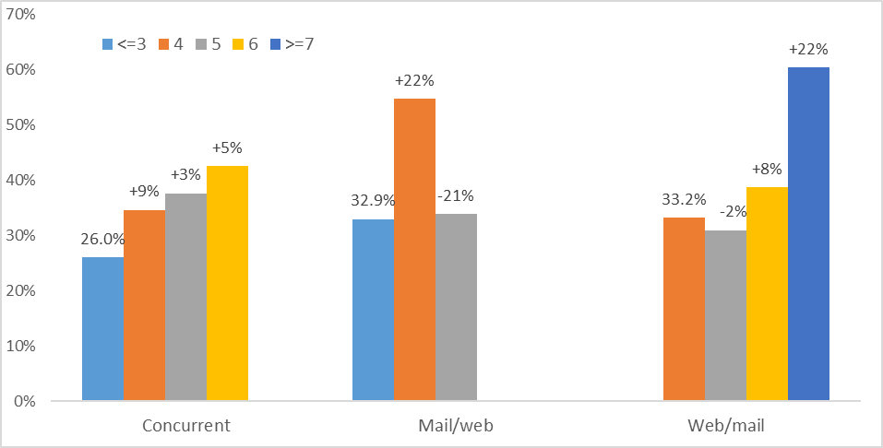
Results: Response rates by number of contacts
Ranging from 2 to 17
Mode number of contacts
Concurrent: 5
Mail/web: 4
Web/Mail: 4
Overall effect
0.12 (p<.0001)

Slide 13
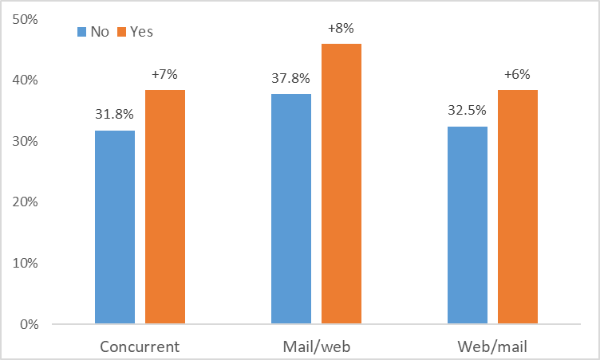
Results: Response rates by pre-notification letter
% sent a pre-notification letter:
Concurrent: 61%
Mail/web: 73%
Web/Mail: 57%
Overall effect
0.29 (p<.05)
Notes:
Difference 6.6% 8.2% 7.3%

Slide 14
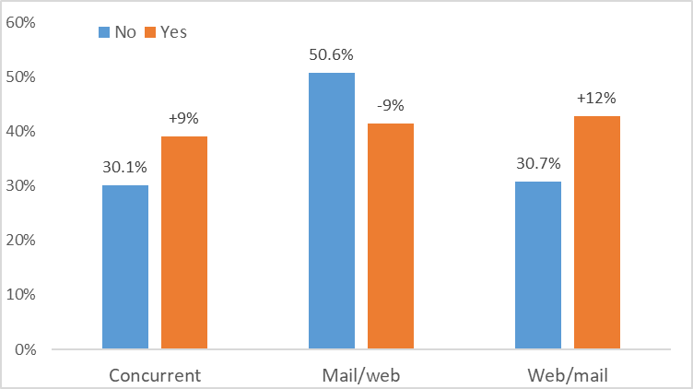
Results: Response rates by incentive
% offered incentive
Concurrent: 64%
Mail/web: 73%
Web/Mail: 44%
Overall effect
0.41 (p=.002)
Notes:
Difference 6.6% 8.2% 7.3%

Slide 15
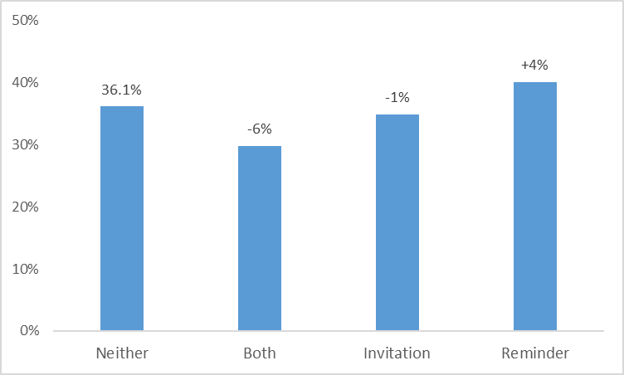
Results: Response rates by use of email
Email use
Concurrent: 1 study used email reminder
Mail/web: 1 study sent web survey via email
Web/Mail:
7%: email invitation
14%: email reminder
11%: both
66%: did not use email

Slide 16
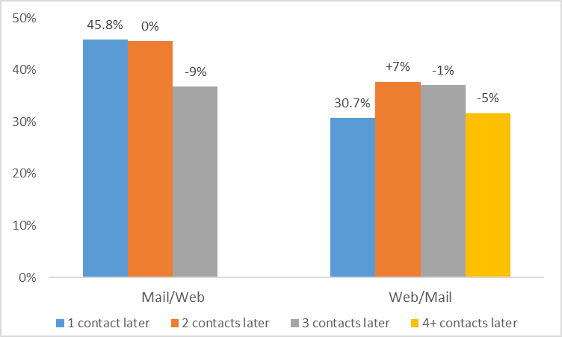
Results: Response rates by timing of second mode
Most studies offered 2nd mode 2 contacts after 1st mode

Slide 17
Summary of findings on Response Rate
Design Feature | Impact on Response Rate
Type of design | mail/web > (concurrent = web/mail)
Number of contacts
Pre-notification
Incentive | concurrent and web/mail: mail/web:
Email (web/mail only) | Email reminder:
Timing of 2nd mode | mail/web: higher RR when offering 2nd mode 1 or 2 contacts later web/mail: higher RR when offering 2nd mode 2 or 3 contacts later

Slide 18
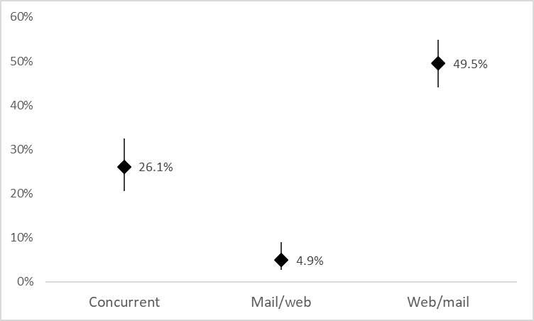
Results: Web completion rates by type of design

Slide 19
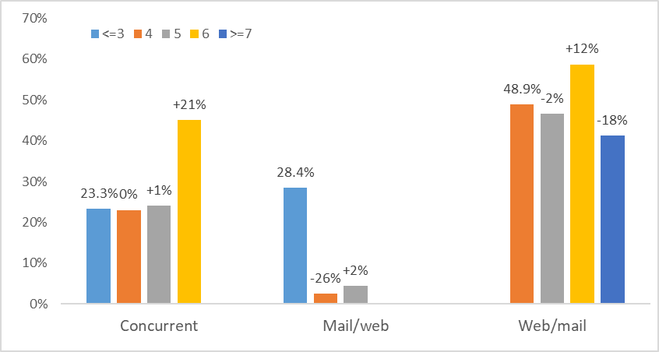
Results: Web completion rates by number of contacts

Slide 20
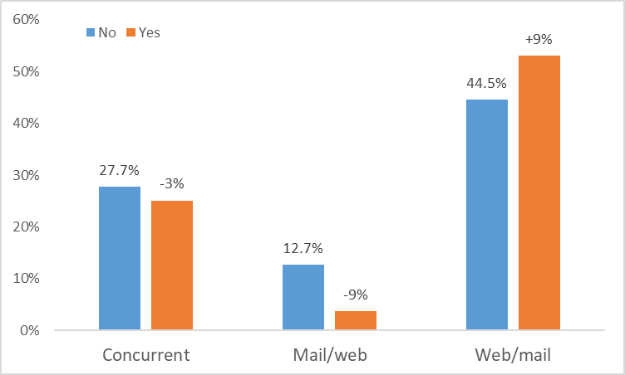
Results: Web completion rates by Pre-notification

Slide 21
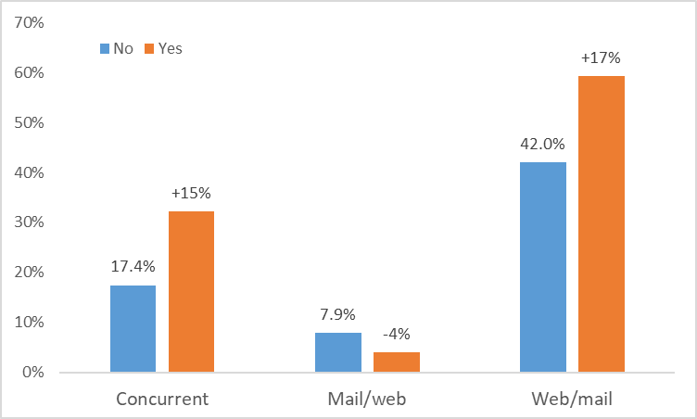
Results: Web completion rates by Incentive

Slide 22
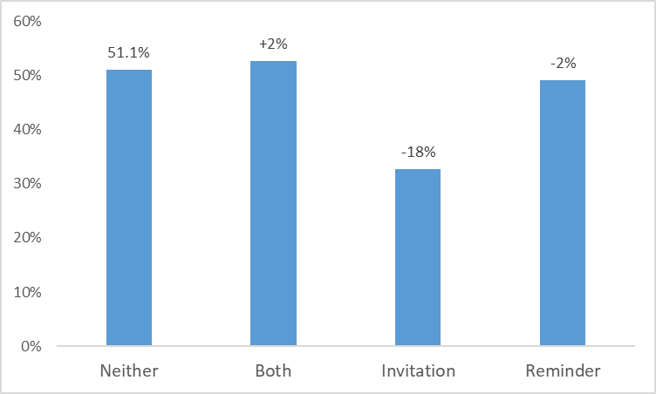
Results: Web completion rates by use of email (Sequential web/mail only)

Slide 23
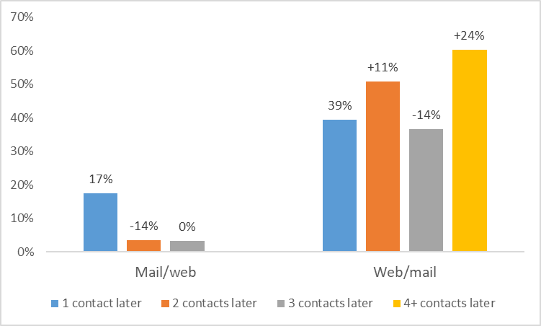
Results: Web completion rates by timing of second mode

Slide 24
Summary of findings on web completion rate
Design Feature | Impact on web completion rate
Type of design | web/mail > concurrent > mail/web
Number of contacts | concurrent and web/mail:
Pre-notification | concurrent and mail/web: web/mail:
Incentive | concurrent and web/mail: mail/web:
Email (web/mail only) | Email invitation+ email reminder:
Timing of 2nd mode | mail/web: higher WCR when offering 2nd mode 1 contact later web/mail: higher WCR when offering 2nd mode 2 or 4+ contacts later

Slide 25
Recommended sequence
If goal is to maximize response rate
Concurrent: 6 contacts, pre-notification, incentive,
Mail/web: 4 contacts, pre-notification, no incentive, offering web at 3rd contact
Web/mail:7+ contacts, pre-notification, incentive, offering mail at 4th contact, email reminder
If goal is maximize web completion rate
Concurrent: 6 contacts, no pre-notification, incentive
Mail/web: 3 contacts, no pre-notification, no incentive, offering web at 2nd contact
Web/mail: 6 contacts, pre-notification, incentive, offering mail at 6th contact, email invitation+email reminder

Slide 26
Limitations and Future Research
Only examined a few selected moderators
Future research should examine other moderators such as target population, type of sampling frame, type and amount of incentives, survey topic
Only examined one moderator at a time
Future research could employ a meta-regression approach to examine the impact of all moderators at the same time
Limited to studies involving an experiment
Future research could expand to include empirical studies that do not include an experiment

Slide 27
Thank You
tingyan@Westat.com
*A big thank-you to Alexis Kokoska and Winnie Xu for their help with coding

