Slide 1
How Can We Best Measure an Establishment's Size? An Evaluation of Universe Extraction for Select U.S. Census Bureau Business Surveys
November 2, 2021
Presented by: Kenishea Donaldson
Additional Authors: Katrina Washington, Erica Wong, Olivia Brozek, Jacob Sandruck, Micah Tyler
U.S. Census Bureau
Any views expressed are those of the author(s) and not necessarily those of the U.S. Census Bureau. The Census Bureau has reviewed this data product for unauthorized disclosure of confidential information and has approved the disclosure avoidance applied. (Approval ID:CBDRB-FY22-ESMD005-002)

Slide 2
Topics Covered
Purpose
Introduction to key terms
Current Methodology
Annualization of Input Data
Editing of Input Data
Research Findings and Results
Improvements and Recommendations

Slide 3
Purpose
The objective of this research is to improve upon the methodology used to determine and validate the measure of size estimates for employer establishments in preparation for the next sample revision for select U.S. Census Bureau economic surveys

Slide 4
Terms to Remember
Business Sample Revision (BSR)
Follows completion of the U.S. Census Bureau’s Economic Census
Sample is reselected
Monthly, quarterly and annual Retail, Wholesale and Service surveys
Business Register (BR)
Database of domestic businesses and establishments
Compilation of data from censuses, surveys, and administrative records
Contains data at the establishment, EIN, and enterprise/firm/company level
Singleunit establishment
Multiunit establishment

Slide 5
Terms to Remember
Universe Extraction (UE)
Process used to build a frame of all in-scope establishments
Economic Census and BR data used to determine revenue Measure of Size (MOS) for each establishment
Run edits on the establishment data used in MOS calculation to define impact on the sample size

Slide 6
Gimme All Your Money…Data
Universe Extraction creates universe of all ‘in-scope’ establishments which may be selected
Pulling current data from the BR
BIRTHDAY (month, day, year) establishment became active
Receipts and payroll from the Economic Census
Administrative receipts and payroll (most recent 3 years)
BIRTHDAY
Admin Receipts & Payroll
‘in-scope’
establishment
UE Frame
Business
Register
(BR)
2012 Econ Census Data
Annualized
Admin Receipts & Payroll
Annualized
2012 Econ Census Data

Slide 7
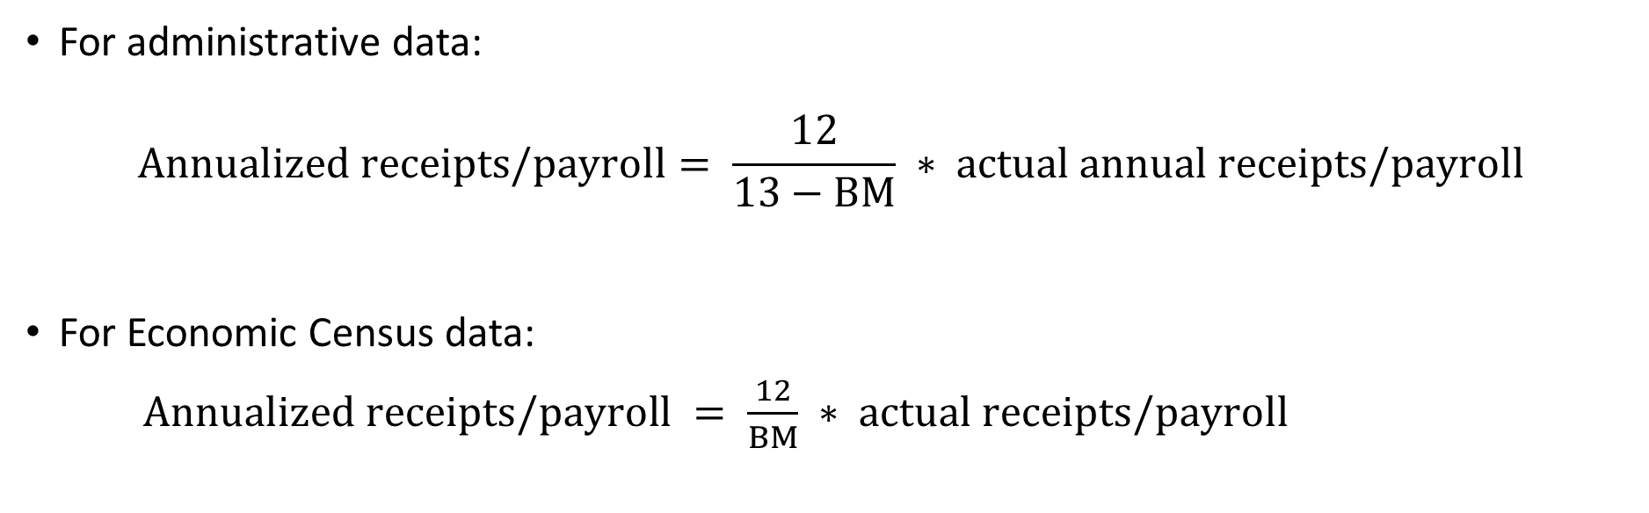
Data Annualization
BIRTHMONTH (BM) and BIRTHYEAR are derived from BIRTHDAY and used to annualize administrative receipts
For administrative data:
$$Annualized receipts/payroll= \frac{12}{13−BM} ∗ actual annual receipts/payroll$$
For Economic Census data:
$Annualized receipts/payroll = \frac{12}{BM} ∗ actual receipts/payroll$

Slide 8
Improvements to Data Annualization
Issues with the annualizing variable – BIRTHDAY
Based on posting date
Assigned at EIN level
Annual filers always receive January as tax month
Immediate goal became finding a variable that is as populated as BIRTHDAY but is a more accurate representation of when an establishment first came into business as an employer

Slide 9
Data Annualization
Availability of comparison variables pulled from the BR
 | Singleunits |  |  |  | Multiunits
 | Total Count = 4,177,000 |  |  |  | Total Count = 1,745,000
New Variable | Populated |  | Missing |  | Populated |  | Missing
BIRTHDAY | 4,177,000 | 100.0% | <15 | 0.0% | 1,745,000 | 100.0% | <15 | 0.0%
BIRTH_PAY | 4,176,000 | 100.0% | 700 | 0.0% | 1,686,000 | 96.6% | 60,000 | 3.4%
BIRTH_RCPT | 3,810,000 | 91.2% | 367,000 | 8.8% | 1,213,000 | 69.5% | 532,000 | 30.5%
BIRTH_START | 2,196,000 | 52.6% | 1,981,000 | 47.4% | 273,000 | 15.6% | 1,472,000 | 84.4%
BIRTH_WAGES | 1,421,000 | 34.0% | 2,756,000 | 66.0% | 199,000 | 11.4% | 1,546,000 | 88.6%
Data reflect the BR as of May 2020
Includes two recommended Social Security Administration dates
Needed a method for verifying accuracy of variables

Slide 10
Verifying Variables
Comparison of date variable vs. first occurrence of payroll data
PAYFIRST was created to represent the first occurrence of non-zero payroll on the BR
Only used non-missing and non-zero estimates and comparison dates from 2012 or later
 | Singleunits
Comparison Date Variable | Equal | PAYFIRST before | PAYFIRST after
BIRTHDAY | 94.6% | 5.1% | 0.4%
BIRTH_PAY | 94.5% | 5.3% | 0.4%
BIRTH_RCPT | 18.5% | 59.2% | 22.2%
BIRTH_START | 28.6% | 2.8% | 68.8%
BIRTH_WAGES | 53.7% | 9.9% | 36.2%
Data reflect the BR as of May 2020

Slide 11
Creation of a Hierarchy
BEST
BUSINESS START DATE
BIRTH_WAGES
BIRTH_PAY
BIRTH_START
BIRTHDAY

Slide 12
Validating the Hierarchy
Updated comparison of date variable vs first occurrence of payroll data
 | Singleunits
Comparison Date Variable | Equal | PAYFIRST after | PAYFIRST before
BIRTHDAY | 94.6% | 0.4% | 5.1%
BIRTH_PAY | 94.5% | 0.4% | 5.3%
BIRTH_START | 28.6% | 68.8% | 2.8%
BIRTH_WAGES | 53.7% | 36.2% | 10.0%
HIERARCHY | 75.1% | 17.3% | 7.5%
The current methodology using BIRTHDAY is more effective than the proposed hierarchy

Slide 13
Creation of MOS
Six established MOS formulas used in BSR-17
Estimates annual receipts for given year
Uses annualized data from BR administrative sources, Census parameters and surveys

Slide 14




Creation of MOS: BSR-17 Formulas
MOS1† = 2014 Admin Receipts
MOS4
= 2012 Census Receipts * $\frac{\text{2014 }\text{Admin} \text{Payroll}}{\text{2012 }\text{Admin} \text{Payroll}}$
MOS2†
= 2013 Admin Receipts * $\frac{\text{2014 }\text{Admin} \text{Payroll}}{\text{2013 }\text{Admin} \text{Payroll}}$
MOS5 = $\frac{\text{2012 }\text{Census} \text{Receipts}}{ \text{Deflation} \text{Factor} }$
MOS3
= 2012 Census Receipts * $\frac{\text{2014 }\text{Admin} \text{Payroll}}{\text{2012 }\text{Census} \text{Payroll}}$
MOS6 = Beta Factor * 2014 Admin Payroll
† For singleunits only

Slide 15
MOS Editing
Ratios using the MOS input data are created and tested against edit boundaries
The 1st and 99th percentiles were set as edit boundaries for each ratio test
The ‘best’ MOS is set based on which ratios pass edits
The number portion of the MOS indicates optimal choice of method

Slide 16
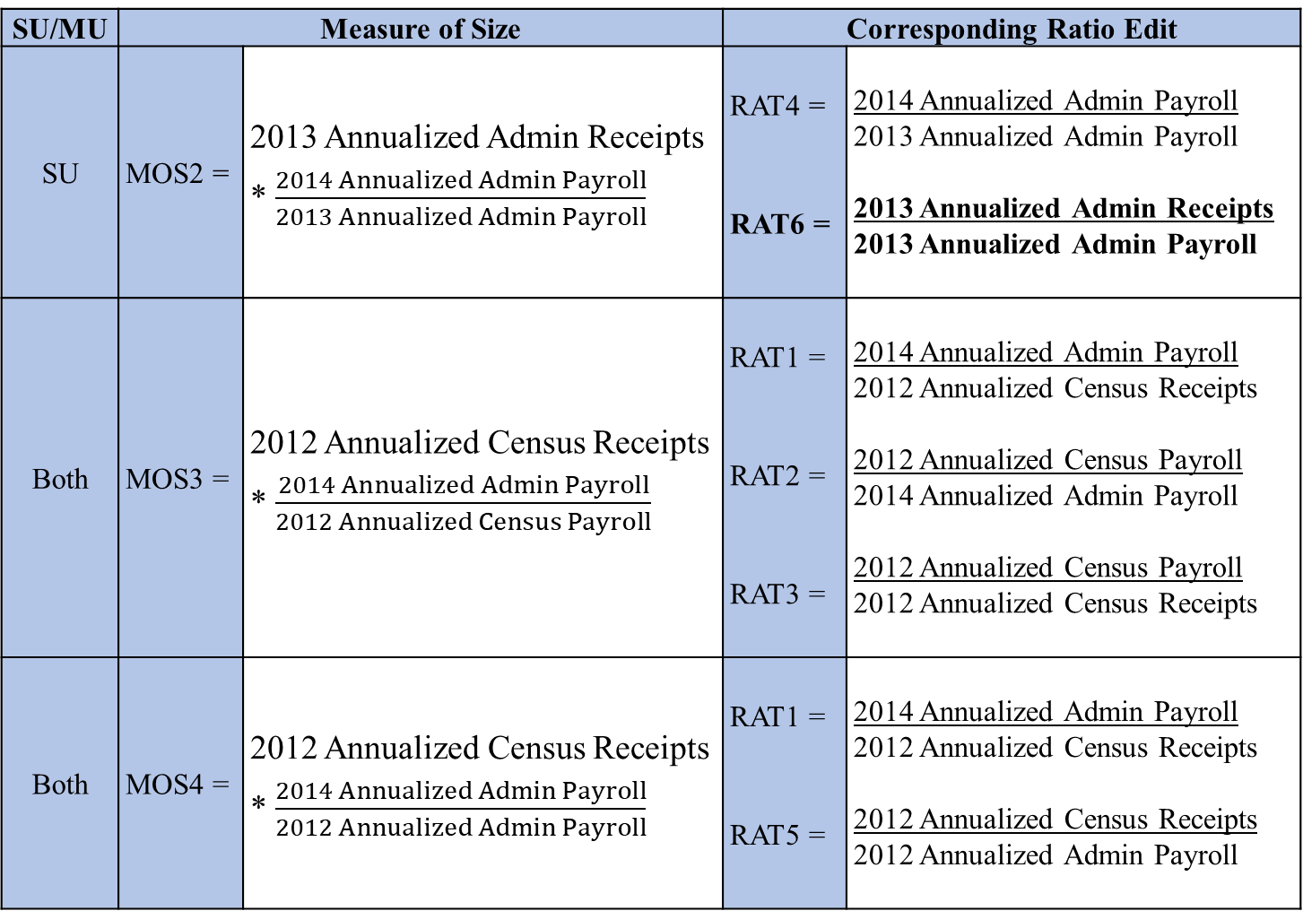
BSR-17 MOS ratio tests for singleunits and multiunits
SU/MU | Measure of Size |  | Corresponding Ratio Edit
SU | MOS2 = | 2013 Annualized Admin Receipts * $\frac{2014 Annualized Admin Payroll}{2013 Annualized Admin Payroll}$ | RAT4 = RAT6 = | 2014 Annualized Admin Payroll 2013 Annualized Admin Payroll 2013 Annualized Admin Receipts 2013 Annualized Admin Payroll
Both | MOS3 = | 2012 Annualized Census Receipts * $\frac{2014 Annualized Admin Payroll}{2012 Annualized Census Payroll}$ | RAT1 = RAT2 = RAT3 = | 2014 Annualized Admin Payroll 2012 Annualized Census Receipts 2012 Annualized Census Payroll 2014 Annualized Admin Payroll 2012 Annualized Census Payroll 2012 Annualized Census Receipts
Both | MOS4 = | 2012 Annualized Census Receipts * $\frac{2014 Annualized Admin Payroll}{2012 Annualized Admin Payroll}$ | RAT1 = RAT5 = | 2014 Annualized Admin Payroll 2012 Annualized Census Receipts 2012 Annualized Census Receipts 2012 Annualized Admin Payroll

Slide 17
Input Data Issues
Approximately 2% of the administrative receipts data values truncated
Affected only the 2014 and/or 2013 administrative receipts data
Used in MOS calculations for MOS1 and MOS2
Affects MOS calculations for singleunit establishments only
MOS1 truncated data used
For MOS2, a ratio edit existed (RAT6) that potentially flagged the truncated data
Ratio Edit 6 Results by 2013 administrative receipts data disposition for singleunits

Slide 18
Improvements to MOS Editing
Data truncation issue went largely undetected
Need method to more effectively edit the input data used in MOS calculations
Tested several methods of outlier detection methodology
Method should be more robust than the ratio edits used currently

Slide 19
Outlier Detection Methodology
Traditional Ratio Edits
Detect if ratio of two variables for a given unit differs markedly from the ratios of the remaining units
Does not account for size differences between units
Many small estimates flagged as outliers, unlike large estimates
Hidiroglou-Berthelot (HB) outlier detection methodology
Incorporates size component to reduce “size masking effect” and transforms ratios to ensure symmetry
Acceptance boundaries vary according to size of unit
Finds both large and small outliers, on both tails of distribution

Slide 20
Result of Ratio Edits on 2013 Administrative Receipts
Comparison of RAT6 results by method for
2013 administrative receipts data disposition for singleunits
Ratio 6 Flag | 2013 Not Truncated |  | 2013 Truncated
Method | 1st/99th | HB | 1st/99th | HB
Total Singleunits | 4,093,000 |  | 84,000
RAT6 flagged | 57,000 | 40,000 | 5,600 | 10,000
Percent Flagged | 1.4% | 1.0% | 6.7% | 11.9%

Slide 21
New Ratio Edit on 2014 Administrative Receipts
2014 Annualized Admin Receipts
2014 Annualized Admin Payroll
RAT7 =
Singleunits with non-missing 2014 administrative receipts using HB edit on RAT7
 | 2014 Truncation
RAT7 Flag | Not Truncated | Truncated
RAT7 not flagged | 4,112,000 | 7,000
RAT7 flagged | 45,500 | 12,500
Total | 4,157,000 | 19,500
Total Truncations Flagged = 64.1%

Slide 22
 |  | NEW MOS (HB Outlier Detection)
 |  | 1 | 2 | 3 | 4 | 5 | 6 | Total
OLD MOS (1st/99th Percent) | 1 | 65,000 | 1,600 | 250 | 40 | 30 | 150 | 67,500
 | 2 | <15 | 13,500 | 1,000 | 50 | <15 | 40 | 14,500
 | 3 | <15 | 250 | 1,000 | 20 | <15 | <15 | 1,200
 | 4 | <15 | 30 | 40 | 40 | <15 | <15 | 100
 | 5 | <15 | 60 | 50 | 70 | <15 | <15 | 200
 | 6 | <15 | 60 | <15 | <15 | <15 | 450 | 550
 | Total | 65,000 | 15,500 | 2,300 | 200 | 60 | 650 | 84,000
Assignment of “best” MOS for singleunits with 2013 truncated data
 |  | NEW MOS (HB Outlier Detection)
 |  | 1 | 2 | 3 | 4 | 5 | 6 | Total
OLD MOS (1st/99th Percent) | 1 | 6,800 | 11,500 | 300 | 20 | 40 | 150 | 18,500
 | 2 | <15 | 1,000 | <15 | <15 | <15 | <15 | 1,000
 | 3 | <15 | 20 | 50 | <15 | <15 | <15 | 70
 | 4 | <15 | <15 | <15 | <15 | <15 | <15 | <15
 | 5 | <15 | <15 | <15 | <15 | <15 | <15 | 20
 | 6 | <15 | <15 | <15 | <15 | <15 | 30 | 30
 | Total | 6,800 | 12,500 | 350 | 20 | 40 | 150 | 19,500
Assignment of “best” MOS for singleunits with 2014 truncated data

Slide 23
Summary
Improvements to Data Annualization
Sought out to resolve issues with annualizing variable, BIRTHDAY
Creation of a hierarchy to use more BR data
Proposal of BIRTH_PAY as a replacement
Improvements to MOS Editing
Review of current BSR-17 methodology which uses 1st and 99th percentiles
Research HB outlier detection as a more robust option
Creation of additional test ratio (RAT7) to edit input data for MOS1 creation

Slide 24
Acknowledgements
Thank you to everyone who helped during this entire research process, including James Burton, James Hunt, Brandy Yarbrough and Joseph Barth. This paper would not be possible without your knowledge, feedback, and support.

Slide 25
For any further questions/comments/feedback,
please contact the author at
Kenishea.Donaldson@census.gov

