Slide 1
The Fully Functional Standard Application Process Portal
John Finamore
FCSM Research and Policy Conference
November 2021

Slide 2
Presentation Outline
Background Information
SAP Technical Framework
SAP Portal Wireframes
SAP Development and Schedule
Conclusions

Slide 3
Background Information

Slide 4
Foundations for Evidence-based Policymaking Act
STANDARD APPLICATION PROCESS (44 USC 3583)
The Director (of the Office of Management and Budget) shall establish a process through which agencies, the Congressional Budget Office, State, local, and Tribal governments, researchers, and other individuals, as appropriate, may apply to access the data assets accessed or acquired under this subchapter by a statistical agency or unit for purposes of developing evidence.

Slide 5
Standard Application Process
The Evidence Act defines the application process to include:
Common application form
Review criteria for access determination
Timeframes for prompt determinations
An appeals process for adverse decisions
Standards for transparency including:
Each application received
The status of each application
The determination made for each application
Any other information, as appropriate, to ensure full transparency

Slide 6
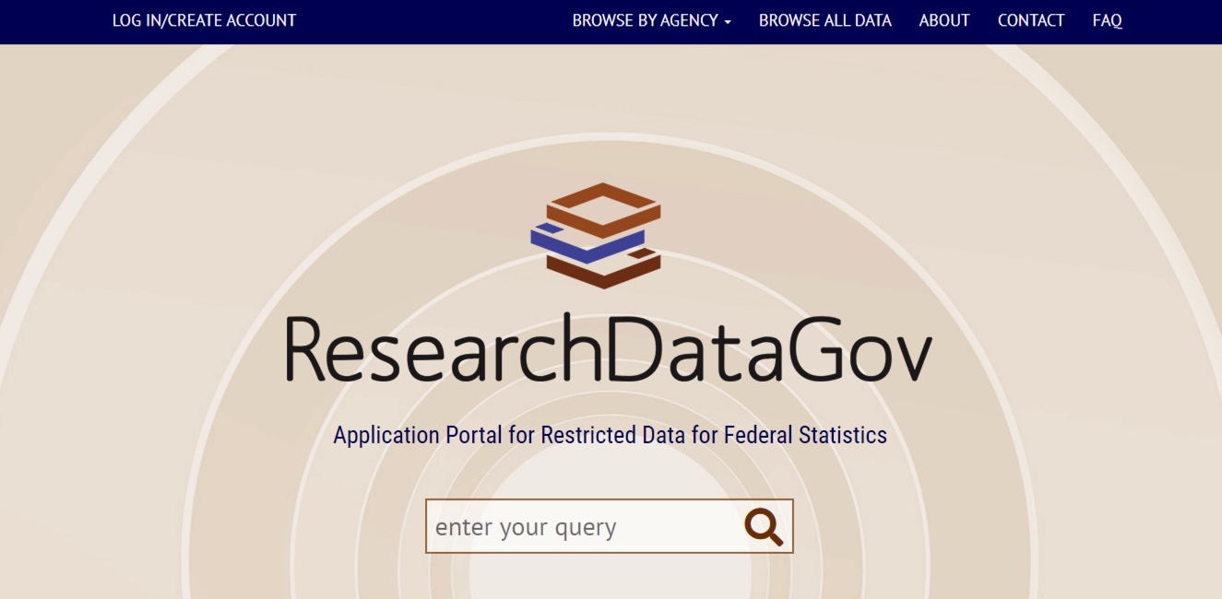
Phase 1 – One-stop Application Portal

Slide 7
Phase 1 – Lessons Learned
Increased communication at all levels of participating agencies
Coordination between the participating agencies and OMB
Increased number of testing opportunities
Sufficient time for engagement and portal development

Slide 8
Phase 2 – SAP Portal Development Process
EVIDENCE ACT – Standard Application Process
OMB
The Law
POLICY
SAP Working Groups
Executive guidance
INTERAGENCY COUNCIL ON STATISTICAL POLICY
ENGAGEMENT
TECHNICAL
Requirements identification
SAP
Technical
WG
With input from…
Stakeholders
Requirements
implementation
CONTRACTOR

Slide 9
SAP Technical Working Group
John Finamore, NCSES (Chair)
James Fetzer, BEA
Matt Durose, BJS
Rachel Morgan, BJS
Beth McLean, BLS
Nicole Nestoriak, BLS
Demetra Collia, BTS
David Beede, Census
Barbara Downs, Census
Heather Madray, Census
Leanna Mellott, Census
Paul Arnsberger, SOI/IRS
David Kinyon, EIA
Kevin Moore, FRB
Tabatha McNeil, NCHS & CBHSQ
Benjamin Franco, SSA
Marc Sinofsky, SSA
Audra Zakzeski, NASS, ERS &NAHMS
Barry Johnson, SOI/IRS (Executive Champion)
Tom Leckey, EIA (Executive Champion)

Slide 10
What the SAP is (and what it is not)
The SAP is:
a standardized cross-agency application process
a process by which applicants find data, apply for access, are reviewed for access, and may appeal adverse determinations
The SAP is NOT:
a data repository or warehouse (agencies curate their data)
a data linkage service (though part of the motivation was making applications for projects linking cross-agency data easier)SPACE

Slide 11
SAP Technical Framework

Slide 12
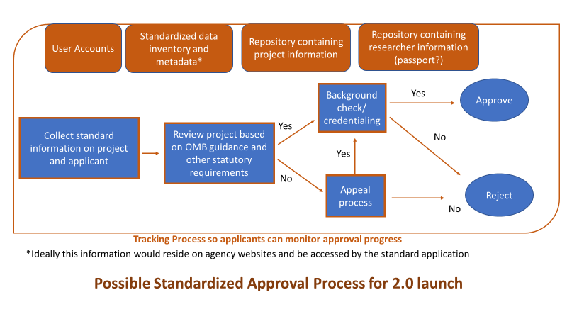
SAP Technical Framework
Components (in blue)
Web-based application
Application review
Appeals process
Credentials
Support Database (in orange)
Metadata
User accounts
Project information
Researcher information

Slide 13
Proposed Application Process
Application Approval
Application Approval
OR
Data Discovery
Application Submission
Application Review
Application Rejection
Appeals Process
OR
OR
Application Rejection
Revise and Resubmit
X weeks (chess clock)
X weeks
X weeks

Slide 14
SAP Portal Wireframes

Slide 23
SAP Development and Schedule

Slide 24
Current SAP Discussion Topics
Metadata requirements (for data discovery purposes)
Multiple-agency requests
Specifics of the appeals process
Amendments for approved applications
Agency resources
Applicant support
Agency transition to the SAP portal
On-going SAP stakeholder engagement

Slide 25
SAP Testing Milestone Schedule
Testing milestone | Targeted stakeholder group | Completion Date
Dashboard testing | 1, 2, 3 | November 2021
Metadata ingest | 2 | December 2021
Beta SAP Metadata inventory | 1,3 | February 2022
Multiple-agency reviews and Metadata edits | 2,3 | March 2022
Beta SAP Portal Release – Phase 2 | 1, 2, 3 | July 2022
Beta SAP Portal Release – Phase 3 | 1, 2, 3 | December 2022
Target stakeholder groups
1 – Applicants
2 – Agency metadata editors
3 – Agency application reviewer

Slide 26
SAP Release Milestone Schedule
Release Milestone | Date
SAP Metadata Inventory Release | March 2022
SAP Portal Release – Phase 2 | August 2022
SAP Portal Release – Phase 3 | December 2022
Notes:
Phase 3 includes the following components:
API for exporting application materials to agency tracking systems
Interface with agency-supported APIs to receive application decisions
Within-SAP component to support 6-week extension request
Within-SAP post-approval amendment component
Reach goals
Retain and share information on researchers’ clearances and training
Electronic signatures

Slide 27
SAP Release Milestone Schedule
Release Milestone | Date
SAP Metadata Inventory Release | March 2022
SAP Portal Release – Phase 2 | August 2022
SAP Portal Release – Phase 3 | December 2022
Data Discovery
Notes:
Phase 3 includes the following components:
API for exporting application materials to agency tracking systems
Interface with agency-supported APIs to receive application decisions
Within-SAP component to support 6-week extension request
Within-SAP post-approval amendment component
Reach goals
Retain and share information on researchers’ clearances and training
Electronic signatures

Slide 28
SAP Release Milestone Schedule
Release Milestone | Date
SAP Metadata Inventory Release | March 2022
SAP Portal Release – Phase 2 | August 2022
SAP Portal Release – Phase 3 | December 2022
Application Approval
Application Approval
OR
Data Discovery
Application Submission
Application Review
Application Rejection
Appeals Process
OR
OR
Application Rejection
Revise and Resubmit
Notes:
Phase 3 includes the following components:
API for exporting application materials to agency tracking systems
Interface with agency-supported APIs to receive application decisions
Within-SAP component to support 6-week extension request
Within-SAP post-approval amendment component
Reach goals
Retain and share information on researchers’ clearances and training
Electronic signatures

Slide 29
SAP Release Milestone Schedule
Release Milestone | Date
SAP Metadata Inventory Release | March 2022
SAP Portal Release – Phase 2 | August 2022
SAP Portal Release – Phase 3 | December 2022
Application Approval
Application Approval
OR
Data Discovery
Application Submission
Application Review
Application Rejection
Appeals Process
OR
OR
Application Rejection
Revise and Resubmit
Notes:
Phase 3 includes the following components:
API for exporting application materials to agency tracking systems
Interface with agency-supported APIs to receive application decisions
Within-SAP component to support 6-week extension request
Within-SAP post-approval amendment component
Reach goals
Retain and share information on researchers’ clearances and training
Electronic signatures

Slide 30
Conclusions

Slide 31
SAP Key Takeaways
The SAP portal will provide a uniform application and review process across the federal statistical agencies and units
The SAP metadata inventory will provide a single location for data discovery of federal restricted data assets
The SAP scope does not include data access activities
Engagement is crucial to the success of the SAP
Federal data owners – Encourage your users (and potential users) to participate in the SAP testing opportunities
Researchers – Stay aware and get involved (SinglePortal@nsf.gov)

Slide 32
John Finamore
jfinamor@nsf.gov

