Slide 1
Comparing the 2019 American Housing Survey to Contemporary Sources of Property Tax Records:
Implications for Survey Efficiency and Quality
Ariel J. Binder¹, Emily Molfino² and John Voorheis¹
1: U.S. Census Bureau, Center for Economic Studies
2: U.S. Department of Housing and Urban Development
Federal Conference on Statistical Methodology (FCSM)
November 2021
The Census Bureau's Disclosure Review Board and Disclosure Avoidance Officers have reviewed this data product for unauthorized disclosure of confidential information and have approved the disclosure avoidance practices applied to this release. (DRB Approval numbers CBDRB-FY2021-CES005-013 and CBDRB-FY2021-CES014-042). Any opinions or interpretations contained in this presentation are those of the authors alone, and do not necessarily represent the views of the Census Bureau or HUD.
1

Slide 2
Incorporating Administrative Records (Adrecs) into Household Surveys
Adrecs can improve the efficiency of data collection.
In terms of dollars spent and respondent time to produce data of a given quality.
Examples:
Sample Frame construction.
Item Supplementation: filling in response with adrecs for all or subset of respondents, or pre-populating a write-in response.
Adrecs can improve the quality of data collection.
Reducing error caused by respondents providing incorrect information (“rounding up” of acreage).
Item Nonresponse: improving imputation models.
Unit Nonresponse: improving the adjustment of survey weights for nonresponse.
AHS has used property tax data in Item Nonresponse for two questions since 2015.
2

Slide 3
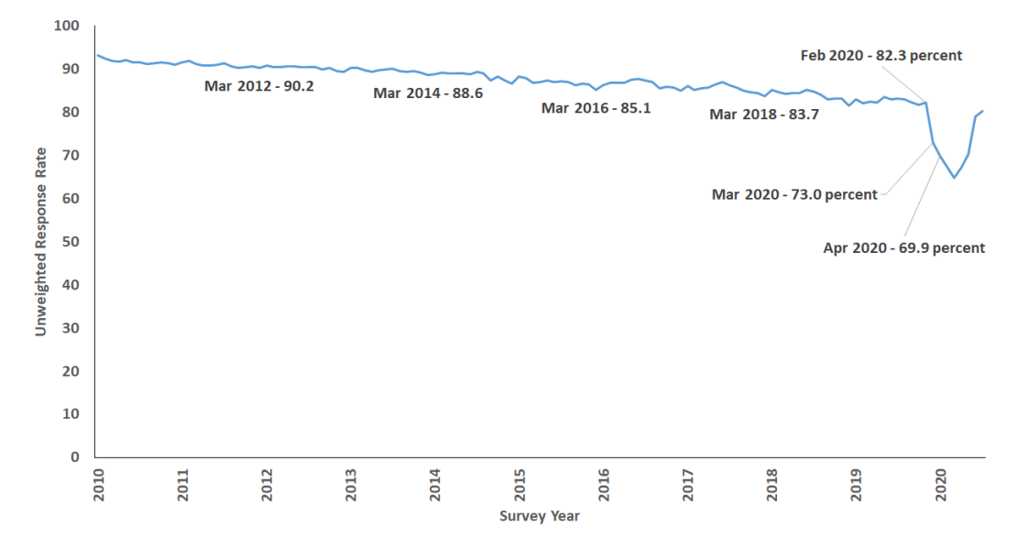
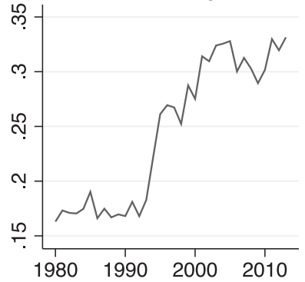
Example: Declining Response Rates to CPS
Basic Monthly CPS Response Rate
March CPS share individuals w/ imputed earnings
Source: Rothbaum and Bee (2021), Figure 1
Source: Stephens and Unayama (2019), Figure 1
Affects myriad other government surveys, including the American Housing Survey (AHS).
Especially problematic if nonresponse is nonrandom.
3

Slide 4
Summary of Current Research
Setting:
Census switched to using a different property tax source since AHS first rolled out its edit procedure.
Interest in expansion of methodology to more variables.
Objectives:
How do coverage rates of AHS in property tax data differ:
Across property tax data sources (S1,S2)?
Across states?
Across key variables?
How do rates of variable agreement differ across these dimensions?
Can we improve coverage rates by
incorporating geographic as well as address information?
combining the two sources?
4

Slide 5
Data Sources and Linking
Data Sources:
2019 AHS household file.
2019 property tax assessment files from Source 1 (S1).
2017 property tax assessment files from Source 2 (S2).
Note: property tax files contain parcels, different concept than addresses.
AHS’s main linking algorithm for S1 and S2:
Exact address text match.
No exact address match—identities of 4 nearest property tax IDs based on lat/lon points.
S1 contains new geographic shape file that traces boundaries of each parcel.
Exploratory algorithm:
Exact geospatial match (i.e. AHS lat/lon point lies inside parcel shape).
Exact address text match.
No exact matches—identities of 4 nearest property tax IDs based on lat/lon points.
5

Slide 6
List of Variables (for now)
Variable | Priority
Year built | high
Lot size (acres) | high
Monthly property tax | high
Unit size (sqft) | other
Bedrooms | other
Bathrooms | other
Number of units in building | other
Stories in building | other
Garage presence and type | other
Basement presence and type | other
In a legal subdivision? | other
return
6

Slide 7
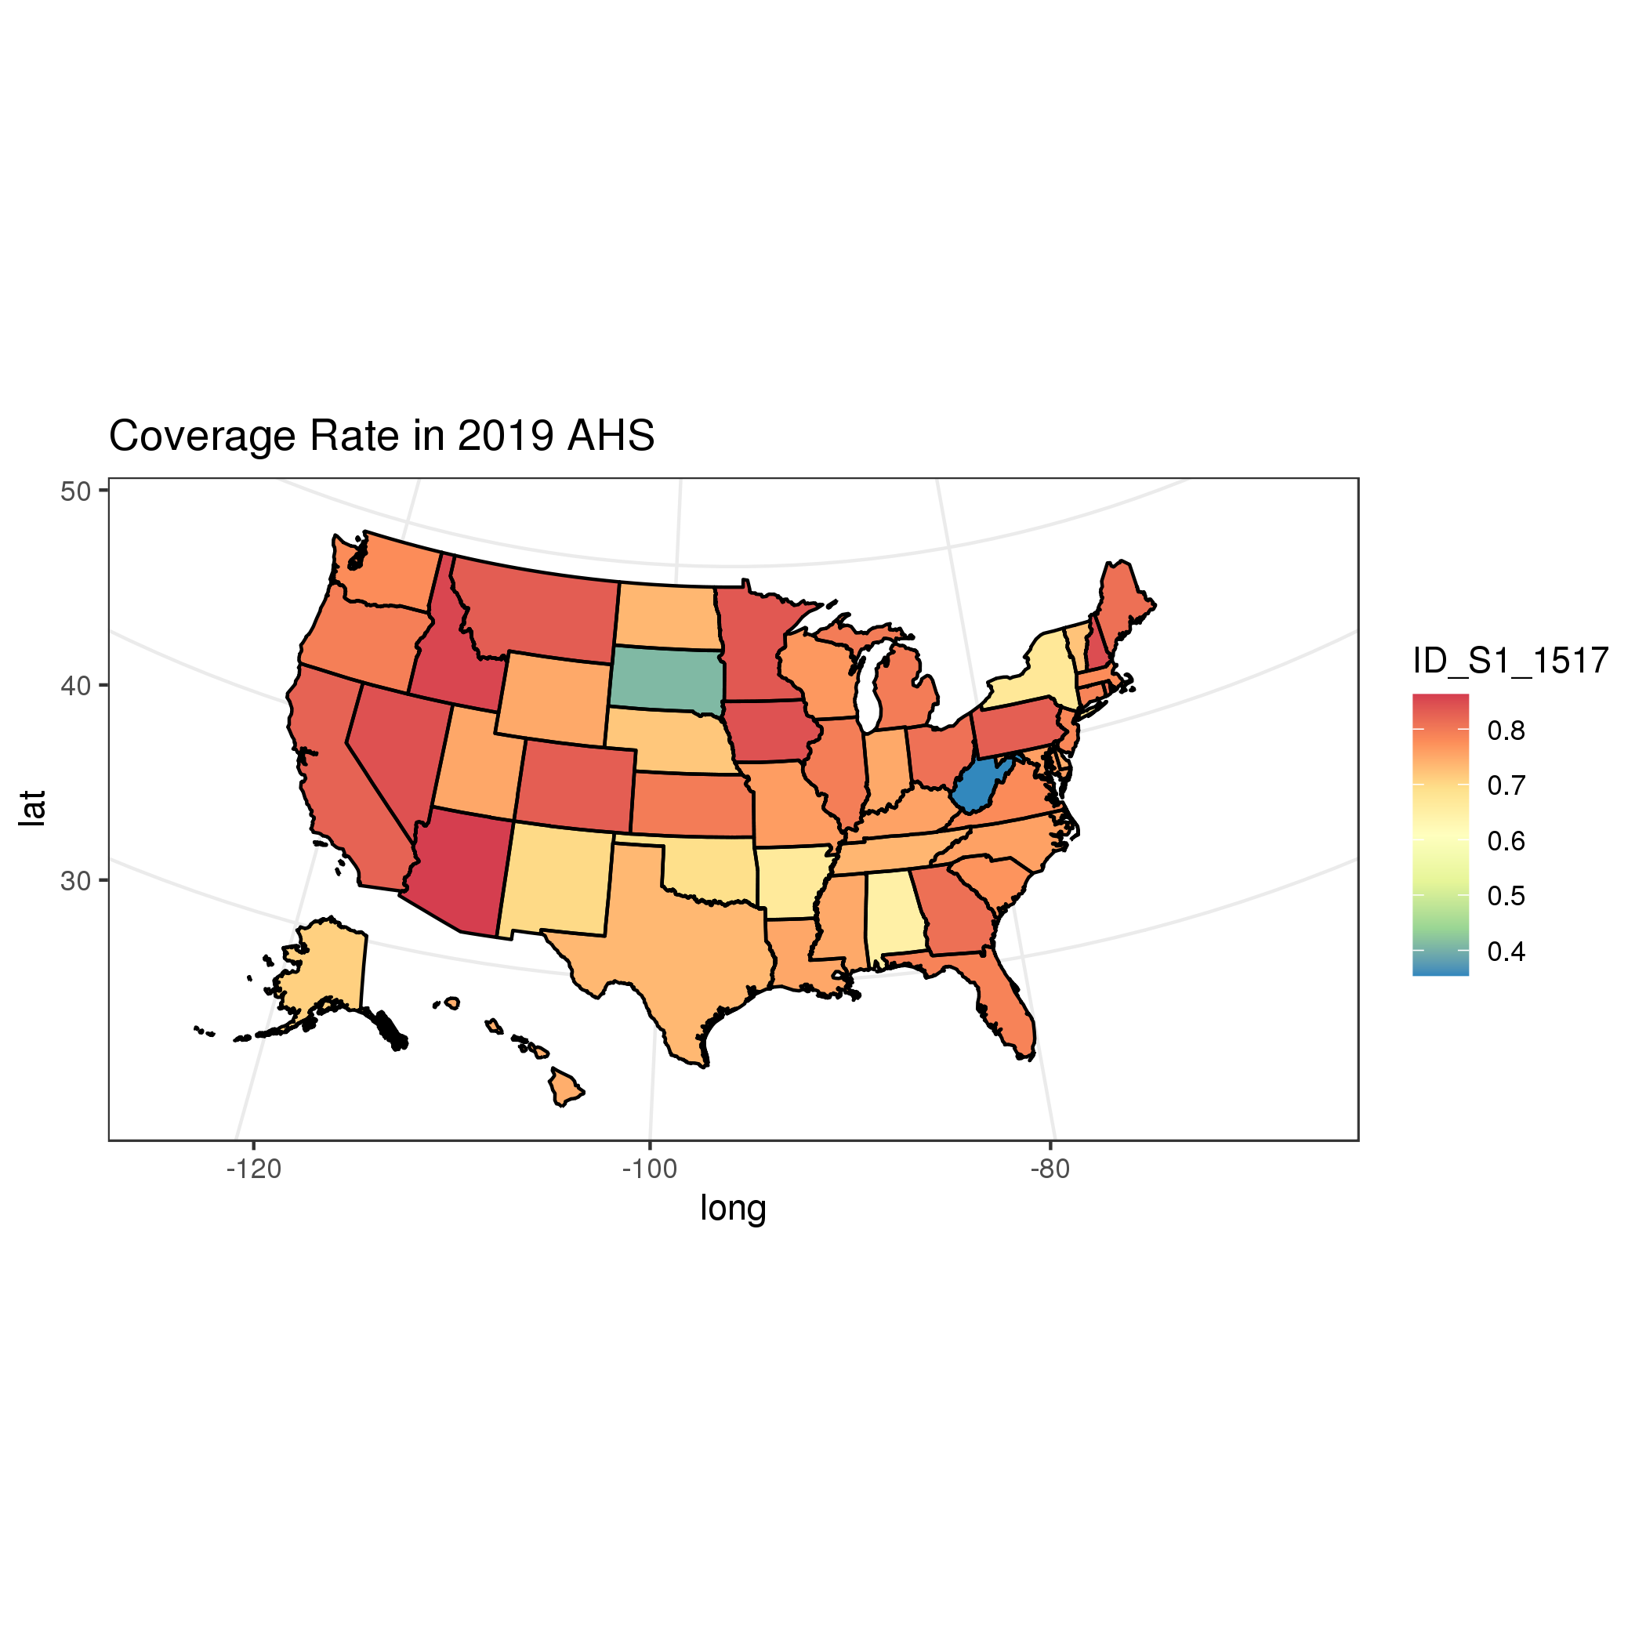
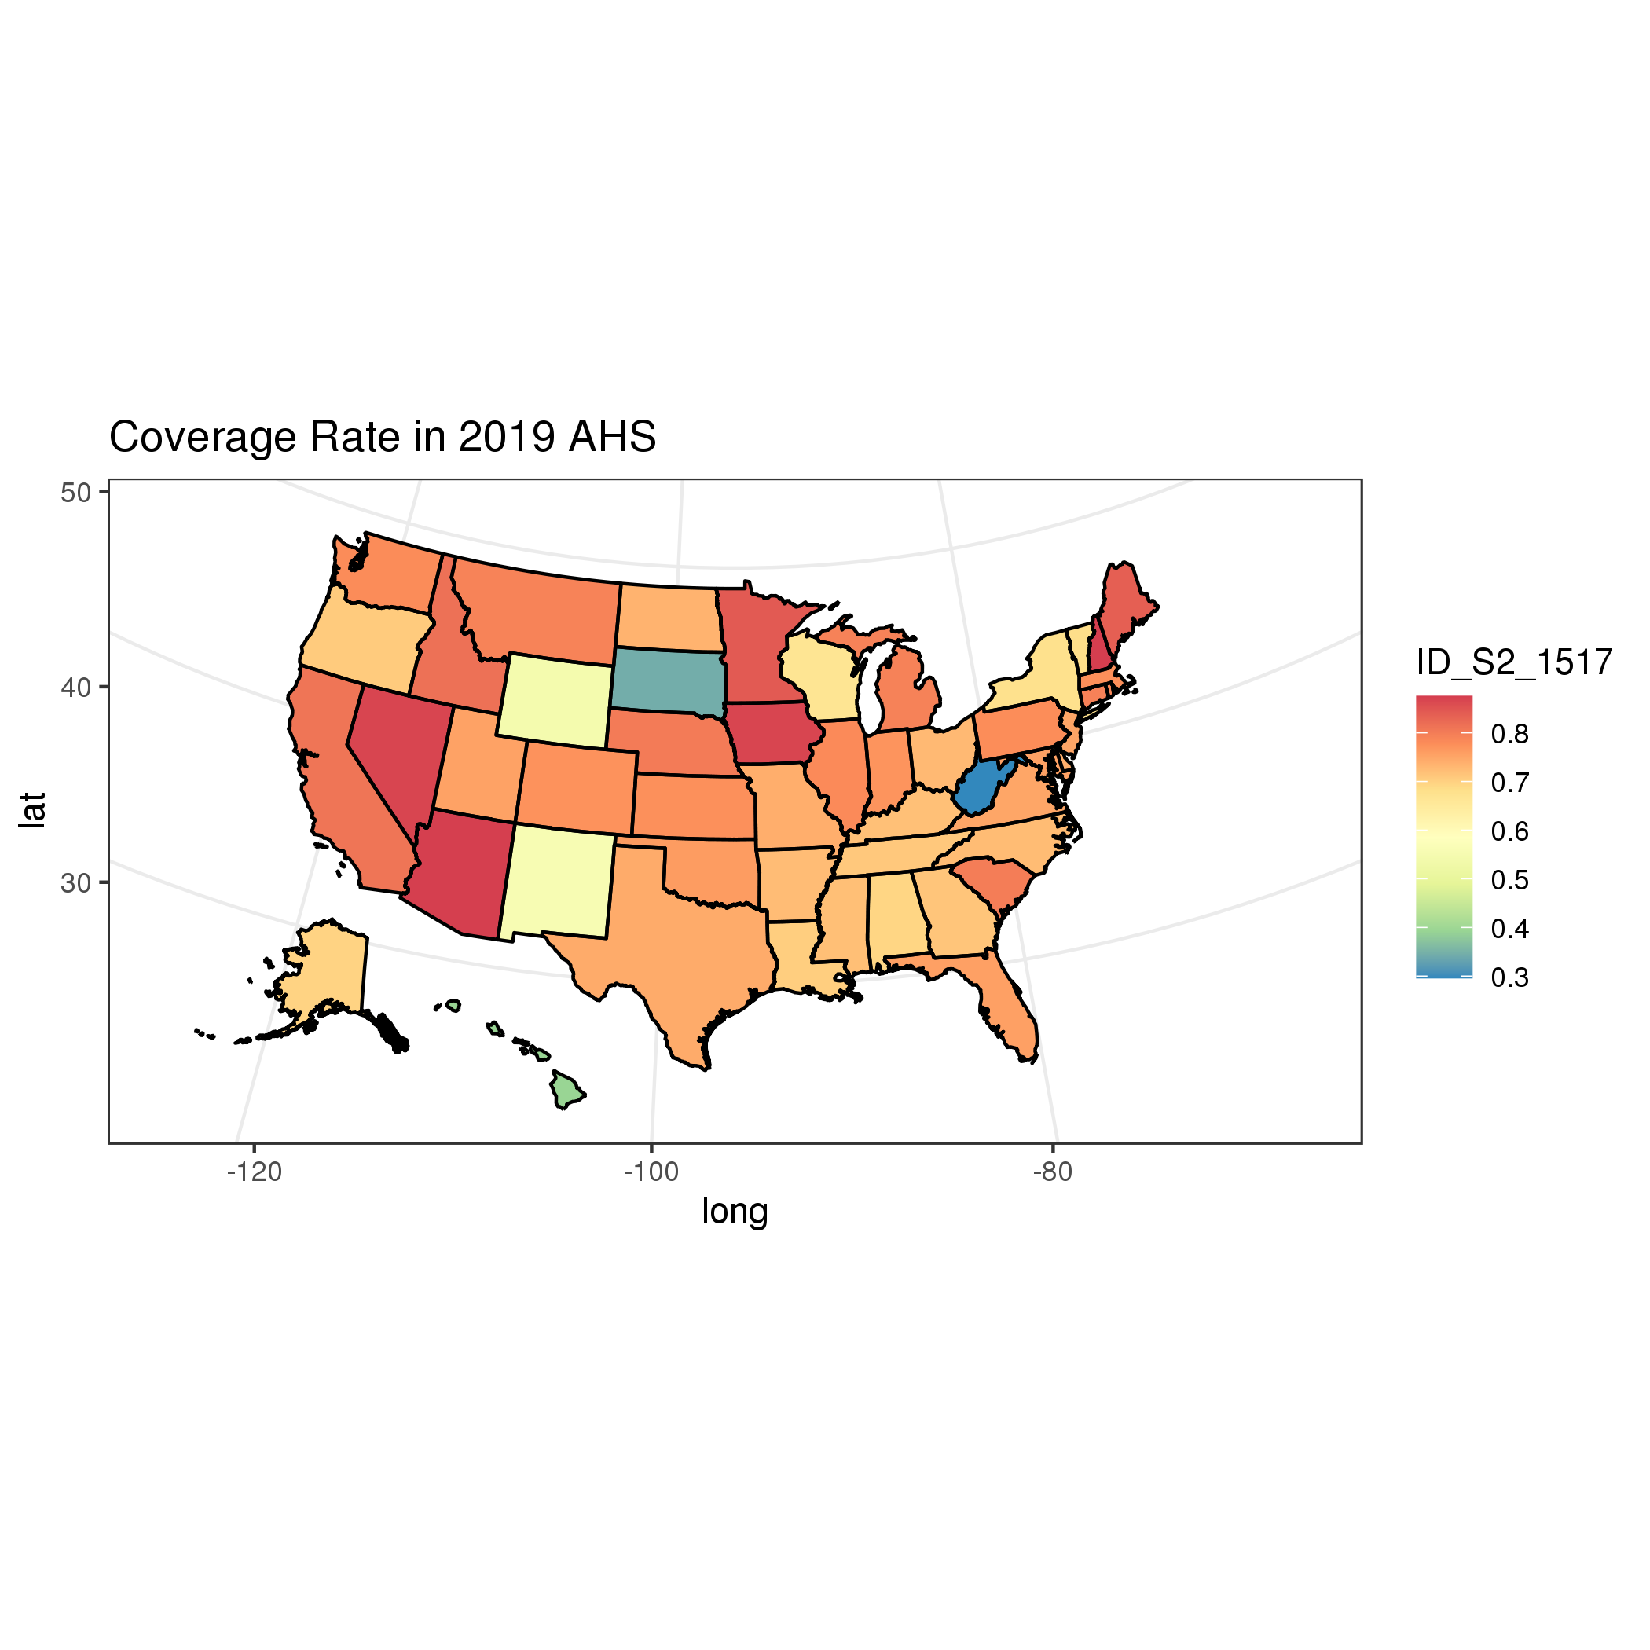
Coverage Rates of S1 and S2 in AHS
S1 coverage rates
National rate = 78%
State min = 35%
State med = 77%
State max = 86%
S2 coverage rates
National rate = 75%
State min = 30%
State med = 76%
State max = 88%
Source: 2019 AHS combined with property tax records from 2019 (S1) and 2017 (S2)
7

Slide 8
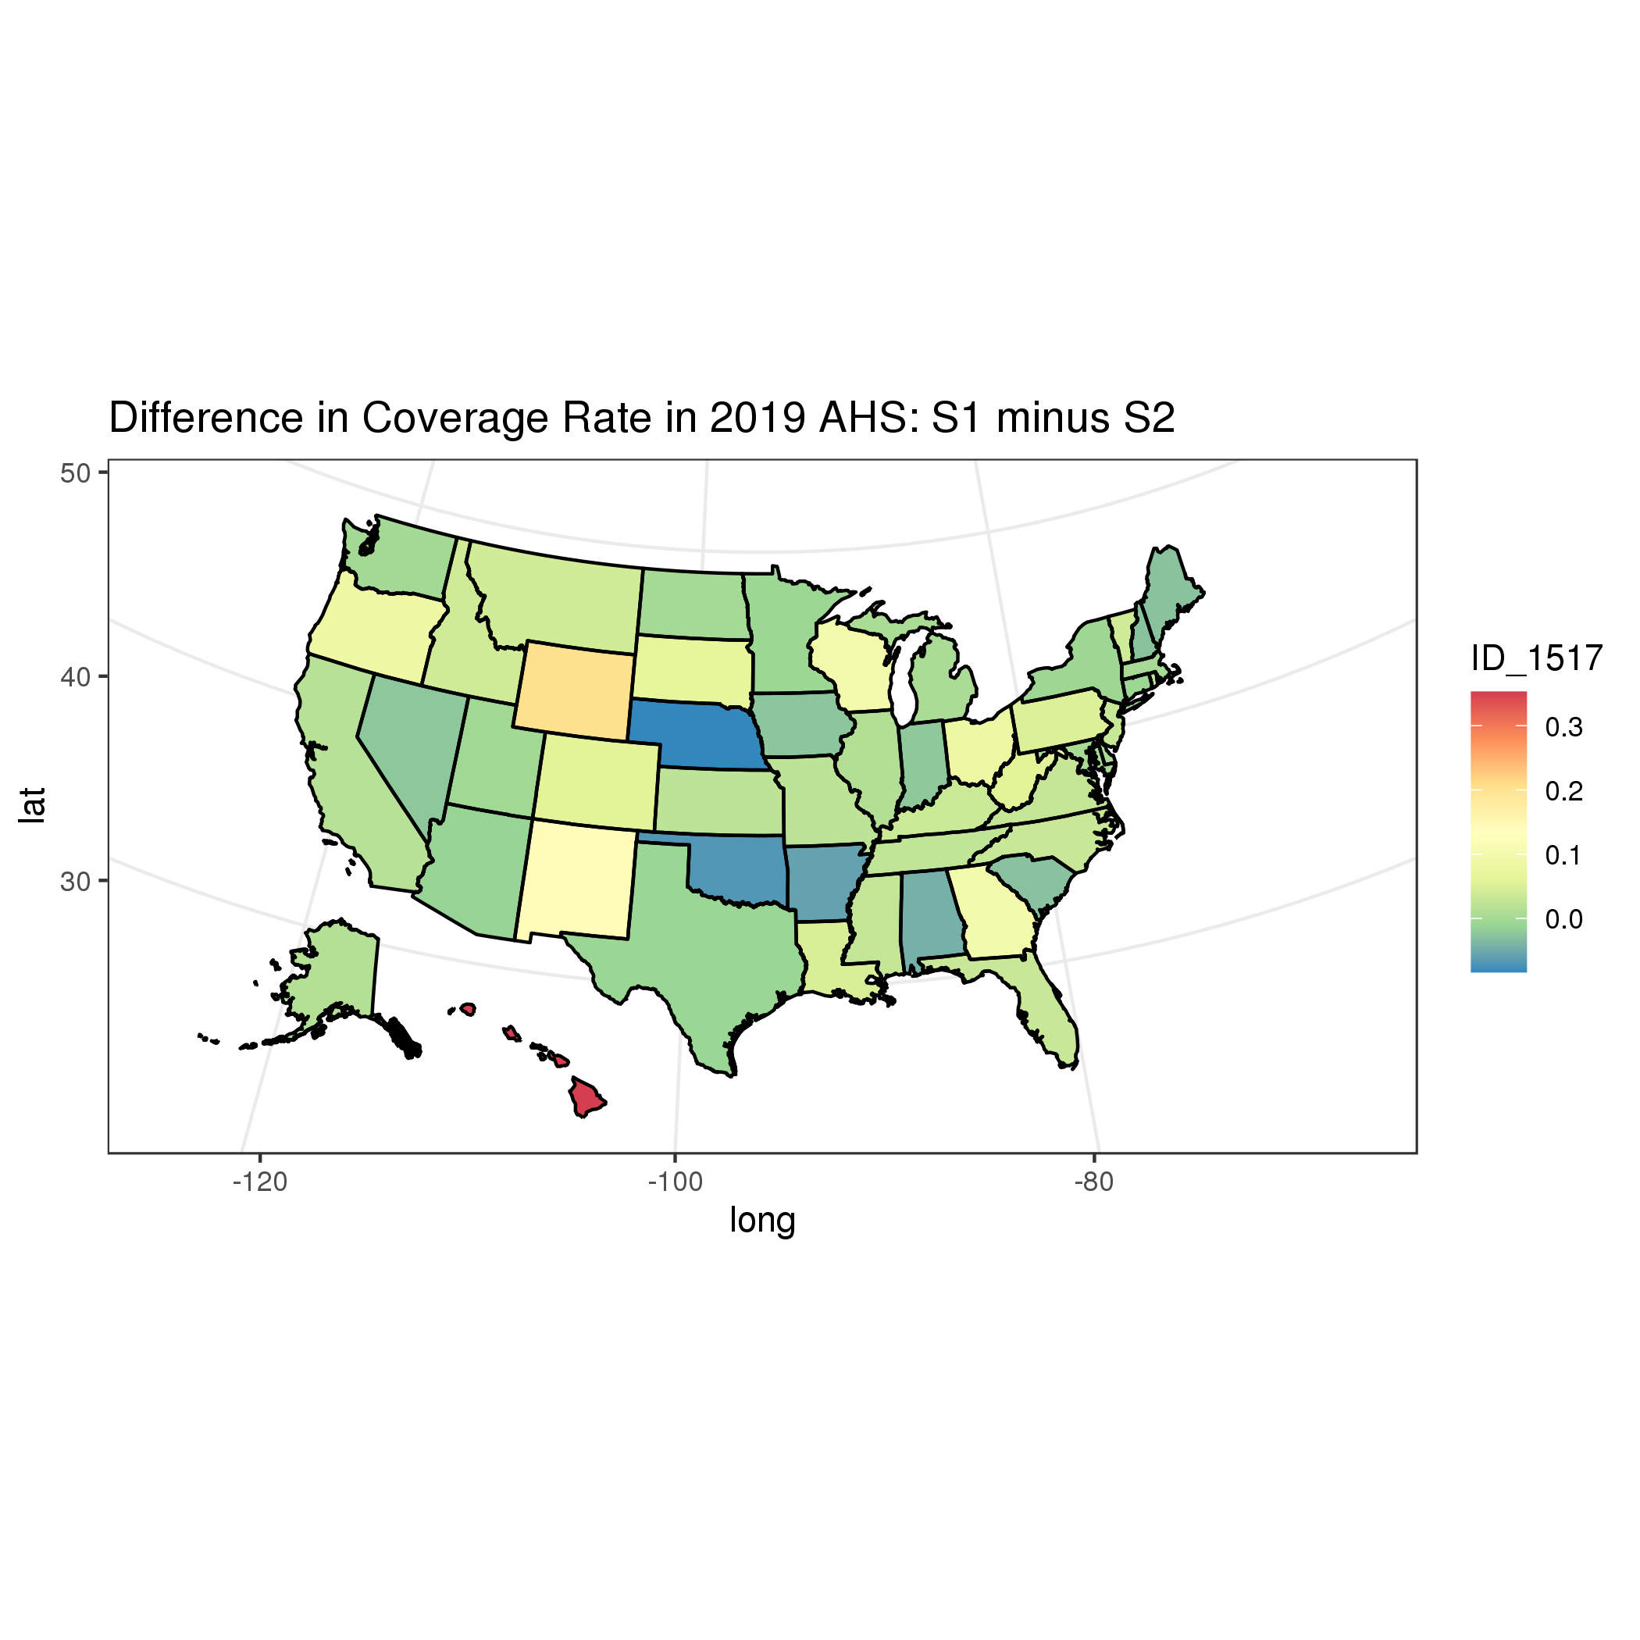
Coverage Rate Differences
Coverage rate differences
National difference = 3%
State min = -8%
State med = 2%
State max = 35%
Source: 2019 AHS combined with property tax records from 2019 (S1) and 2017 (S2)
8

Slide 9
Calculating Agreement Rates
Conditional agreement rate = share of observations with nonmissing adrec value where AHS and adrec have same value.
Unconditional agreement rate = share of all AHS observations where AHS and adrec have same value.
That is, conditional agreement rate = unconditional agreement rate / coverage rate.
We report both conditional and unconditional agreement rates. Due to variance in coverage rates by state.
9

Slide 10
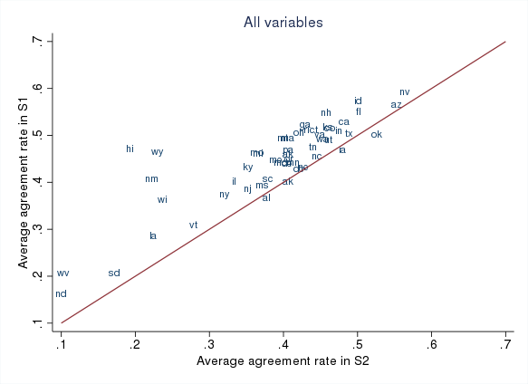
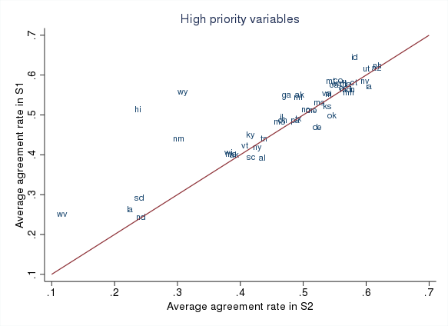
Average Unconditional Agreement Rates
Source: 2019 AHS combined with property tax records from 2019 (S1) and 2017 (S2)
10

Slide 11
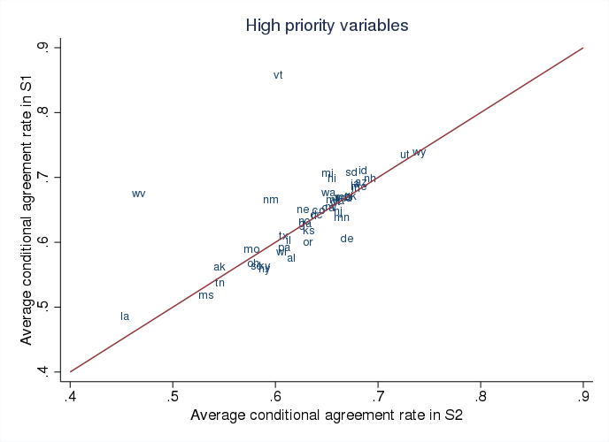
Average Conditional Agreement Rates (excl AK and ND)
Source: 2019 AHS combined with property tax records from 2019 (S1) and 2017 (S2)
11

Slide 12
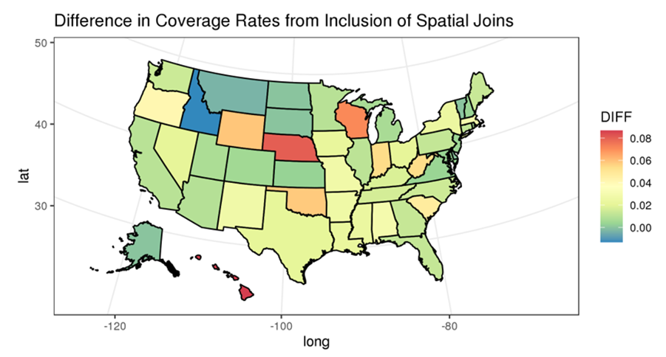
Improvement in S1 Coverage Rates from Incorporating Geospatial Info
Exploratory algorithm:
Exact geospatial match (i.e. AHS lat/lon point lies inside parcel shape).
Exact address text match.
Source: 2019 AHS combined with property tax records from 2019 (S1) and 2017 (S2)
12

Slide 13
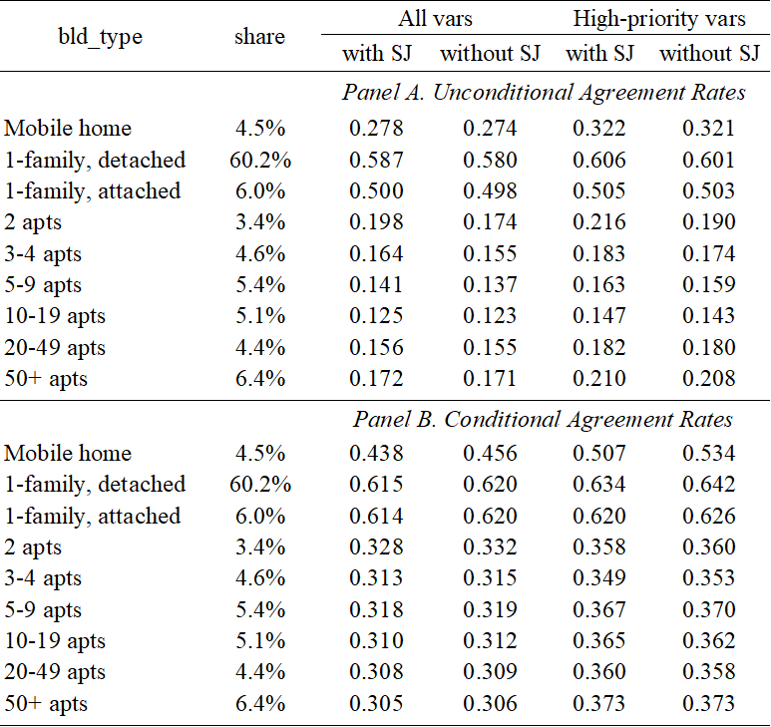
Lack of Improvement in S1 Agreement Rates
Source: 2019 AHS combined with property tax records from 2019 (S1) and 2017 (S2)
13

Slide 14
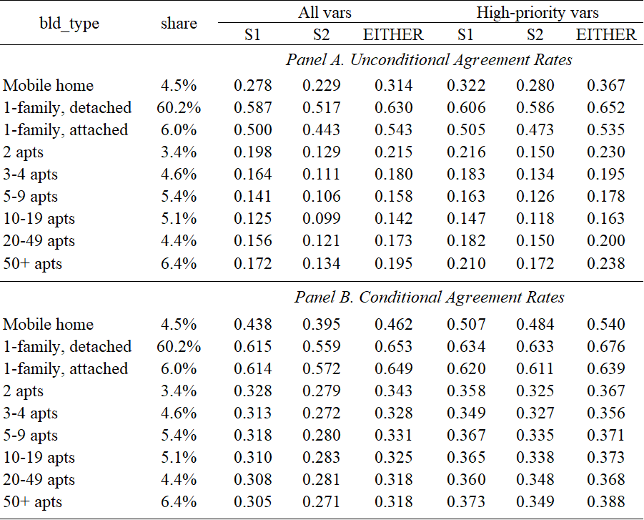
Can We Leverage Both Sources to Improve Agreement Rates?
Agreement rate improvements are always < 15% relative to S1 agreement rate.
Source: 2019 AHS combined with property tax records from 2019 (S1) and 2017 (S2)
14

Slide 15
Discussion and Future Work
Replacing AHS responses with third-party property tax records would be challenging for some states, and for multi-unit apartment buildings. See Molfino’s forthcoming whitepapers.
For certain states and variables, full replacement and/or supplementation appear promising.
Especially for single-family homes.
Future work: build on existing Item Nonresponse routines (explained in Molfino’s work), develop other exploratory Nonresponse or Supplementation routines.
Geospatial info improves coverage but is slightly less accurate than address info.
Future work: match on address first, then geo info.
Two sources do not seem much better than one on average.
Future work: but maybe for certain states or variables.
15

Slide 16
Incorporating Administrative Records into Household Surveys
Sample Frames: National Teacher and Principal Survey, National Survey of Children’s Health, and the National Sample Survey of Registered Nurses.
Unit Nonresponse: Research on using Adrecs in the creation of survey weights (e.g., ACS and CPS).
Item Nonresponse: Adrecs are utilized in nonresponse imputation on the SIPP.
Item Supplementation: Multiple projects assessing item supplementation (e.g., acreage on ACS).
16

Slide 17
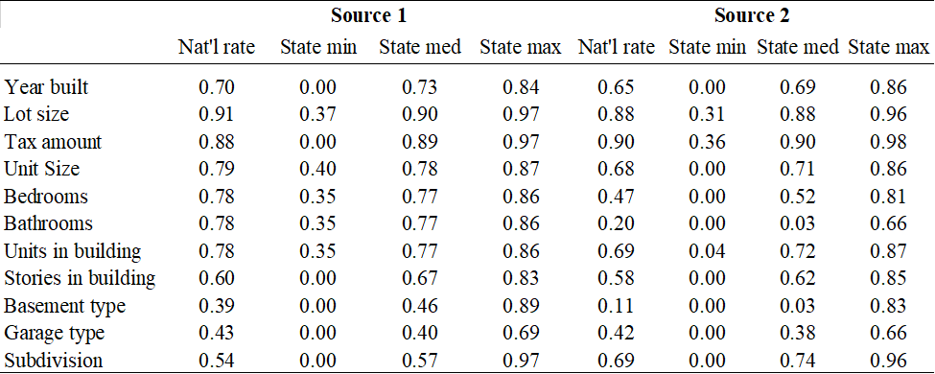
Coverage Rates Summary by Variable
Source: 2019 AHS combined with property tax records from 2019 (S1) and 2017 (S2)
17

Slide 18
AHS-S1-S2 linkage: constructing agreement rates
Numerical variables:
YRBUILT, LOTSIZE, UNITSIZE: used public-use categories.
PROTAXAMT: assigned agreement if within $100 (after topcoding at $8300).
BATHS: collapsed 7-13 category into 7 (no full bath).
Links well to totbath_calc variable for S2.
For S1, combined baths + 0.5*partial_baths info. In addition, baths info is often reported in decimal format (i.e. 100==1).
If missing, assigned the value 7.
STORIES:
S2: rounded the floors variable (and assigned 1 if 0).
S1: same, plus handling of text (e.g. “1+” assigned to 1, “1.75+” assigned to 2).
Character variables:
GARAGE, FOUNDTYPE, SUBDIV: assigned the code “no” if missing (4 for FOUNDTYPE).
GARAGE, FOUNDTYPE: detailed codings translated into AHS codings.
Crude process for FOUNDTYPE: only matched codes 1-4 (5-9 refer to mobile homes).
18

Slide 19
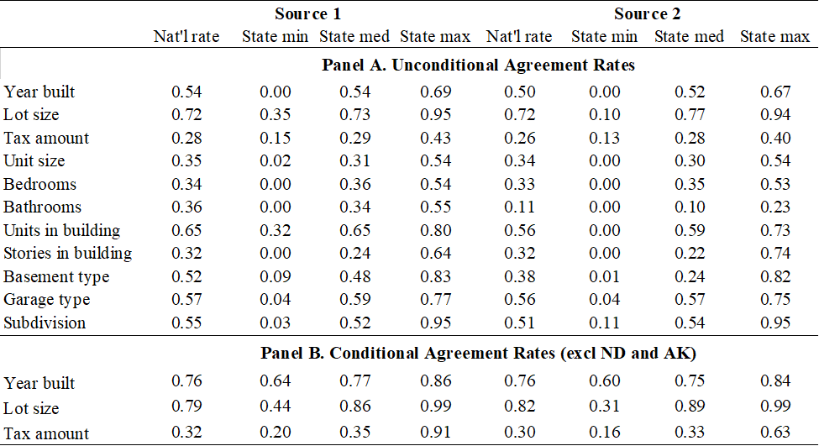
Agreement Rates Summary by Variable
Source: 2019 AHS combined with property tax records from 2019 (S1) and 2017 (S2)
19

