Slide 1
Determining Household Obesity Status Using Scanner Data
Elina T. Page
Sabrina K. Young
Megan Sweitzer
Abigail Okrent
Economic Research Service
November 2, 2021
2021 FCSM Research and Policy Conference
The findings and conclusions in this presentation are those of the authors and should not be construed to represent any official USDA or U.S. Government determination or policy. The analysis, findings, and conclusions expressed in this presentation should also not be attributed to IRI.

Slide 2
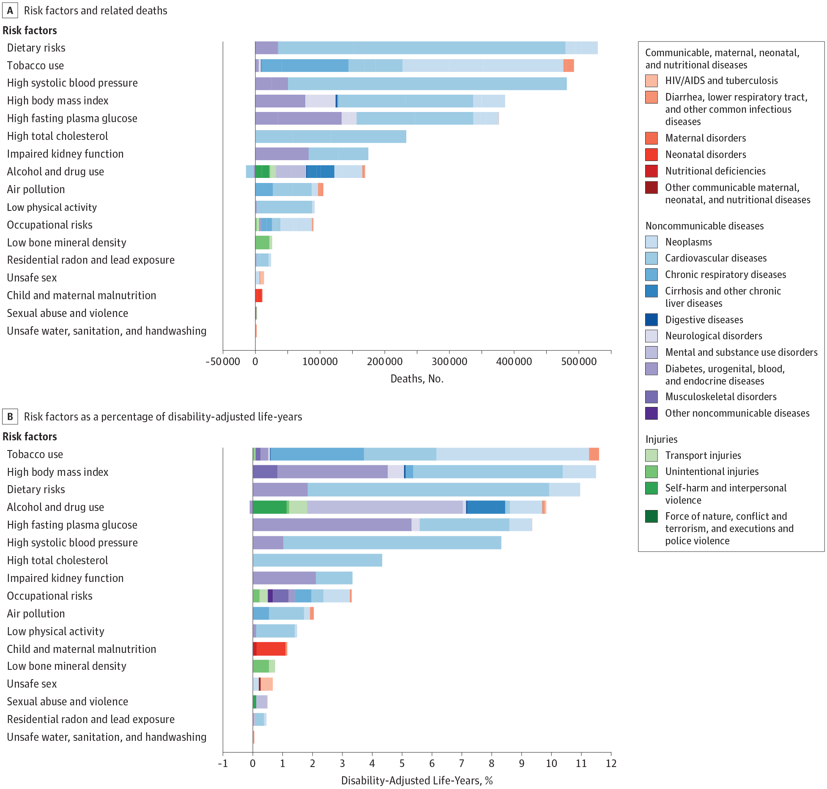
Diet is the Primary Contributor to Poor Health in the US
Source: US Burden of Disease Collaborators. The State of US Health, 1990-2016: Burden of Diseases, Injuries, and Risk Factors Among US States. JAMA 2018.

Slide 3
Obesity in the United States
Current rate of obesity: 40% of adults
21% of youth
Obesity linked to increased risk of morbidity and mortality.
Economic burden of disease: $1.7 trillion
$480.7 billion in direct expenditures
$1.24 trillion in lost productivity
Sources: Ogden et al. (2020)
Waters and Graf (2018)

Slide 4
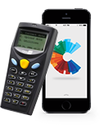
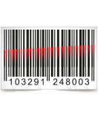
Scanner Data
Household Scanner Data:
IRI Consumer Network
Itemized food purchase data for 120,000 households
Household demographics and survey weights
IRI Medprofiler
Opt-in survey on health and medical conditions
Includes self-reported height and weight

Slide 5
Issue and Research Objective
Issue:
Medprofiler height and weight are self-reported and may be biased.
Objective:
Validate Medprofiler BMI distributions by comparing to
self-reported and measured BMI distributions from NHANES
and test methods of adjustment.

Slide 6
Methods of Adjustment
Remove outliers:
based on interquartile range
based on range of values reported in NHANES
Correct misreporting using self-reported and measured BMI in NHANES and percentile ranking regressions.
Percentile rank self-reported NHANES BMI
Regress measured weight on cubic splines of the percentile ranks
Apply estimated coefficients to self-reported Medprofiler BMI
Source: Courtemanche et al. (2015)

Slide 7
Composition of NHANES and IRI MedProfiler Samples
 | Ages 20+
 | NHANES | MedProfiler
Sample size | 20,409 | 320,682
Hispanic (%) | 14 | 13
Non-Hispanic White (%) | 66 | 70
Non-Hispanic Black (%) | 11 | 11
Non-Hispanic Asian (%) | 06 | 04
Other (%) | 03 | 02
Male (%) | 49 | 45
Actual measurements
Mean BMI (kg/m2) | 29.23 | --
Proportion underweight (%) | 02 | --
Proportion normal weight (%) | 27 | --
Proportion overweight (%) | 32 | --
Proportion obese (%) | 39 | --
Self-reported measurements
Mean BMI (kg/m2) | 28.49 | 28.86
Proportion underweight (%) | 02 | 02
Proportion normal weight (%) | 31 | 30
Proportion overweight (%) | 34 | 33
Proportion obese (%) | 34 | 35

Slide 8
Self-Reported (MedProfiler) and Measured (NHANES) BMI for Adults (20+)

Slide 13
Results: A Comparison of Methods

Slide 14
Results: A Comparison of Methods
 | Mean BMI (kg/m2) | Underweight (%) | Normal weight (%) | Overweight (%) | Obese (%)
NHANES (Measured) | 29.23 | 02 | 27 | 32 | 39
NHANES (Self-Reported) | 28.49 | 02 | 31 | 34 | 34
MedProfiler (Unadjusted) | 28.86 | 02 | 30 | 33 | 35
MedProfiler (NHANES Outliers Excluded) | 28.81 | 02 | 30 | 33 | 35
MedProfiler (IQR Outliers Excluded) | 28.18 | 02 | 31 | 34 | 33
MedProfiler (Percentile Ranking Regressions) | 29.26 | 01 | 28 | 32 | 39

Slide 15
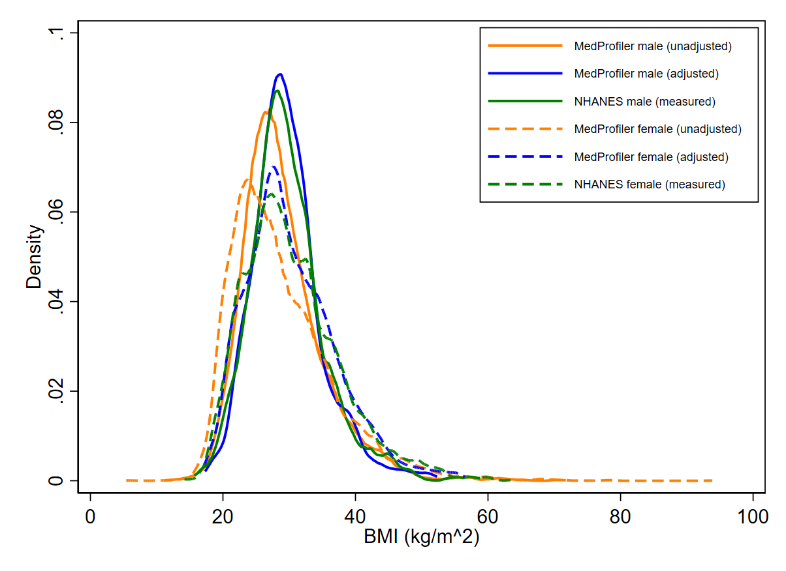
Predicted BMI Using Percentile Ranking Regressions: Hispanic Adults

Slide 16
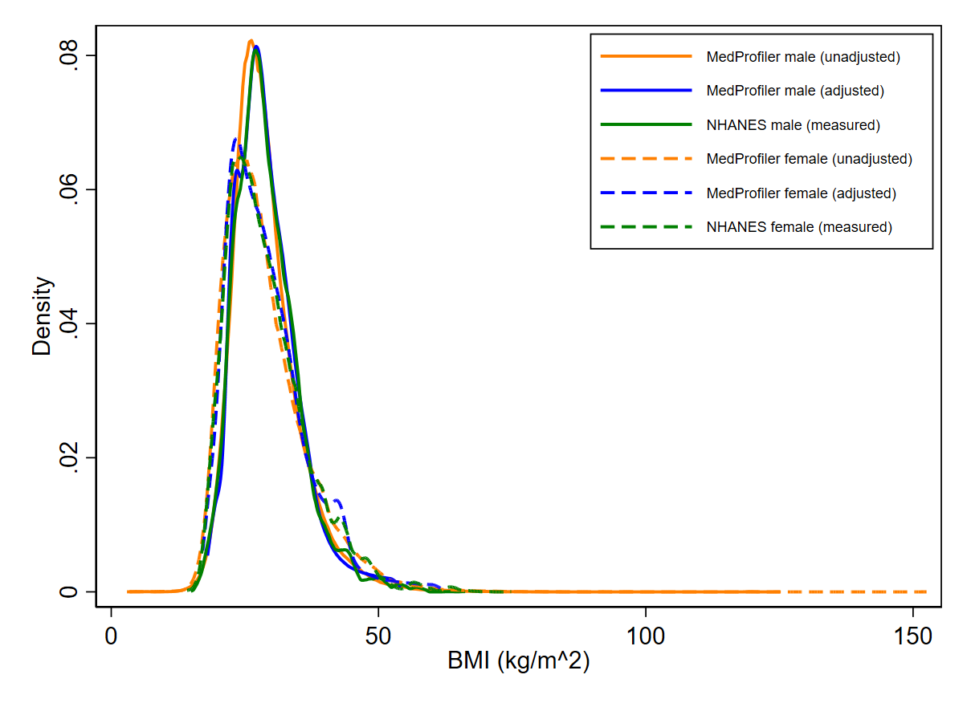
Predicted BMI Using Percentile Ranking Regressions: Non-Hispanic White Adults

Slide 17
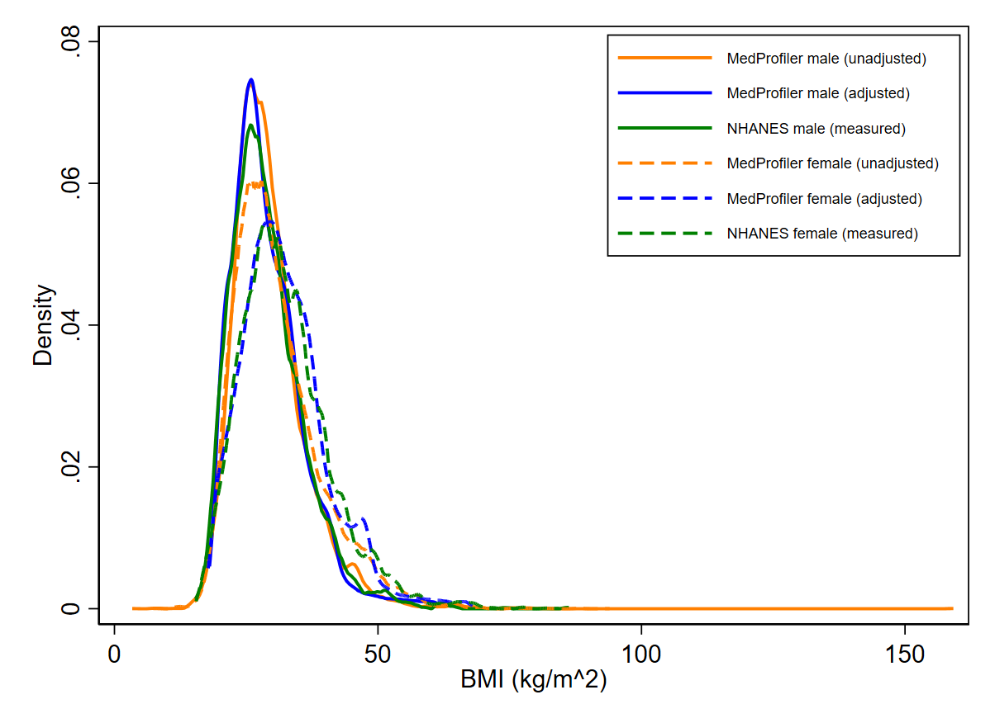
Predicted BMI Using Percentile Ranking Regressions: Non-Hispanic Black Adults

Slide 18
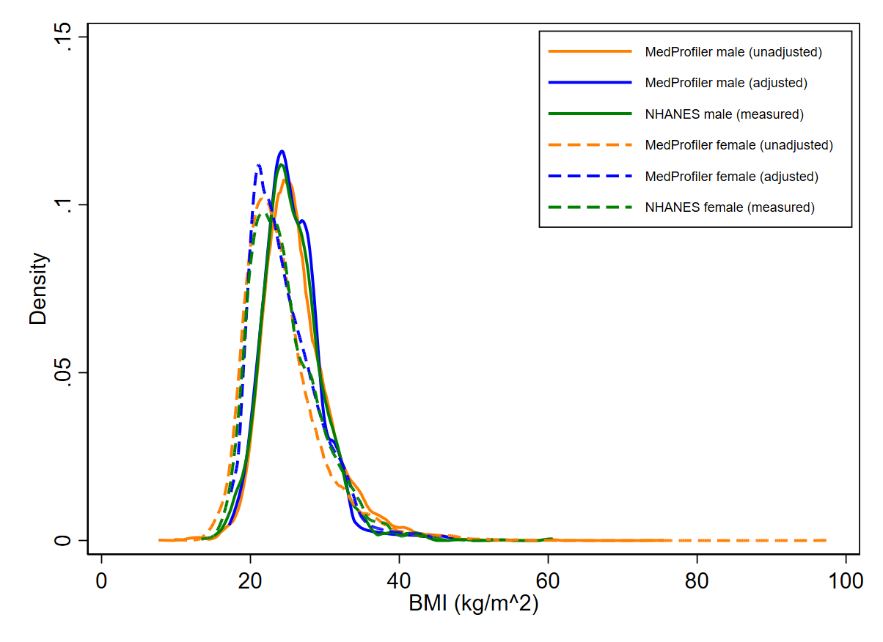
Predicted BMI Using Percentile Ranking Regressions: Non-Hispanic Asian Adults

Slide 19
Next Steps
Finalize guidance for researchers:
For adjusting BMI.
For defining household obesity.
Analyze household food purchases by household obesity status.

Slide 20
Thank you!
elina.t.page@usda.gov

