Slide 1
Measuring the Distributional Effects of Climate Change and Environmental Inequality with Linked Survey, Census and Administrative Data
John Voorheis
U.S. Census Bureau
Federal Committee on Statistical Methodology Annual Conference
November 2, 2021
This paper is released to inform interested parties of research and to encourage discussion. The views expressed are those of the authors and not necessarily those of the U.S. Census Bureau. All results have been reviewed to ensure that no confidential information is disclosed. DRB release authorization numbers CBDRB-FY19-CMS-7029, CBDRB-FY19-CMS-7227, CBDRB-FY19-CMS-7328, CBDRB-FY19-CMS-7735 and CBDRB-FY2021-CES010-023

Slide 2
Background
Climate change – driven by greenhouse gas emissions – is already impacting individuals, households and firms, and these impacts are projected to increase over the next decades
Ex. Drought-driven forest fires and smoke, flooding, increasingly strong hurricanes, extreme heat
The distribution of these climate impacts – and other environmental hazards – is not equally shared across the population
Non-white and lower income individuals are exposed to higher levels of pollution
Exposure to environmental hazards has negative impacts
Short term effects: health impacts, unemployment, earnings losses
Longer term effects: lower educational attainment, lower permanent earnings, death

Slide 3
Background
Understanding exposure to and the impacts of climate change have become increasingly salient in the last few years
Within the federal government, there has been a flurry of activity around these issues, especially in the last year, especially as it is related to recent executive orders (e.g. EO 13990, EO 14008)
What role might the Census Bureau play in these activities?
Leveraging data on people, households and firms to improve our understanding who is exposed to environmental hazards, and the impacts of these exposures

Slide 4
Moving from Aggregate data to Microdata
Most of our understanding of patterns in environmental inequality are derived from studies using aggregate demographic data
For instance, tabular tract level demographic data from the Decennial Census or the American Community Survey
Using aggregate data has some drawbacks:
It necessitates a focus on communities vs. people, while flattening the dynamics of neighborhood change
It usually does not allow for intersectional analysis
It complicates measurement of cumulative hazards (across hazards and over time)
Can confidential microdata alleviate some of these constraints?

Slide 5
Using Microdata to Study The Impacts of Climate Change
Confidential microdata at the US Census Bureau has promise for expanding our understanding of the distribution of environmental hazards
The Census Bureau’s Data Linkage Infrastructure allows researchers to link individuals across datasets and over time
This allows us to measure individual exposure to hazards across time as individuals move
It also allows us to attach a rich set of characteristics, including demographic information, as well as socioeconomic circumstances, housing characteristics and participation in social programs

Slide 6
(Environmental) Inequality of What
Using microdata, we can examine two types of environmental inequality
Inequality in exposure to environmental hazards – who is exposed?
Inequality in the effects of exposure – among people exposed, what are the distribution of outcomes?
Two case studies:
What Caused Racial Disparities in PM2.5 to Fall?
The Unequal Effects of Hurricanes in the United States

Slide 7
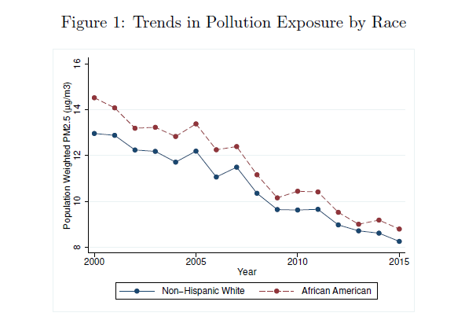
Case Study: Air Pollution (Currie, Voorheis and Walker, 2021)
Study links satellite derived data on fine particulate matter exposure linked to the American Community Survey and Decennial Census
Between 2000 and 2015, Black-White PM2.5 exposure fell by about half
What caused this decline?
DRB release authorization numbers CBDRB-FY19-CMS-7029, CBDRB-FY19-CMS-7227, CBDRB-FY19- CMS-7328 and CBDRB-FY19-CMS-7735

Slide 8
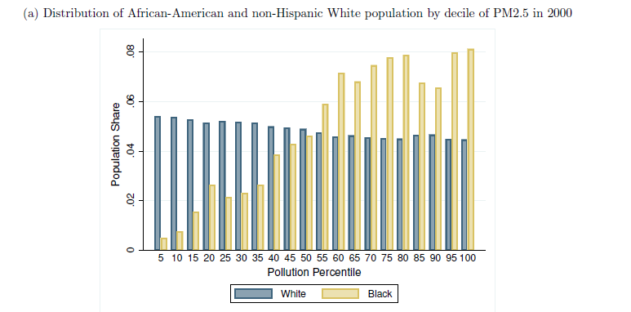
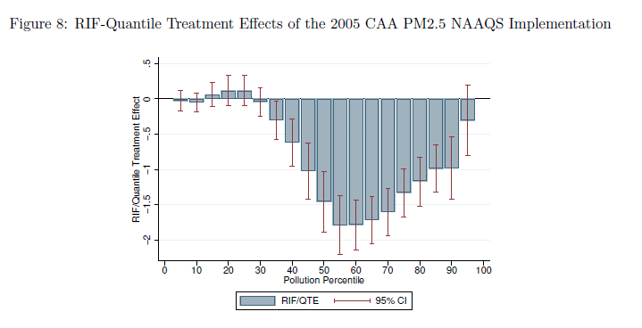
Case Study: Air Pollution (Currie, Voorheis and Walker, 2021)
In the middle of this period, new air quality standards came into effect for PM2.5
These standards disproportionately affected communities which were disproportionately Black
Counterfactual exercises suggest that about 60% of the reduction in Black-white disparities was due to these standards
DRB release authorization numbers CBDRB-FY19-CMS-7029, CBDRB-FY19-CMS-7227, CBDRB-FY19- CMS-7328 and CBDRB-FY19-CMS-7735

Slide 9
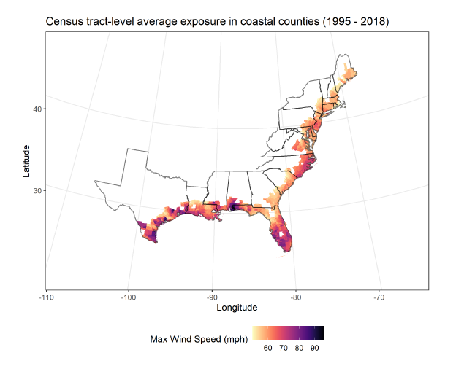
Case Study: Hurricanes (Colmer, Voorheis and Williams, 2021)
Study combines spatially continuous data on hurricane exposure with linked ACS and IRS 1040 information
Provides individual panel of data on earnings, migration, race, education, etc.
Two main facts about the distributional consequences of hurricanes:
What are the income effects of hurricanes on average?
How are these effects distributed by income and race?
Focus on coastal counties in “hurricane states”
DRB release authorization number CBDRB-FY2021-CES010-023

Slide 10
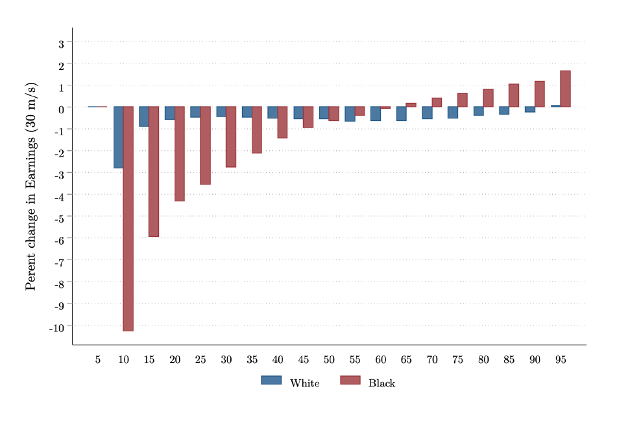
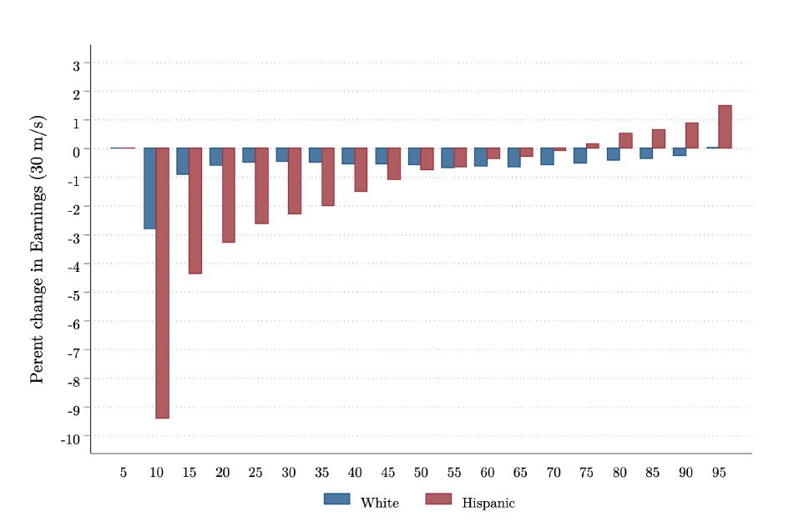
Case Study: Hurricanes (Colmer, Voorheis and Williams, 2021)
On average, hurricanes have a large negative effect on earnings, but a smaller negative effect on total income
Suggests transfers and the social safety net partially offset losses
However, large disparities across the income distribution and between racial and ethnic groups
Black and Hispanic individuals see much larger losses in earnings at the bottom of the income distribution
DRB release authorization number CBDRB-FY2021-CES010-023

Slide 11
Moving Forward: Developing An Environmental Impacts Frame
Case studies show the value of using Census Bureau microdata to study environmental inequality and the impacts of climate change
However, work to this point has been conducted using ad hoc data linkages, which may not be easily extendable to the examination of other environmental hazards
Building a more structured data infrastructure for studying the relationship between the environment and people would facilitate future work and more timely results
Proposal: Develop an Environmental Impacts Frame (EIF)

Slide 12
Moving Forward: Developing An EIF
Plan: build the EIF as a set of modules, which together can be used to answer a broad set of questions about the impact of climate change and environmental hazards
Key components:
Birth, death, basic demographics (Numident, Decennial Census, ACS)
Residential history information (IRS 1040s, other administrative records)
Income, labor market outcomes, family structure (IRS 1040s and W-2s)
Geospatial information on environmental hazards
Additionally, can update some information (residential locations) in close to real time

Slide 13
Moving Forward: Climate Impacts and Demographics
Two uses for the EIF, once we’ve built a prototype:
Research on the causes and consequences of environmental inequality
New experimental aggregate statistics
Our first prototype will focus on the demographics of exposure to wildfire-related smoke
Will we be able to produce estimates of demographics of those exposed in close to real time?
Eventually, we plan to produce data products on the distribution of other potential impacts of climate change
Extreme heat
Flood risk
Sea level rise

Slide 14
Thanks!
John Voorheis
john.l.voorheis@census.gov

